Slide 1

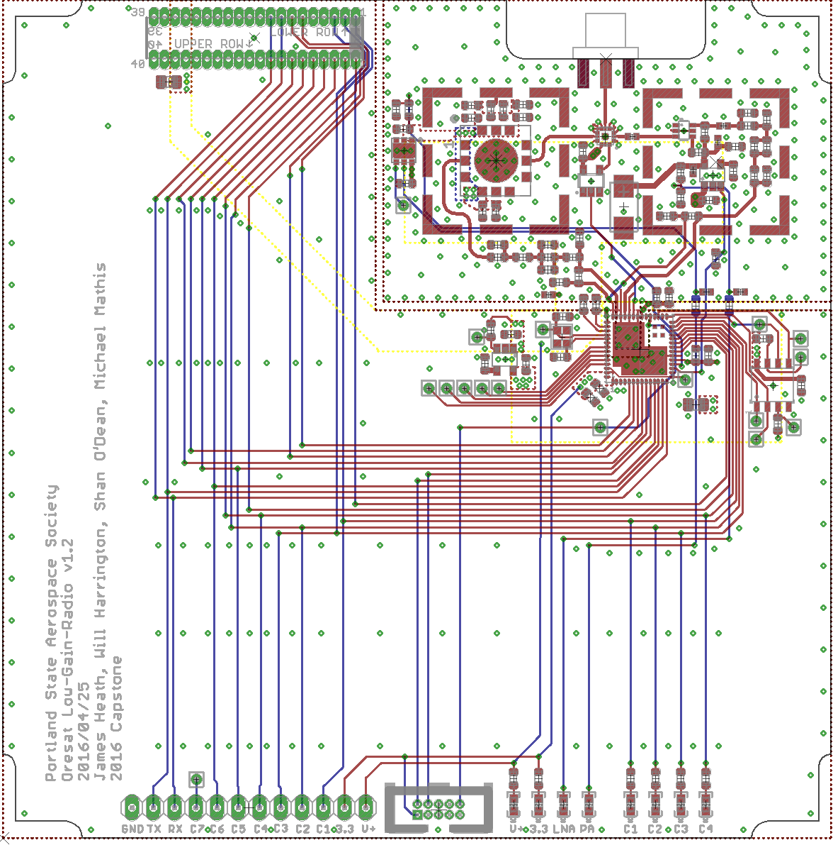
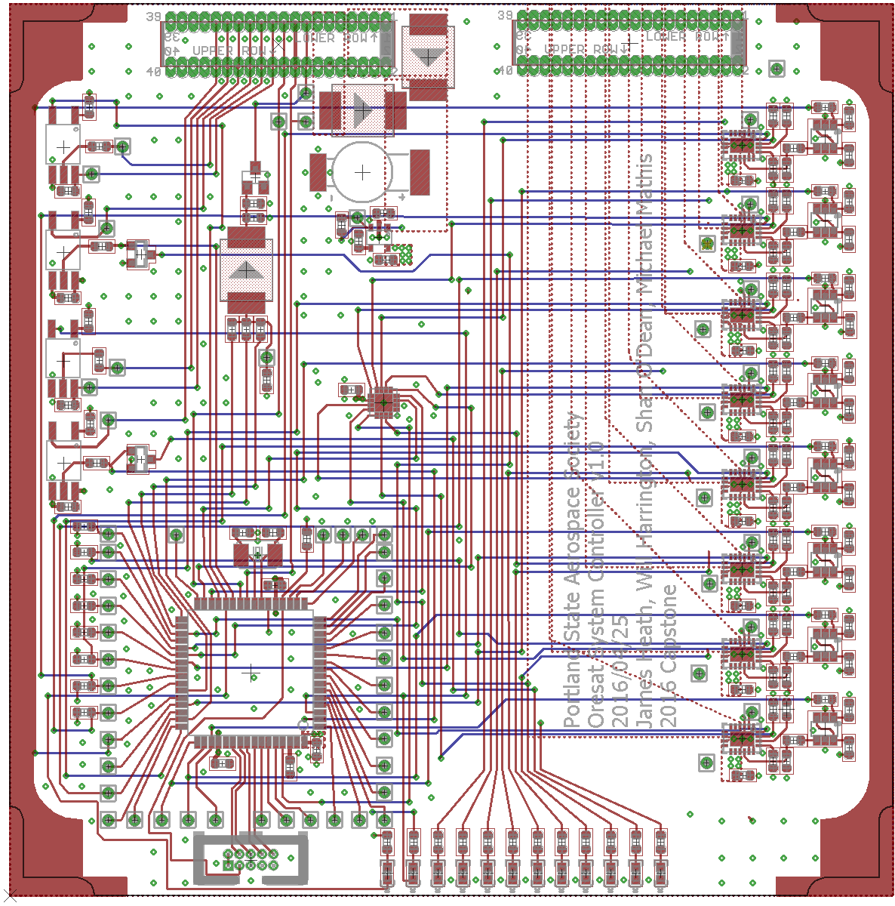

Cubesat Command Control and Communications System
Project Team:
Will Harrington
Jake Heath
Michael Mathis
Shan Quinney
Introduction
Development
Results
Ice breaker,
How to get data and pictures from satellite.
What is a cubesat.
What is a latch-up event and why is it bad.
Define C3 function
Must fit in cubesat problems problems and more problems
Building the boardscv
Practicum board
Protoboards
Subsections of the boards
Firmware
Pictures of us building
Rad hardened analogues
Proposal
one for C3, one for System monitoring and reset.
Spectrum analyzer
pictures of us doing
the 10km test
Two final boards
Capabilities of the boards
Satisfaction of sponsor
Cost
Number of parts
Highlisght of
a visio diagram of the
final system
Building the boardscv
Special thanks to:
Andrew Greenberg
Theo
Glenn
PSAS
Dr. Teuscher
Department of Electrical and Computer Engineering

