Slide 1

Financial growth & strategy
Presented by Frey Munch

Slide 2
16 Calls, 100% Preventable: Fixing Self-Service Failures in ATT's Rewards Program
16 Calls, 100% Preventable: Fixing Self-Service Failures in ATT's Rewards Program
Analysis of 16 customer calls for ATT's Rewards & Loyalty program reveals that 100% of this call volume is driven by preventable friction in the digital experience and operational backend.

Slide 3
Targeted Analysis Covers 16 Calls for ATT's Rewards & Loyalty Program
Targeted analysis of 16 ATT Rewards & Loyalty calls reveals high-friction customer journeys.
The Situation
This analysis covers 16 customer support calls filtered for the "ATT" product line where the primary call reasons were "Rewards & Loyalty" or "Products & Offers". The findings represent a targeted look at high-friction customer journeys within the loyalty program.

Slide 4
Redemption Failures Drive 7 Calls (43.75%) in Rewards & Loyalty
Pain Point 1: Redemption Failures Drive 7 Calls
Customers expecting cashback rewards are receiving points instead and are unable to find or change their redemption preference in the app or website, forcing them to call.
7 separate customers called because the self-service path to manage redemption preferences is either missing, broken, or too difficult to find.
7 calls | 43.75% of total
Implement a clear, easily discoverable self-service 'Redemption Preferences' section in the rewards dashboard.

Slide 5
Incorrect Category Bonuses Drive 4 Calls (25%) Due to Merchant Miscoding
Pain Point 2: Incorrect Bonuses Drive 4 Calls
Customers are not receiving expected category bonuses because of how merchants are coded in the backend system, leading to confusion and a sense of being short-changed.
4 customers called after noticing their purchases at locations like gas stations were miscoded as convenience stores, making them ineligible for the correct bonus multiplier.
4 calls | 25.0% of total
Display the merchant category code (MCC) for each transaction and provide an in-app diagnostic tool to explain why a specific bonus was or was not applied.

Slide 6
Missing Promotional Bonuses Drive 3 Calls (18.75%) Due to Crediting Delays
Pain Point 3: Missing Promotions Drive 3 Calls
Welcome and anniversary bonuses are not being credited correctly or on time, forcing customers to call and manually request the points they were promised.
3 customers called because their promotional bonuses were either partially paid or completely missing long after the qualifying conditions were met.
3 calls | 18.75% of total
Implement an in-app offer and bonus tracker showing progress toward spend requirements and a clear "Pending Bonuses" section with estimated posting dates.

Slide 7
Two Quick Wins Can Immediately Deflect 8 Calls (50%)
Start Monday: 2 Quick Wins
Action | Theme | Resolves | Why It's Fast
Build a clear 'Redemption Preferences' self-service UI | Rewards & Loyalty | ~7 calls (43.75%) | This is a front-end change that clarifies an existing, but hidden, backend process.
Send 60-day advance notifications for tier downgrades | Rewards & Loyalty | ~1 call (6.25%) | Utilizes existing email/push notification systems to deliver a new, templated message.

Slide 8
Where to Act First
Where to Act First
Having identified the key pain points, this section prioritizes solutions by surfacing where limited effort yields the greatest call deflection, guiding where to act first.

Slide 9
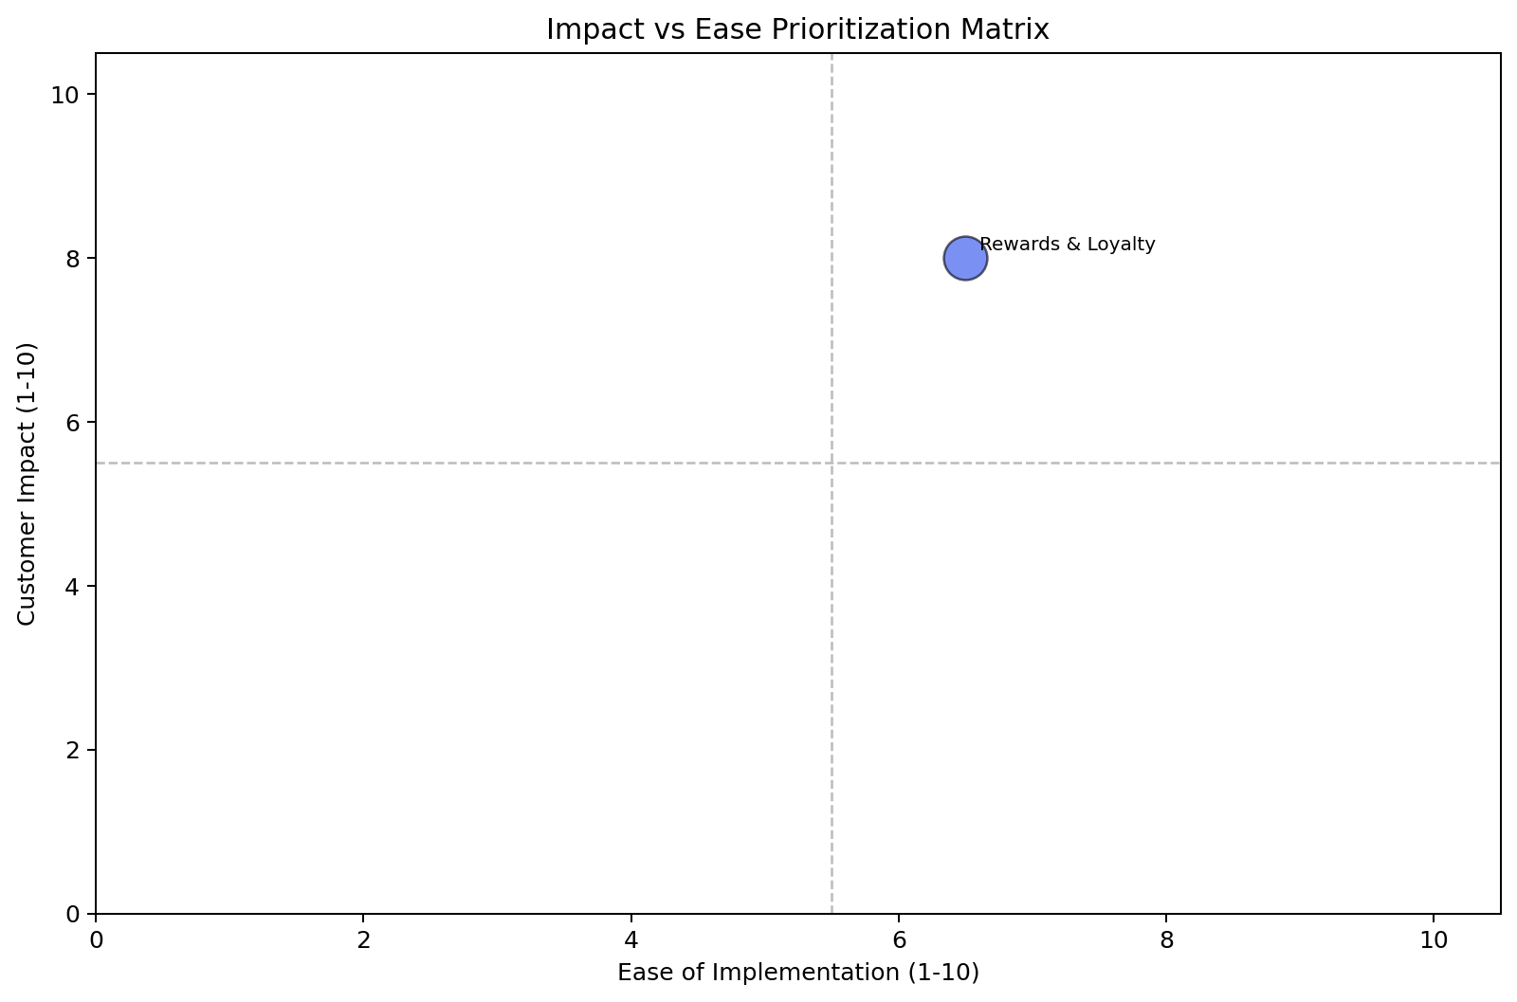
Rewards & Loyalty: Prioritization Matrix Shows High Impact & Ease
Rewards & Loyalty is the highest priority theme, scoring 7.4, with 16 calls and high impact/ease.
Impact vs. Ease: Prioritization Matrix
Theme | Volume (calls) | Top 3 Problems | Recommended Solutions | Ease (1–10) | Impact (1–10) | Priority Score
Rewards & Loyalty | 16 | Cashback posted as points (7 calls), Incorrect category bonus (4 calls), Promotional bonus missing (3 calls) | Build redemption preference UI, Display merchant category codes, Implement in-app bonus tracker | 6.5 | 8.0 | 7.4

Slide 10
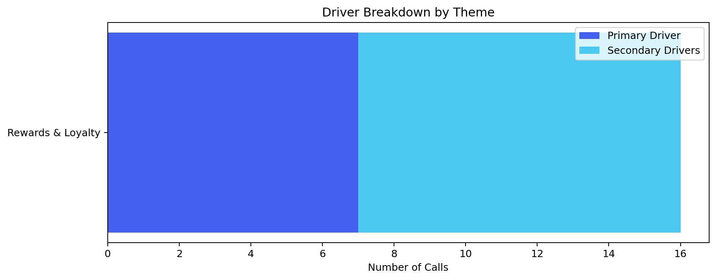
Focusing on Rewards & Loyalty Delivers 87.5% Call Deflection
The Biggest Bet
Rewards & Loyalty — fixing the top 3 drivers alone deflects 14 calls (87.5% of total volume) and is achievable within one quarter.

Slide 11
Recommended Actions by Owning Team
Recommended Actions by Owning Team
Building on the prioritization matrix, this section outlines specific, high-priority actions organized by owning team for clear accountability, sequenced by priority score.

Slide 12
Digital / UX Team Can Resolve 8 Calls (50%) in Rewards & Loyalty
Digital / UX
Action | Theme | Resolves | Priority
Implement a clear 'Redemption Preferences' section in the rewards dashboard | Rewards & Loyalty | ~7 calls (43.75%) | 7.4
Implement a 'Points Transfer History' section with status and estimated completion | Rewards & Loyalty | ~1 call (6.25%) | 7.4

Slide 13
Operations Team Can Resolve 4 Calls (25%) by Displaying MCC
Operations
Action | Theme | Resolves | Priority
Display merchant category code (MCC) and applied earn rate for each transaction | Rewards & Loyalty | ~4 calls (25.0%) | 7.4

