Slide 1

Financial growth & strategy
Presented by Frey Munch

Slide 2
3 Quick Wins Can Eliminate 10 Calls (62.5%) of Rewards & Loyalty Friction
Implement a real-time transfer status tracker (Rewards & Loyalty) resolves ~4 calls (25.0%) by leveraging existing data feeds for a fast front-end UI update.
Develop an in-app offer tracker (Rewards & Loyalty) resolves ~3 calls (18.75%) by leveraging existing promotional data to build a simple progress bar.
Add a 'pending points' section (Rewards & Loyalty) resolves ~3 calls (18.75%) by displaying existing data to improve transparency.

Slide 3
The Situation
Context
This report analyzes 16 customer calls specifically concerning ATT Rewards & Loyalty, revealing a single, highly preventable theme. The analysis focused on calls where the primary reason was related to rewards and loyalty programs for the ATT product.
Pain Point 1: Partner Transfer Delays
Impact: 4 calls, 25.0% of volume
Fix: Implement a real-time transfer status tracker in the mobile app and web, with estimated completion times and push notifications for status changes.
Pain Point 2: Promotional Points Missing
Impact: 3 calls, 18.75% of volume
Fix: Develop an in-app offer tracker with progress bars and clear, concise qualifying criteria for each promotion.
Pain Point 3: Points Not Credited
Impact: 3 calls, 18.75% of volume
Fix: Add a 'pending points' section to the rewards dashboard and display the earn rate per transaction in the transaction history.

Slide 4
Recommended Actions by Owning Team
Digital / UX
Implement a real-time transfer status tracker in the mobile app and web, with estimated completion times and push notifications for status changes.
Develop an in-app offer tracker with progress bars and clear, concise qualifying criteria for each promotion.
Communications
Send push notification/email when partner transfer is initiated with estimated completion time, and another upon completion. Provide in-app visibility of pending transfers.
Implement an in-app offer tracker with a progress bar. Send push notification when customer qualifies for promotion and another when points are credited.

Slide 5
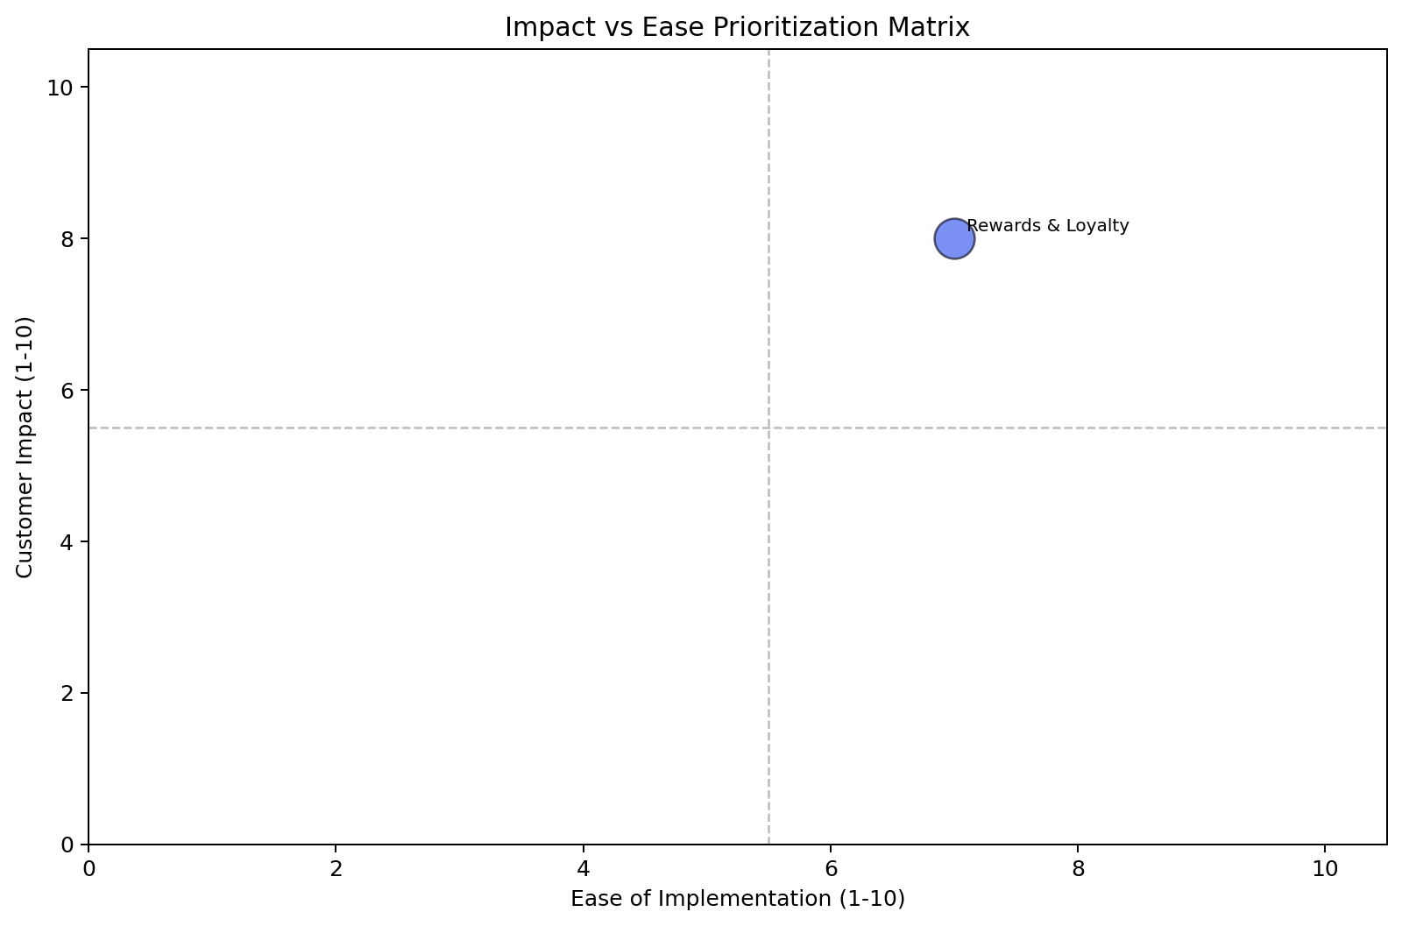
Impact vs. Ease: Full Prioritization
Rewards & Loyalty — fixing the top 3 drivers alone deflects 10 calls (62.5% of total volume) and is achievable within one quarter.
Theme | Volume (calls) | Top 3 Problems | Recommended Solutions | Ease (1–10) | Impact (1–10) | Priority Score
Rewards & Loyalty | 16 | Partner Transfer Delay (4 calls), Promotional Points Missing (3 calls), Points Not Credited (3 calls) | Implement a real-time transfer status tracker, Develop an in-app offer tracker, Add a 'pending points' section | 7.0 | 8.0 | 7.6

Slide 6
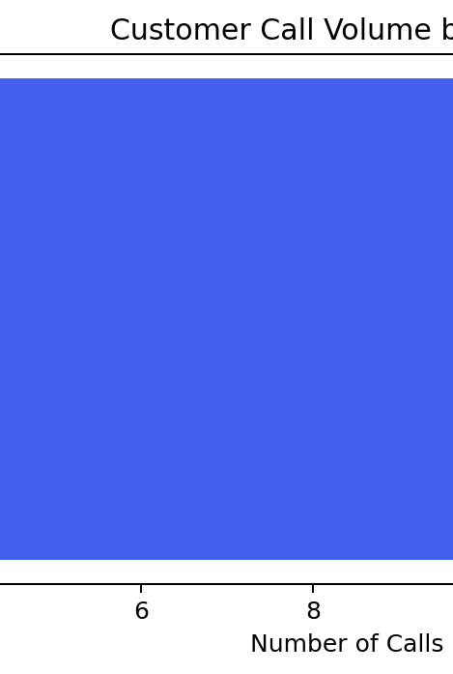
Rewards & Loyalty
— 16 calls (3.2%)
Priority: 7.6/10 | Ease: 7.0/10 | Impact: 8.0/10 | Volume: 16 calls | 3.2% of overall analyzed volume
Customers are consistently calling about missing or delayed rewards, indicating a fundamental lack of transparency and real-time status updates within the loyalty program. These 16 calls represent direct customer frustration and avoidable contact center load, stemming from a fragmented digital experience and insufficient proactive communication.
Without addressing the underlying issues in rewards visibility and communication, the 16 customers calling monthly about their loyalty program status will continue to drive avoidable contacts, directly impacting customer satisfaction and operational costs.
Driver | Call Count | % of Theme | Recommended Solution
Partner Transfer Delay | 4 | 25.0% | Implement a real-time transfer status tracker in the mobile app and web, with estimated completion times and push notifications for status changes.
Partner Transfer Delay | 4 | 25.0% | Send push notification/email when partner transfer is initiated with estimated completion time, and another upon completion. Provide in-app visibility of pending transfers.
Promotional Points Missing | 3 | 18.75% | Develop an in-app offer tracker with progress bars and clear, concise qualifying criteria for each promotion.
Promotional Points Missing | 3 | 18.75% | Implement an in-app offer tracker with a progress bar. Send push notification when customer qualifies for promotion and another when points are credited, explaining amount and sour...
Points Not Credited | 3 | 18.75% | Add a 'pending points' section to the rewards dashboard and display the earn rate per transaction in the transaction history.
Points Not Credited | 3 | 18.75% | Display 'pending points' in rewards dashboard. Send push notification when points are credited. If not credited, provide in-app message/email explaining the reason.
Redemption Minimum Too High | 3 | 18.75% | Clearly display the minimum redemption threshold and points-to-dollar conversion rate on the rewards redemption page, with a redemption calculator.
Redemption Minimum Too High | 3 | 18.75% | Clearly display minimum redemption threshold on rewards dashboard and redemption screen. Provide a redemption calculator.

