Slide 1

Financial growth & strategy
Presented by Frey Munch

Slide 2
5 Quick Wins Can Eliminate 14 Rewards & Loyalty Calls — 87.5% of Total Volume
Analysis of 16 ATT customer calls for Rewards & Loyalty reveals critical areas for immediate improvement.
Quick Wins: Start Monday
  Rewards & Loyalty — resolves ~4 calls | Fast because Leverages existing digital channels for immediate transparency.
  Rewards & Loyalty — resolves ~3 calls | Fast because Integrates with current app features, providing instant clarity.
  Rewards & Loyalty — resolves ~3 calls | Fast because Adds data points to existing dashboards, improving self-service.

Slide 3
Key Pain Points — 3 Issues Driving 62.5% of Rewards & Loyalty Call Volume
Pain Point 1: Partner Transfer Status
  4 calls | 25.0% of total volume
  Customers are unable to track the status or expected timeline of their points transferred to partners, leading to calls for updates and clarification.
  Implement a real-time partner transfer status tracker in the mobile app and web portal, with proactive notifications.
  Digital/UX
Pain Point 2: Missing Promotional Points
  3 calls | 18.75% of total volume
  Customers are not receiving promotional points as expected, often due to unclear terms, poor eligibility communication, or absent crediting notifications.
  Develop an in-app promotional offer tracker with clear eligibility criteria, progress bars, and push notifications.
  Digital/UX
Pain Point 3: Lack of Pending Points Visibility
  3 calls | 18.75% of total volume
  Points are not credited as expected, and customers lack visibility into pending points or per-transaction earn rates, forcing them to call for clarification.
  Display pending points and per-transaction earn rates in the rewards dashboard and transaction history, with notifications upon crediting.
  Digital/UX

Slide 4
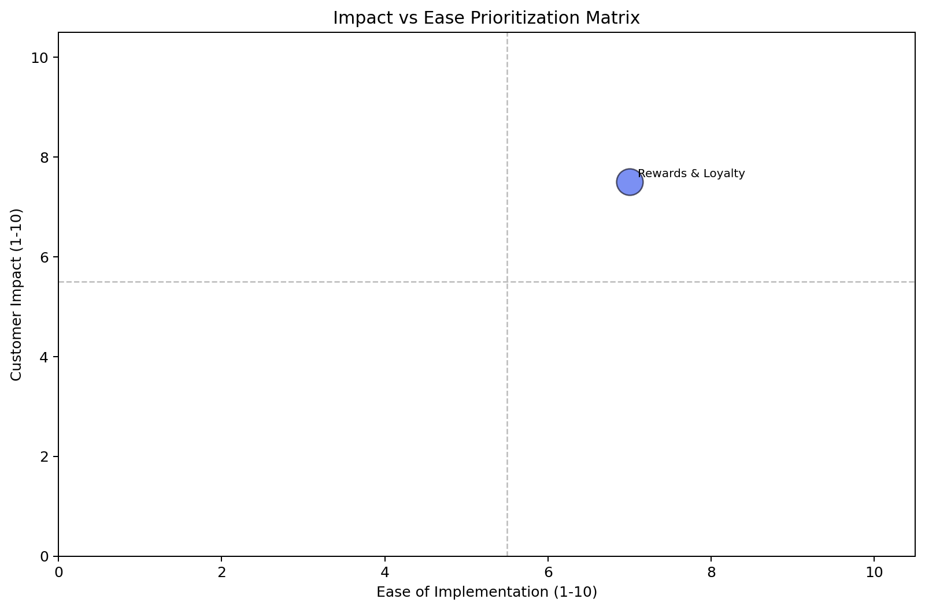
Impact vs. Ease Analysis — Full Theme Prioritization
Theme | Volume (call count) | Top Issue | Solution | Owning Team | Ease | Impact | Priority
Rewards & Loyalty | 16 | Lack of visibility and communication regarding partner transfer status and timelines. | Implement a real-time partner transfer status tracker | Digital/UX | 7.0 | 7.5 | 7.3

Slide 5
Recommended Actions by Owning Team
Digital / UX
Addresses Rewards & Loyalty — eliminates 4 calls by providing immediate transparency on transfer status and timelines in the mobile app and web portal.
Addresses Rewards & Loyalty — eliminates 3 calls by showing clear eligibility criteria, progress bars, and push notifications for promotional points.
Addresses Rewards & Loyalty — eliminates 3 calls by showing pending points and per-transaction earn rates in the rewards dashboard and transaction history, with notifications upon crediting.
Addresses Rewards & Loyalty — eliminates 3 calls by updating UI on redemption screens and dashboards to prevent failed attempts.
Addresses Rewards & Loyalty — eliminates 2 calls by showing merchant category codes, bonus caps, and progress within the app.
Addresses Rewards & Loyalty — eliminates 1 call by automating notifications and providing a real-time tier qualification progress tracker.

Slide 6
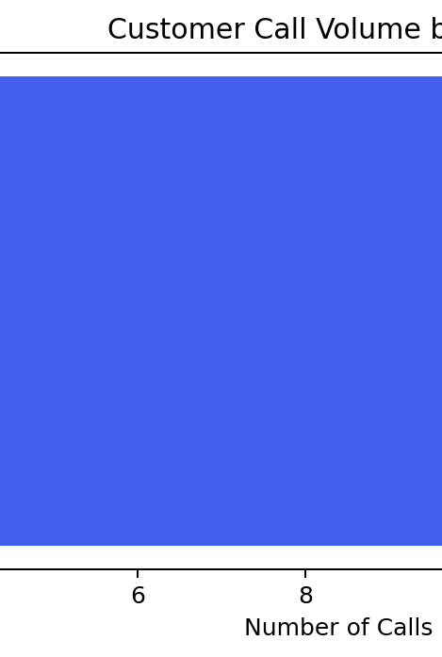
Rewards & Loyalty
— 16 calls (100.0%)
Priority: 7.3 | Impact: 7.5 | Ease: 7.0 | Volume: 16 calls (100.0%)
Customers calling about Rewards & Loyalty are primarily frustrated by a lack of digital visibility into their points, promotional offers, and partner transfers. This digital friction forces avoidable calls, directly impacting operational efficiency and customer satisfaction by creating uncertainty and a perceived lack of control over their loyalty benefits.
Driver | Call Count | % of Theme | Recommended Solution
Lack of visibility and communication regarding partner transfer status and timelines. | 4 | 25.0% | Implement a real-time partner transfer status tracker in the mobile app and web portal, with proactive notifications.
Missing promotional points due to lack of offer tracking, clear eligibility, and proactive communication. | 3 | 18.75% | Develop an in-app promotional offer tracker with clear eligibility criteria, progress bars, and push notifications.
Points not credited as expected, with insufficient visibility into pending points or posting timelines. | 3 | 18.75% | Display pending points and per-transaction earn rates in the rewards dashboard and transaction history, with notifications upon crediting.
Unawareness of minimum redemption thresholds leading to failed attempts. | 3 | 18.75% | Clearly display minimum redemption thresholds on the redemption options screen and rewards dashboard.
Category bonuses not applied as expected, lacking transparency on rules, mapping, and caps. | 2 | 12.5% | Provide transparency on category bonus application, including merchant category codes and bonus caps with progress.
Surprise tier downgrades due to insufficient warning and lack of qualification progress visibility. | 1 | 6.25% | Implement proactive in-app notifications for upcoming tier changes and a real-time tier qualification progress tracker.

