Slide 1

Financial growth & strategy
Presented by Frey Munch

Slide 2
Friction Analysis: Executive Summary
Friction analysis complete.
16 customer calls analyzed | 2 friction themes identified | 50% preventable
Quick Wins (5 identified)
Simplify redemption flow to allow setting a default redemption method and make the setting more accessible (e.g., 1-2 taps from rewards dashboard).
Display MCC for each transaction, provide an in-app explainer for category bonus exclusions, and offer a mechanism to dispute incorrect MCC.
Implement a real-time welcome bonus tracker, display qualifying spend progress, and present bonus terms and exclusions in a mobile-friendly, easily digestible format.
Show qualifying merchants for bonus categories, provide a real-time earn rate preview, and integrate bonus category spend progress directly into the transaction detail screen.

Slide 3
Critical Pain Points
#1: Customers struggle to find and set their cashback redemption preferences due to deep navigation (4 levels deep) and the absence of a default redemption option.
Impact: Score 8.0/10 — See impact score
Driver: Digital
Fix: Redesign the cashback redemption preference flow to be more accessible (max 2 taps) and introduce a 'set as default' option for future redemptions.
#2: The welcome bonus tracker is not real-time, updating only once per statement cycle, and bonus terms are presented in a mobile-unfriendly format.
Impact: Score 8.0/10 — 1.0% volume
Driver: Digital
Fix: Develop a real-time welcome bonus tracker and reformat bonus terms and exclusions for optimal mobile readability.
#3: Points transfer status lacks estimated completion times and clear warnings about irreversibility, leading to customer anxiety and calls.
Impact: Score 7.0/10 — 1.0% volume
Driver: Digital
Fix: Enhance the points transfer confirmation screen to include estimated completion times and a prominent, clear warning about the irreversible nature of transfers.

Slide 4
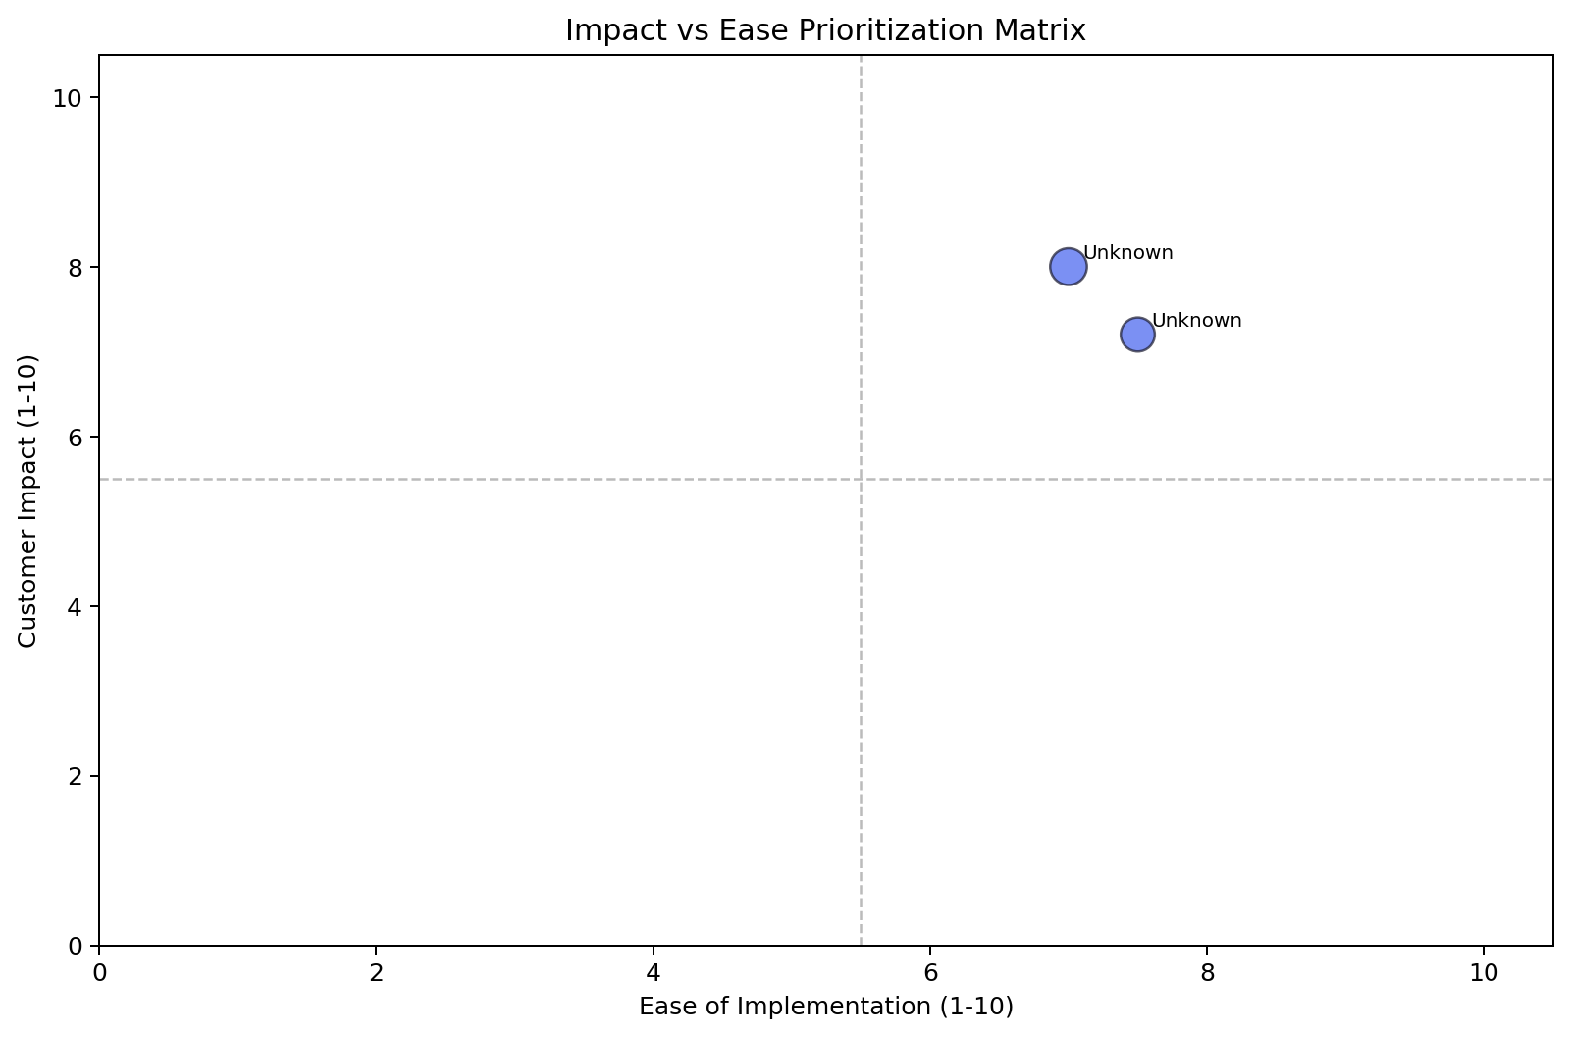
Impact vs. Ease Prioritization
Theme | Calls | Impact | Ease | Priority | Quadrant
? | 9 calls (0.6%) | 8.0 | 7.0 | 7.6 | Quick Win
? | 7 calls (0.4%) | 7.2 | 7.5 | 7.3 | Quick Win

Slide 5
The Biggest Bet
N/A
Impact 8.0/10 · Ease 7.0/10 · 9 calls (0.6%)
Quadrant: Quick Win
Primary Driver: Digital
Contributing Factors
digital
Quick Wins
Simplify redemption flow to allow setting a default redemption method and make the setting more accessible (e.g., 1-2 taps from rewards dashboard).
Display MCC for each transaction, provide an in-app explainer for category bonus exclusions, and offer a mechanism to dispute incorrect MCC.
Implement a real-time welcome bonus tracker, display qualifying spend progress, and present bonus terms and exclusions in a mobile-friendly, easily di

Slide 6
Recommended Actions by Owning Team
Digital / UX Team
Simplify redemption flow to allow setting a default redemption method and make the setting more accessible (e.g., 1-2 taps from rewards dashboard).
Redesign the cashback redemption preference flow to be more accessible (max 2 taps) and introduce a 'set as default' option for future redemptions.

Slide 7
Theme 1
Metric | Value
Calls | 9 calls (0.6%)
Impact Score | 8.0/10
Ease Score | 7.0/10
Priority Score | 7.6
Quadrant | Quick Win
Primary Driver | Digital
Preventability | 50%
Factor 1 | digital
Solution 1 | Simplify redemption flow to allow setting a default redemption method and make t
Solution 2 | Display MCC for each transaction, provide an in-app explainer for category bonus
Solution 3 | Implement a real-time welcome bonus tracker, display qualifying spend progress,
Driver | Volume | Type | Dimension | Solution
Cashback redemption preference setting is hidden a | 0.0% | Secondary | Digital | -
Merchant category code (MCC) for bonus determinati | 0.0% | Secondary | Digital | -
Tier status page is not mobile-optimized, lacks pr | 0.0% | Secondary | Digital | -
Welcome bonus tracker lacks real-time progress and | 0.0% | Secondary | Digital | -
Category bonus tracking doesn't show qualifying me | 0.0% | Secondary | Digital | -

Slide 8
Theme 2
Metric | Value
Calls | 7 calls (0.4%)
Impact Score | 7.2/10
Ease Score | 7.5/10
Priority Score | 7.3
Quadrant | Quick Win
Primary Driver | Digital
Preventability | 50%
Factor 1 | digital
Solution 1 | Simplify cashback redemption preference setting to 1-2 taps and add an option to
Solution 2 | Add an anniversary bonus tracker with estimated posting timeline and display the
Solution 3 | Display MCC for each transaction, provide an in-app mechanism to report incorrec
Driver | Volume | Type | Dimension | Solution
Cashback redemption preference setting is hidden u | 0.0% | Secondary | Digital | -
Points transfer status shows 'Processing' with no | 0.0% | Secondary | Digital | -
Anniversary bonus posting timeline is not document | 0.0% | Secondary | Digital | -
Merchant category code (MCC) used for bonus determ | 0.0% | Secondary | Digital | -
Welcome bonus tracker doesn't show qualifying spen | 0.0% | Secondary | Digital | -

