Slide 1
Digital Friction Analysis: ATT
Customer Call Reduction Opportunities

Slide 2
Executive Summary
This analysis focuses on 500 ATT customer calls, specifically those related to 'Rewards & Loyalty'. The investigation identified 1 core theme, 'Rewards & Loyalty', which account...
Rewards Redemption Preference Confusion: 7 calls (1.4%). Implement a prominent and easily discoverable section in the app for managing rewards redemption preference...
Category Bonus Discrepancies: 4 calls (0.8%). Provide an in-app explainer or FAQ section detailing how merchant category codes affect bonus categories. D...
Unexplained Partial Welcome Bonuses: 2 calls (0.4%). Implement an in-app offer tracker with a progress bar and clear criteria for bonus fulfillment. If a partia...
Solution: Add clear redemption preference settings in the rewards dashboard, allowing customers to easily switch between cashback and points. | Theme: Rewards & Loyalty | Impact...
Solution: Implement an in-app offer tracker with a progress bar and clear checklist of qualifying criteria for welcome bonuses. | Theme: Rewards & Loyalty | Impact Calls: 2 | Im...
Solution: Implement proactive 60-day advance notifications (push, email, in-app) for upcoming tier downgrades, clearly outlining lost benefits. | Theme: Rewards & Loyalty | Impa...

Slide 3
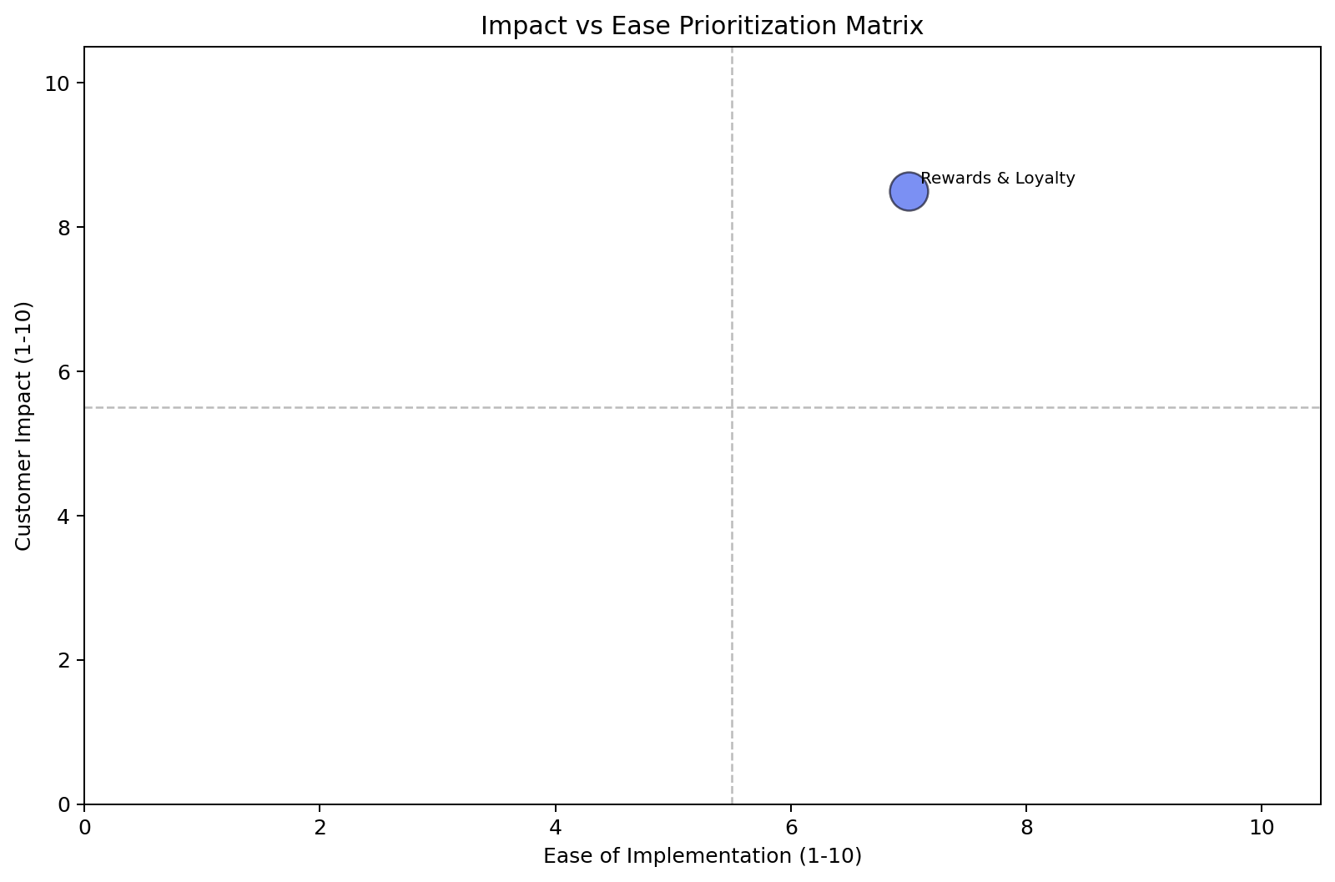
Impact vs Ease Prioritization
Rewards & Loyalty: 16 calls | Impact 8.5 | Ease 7.0 | Priority 7.9

Slide 4
Recommended Actions by Dimension
Digital: Add clear redemption preference settings in the rewards dashboard, allowing customers to easily switch betw... (Rewards & Loyalty, ~7 calls)
Digital: Display merchant category code (MCC) and applied earn rate for each transaction in the transaction history,... (Rewards & Loyalty, ~3 calls)
Communication: Provide clear in-app guidance on redemption preferences during onboarding and ensure an easily accessible o... (Rewards & Loyalty, ~7 calls)
Communication: Implement an in-app explainer for merchant category codes and their impact on bonus earnings. Display the a... (Rewards & Loyalty, ~4 calls)

Slide 5
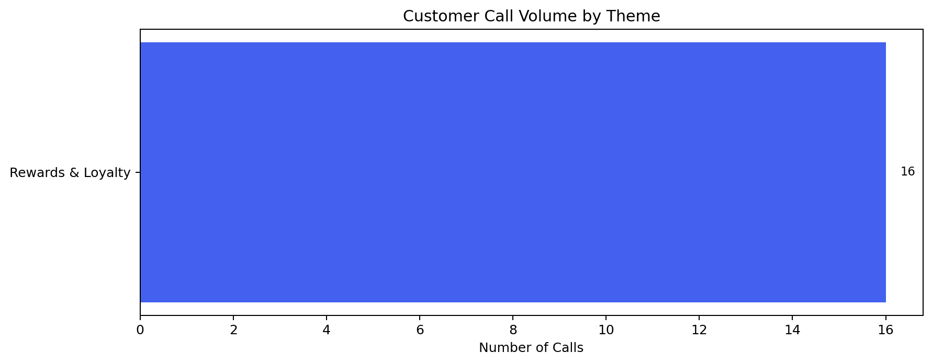
Rewards & Loyalty — Detailed Analysis
Rewards & Loyalty: 16 calls | Impact 8.5 | Ease 7.0
Customer's cashback was posted as points instead of statement credit. They can't find where to ch... (primary) - 7 calls
Cashback posted as points instead of statement credit; inability to change redemption preference. (primary) - 7 calls
Customer used their card at a gas station but didn't get the 5x gas category bonus. The merchant... (secondary) - 3 calls
Category bonus not applied due to merchant coding discrepancies (e.g., gas station coded as conve... (secondary) - 4 calls

