Slide 1
Digital Friction Analysis: ATT
Customer Call Reduction Opportunities

Slide 2
Executive Summary
This analysis focuses on 16 ATT customer calls, specifically addressing 'Rewards & Loyalty' issues. The data was filtered by 'Rewards & Loyalty' call reason and 'ATT' product, r...
Cashback Redemption Preference Confusion: 7 calls (43.8%). Implement clear, self-service options in-app/web to manage cashback redemption preferences (points vs. stat...
Incorrect Category Bonus Application: 3 calls (18.8%). Improve MCC mapping logic, provide transparent in-app MCC lookup/explanation tools, and display MCC for eac...
Welcome Bonus Shortfalls: 2 calls (12.5%). Implement an in-app offer tracker with progress, ensure automated and accurate bonus fulfillment, and proac...
Solution: Implement clear, self-service options in-app/web to manage cashback redemption preferences (points vs. statement credit). | Theme: Rewards & Loyalty | Impact Calls: 7...
Solution: Improve MCC mapping logic, provide transparent in-app MCC lookup/explanation tools. | Theme: Rewards & Loyalty | Impact Calls: 3 | Impact Percentage: 18.75

Slide 3
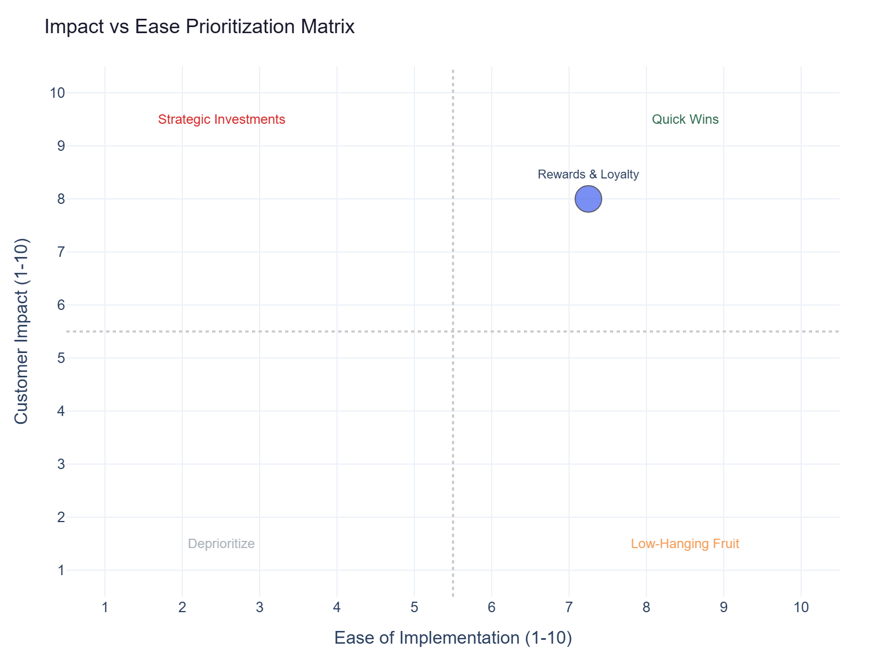
Impact vs Ease Prioritization
Rewards & Loyalty: 16 calls | Impact 8.0 | Ease 7.2 | Priority 7.7

Slide 4
Recommended Actions by Dimension
Digital: Provide clear, self-service option to manage cashback redemption preferences (points vs. statement credit)... (Rewards & Loyalty, ~7 calls)
Digital: Implement a real-time merchant category code lookup tool or provide clear examples of how common merchants... (Rewards & Loyalty, ~3 calls)
Operations: Implement clear, self-service redemption preference settings in-app and ensure correct cashback posting. (Rewards & Loyalty, ~7 calls)
Operations: Improve merchant category code (MCC) mapping logic and provide customer-facing MCC lookup/explanation tools. (Rewards & Loyalty, ~4 calls)
Communication: Clearly communicate default redemption preferences during onboarding and provide an easily discoverable in-... (Rewards & Loyalty, ~7 calls)
Communication: Provide an in-app tool or FAQ explaining how merchant categories are determined and how they impact bonus e... (Rewards & Loyalty, ~3 calls)
Policy: Implement a clear, self-service option in the app/web to select preferred cashback redemption method (point... (Rewards & Loyalty, ~7 calls)
Policy: Provide transparent merchant category code (MCC) mapping in the app, allowing customers to see how transact... (Rewards & Loyalty, ~3 calls)

Slide 5
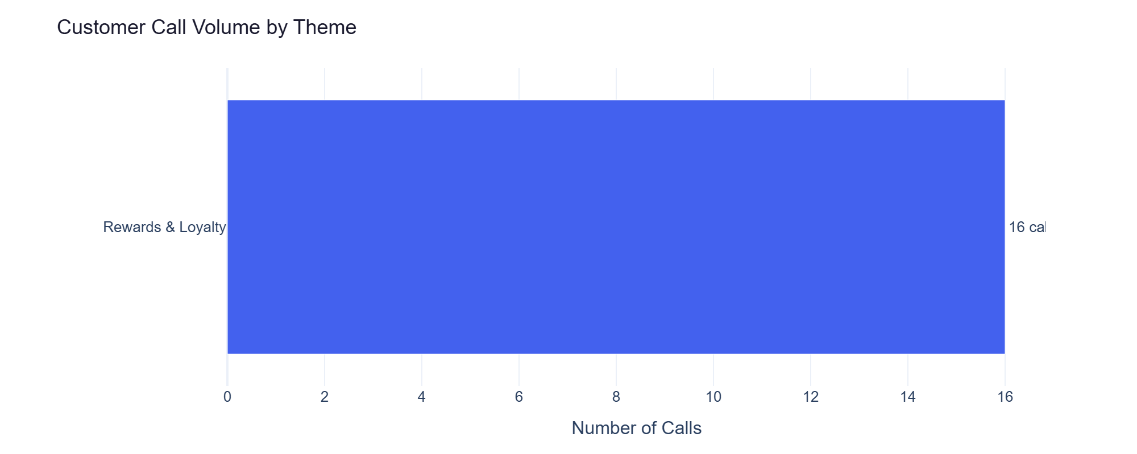
Rewards & Loyalty — Detailed Analysis
Rewards & Loyalty: 16 calls | Impact 8.0 | Ease 7.2
Customer's cashback was posted as points instead of statement credit. They can't find where to ch... (primary) - 7 calls
Cashback posted as points instead of statement credit; redemption preference unclear (primary) - 7 calls
Customer's cashback was posted as points instead of statement credit. They can't find where to ch... (primary) - 7 calls
Cashback posted as points instead of statement credit; customer can't change redemption preference. (primary) - 7 calls

