Slide 1
Digital Friction Analysis: ATT
Customer Call Reduction Opportunities

Slide 2
Executive Summary
This analysis focuses on 4 ATT customer calls, specifically addressing 'Rewards Redemption' within the 'Rewards & Loyalty' theme. All identified friction points were preventable...
Welcome Bonus Tracker & Terms Clarity: 1 calls (25.0%). Implement a real-time welcome bonus spend tracker on the rewards dashboard with a progress bar and clearly...
Anniversary Bonus Crediting Delays & Visibility: 1 calls (25.0%). Establish a clear SLA for anniversary bonus crediting, automate tracking and notifications, and prominently...
Cashback Redemption Preference Confusion: 1 calls (25.0%). Simplify the redemption preference setting by moving it to a top-level rewards section, adding a 'Set as de...
Solution: Simplify cashback redemption preference settings and add default options. | Theme: Rewards & Loyalty | Impact Calls: 1 | Impact Percentage: 25.0
Solution: Display anniversary bonus posting timelines and account anniversary dates, with proactive notifications. | Theme: Rewards & Loyalty | Impact Calls: 1 | Impact Percenta...

Slide 3
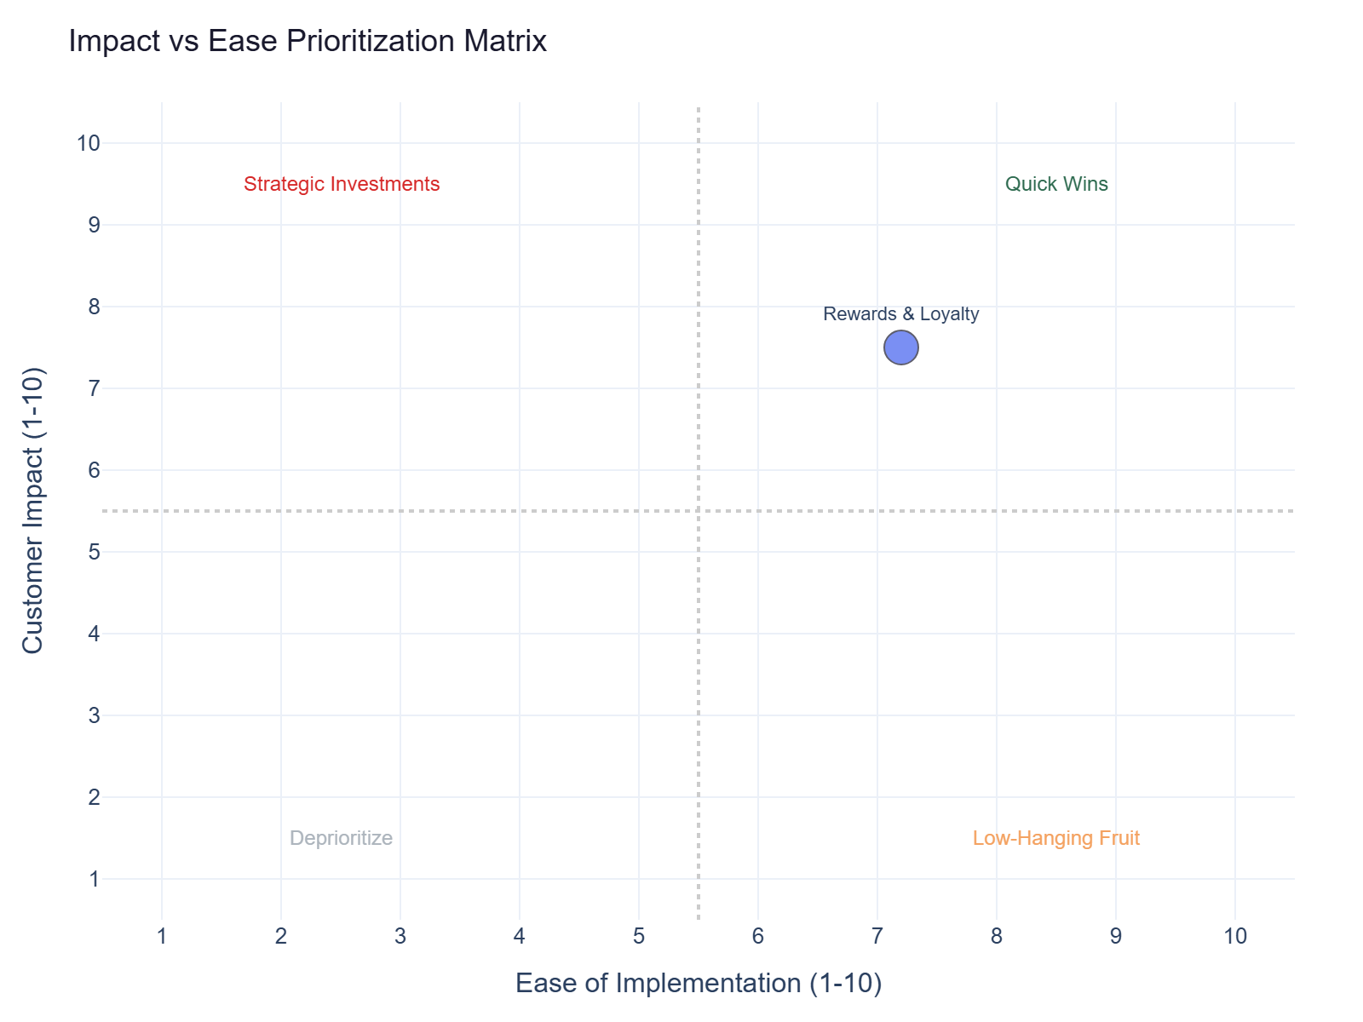
Impact vs Ease Prioritization
Rewards & Loyalty: 4 calls | Impact 7.5 | Ease 7.0 | Priority 7.4

Slide 4
Recommended Actions by Dimension
Digital: Move redemption preference to top-level rewards settings (1 tap from dashboard). Add 'Set as default' optio... (Rewards & Loyalty, ~1 calls)
Digital: Display anniversary bonus posting timeline and account anniversary date prominently in rewards section. Sen... (Rewards & Loyalty, ~1 calls)
Operations: Implement a clear SLA for anniversary bonus crediting (e.g., 30 days post-anniversary) and automate trackin... (Rewards & Loyalty, ~1 calls)
Operations: Automate real-time bonus calculation and crediting based on spend, ensuring accurate application of terms. (Rewards & Loyalty, ~1 calls)
Communication: Send push notification when anniversary bonus is credited or if there's a delay. (Rewards & Loyalty, ~1 calls)

Slide 5
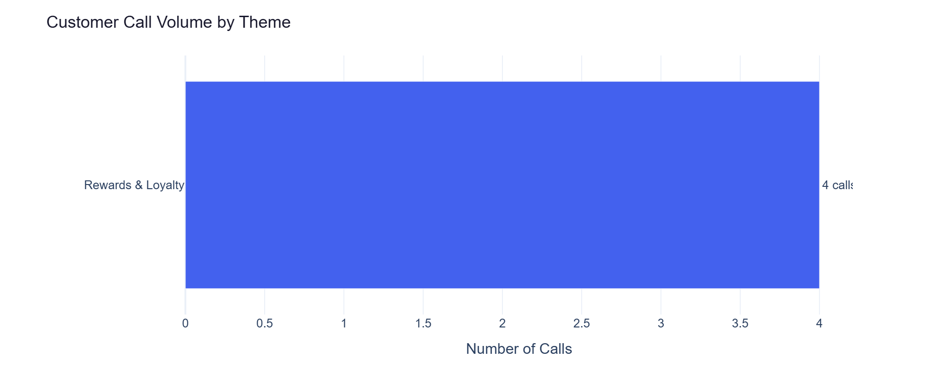
Rewards & Loyalty — Detailed Analysis
Rewards & Loyalty: 4 calls | Impact 7.5 | Ease 7.2
Cashback redemption preference setting is hidden and lacks default option (primary) - 1 calls
Anniversary bonus posting timeline and account anniversary date are not visible in the app (primary) - 1 calls
Merchant category code (MCC) and bonus exclusions are not transparent for category bonuses (primary) - 1 calls
Welcome bonus tracker is not real-time and terms are hard to read on mobile (primary) - 1 calls

