Slide 1
Digital Friction Analysis: ATT Rewards & Loyalty
Customer Call Reduction Opportunities — Feb 2026

Slide 2
Executive Summary
Analyzed 5 key friction points in ATT Rewards & Loyalty programs.
Overall preventability is 100% across all identified issues.
Dominant friction driver: Digital (4 out of 5 findings), followed by Communication (1 out of 5 findings).
All 5 findings are multi-factor issues, highlighting complex interdependencies.
Improving cashback redemption is a quick win, while bonus tracking and tier communication are strategic investments.

Slide 3
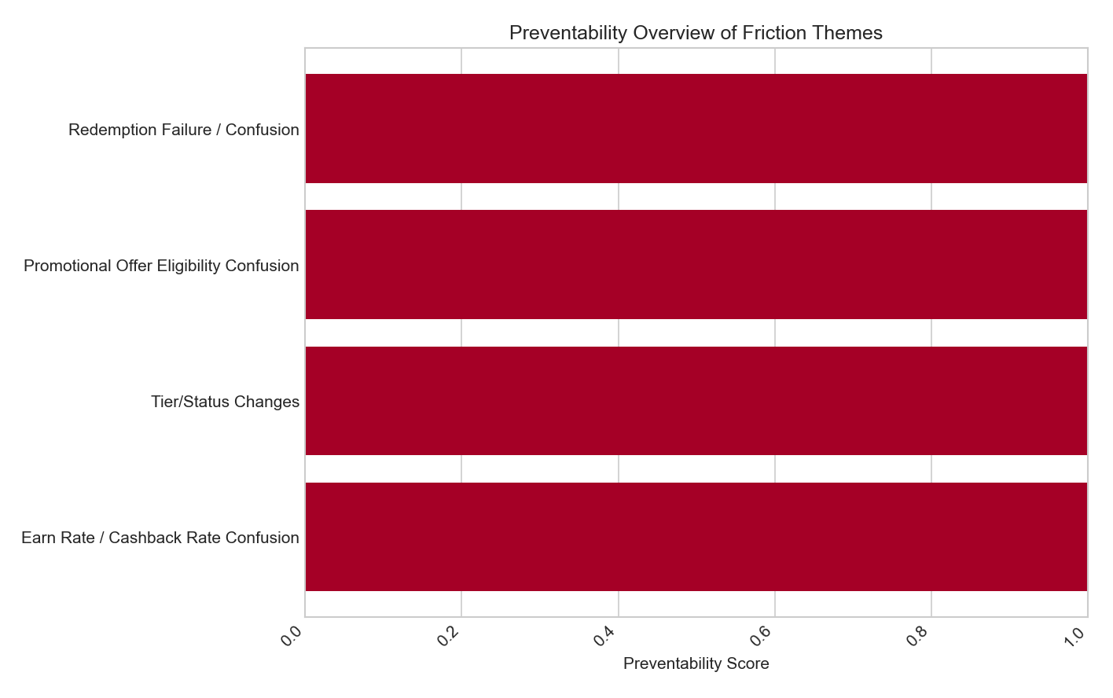
Cashback Redemption Confusion — 43.75% of Rewards Calls
Primary driver: Digital (deeply nested preference setting, no 'Set as default' option).
Contributing: Communication (lack of clear guidance/tutorials).
Preventability: 100% — streamline preference setting, add auto-redemption, provide in-app tutorials.
Recommended: Streamline redemption preference setting to a top-level rewards setting, add a 'Set as default' option, and allow auto-redemption rules. Provide in-app tutorials and proactive messages to guide users on managing preferences.

Slide 4
Welcome Bonus Tracking Anxiety — 12.5% of Rewards Calls
Primary driver: Digital (no real-time tracker, updates only per statement cycle).
Contributing: Communication (bonus terms in fine print, hard to read on mobile).
Preventability: 100% — implement real-time tracker, clear terms, push notifications.
Recommended: Implement a real-time welcome bonus spend tracker with a progress bar and days remaining. Clearly list qualifying/non-qualifying purchases. Send push notifications for progress updates and present bonus terms in a clear, mobile-friendly format.

Slide 5
Merchant Category Code Confusion — 18.75% of Rewards Calls
Primary driver: Digital (invisible MCCs, no mechanism to report incorrect coding).
Contributing: Communication (unclearly explained category bonus exclusions).
Preventability: 100% — display MCCs, allow flagging, clear exclusions.
Recommended: Display MCC and assigned category for each transaction, allow customers to flag incorrect categorization, and clearly list category bonus exclusions with examples. Add in-app explainers for MCCs and their impact.

Slide 6
Unexpected Tier Downgrades — 6.25% of Rewards Calls
Primary driver: Communication (no proactive notification before downgrade).
Contributing: Digital (mobile-unoptimized page, no progress bar for next tier).
Preventability: 100% — update mobile page, implement advance notifications.
Recommended: Update the tier status page for mobile with a clear progress bar. Implement 90-day and 30-day advance notification system (email/push) for tier downgrades, clearly stating current/new status and affected benefits.

Slide 7
Lack of Real-time Bonus Tracking — 6.25% of Rewards Calls
Primary driver: Digital (no real-time visibility into category bonus tracking/earn rates).
Contributing: Communication (no in-app tips on maximizing rewards).
Preventability: 100% — show merchant earning rate preview, bonus category progress.
Recommended: Show merchant earning rate preview on each transaction, display bonus category progress on the main rewards dashboard, and add a real-time earn rate indicator on transaction detail screens with a qualifying merchant badge. Provide in-app tips on maximizing rewards.

Slide 8

Impact vs Ease Matrix
Quick Wins (do first): Streamline cashback redemption preference setting (Impact: 0.85, Ease: 0.9).
Strategic Investments: Implement real-time welcome bonus tracker (Impact: 0.8, Ease: 0.767), update tier status page with notifications (Impact: 0.805, Ease: 0.75), display MCCs and category bonus progress (Impact: 0.75, Ease: 0.7), show merchant earning rate preview (Impact: 0.7, Ease: 0.75).

Slide 9
Recommended Actions
Digital/UI: Streamline cashback redemption preference setting, implement real-time welcome bonus spend tracker, update tier status page for mobile, display MCC and assigned category for each transaction, show merchant earning rate preview.
Communication: Provide in-app tutorials and proactive messages for redemption, send push notifications for bonus progress, implement 90-day and 30-day advance notification for tier downgrades, clearly list category bonus exclusions with examples, provide in-app tips on maximizing rewards.

Slide 10
Data Appendix
Source: Filtered data for Product = ATT, Call Reason = Rewards & Loyalty.
Analysis: Focused on Digital and Communication friction dimensions.
Methodology: Multi-dimensional friction analysis, identifying dominant drivers and contributing factors.
Total findings analyzed: 5.

