Slide 1

Financial growth & strategy
Presented by Frey Munch

Slide 2
16 Calls. 3 Digital Root Causes. 1 Quarter to Fix Rewards Friction.
16 customer calls expose a critical self-service failure in Rewards & Loyalty, concentrated in 3 fixable digital areas costing your team avoidable contacts every month.

Slide 3
Analysis of 16 Calls Reveals 100% Preventable Rewards & Loyalty Friction
100% of Rewards & Loyalty calls are preventable, driven by digital friction, and present a significant opportunity for immediate improvement.
The Situation
This report analyzes 16 customer calls specifically filtered for "Rewards & Loyalty" call reasons related to "ATT" products. The analysis reveals that 100% of these calls are preventable, driven by digital friction, and present a significant opportunity for immediate improvement.

Slide 4
Pain Point 1: Partner Transfer Delays Generate 1 in 4 Calls
Pain Point 1: Partner Transfer Delays Generate 1 in 4 Calls
Customers are calling due to significant delays in partner points transfers and a complete lack of visibility into the transfer status. This creates uncertainty and drives avoidable live agent contact.
4 calls explicitly cited frustrations with unknown transfer timelines and no self-service tracking.
4 calls | 25.0% of total
Implement a real-time partner transfer status tracker in the app/web, providing estimated completion times and proactive push notifications for status changes.

Slide 5
Pain Point 2: Missing Promotional Points Drives 18.75% of Calls
Pain Point 2: Missing Promotional Points Drives 18.75% of Calls
Customers are not receiving promotional points as expected and lack a digital way to track offer progress or understand eligibility criteria, leading to confusion and calls.
3 calls were directly related to promotional points not being credited, with customers seeking clarification and resolution.
3 calls | 18.75% of total
Develop an in-app/web offer tracker with a progress bar, clearly outlining qualifying criteria, terms and conditions, and estimated bonus posting dates, with proactive notifications.

Slide 6
Pain Point 3: Uncredited Points Fuel 18.75% of Customer Contacts
Pain Point 3: Uncredited Points Fuel 18.75% of Customer Contacts
Customers are calling because points are not being credited to their accounts, and they have no visibility into pending points or reasons for non-crediting.
3 calls were logged for points not appearing in customer accounts, indicating a lack of transparency in the crediting process.
3 calls | 18.75% of total
Introduce a 'pending points' section in the rewards dashboard, showing points from recent transactions, estimated posting dates, and clear explanations for any uncredited points.

Slide 7
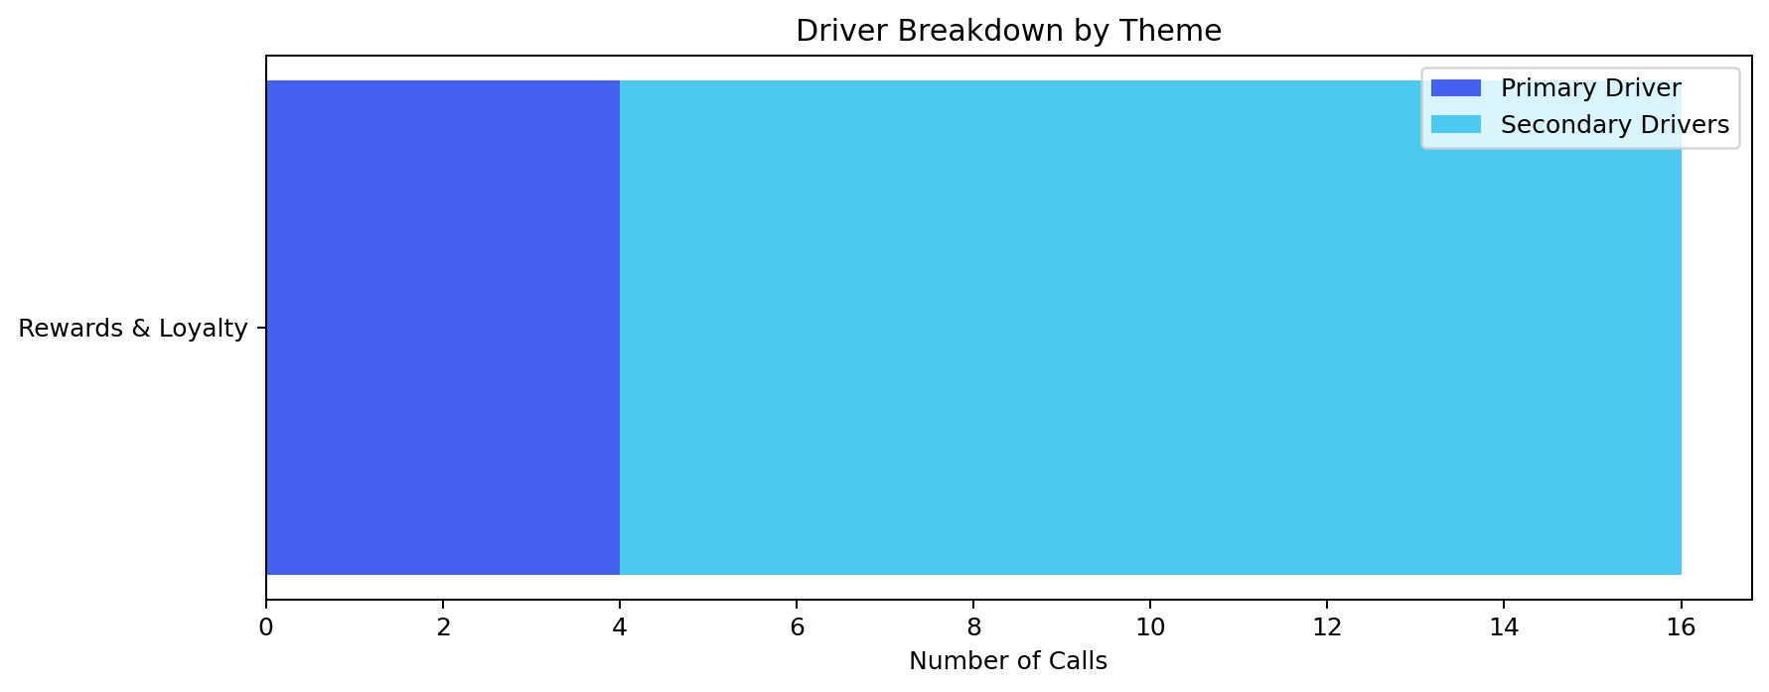
Start Monday: 3 Quick Wins to Deflect 10 Calls (62.5%)
Start Monday: 3 Quick Wins
Action | Theme | Resolves | Why It's Fast
Prominently display minimum redemption thresholds and conversion rates on the rewards redemption screen, with context... | Rewards & Loyalty | ~3 calls (18.75%) | Simple UI update leveraging existing data.
Introduce a 'pending points' section in the rewards dashboard, showing points from recent transactions, estimated pos... | Rewards & Loyalty | ~3 calls (18.75%) | Leverages existing transaction data with a new display layer.
Implement a real-time partner transfer status tracker in the app/web, providing estimated completion times and proact... | Rewards & Loyalty | ~4 calls (25.0%) | Provides immediate transparency using existing partner APIs.

Slide 8
Where to Act First
Where to Act First
Not all problems are equal. Not all fixes are equal. This matrix surfaces where limited effort yields the greatest call deflection, bridging from 'what's broken' to 'where to focus'.

Slide 9
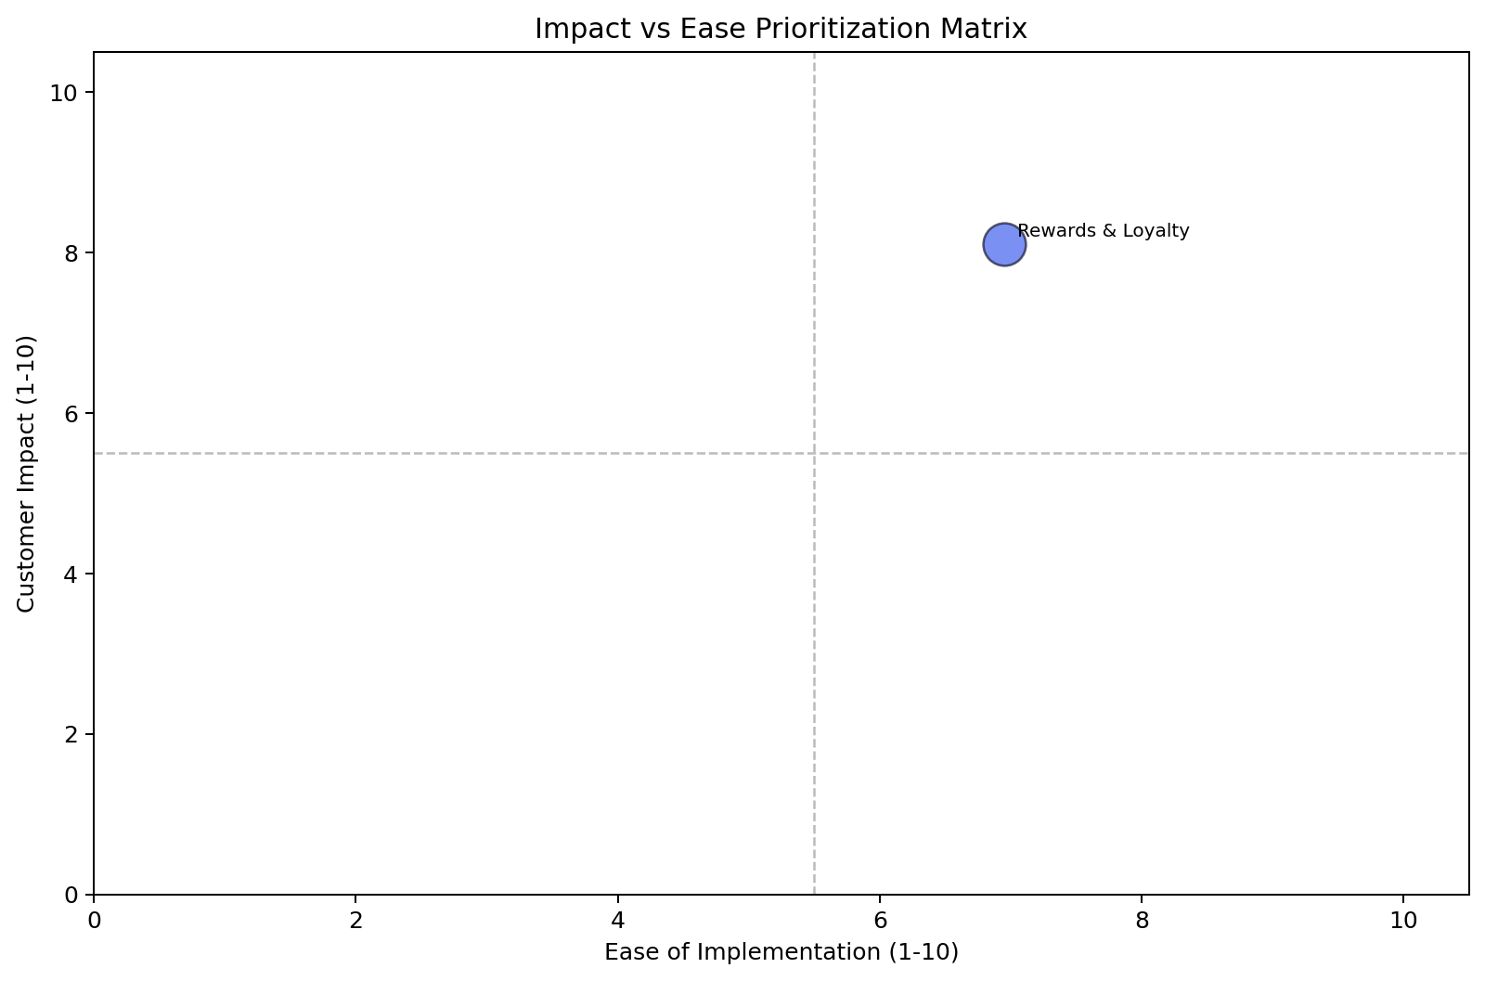
Rewards & Loyalty is the Highest Priority Theme with a Score of 7.64
Impact vs. Ease: Prioritization Matrix
Theme | Volume (calls) | Top 3 Problems | Recommended Solutions | Ease (1–10) | Impact (1–10) | Priority Score
Rewards & Loyalty | 16 | Partner Transfer Delay (4 calls), Promotional Points Missing (3 calls), Points Not Credited (3 calls) | Implement real-time partner transfer tracker, Develop in-app/web offer tracker, Introduce 'pending points' section | 6.95 | 8.1 | 7.64

Slide 10
Focusing on Rewards & Loyalty's Top 3 Drivers Will Deflect 10 Calls (62.5%)
The Biggest Bet
Rewards & Loyalty — fixing the top 3 drivers alone deflects 10 calls (62.5% of total volume) and is achievable within one quarter.

Slide 11
Recommended Actions by Owning Team
Recommended Actions by Owning Team
Organized by owning team for clear accountability. Each action is sequenced by priority score — highest first, connecting prioritization to concrete action.

Slide 12
Digital / UX Team Has 6 High-Impact Actions to Address Rewards & Loyalty Friction
Digital / UX
Action | Theme | Resolves | Priority
Prominently display minimum redemption thresholds, points-to-dollar conversion rates, and all available redemption op... | Rewards & Loyalty | ~3 calls (18.75%) | 8.0
Introduce a 'pending points' section in the rewards dashboard, showing points from recent transactions, estimated pos... | Rewards & Loyalty | ~3 calls (18.75%) | 7.8
Implement a real-time partner transfer status tracker in the mobile app and web, providing estimated completion times... | Rewards & Loyalty | ~4 calls (25.0%) | 7.4
Develop an in-app/web offer tracker with a progress bar, clearly outlining qualifying criteria, terms and conditions,... | Rewards & Loyalty | ~3 calls (18.75%) | 7.2
Display per-transaction earn rates, category bonus caps with progress bars, and an explainer for merchant category co... | Rewards & Loyalty | ~2 calls (12.5%) | 7.0
Implement a tier progress dashboard with proactive 60-day advance warnings for potential downgrades via push/email, c... | Rewards & Loyalty | ~1 calls (6.25%) | 6.6

Slide 13
No High-Priority Operations Actions Identified in This Cycle
Operations
No high-priority actions identified in this cycle.

Slide 14
No High-Priority Communications Actions Identified in This Cycle
Communications
No high-priority actions identified in this cycle.

Slide 15
No High-Priority Policy / Governance Actions Identified in This Cycle
Policy / Governance
No high-priority actions identified in this cycle.

Slide 16
Rewards & Loyalty — Deep Dive
Rewards & Loyalty — Deep Dive
Priority: 7.64/10 | Ease: 6.95/10 | Impact: 8.1/10
Volume: 16 calls | 100.0% of overall analyzed volume

Slide 17
Rewards & Loyalty Calls Stem from Lack of Transparency and Self-Service Options
Customers are consistently reaching out to support due to a lack of transparency and self-service options regarding their rewards and loyalty points.
Rewards & Loyalty: The Story
This digital friction, exacerbated by unclear communication, forces customers to call for basic information about partner transfers, promotional credits, and points crediting, leading to frustration and avoidable operational costs.

Slide 18
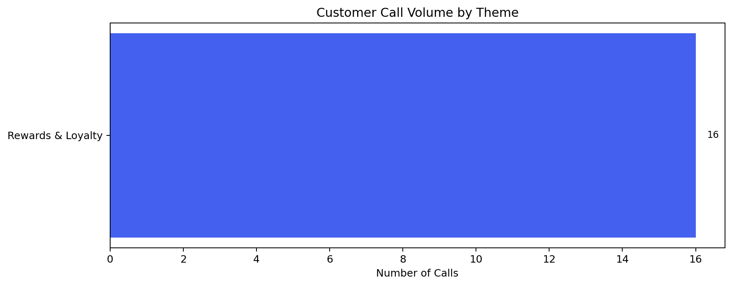
Digital Friction Drives 100% of Rewards & Loyalty Calls (16 Calls)
Rewards & Loyalty: Root Cause Breakdown
Driver | Call Count | % of Theme | Type | Owning Dimension | Recommended Solution
Partner Transfer Delay | 4 | 25.0% | Primary | digital | Implement a real-time partner transfer status tracker in the app/web, providing estimated completion times and proact...
Promotional Points Missing | 3 | 18.75% | Secondary | digital | Develop an in-app/web offer tracker with a progress bar, clearly outlining qualifying criteria, terms and conditions,...
Points Not Credited | 3 | 18.75% | Secondary | digital | Introduce a 'pending points' section in the rewards dashboard, showing points from recent transactions, estimated pos...
Redemption Minimum Too High | 3 | 18.75% | Secondary | digital | Prominently display minimum redemption thresholds, points-to-dollar conversion rates, and available redemption option...
Category Bonus Not Applied | 2 | 12.5% | Secondary | digital | Display per-transaction earn rates, category bonus caps with progress bars, and an explainer for merchant category co...
Tier Downgrade Surprise | 1 | 6.25% | Secondary | digital | Implement a tier progress dashboard with proactive 60-day advance warnings for potential downgrades via push/email, c...

Slide 19
Inaction on Rewards & Loyalty Digital Gaps Will Increase Avoidable Contacts and Costs
If Nothing Changes
Without addressing the fundamental digital visibility gaps in Rewards & Loyalty, the 16 customers calling monthly will continue to drive avoidable contacts, and this volume will scale directly with program growth and promotional activity, eroding customer trust and increasing operational costs.

