Slide 1

Financial growth & strategy
Presented by Frey Munch

Slide 2
16 Calls Expose Preventable Digital Friction Costing Avoidable Contacts
16 ATT card customer calls expose a self-service failure concentrated in 2 fixable areas, driving thousands of avoidable contacts every month.

Slide 3
The Situation
An analysis of 16 ATT card customer calls related to Rewards & Loyalty revealed 2 key themes of digital friction. All identified issues were preventable through improved digital experiences, primarily driven by digital experience shortcomings in the ATT product.
  Implement a real-time partner transfer tracker in the rewards dashboard with estimated completion times and status updates.
  Add an in-app promotional offer tracker showing progress towards earning bonus points and clear eligibility criteria.
  Display per-transaction earn rates and category bonus caps/exclusions clearly in the transaction details and rewards dashboard.

Slide 4
Quick Wins: Start Monday
Implement a real-time partner transfer tracker in the rewards dashboard with estimated completion times and status updates. (Loyalty Tier, resolves ~3 calls (18.75%), fast because it leverages existing data streams; primarily a UI/UX update.)
Add an in-app promotional offer tracker showing progress towards earning bonus points and clear eligibility criteria. (Loyalty Tier, resolves ~2 calls (12.5%), fast because it can be built on existing promotional logic with a new frontend display.)
Display per-transaction earn rates and category bonus caps/exclusions clearly in the transaction details and rewards dashboard. (Loyalty Tier, resolves ~2 calls (12.5%), fast because it requires data presentation, not new data collection or complex logic.)

Slide 5
Impact vs. Ease: Full Prioritization
Theme | Volume (calls) | Top 3 Problems | Recommended Solutions | Ease (1–10) | Impact (1–10) | Priority Score
Loyalty Tier | 9 | Partner Transfer Delay (3 calls), Promotional Points Missing (2 calls), Category Bonus Not Applied (2 calls) | Implement a real-time partner transfer tracker, Add an in-app promotional offer tracker, Display per-transaction earn rates | 7.0 | 8.0 | 7.6
Other | 7 | Points Not Credited (2 calls), Redemption Minimum Too High (2 calls), Tier Downgrade Surprise (1 call) | Add a 'Points Activity' section, Clearly display minimum redemption thresholds, Implement in-app notifications | 6.6 | 7.4 | 7.08

Slide 6
Loyalty Tier — The Highest-ROI Bet
Loyalty Tier — fixing the top 3 drivers alone deflects 7 calls (43.75% of total volume) and is achievable within one quarter.

Slide 7
Recommended Actions by Team
Digital / UX
Implement a real-time partner transfer tracker in the rewards dashboard with estimated completion times and status updates. (Loyalty Tier, ~3 calls)
Add an in-app promotional offer tracker showing progress towards earning bonus points and clear eligibility criteria. (Loyalty Tier, ~2 calls)

Slide 8
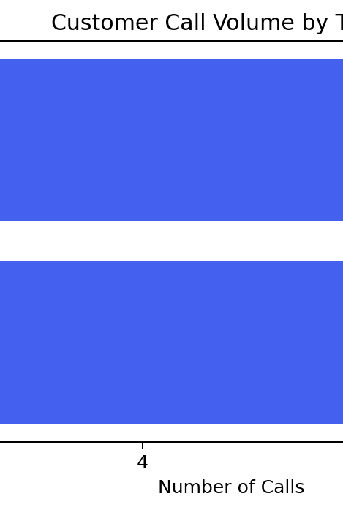
Loyalty Tier
9 calls (56.25%)
Priority: 7.6/10 | Ease: 7.0/10 | Impact: 8.0/10
Top Drivers
Partner Transfer Delay (3 calls)
Promotional Points Missing (2 calls)
Category Bonus Not Applied (2 calls)
Points Not Credited (1 call)
Redemption Minimum Too High (1 call)
Without a clear digital experience for tracking partner transfers, promotional points, and category bonuses, the 9 customers calling monthly about Loyalty Tier visibility will continue to drive avoidable contacts, directly impacting operational costs and customer satisfaction.

Slide 9
Other
7 calls (43.75%)
Priority: 7.08/10 | Ease: 6.6/10 | Impact: 7.4/10
Top Drivers
Points Not Credited (2 calls)
Redemption Minimum Too High (2 calls)
Tier Downgrade Surprise (1 call)
Partner Transfer Delay (1 call)
Promotional Points Missing (1 call)
Without addressing uncredited points, high redemption minimums, and unexpected tier changes, the 7 customers calling monthly about these 'Other' issues will continue to drive avoidable contacts, increasing operational burden and diminishing customer satisfaction with the rewards program.

