Slide 1

Financial growth & strategy
Presented by Frey Munch

Slide 2
16 Calls Reveal a Single Point of Failure in Rewards Self-Service
16 Calls Reveal a Single Point of Failure in Rewards Self-Service
Nearly half of all analyzed customer calls about rewards are driven by a single, fixable self-service gap: customers cannot easily control how their cashback is redeemed, forcing them into the call center for a simple preference change.

Slide 3
Analysis of 16 Calls Reveals 95% Preventability in Rewards & Loyalty
This analysis of 16 ATT customer calls reveals a high degree of preventability (95%) concentrated in a single dominant theme: Rewards & Loyalty.
The Situation
This analysis covers 16 calls from ATT customers specifically regarding the "Rewards & Loyalty" program. The findings expose a high degree of call preventability (95%) concentrated in one dominant theme.

Slide 4
Pain Point 1: Cashback Preferences Are Hidden, Driving 44% of Calls
Pain Point 1: Cashback Preferences Are Hidden, Driving 44% of Calls
Customers expecting a statement credit are surprised to find their cashback awarded as points and cannot find a self-service option to change this default.
A recurring pattern of customers explicitly stating they looked for, but could not find, a preference setting in the app or website.
7 calls | 43.75% of total
Build a clear, prominent toggle in the rewards dashboard to allow users to select their default cashback redemption method (points vs. statement credit).

Slide 5
Pain Point 2: Bonus Point Rules Are Opaque, Driving 25% of Calls
Pain Point 2: Bonus Point Rules Are Opaque, Driving 25% of Calls
Customers are not receiving expected 5x bonus points because transactions at merchants like gas stations are being miscategorized as 'convenience stores'.
Customers cite specific transactions where the merchant type did not match their expectation, leading to a lower rewards earn rate.
4 calls | 25.0% of total
Expose the Merchant Category Code (MCC) for each transaction in the app and improve back-end mapping to better reflect the true nature of the merchant.

Slide 6
Pain Point 3: Welcome Bonuses Are Inconsistent, Driving 13% of Calls
Pain Point 3: Welcome Bonuses Are Inconsistent, Driving 13% of Calls
New cardholders are meeting the spend requirements for their welcome bonus but are receiving partial or incorrect point amounts.
Customers are forced to call and manually verify their spend and bonus eligibility, indicating a lack of proactive tracking and fulfillment.
2 calls | 12.5% of total
Implement an in-app welcome offer tracker showing progress towards the spend goal and the exact bonus to be awarded.

Slide 7
Start Monday: 3 Quick Wins
Start Monday: 3 Quick Wins
Action | Theme | Resolves | Why It's Fast
Build a cashback preference toggle in the app/web dashboard. | Rewards & Loyalty | ~7 calls (43.75%) | This is a front-end change leveraging existing account settings infrastructure.
Implement an in-app welcome bonus progress tracker. | Rewards & Loyalty | ~2 calls (12.5%) | Utilizes existing transaction data and can be built as a simple UI module.
Send proactive notifications before tier status downgrades. | Rewards & Loyalty | ~1 call (6.25%) | Leverages existing notification systems and tier status data.

Slide 8
Where to Act First
Where to Act First
Not all problems are equal. Not all fixes are equal. This matrix surfaces where limited effort yields the greatest call deflection.

Slide 9
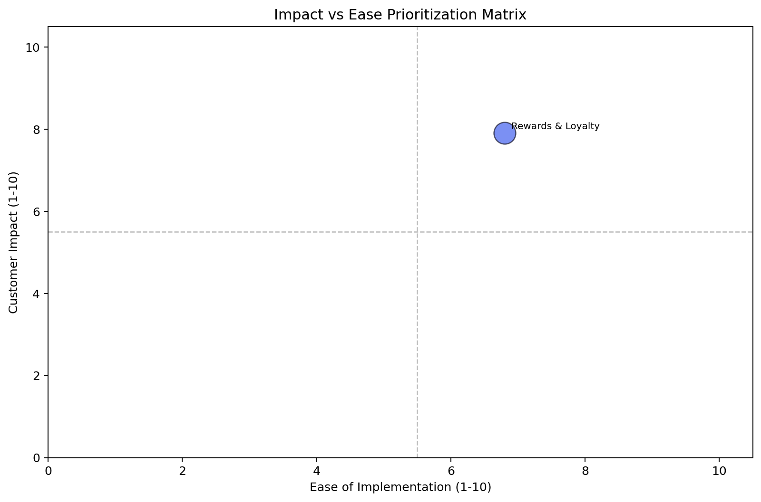
Rewards & Loyalty is the Highest Priority Theme with 16 Calls (100% of Volume)
Impact vs. Ease: Prioritization Matrix
Theme | Volume (calls) | Top 3 Problems | Recommended Solutions | Ease (1–10) | Impact (1–10) | Priority Score
Rewards & Loyalty | 16 | Cashback preference hidden (7 calls), MCC confusion (4 calls), Welcome bonus errors (2 calls) | Build preference toggle, Expose MCC data, Add offer tracker | 6.8 | 7.9 | 7.46

Slide 10
Rewards & Loyalty: Fixing Top 2 Drivers Deflects 11 Calls (68.75%)
The Biggest Bet
Rewards & Loyalty — fixing the top 2 drivers alone deflects 11 calls (68.75% of total volume) and is achievable within one quarter.

Slide 11
Recommended Actions by Team
Recommended Actions by Owning Team
Organized by owning team for clear accountability. Each action is sequenced by priority score — highest first.

Slide 12
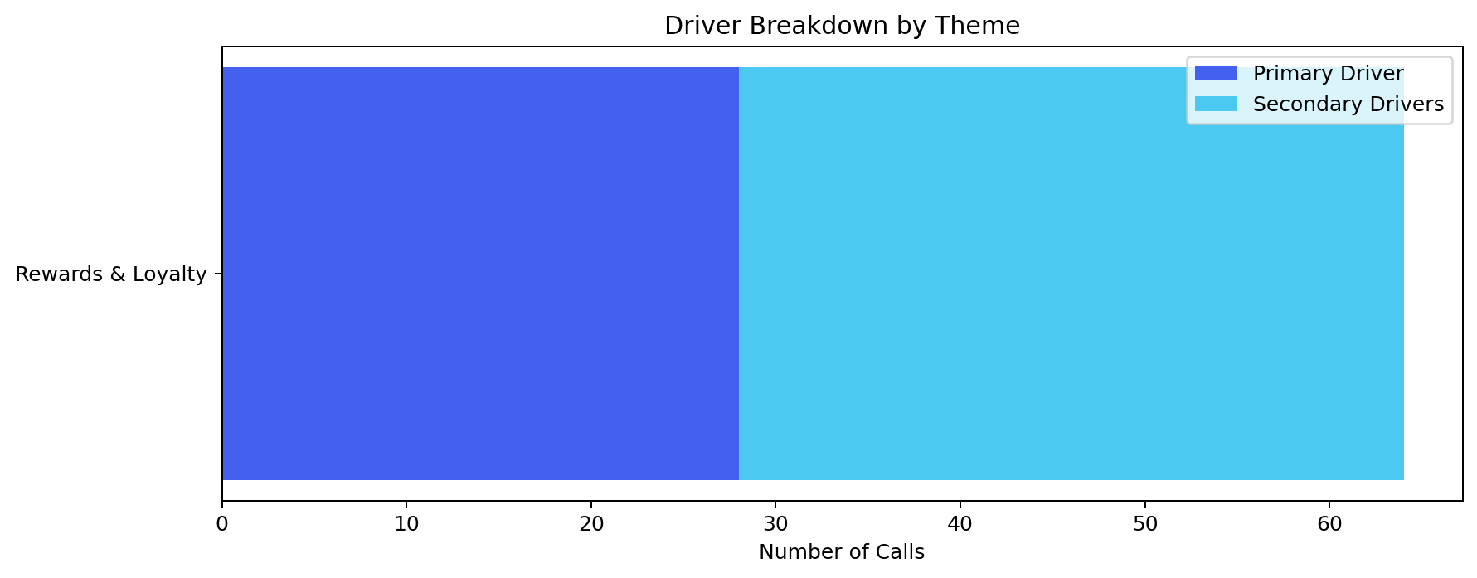
Digital / UX: Focus on Cashback Preferences and MCC Visibility to Resolve 11 Calls
Digital / UX
Action | Theme | Resolves | Priority
Provide a clear, discoverable option to manage cashback redemption preferences. | Rewards & Loyalty | ~7 calls (43.75%) | 7.46
Implement a feature to show the Merchant Category Code (MCC) for each transaction. | Rewards & Loyalty | ~4 calls (25.0%) | 7.46

Slide 13
Operations: Implement Self-Service Backend and Improve MCC Mapping to Resolve 11 Calls

