Slide 1
Digital Friction Analysis: ATT Rewards & Loyalty
Customer Call Reduction Opportunities

Slide 2
Executive Summary
This analysis focuses on 16 ATT customer calls related to Rewards & Loyalty issues, identifying critical friction points and opportunities for reduction. The data reveals a sing...
Hidden Cashback Redemption Preferences: 7 calls (43.8%). Redesign the rewards section to bring redemption preference settings to a top-level menu, allowing customer...
Unclear Bonus Eligibility & MCC Visibility: 3 calls (18.8%). Display the MCC and assigned category for each transaction, and provide clear explanations and examples for...
Non-Real-time Welcome Bonus Tracking: 2 calls (12.5%). Implement a real-time welcome bonus spend tracker on the rewards dashboard with a progress bar and clear di...
Solution: Redesign the rewards section to bring redemption preference settings to a top-level menu, allowing customers to set a default redemption method (e.g., auto statement c...
Solution: Display the MCC and assigned category for each transaction, and provide clear explanations and examples for category bonus exclusions. | Theme: Rewards & Loyalty | Imp...
Solution: Implement a real-time welcome bonus spend tracker on the rewards dashboard with a progress bar and clear display of remaining days and qualifying purchase exclusions....

Slide 3
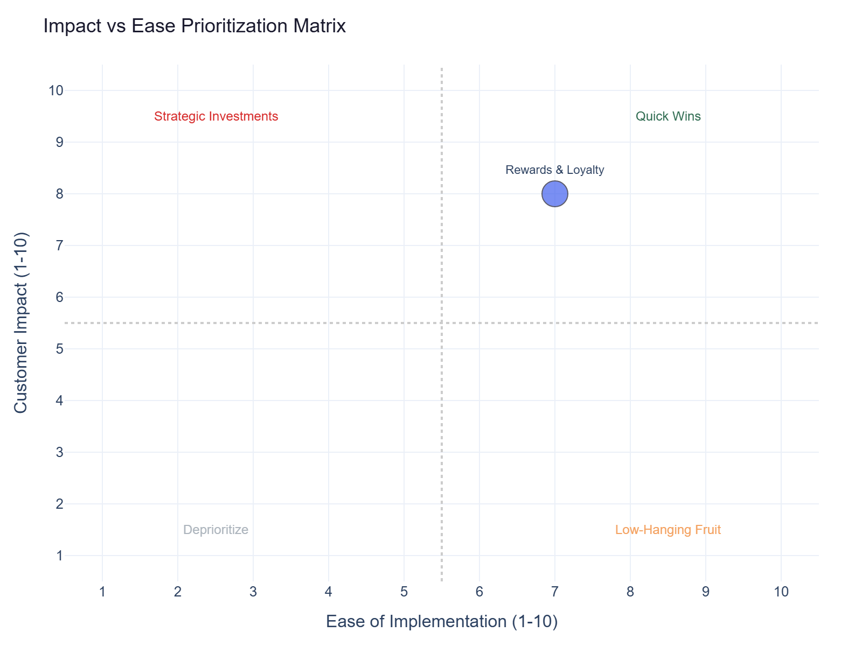
Impact vs Ease Prioritization
Rewards & Loyalty: 16 calls | Impact 8.0 | Ease 7.0 | Priority 7.6

Slide 4
Recommended Actions by Dimension
Digital: Move redemption preference to top-level rewards settings (1 tap from dashboard) and add 'Set as default' op... (Rewards & Loyalty, ~7 calls)
Digital: Show MCC code and category assigned to each transaction, allow flagging incorrect categorization, and clear... (Rewards & Loyalty, ~3 calls)
Communication: Move redemption preference to top-level rewards settings (1 tap from dashboard). Add 'Set as default' optio... (Rewards & Loyalty, ~7 calls)
Communication: Show the MCC code and category assigned to each transaction. Allow customers to flag incorrect merchant cat... (Rewards & Loyalty, ~3 calls)

Slide 5
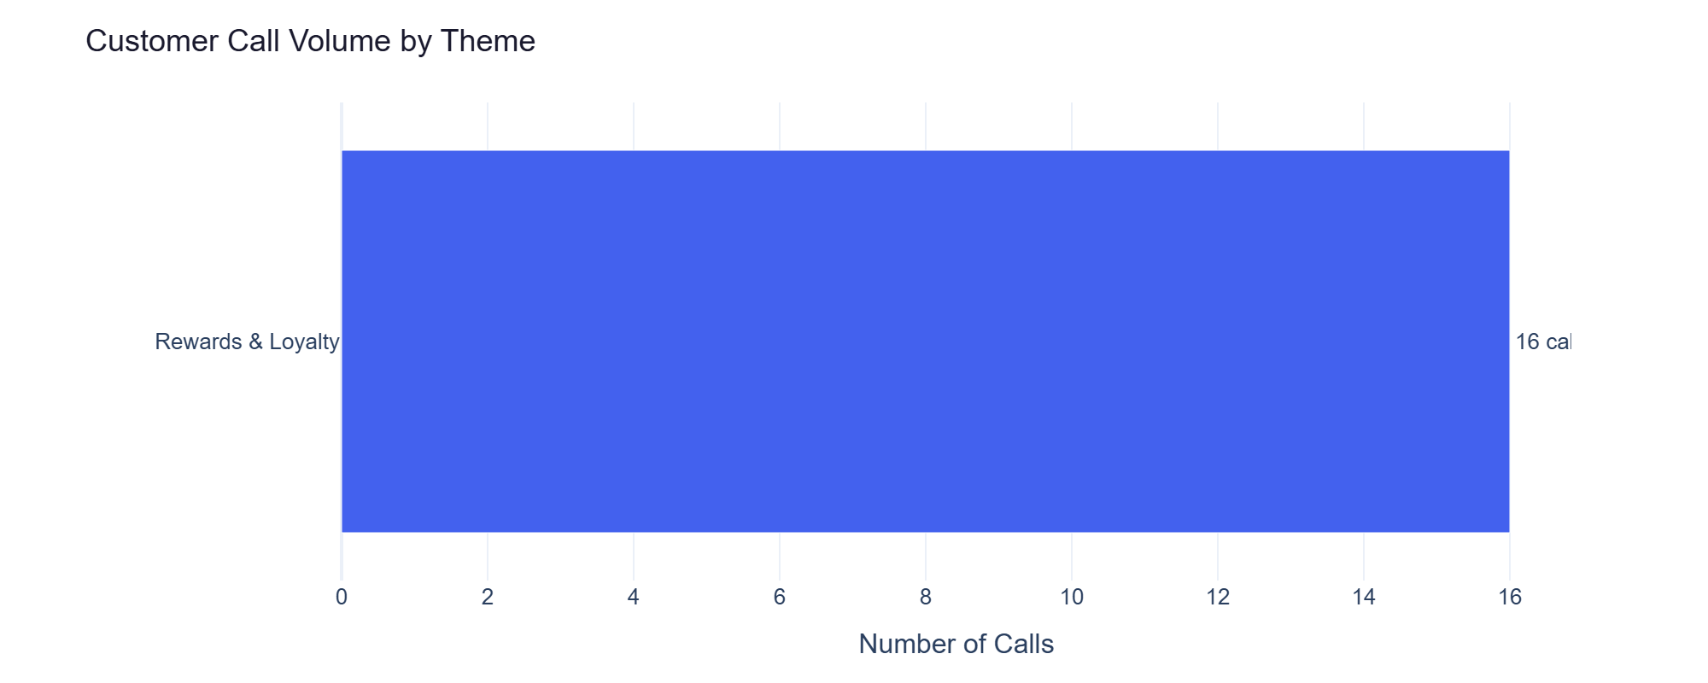
Rewards & Loyalty — Detailed Analysis
Rewards & Loyalty: 16 calls | Impact 8.0 | Ease 7.0
Cashback redemption preference setting is hidden and no default option exists (primary) - 7 calls
Cashback redemption preference setting is hidden and no default redemption option. (primary) - 7 calls
Merchant category code (MCC) for bonus determination is not visible, leading to confusion on bonu... (secondary) - 3 calls
Merchant category code (MCC) for bonus determination is not visible, and category bonus exclusion... (secondary) - 3 calls

