Slide 1
Digital Friction Analysis: ATT Rewards & Loyalty
Customer Call Reduction Opportunities

Slide 2
Executive Summary
This analysis focuses on 16 ATT customer calls related to Rewards & Loyalty, identifying 7 distinct digital friction points. The primary issue, affecting 43.75% of these calls,...
Cashback Redemption Preference Confusion: 7 calls (43.8%). Add a prominent 'Redemption Preferences' section in the rewards dashboard.
Incorrect Category Bonus Application: 3 calls (18.8%). Implement a transaction detail view that clearly displays the merchant category code (MCC) and the associat...
Partial Welcome Bonus Receipt: 2 calls (12.5%). Introduce an 'Offer Tracker' in the rewards section, showing progress towards welcome bonuses.
Solution: Add a prominent 'Redemption Preferences' section in the rewards dashboard. | Theme: ATT_Rewards & Loyalty | Impact Calls: 7 | Impact Percentage: 43.75
Solution: Introduce an 'Offer Tracker' for welcome bonuses. | Theme: ATT_Rewards & Loyalty | Impact Calls: 2 | Impact Percentage: 12.5
Solution: Implement proactive tier downgrade notifications. | Theme: ATT_Rewards & Loyalty | Impact Calls: 1 | Impact Percentage: 6.25

Slide 3
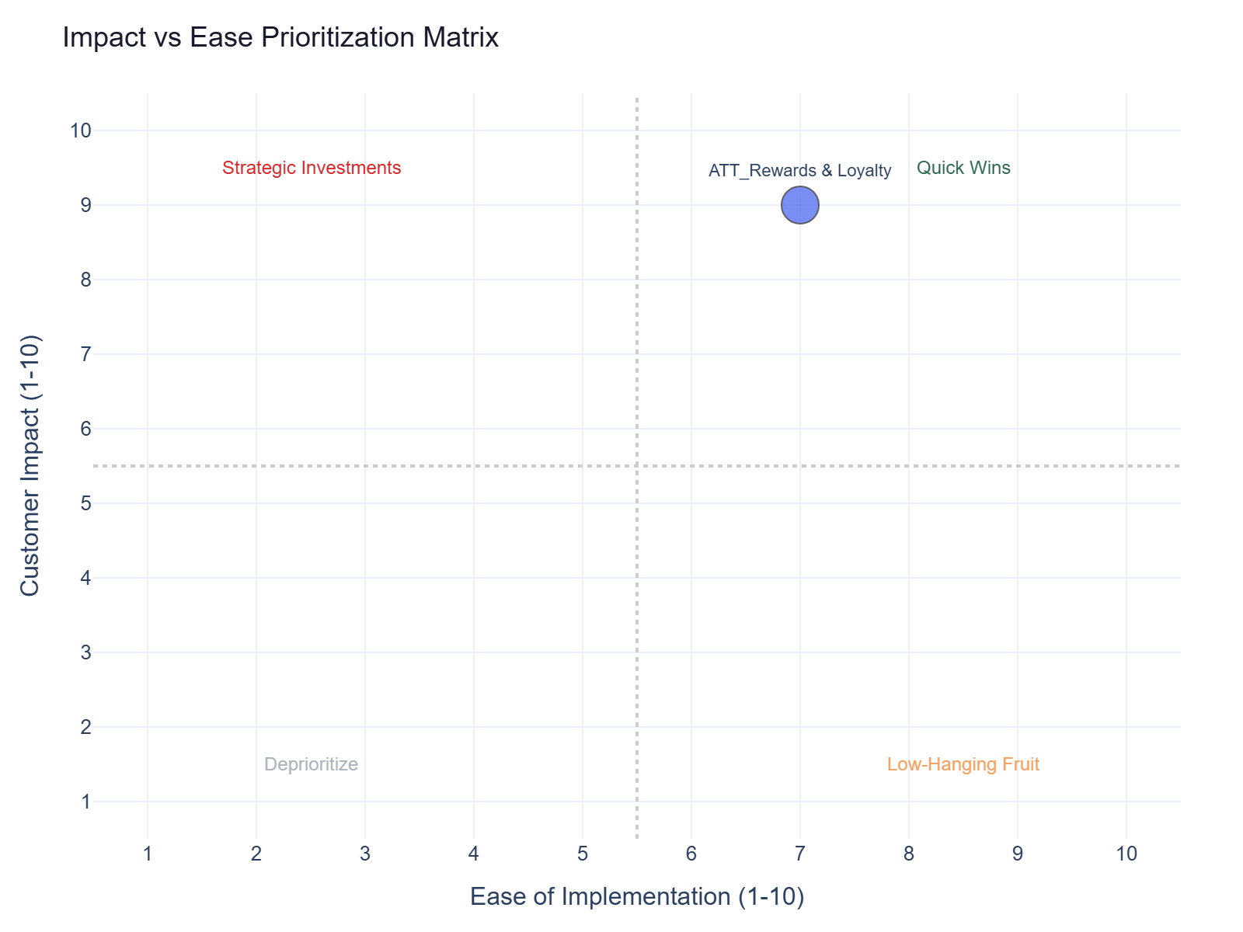
Impact vs Ease Prioritization
ATT_Rewards & Loyalty: 16 calls | Impact 9.0 | Ease 7.0 | Priority 8.2

Slide 4
Recommended Actions by Dimension
Digital: Add a prominent 'Redemption Preferences' section in the rewards dashboard allowing customers to easily sele... (ATT_Rewards & Loyalty, ~7 calls)
Digital: Implement a transaction detail view that clearly displays the merchant category code (MCC) and the associat... (ATT_Rewards & Loyalty, ~3 calls)

Slide 5
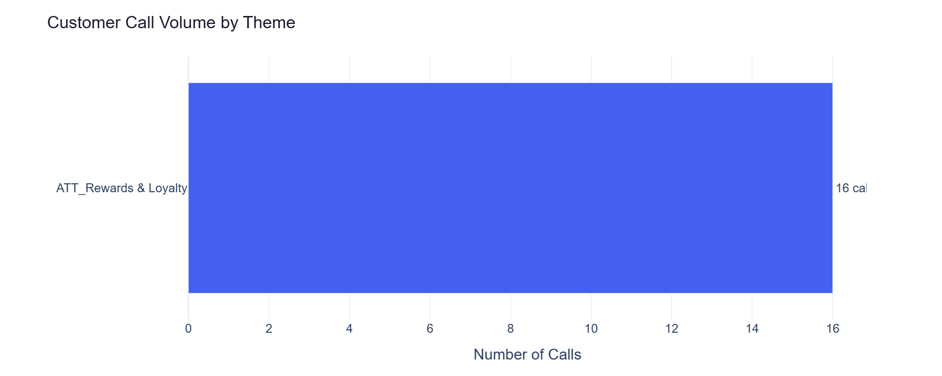
ATT_Rewards & Loyalty — Detailed Analysis
ATT_Rewards & Loyalty: 16 calls | Impact 9.0 | Ease 7.0
Customer's cashback was posted as points instead of statement credit. They can't find where to ch... (primary) - 7 calls
Customer used their card at a gas station but didn't get the 5x gas category bonus. The merchant... (secondary) - 3 calls
Customer signed up for a 60,000 point welcome bonus offer but only received 40,000 after meeting... (secondary) - 2 calls
Customer was downgraded from Platinum to Gold tier without any warning or notification. Lost acce... (secondary) - 1 calls

