Slide 1

Financial growth & strategy
Presented by Frey Munch

Slide 2
EXECUTIVE SUMMARY
16 customer calls analyzed | 50% preventable
Quick Wins:
• Cashback redemption preference setting is hidden and no default can be set (Priority: 7.9, Impact: 8.5, Ease: 7.0)
• Tier status and benefits page is not mobile-friendly, no progress bar, and no proactive notification for tier downgrade (Priority: 7.3, Impact: 7.5, Ease: 7.0)

Slide 3
Critical Pain Points
The welcome bonus tracker does not show qualifying spend progress in real-time, updating only once per statement cycle. Additionally, bonus terms and qualifying purchase exclusions are presented in fine print that is difficult to read and understand on mobile devices. New customers call regarding their welcome bonus because the tracker is not real-time, and the bonus terms and qualifying purchase exclusions are presented in fine print that is difficult to read on mobile devices.
Cashback redemption preference setting is hidden under Rewards > Settings > Preferences > Redemption Method (4 levels deep), making it difficult to find and manage. There is no option to set a default redemption method, requiring manual selection each time. Customers struggle to find and set their cashback redemption preferences due to deep navigation and the inability to set a default, leading to repeated manual selections and calls.
Customers cannot see the Merchant Category Code (MCC) used for bonus determination, leading to confusion about why certain transactions did not earn expected bonus points. Category bonus exclusions (e.g., gas stations inside grocery stores, warehouse clubs) are not clearly explained or visible. Customers are confused about why they are not receiving bonus points because the Merchant Category Codes (MCC) used for bonus determination are not visible, and category bonus exclusions are not clearly explained.
Impact: 9.0 | Priority: 9.0
Impact: 8.5 | Priority: 8.5
Impact: 7.5 | Priority: 7.5
Issue:
Issue:
Issue:
The welcome bonus tracker does not show qualifying spend progress in real-time, updating only once per statement cycle. Additionally, bonus terms and qualifying purchase exclusions are presented in fine print that is difficult to read and understand on mobile devices. New customers call regarding their welcome bonus because the tracker is not real-time, and the bonus terms and qualifying purchase exclusions are presented in fine print that is difficult to read on mobile devices.
Cashback redemption preference setting is hidden under Rewards > Settings > Preferences > Redemption Method (4 levels deep), making it difficult to find and manage. There is no option to set a default redemption method, requiring manual selection each time. Customers struggle to find and set their cashback redemption preferences due to deep navigation and the inability to set a default, leading to repeated manual selections and calls.
Customers cannot see the Merchant Category Code (MCC) used for bonus determination, leading to confusion about why certain transactions did not earn expected bonus points. Category bonus exclusions (e.g., gas stations inside grocery stores, warehouse clubs) are not clearly explained or visible. Customers are confused about why they are not receiving bonus points because the Merchant Category Codes (MCC) used for bonus determination are not visible, and category bonus exclusions are not clearly explained.
Fix:
Fix:
Fix:
Develop a real-time welcome bonus tracker with a visual progress bar that updates immediately after qualifying purchases. Redesign the display of bonus terms and exclusions to be m (Digital)
Simplify the navigation path for cashback redemption preferences to 1-2 taps. Introduce a feature allowing users to set a default redemption method. Provide an in-app contextual ti (Digital)
Display the MCC for each transaction within the in-app transaction history. Create an easily accessible section explaining category bonus exclusions with examples. Consider adding (Digital)

Slide 4
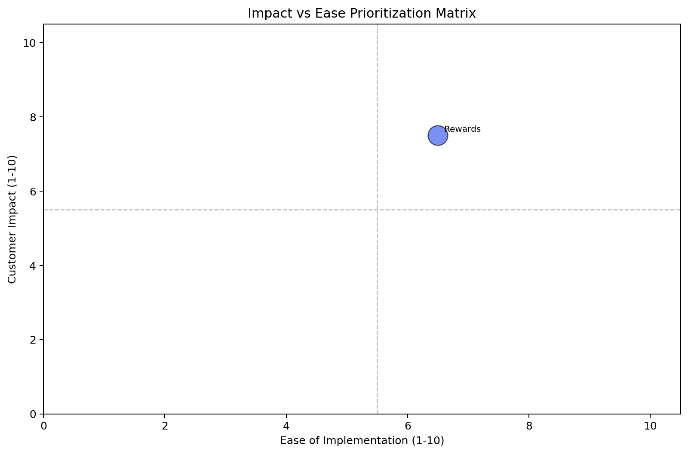
Impact vs. Ease — Full Theme Prioritization
Rewards — Strategic Investment
Calls: 16 | Impact: 7.5 | Ease: 6.5 | Priority: 7.1
digital; communication

Slide 5
Low Hanging Fruit
• Cashback redemption preference setting is hidden and no default can be set (Priority: 7.9, Impact: 8.5, Ease: 7.0)
Tier status and benefits page is not mobile-friendly, no progress bar, and no pr
Resolves ~16 calls from Rewards

Slide 6
Recommended Actions by Owning Team
Digital / UX
• Simplify the navigation path for cashback redemption preferences to 1-2 taps. Introduce a feature allowing users to set a default redemption method. Provide an in-app contextual tip or guided tour for
• Display the MCC for each transaction within the in-app transaction history. Create an easily accessible section explaining category bonus exclusions with examples. Consider adding an in-app mechanism

Slide 7
Rewards
Calls: 16 | 1.0% | Impact: 7.5 | Ease: 6.5 | Priority: 7.1
CORE ISSUE
Driver | Calls
Cashback redemption preference setting is hidden a | 0.0%
Merchant category code (MCC) for bonus is not visi | 0.0%
Welcome bonus tracker is not real-time and terms a | 0.0%
Tier status and benefits page is not mobile-friend | 0.0%
Anniversary bonus posting timeline is not document | 0.0%
digital; communication
PRIMARY DRIVER
Digital
SOLUTIONS
1. Cashback redemption preference setting is hidden and no default can be set (Priority: 7.9, Impact: 8.5, Ease: 7.0) [Digital]
2. Tier status and benefits page is not mobile-friendly, no progress bar, and no proactive notification for tier downgrade (Priority: 7.3, Impact: 7.5, Ease: 7.0) [Digital]

