Slide 1

Financial growth & strategy
Presented by Frey Munch

Slide 2
Friction analysis complete.
16 customer calls analyzed | 1 friction themes identified | 50% preventable

Slide 3
Critical Pain Points
Cashback redemption preference setting is hidden under Rewards > Settings > Preferences > Redemption Method (4 levels deep), making it difficult for customers to find and manage. There is also no option to set a default redemption method, requiring manual selection for every redemption.
Customers cannot see the Merchant Category Code (MCC) used for bonus determination for their transactions, leading to confusion when category bonuses are not applied as expected. Additionally, category bonus exclusions (e.g., gas stations inside grocery stores) are not clearly explained, and there is no digital way to report incorrect merchant coding.
The welcome bonus tracker does not show qualifying spend progress in real-time, updating only once per statement cycle, causing anxiety and calls for status updates. Furthermore, bonus terms and qualifying purchase exclusions are presented in fine print that is difficult to read on mobile devices.
0 calls | | Priority: 8.0
0 calls | | Priority: 7.0
0 calls | | Priority: 7.0
Issue:
Issue:
Issue:
Cashback redemption preference setting is hidden under Rewards > Settings > Preferences > Redemption Method (4 levels deep), making it difficult for customers to find and manage. There is also no option to set a default redemption method, requiring manual selection for every redemption.
Customers cannot see the Merchant Category Code (MCC) used for bonus determination for their transactions, leading to confusion when category bonuses are not applied as expected. Additionally, category bonus exclusions (e.g., gas stations inside grocery stores) are not clearly explained, and there is no digital way to report incorrect merchant coding.
The welcome bonus tracker does not show qualifying spend progress in real-time, updating only once per statement cycle, causing anxiety and calls for status updates. Furthermore, bonus terms and qualifying purchase exclusions are presented in fine print that is difficult to read on mobile devices.
Fix:
Fix:
Fix:
Simplify navigation to redemption preferences (max 2 taps) and add a 'Set as Default' option for cashback redemption methods.
Display MCC for each transaction in the rewards history, provide clear in-app explanations for category bonus exclusions, and implement an in-app feature to dispute incorrect MCC coding.
Implement a real-time welcome bonus spend tracker in the mobile app and optimize bonus terms and qualifying purchase exclusions for mobile readability.
Digital
Digital
Digital

Slide 4
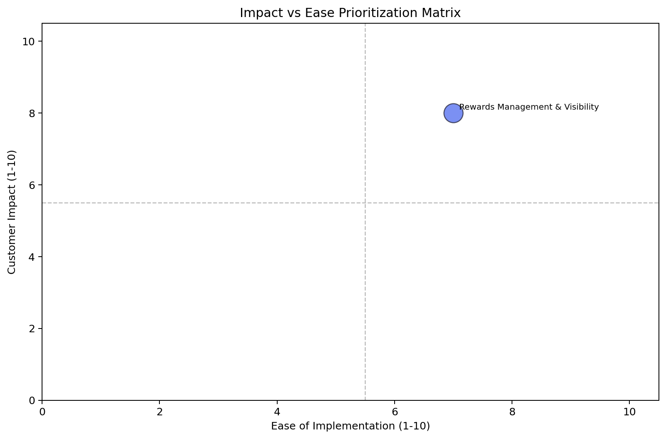
Impact vs. Ease Prioritization
Theme | Calls | Impact | Ease | Priority | Quadrant
Rewards Management & Visibility | 16 calls (1.0%) | 8.0 | 7.0 | 7.6 | Quick Win

Slide 5
16 calls (1.0%)
Rewards Management & Visibility
Impact 8.0/10 · Ease 7.0/10 · Quick Win. Primary driver: Digital.

Slide 6
Recommended Actions by Owning Team
Digital / UX
• Simplify navigation to redemption preferences (max 2 taps) and add a 'Set as Default' option for cashback redemption methods.
• Display MCC for each transaction in the rewards history, provide clear in-app explanations for category bonus exclusions, and implement an in-app feature to dispute incorrect MCC coding.

Slide 7
Rewards Management & Visibility
Calls: 16 | 1.0% | Impact: 8.0 | Ease: 7.0 | Priority: 7.6
CORE ISSUE
Driver | Calls
Cashback redemption preference setting is hidden a | 0.0%
Merchant category code for bonus determination is | 0.0%
Welcome bonus tracker doesn't show real-time progr | 0.0%
Tier status and benefits page not mobile-friendly, | 0.0%
Anniversary bonus posting timeline not documented | 0.0%
Rewards Management & Visibility friction analysis
PRIMARY DRIVER
Digital
SOLUTIONS
1. Simplify navigation to redemption preferences (max 2 taps) and add a 'Set as Default' option for cashback redemption methods. [Digital]
2. Implement a real-time welcome bonus spend tracker in the mobile app and optimize bonus terms and qualifying purchase exclusions for mobile readability. [Digital]
3. Display the account anniversary date in-app, document anniversary bonus posting timelines, and add an in-app tracker for pending anniversary bonuses. [Digital]

