Slide 1

Financial growth & strategy
Presented by Frey Munch

Slide 2
EXECUTIVE SUMMARY
Analysis of 16 friction-related customer calls across 3 themes.
50% of total volume is deflectable with easy implementations.
Quick Wins:
Implement a real-time transfer status tracker in the app for partner points, showing estimated completion.
Add an in-app promotional offer tracker with progress bar and clear eligibility criteria.
Display 'pending points' view in the rewards dashboard with estimated posting dates.

Slide 3
Critical Pain Points
Customers are not seeing promotional points or regular points credited to their account and lack visibility into pending points or promotion progress.
Customers are calling due to delays in partner rewards transfers and lack of visibility into the transfer status.
Customers are frustrated by high redemption minimums that are not clearly communicated before they attempt to redeem.
Impact: 9.0 | Priority: 9.0
Impact: 8.0 | Priority: 8.0
Impact: 7.0 | Priority: 7.0
Issue: Customers are not seeing promotional points or regular points credited to their account and lack visibility into pending points or promotion progress.
Issue: Customers are calling due to delays in partner rewards transfers and lack of visibility into the transfer status.
Issue: Customers are frustrated by high redemption minimums that are not clearly communicated before they attempt to redeem.
Fix: Add a 'pending points' section to the rewards dashboard and a promotional offer tracker showing progress towards earning bonuses. Clearly display earn rates per transaction and explain any exclusions (Digital)
Fix: Implement a real-time transfer tracker in the app/web, showing current status and estimated completion time. Proactively communicate expected transfer timelines. (Digital)
Fix: Prominently display minimum redemption thresholds on the rewards dashboard and within the redemption flow before a customer initiates the process. (Digital)

Slide 4
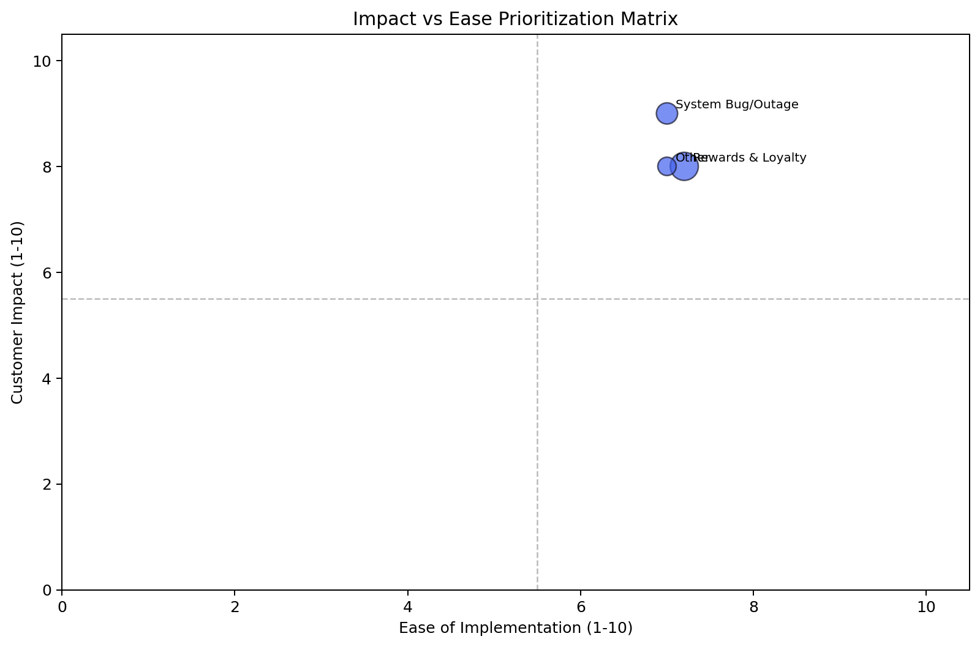
Impact vs. Ease — Full Theme Prioritization
System Bug/Outage — Quick Win
Calls: 7 | Impact: 9.0 | Ease: 7.0 | Priority: 8.2
Rewards & Loyalty — Quick Win
Calls: 16 | Impact: 8.0 | Ease: 7.2 | Priority: 7.7
Other — Quick Win
Calls: 4 | Impact: 8.0 | Ease: 7.0 | Priority: 7.6

Slide 5
Low Hanging Fruit
1. Implement a 'pending points' section on the rewards dashboard and a promotional offer tracker.
Implement a real-time transfer tracker in the app/web with status and estimated ; Prominently display minimum redemption thresholds on the rewards dashboard and w
Resolves ~16 calls from Rewards & Loyalty
2. Implement a real-time transfer status tracker in the app for partner points, showing estimated completion.
Add an in-app promotional offer tracker with progress bar and clear eligibility ; Display 'pending points' view in the rewards dashboard with estimated posting da
Resolves ~7 calls from System Bug/Outage
3. Clearly display redemption minimums and options for partial redemption or alternatives in the rewards section.
Implement an in-app bonus tracker or detailed transaction view showing how point; Add a 'Transfer History' section with real-time status updates and estimated com
Resolves ~4 calls from Other

Slide 6
Recommended Actions by Owning Team
■ Digital / UX
• Add a 'pending points' section to the rewards dashboard and a promotional offer tracker showing progress towards earning bonuses. Clearly display earn rates per transaction and explain any exclusions
• Implement a real-time transfer tracker in the app/web, showing current status and estimated completion time. Proactively communicate expected transfer timelines.

Slide 7
System Bug/Outage
Calls: 7 | 0.4% | Impact: 9.0 | Ease: 7.0 | Priority: 8.2
CORE ISSUE
Driver | Calls
Partner Transfer Delay (digital, 3 calls) | 0.0%
Promotional Points Missing (digital, 2 calls) | 0.0%
Points Not Credited (digital, 1 call) | 0.0%
Redemption Minimum Too High (digital, 1 call) | 0.0%
System Bug/Outage friction analysis
PRIMARY DRIVER
Digital
SOLUTIONS
1. Implement a real-time transfer status tracker in the app for partner points, showing estimated completion. [Digital]
2. Add an in-app promotional offer tracker with progress bar and clear eligibility criteria. [Digital]
3. Display 'pending points' view in the rewards dashboard with estimated posting dates. [Digital]

Slide 8
Rewards & Loyalty
Calls: 16 | 1.0% | Impact: 8.0 | Ease: 7.2 | Priority: 7.7
CORE ISSUE
Driver | Calls
Lack of visibility/tracking for points (pending, n | 0.0%
Partner Transfer Delay (lack of tracking/visibilit | 0.0%
Redemption Minimum Too High (lack of eligibility v | 0.0%
Category Bonus Not Applied (lack of earn rate visi | 0.0%
Tier Downgrade Surprise (lack of awareness/visibil | 0.0%
Rewards & Loyalty friction analysis
PRIMARY DRIVER
Digital
SOLUTIONS
1. Implement a 'pending points' section on the rewards dashboard and a promotional offer tracker. [Digital]
2. Implement a real-time transfer tracker in the app/web with status and estimated completion. [Digital]
3. Prominently display minimum redemption thresholds on the rewards dashboard and within the redemption flow. [Digital]

Slide 9
Other
Calls: 4 | 0.2% | Impact: 8.0 | Ease: 7.0 | Priority: 7.6
CORE ISSUE
Driver | Calls
Redemption Minimum Too High (digital, 1 call) | 0.0%
Category Bonus Not Applied (digital, 1 call) | 0.0%
Partner Transfer Delay (digital, 1 call) | 0.0%
Points Not Credited (digital, 1 call) | 0.0%
Other friction analysis
PRIMARY DRIVER
Digital
SOLUTIONS
1. Clearly display redemption minimums and options for partial redemption or alternatives in the rewards section. [Digital]
2. Implement an in-app bonus tracker or detailed transaction view showing how points were calculated, including category bonuses. [Digital]
3. Add a 'Transfer History' section with real-time status updates and estimated completion times for partner transfers. [Digital]

