Slide 1
Advanced DBMS Concepts
SQL
Submitted by:- Yash Khandelwal Vinay Patidar Vrinda Thepadia Sanjay Dangi Rohit Kumar
Complex queries
Indexing
Triggers
Assertions

Slide 2
01
Complex Queries
Queries involving multiple tables, subqueries, joins, grouping, and aggregation for advanced data retrieval and manipulation.

Slide 3
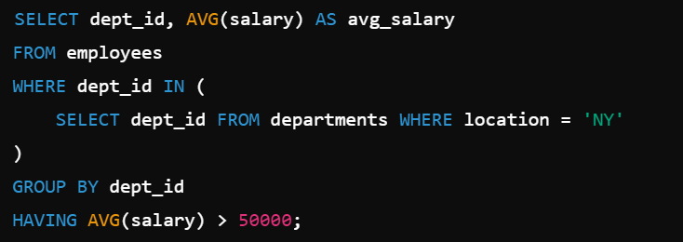
Key Features
Joins: Combine rows from two or more tables (INNER, LEFT, RIGHT, FULL).
Subqueries: Nested queries within another query.
Aggregation: Functions like sum, avg…
Group By and Having: Group rows and filter aggregated data.

Slide 4
02
Indexing
A database optimization technique that uses a data structure to improve query performance.

Slide 5
Key Types
Primary Index: Based on primary key.
Unique Index: Ensures uniqueness in columns.
Clustered Index: Determines the physical order of data.
Non-Clustered Index: Separate from the actual data.
Advantages
Faster search and retrieval
Improves WHERE clause performance

Slide 6
03
Triggers
Triggers are automated procedural code executed in response to specific database events (INSERT, UPDATE, DELETE).

Slide 7
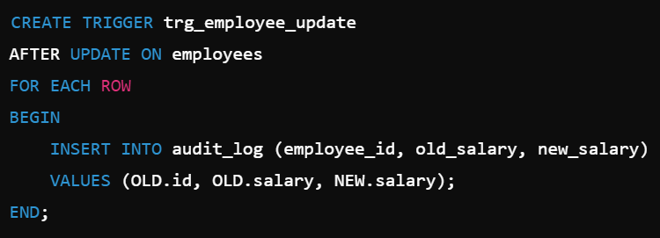
Key Features
Before Trigger: Based on primary key.
After Trigger: Ensures uniqueness in columns.
Instead of Triggers: Determines the physical order of data.
Use Cases
Enforcing business rules.
Logging and auditing.

Slide 8
04
Assertions
Assertions enforce data integrity rules at the database level by ensuring certain conditions are always true.

Slide 9
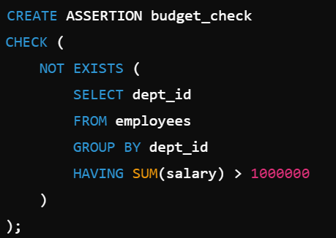
Key Features
Enforce constraints across multiple rows or tables.
Ensure consistency beyond standard constraints
Use Cases
Ensuring total department salary stays below a budget limit.

Slide 10
Thank You!

