Slide 1


Jayawantrao Sawant College of Engineering Department of Information Technology
Project Presentation
On
“E-Ticketing System
for
public transport”
By-
Chirayu Deokar (B150408556)
Iliyas Khan (B150408559)
Shantanu Kulkarni (B150408563)
Utkarsh Patil (B150408566)
Guided by-
Prof. Suruchi Nannaware

Slide 2
Content
Abstract
Introduction
Literature Survey
Disadvantages of Existing System
Proposed system
Methodologies to implement the System modules System Requirements
Algorithms Used
Goals and Objectives
Project and System Requirements
Conclusion
References

Slide 3
Abstract
Existing System Constraints
Advantages of our System
Ease of booking
QR Code
Wallet payment
Security
Data Analysis

Slide 4
Introduction
Users interact with the system from anywhere
User can book bus seat in advance
Payment can be done using E wallet
User generates QR code
Conductor scans QR code
Data Analyst performs analysis on gathered data

Slide 5
Literature Survey
IEEE Papers | Technology Used | Description | Drawbacks
GPS Supported City Bus Tracking & Smart Ticketing System (2015) | GPS & Smart Card | Gives information about vehicle position and route travelled by vehicle and includes the integrated use of smart cards with GPS system. | Expensive to introduce. Risks of fake smart cards-ticket still exist.
RFID and Android Based Smart Ticketing and Destination Announcement System (2016) | RFID tag & GPS | Combines RFID and GPS technology to design an automatic bus-ticketing system | Sometimes not as accurate or reliable as barcode scanners. Implementation can be difficult & time consuming.
Electronic Ticket Machine Data Analytics for Public Bus Transport Planning (2017) | ETM | Line-planning for bus transport systems based on data elicited from Electronic Ticket Machine (ETM). | Expensive to Introduce. Lots of specific technical requirements both passenger and transport operators.

Slide 6
Proposed system
Beneficial to employees and passengers
Information available at fingertips
Easy Booking and Execution of the system
Security :
Authentication
AES
Data analysis helps in monitoring overall function

Slide 7
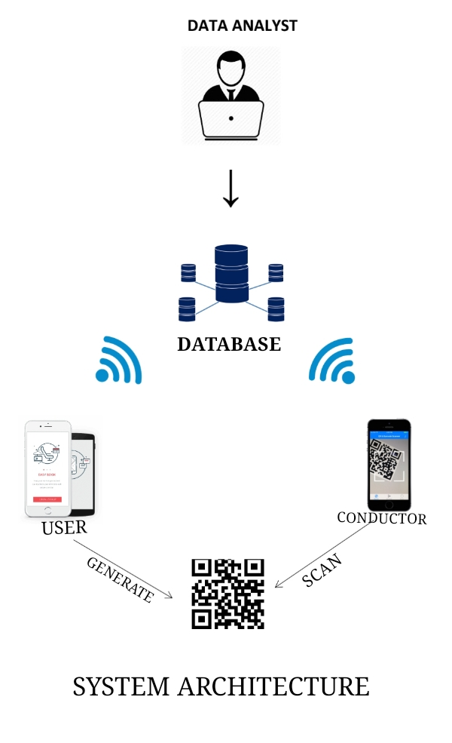
Architecture Diagram

Slide 8
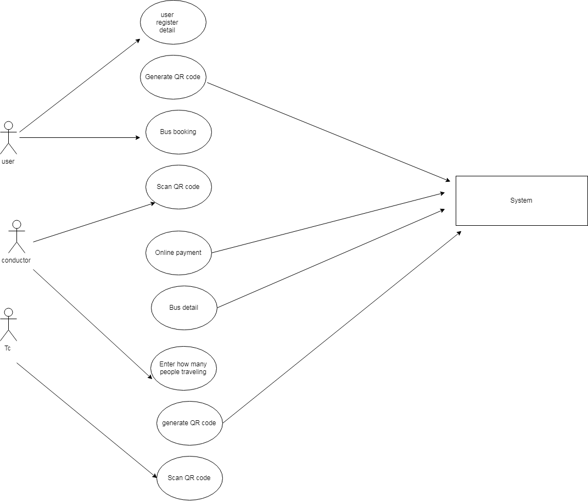
Usecase Diagram

Slide 9
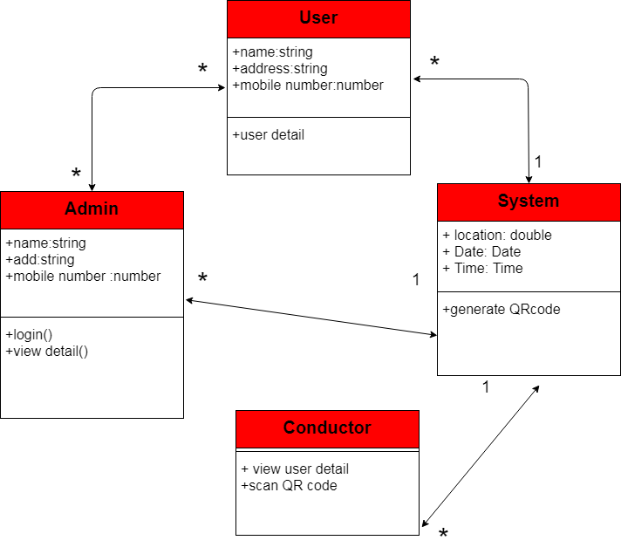
Class Diagram

Slide 10

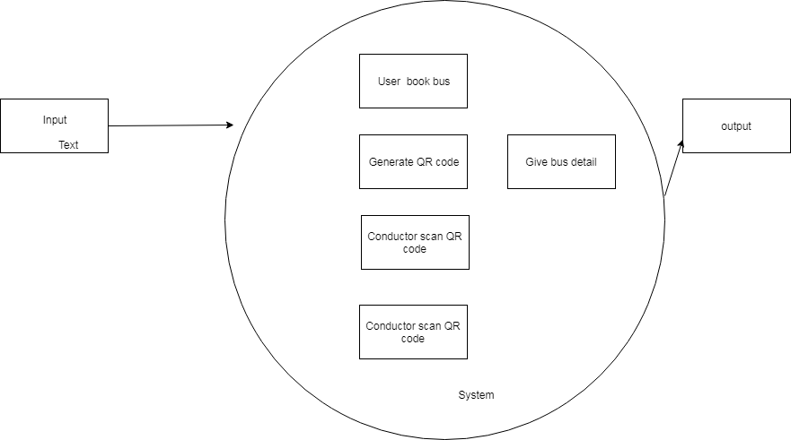
DFD level 0
DFD level 1

Slide 11
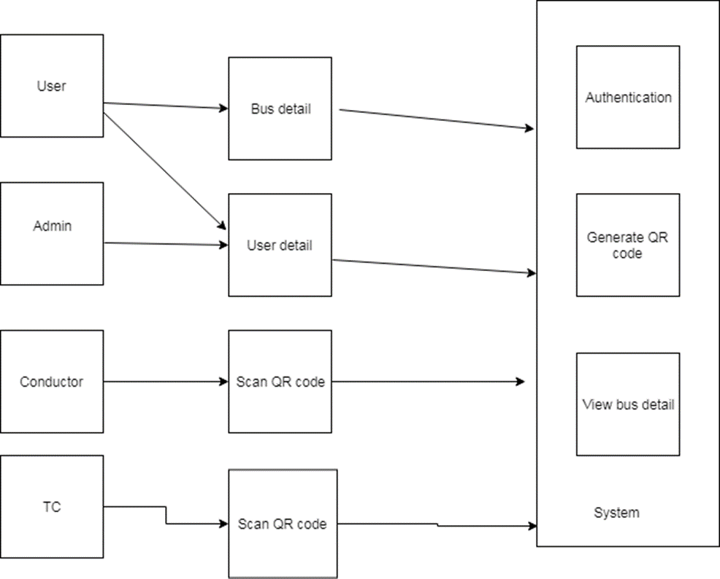
DFD level 2

Slide 12
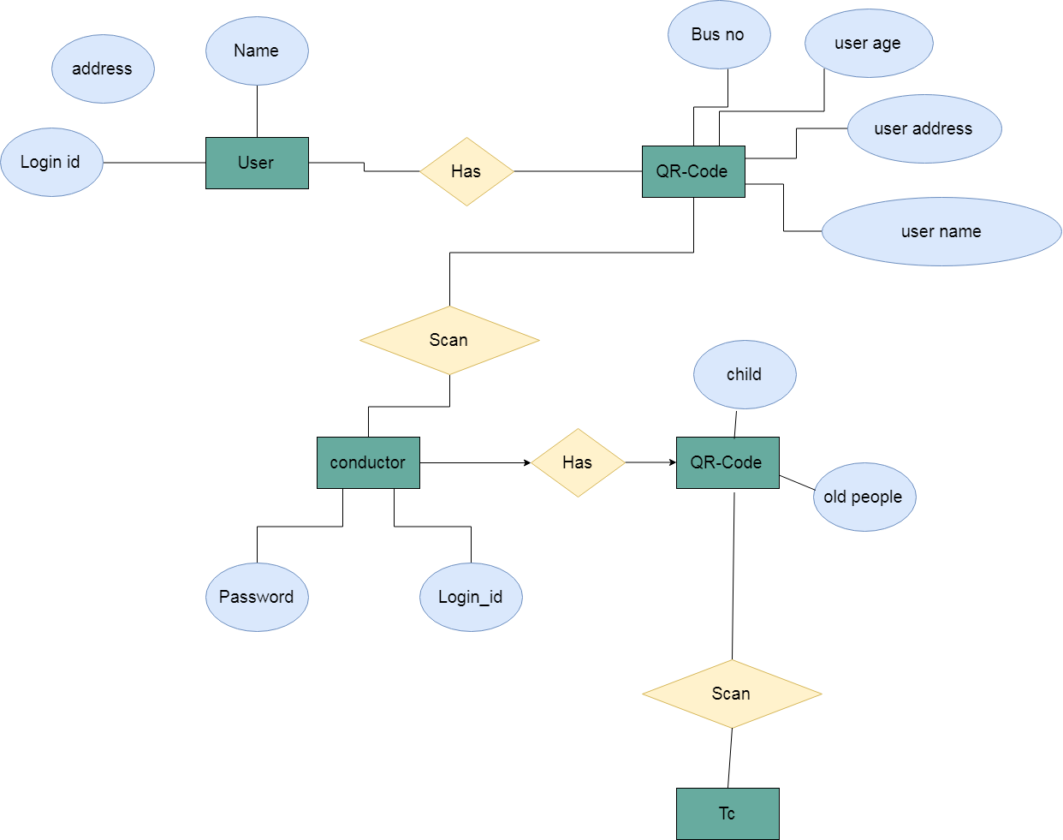
ER Diagram

Slide 13
Methodologies to implement the System modules
User
Conductor
QR code
4. Admin

Slide 14
USER
Register or login
Select source and destination
Check bus availability
A unique QR code is generated
User can travel in any bus on that route
Other Features :
Bus Tracking
E -wallet Management

Slide 15
CONDUCTOR
Scan Users QR code
Validate Passenger details
Automatically update database

Slide 16
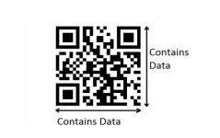
QR code
QR code is a 2 dimensional barcode
Can b read horizontally as well as vertically
A unique QR code for every booking
QR code contains:
user details
Source
Destination
date and time of booking
total fare.

Slide 17
Admin
Admin plays an important role in smooth functioning of the system
Managing data stored in database
Adding new busses to the system
Allotting new TC to bus
A well organized machine learning algorithm helps admin analyse the data and take better decisions
We have analyse the number of adults and children travelling in a particular period

Slide 18
Algorithms
1] AES (Advanced Encryption Standard)
AES is more secure algorithm. It is established by U.S. National Institute of Standards and Technology in 2001.
AES is symmetric key algorithm.
So we use the AES algorithm to secure the information i.e. stored in QR code.
This algorithm is generally divided in to two steps. The following step is involved:-

Slide 19

Step1- Convert the data into QR code

Slide 20

Step1- Convert QR code into data

Slide 21
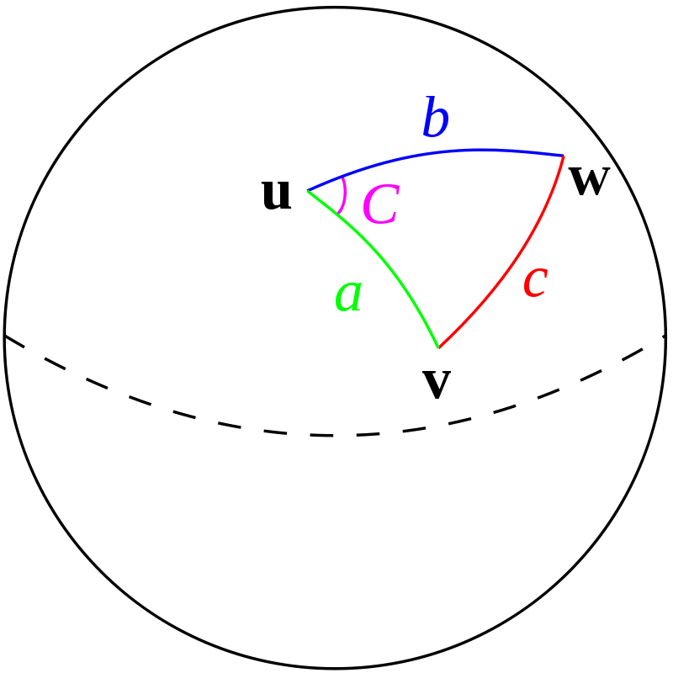
Algorithms
2] Haversine
The haversine formula determines the great-circle distance between two points on a sphere given their longitudes and latitudes.
The haversine formula is used in electronics and other applications such as navigation. It helps in finding out the distance between two points on a sphere.

Slide 22
Haversine Formulation
Let the central angle Θ between any two points on a sphere be:
Θ = d/r
where:
- d is the distance between the two points (along a great circle of the sphere; see spherical distance),
- r is the radius of the sphere.
The haversine formula hav of Θ is given by
where r is the radius of earth(6371 km), d is the distance between two points, φ1, φ2 latitude of the two points and λ1, λ2 is longitude of the two points respectively.

Slide 23


Haversine Formulation
Solving d by applying the inverse haversine or by using the inverse sine function, we get:
OR

Slide 24
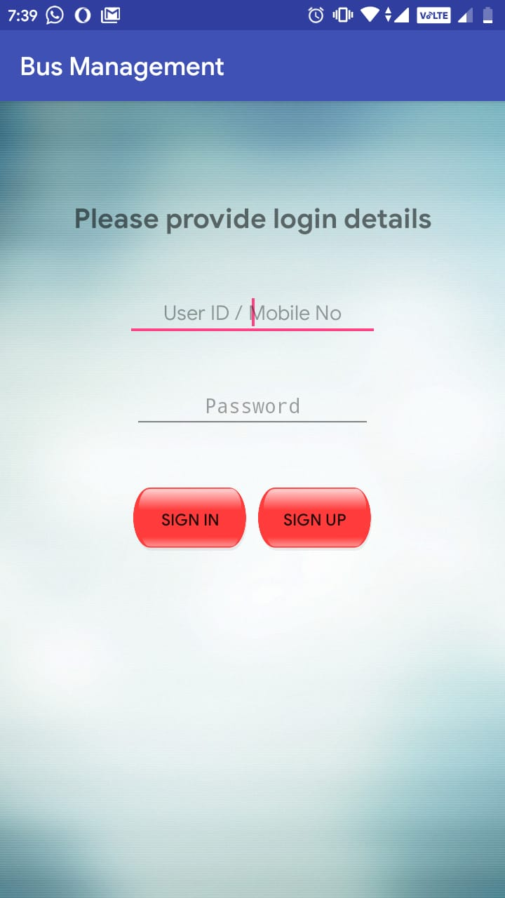
Results

Slide 25
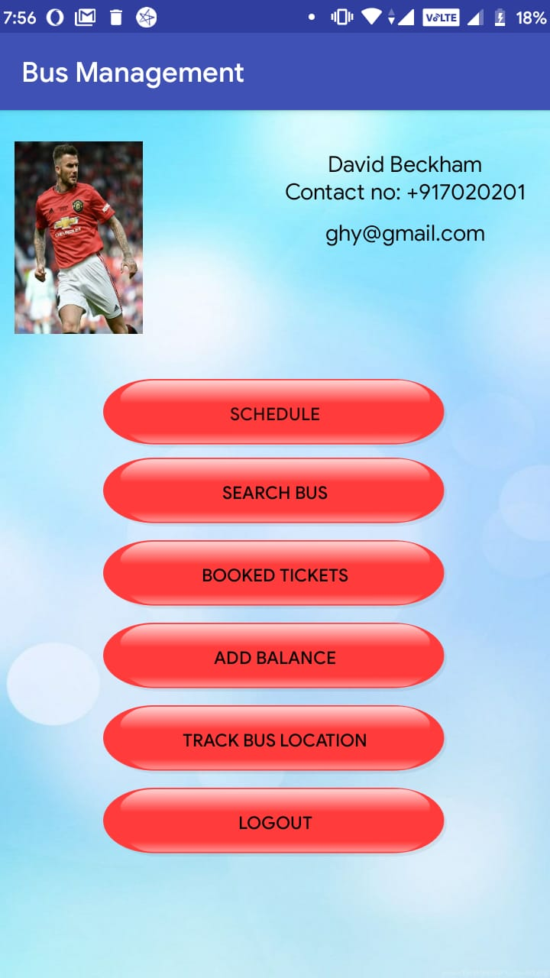

Slide 26
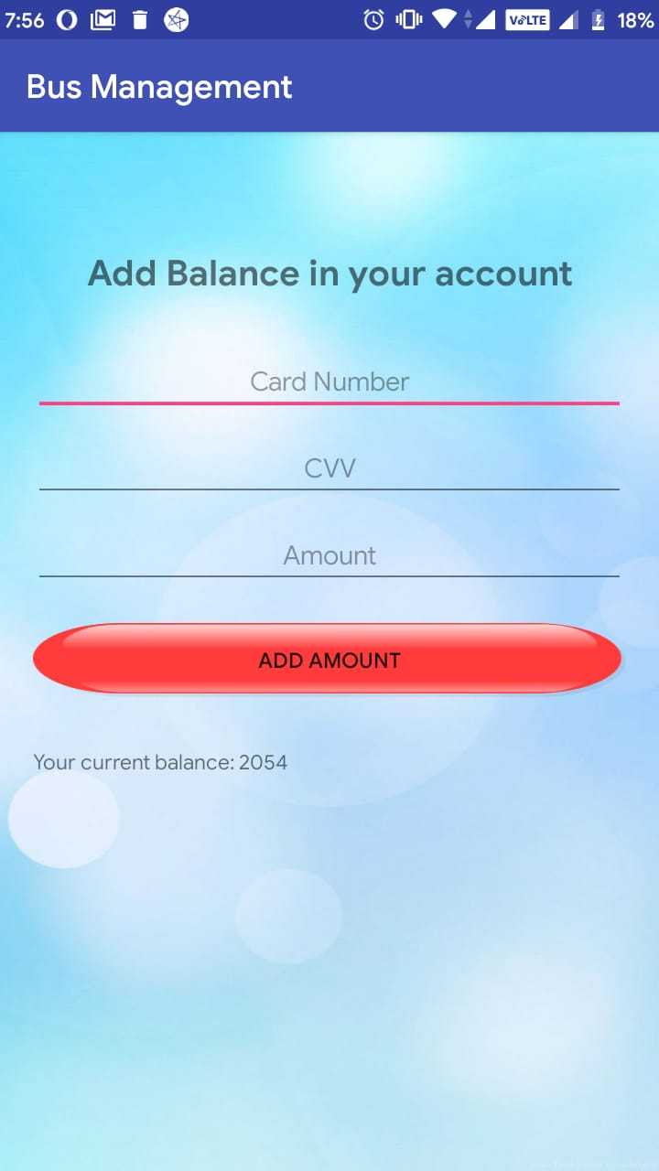

Slide 27
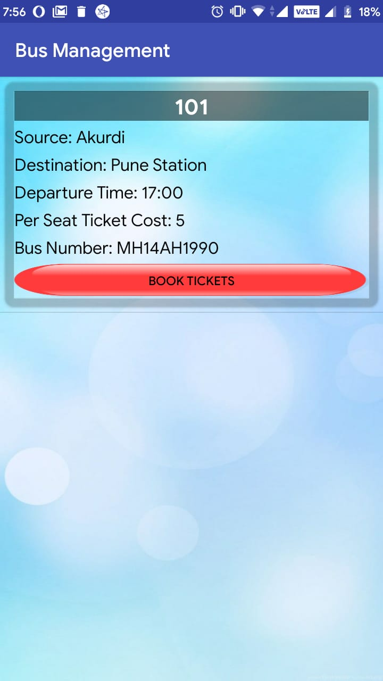

Slide 28
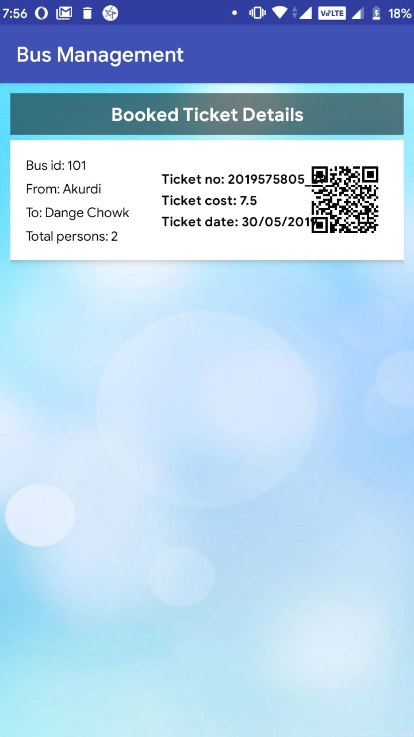

Slide 29
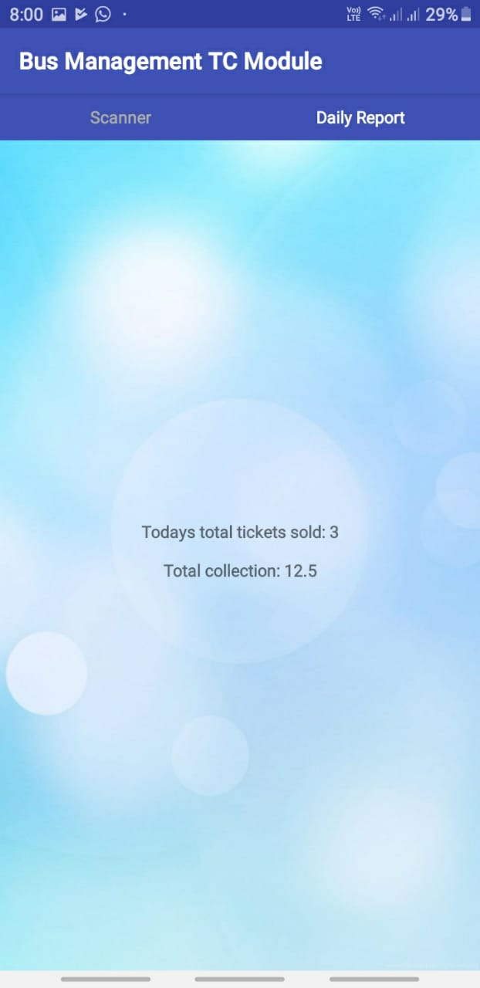

Slide 30
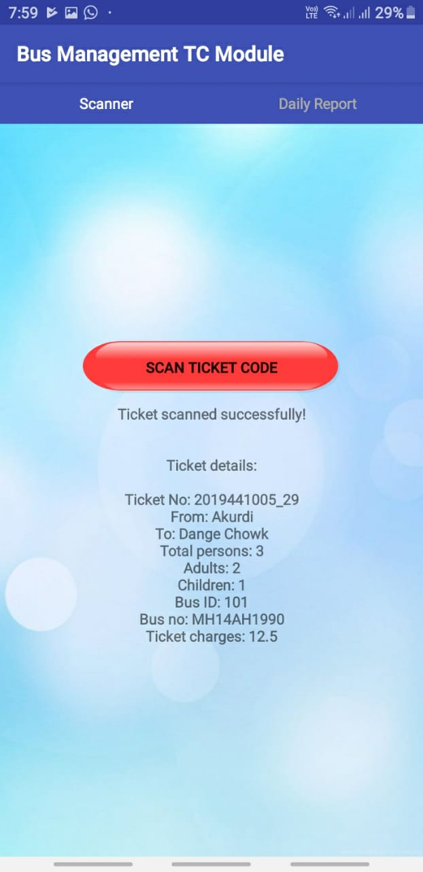

Slide 31
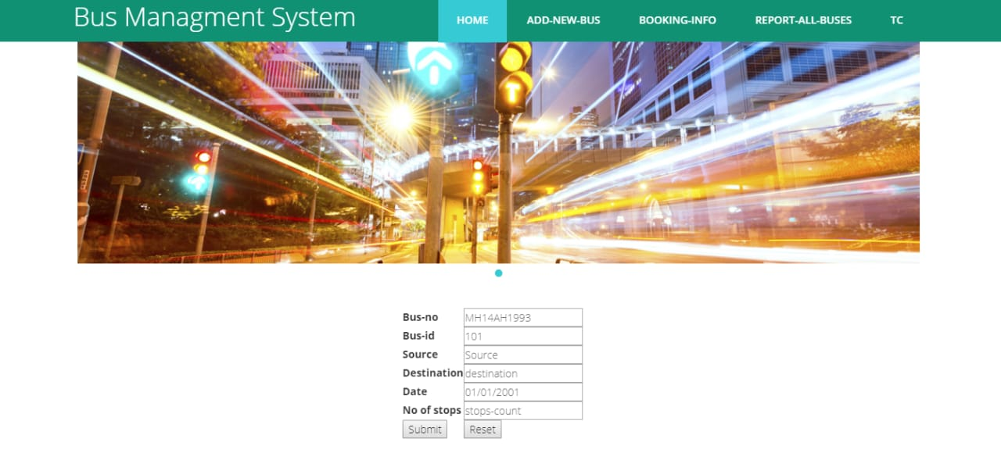

Slide 32
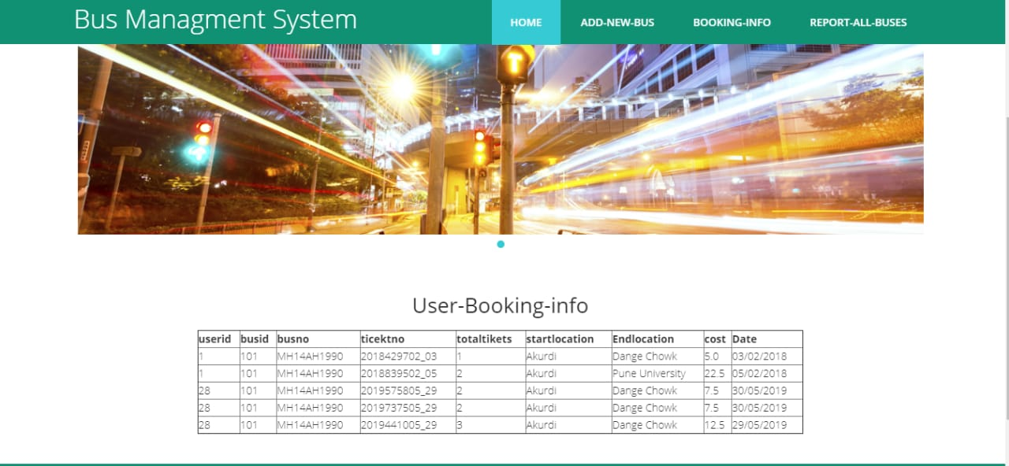

Slide 33
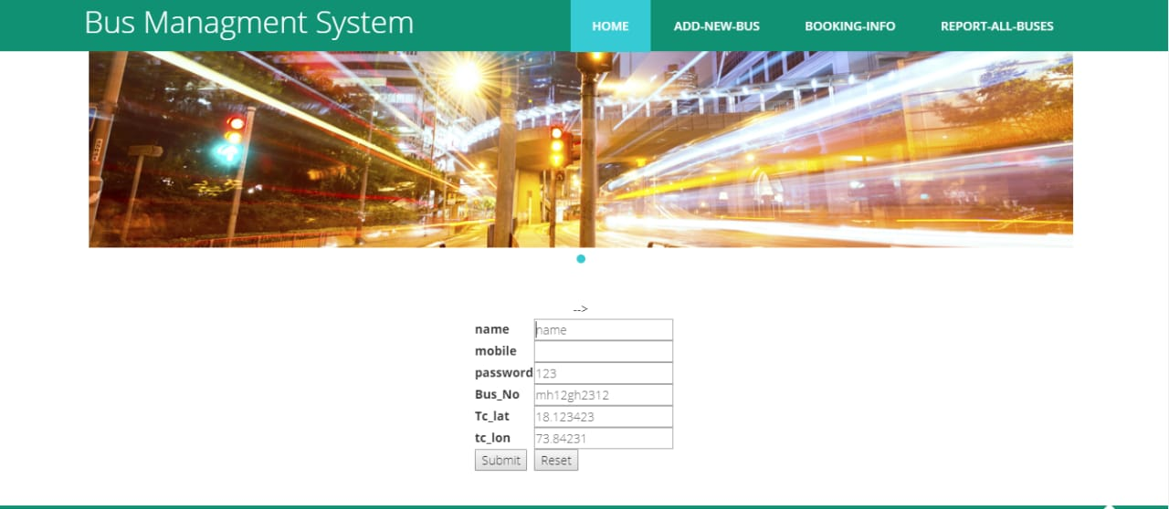

Slide 34
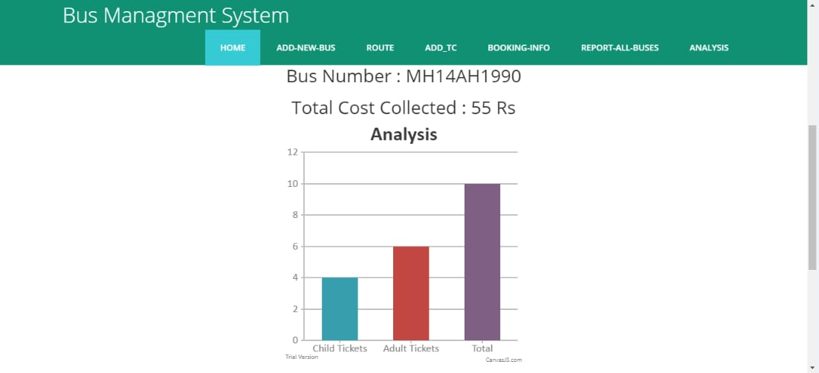
Data Analysis
Analysis of Children and Adult tickets
Histogram prepared gives a broader sense of travelers
Other Analysis showing bus route traffic can also be useful

Slide 35
Goals and objectives
Consumers now gain time because they have the possibility to buy and use their tickets whenever they want and wherever they are thanks to their smartphones.
The E-ticket is also eco-friendlier, compared to the paper ticket it doesn't need to be printed, paper consumption will thus decrease, making it even better for our planet
It will be impossible to lose your ticket.
To make the whole journey of a passenger enjoyable and hassle-free.
The location of the bus can be observed continuously using GPS system.

Slide 36
Project Requirements
Android Studio :- To develop android based app
MySql , Xampp :- To Store Database Information
PHP :- To Create Web Services

Slide 37
System Requirements
Hardware Requirements:
System : Intel I3 Processor.
Hard Disk : 20 GB.
Monitor : 15 VGA Colour.
Mouse : Logitech.
Ram : 4 GB
Software Requirements:
Operating system : Windows 7 and above.
Coding Language : JAVA, ANDROID
IDE : Android Studio
Database : MYSQL

Slide 38
Problem Statement
“To design and Implement a secured E-Ticketing system for public bus transport to provide hassle free travel to daily users”

Slide 39
Conclusion
This system provides online reservation of bus. System is user friendly and accurate .It is available for 24 hours. No need to go to the bus enquiry office.
The system is automatic and online which save everyone’s valuable time.
Bus Tracking will help users to get Real time Location of buses.
Data analysis provides smooth functioning of the overall travel system.

Slide 40
References
[1] Anila Cyril, Varghese George, Raviraj H. Mulangi "Electronic Ticket Machine Data Analytics for Public Bus Transport Planning", 2017 International Conference on Energy, Communication, Data Analytics and Soft Computing (ICECDS), 21 June 2018.
[2] Ajay Shingare, AnkitaPendole, Nikita Chaudhari and Parikshit DeshpandeGPS Supported City Bus Tracking Smart Ticketing System, 2015 International Conference on Green Computing and Internet of Things (ICGCIoT), 14 January 2016
[3] Prasun Chowdhury, Poulami Bala, Diptadeep Addy,Sumit Giri, Aritra Ray Chaudhuri RFID and Android Based Smart Ticketing and Destination Announcement System (ICACCI) 03 November 2016
[4] Van Ly, M.; Martin, S.; Trivedi, M.M. Driver classification and driving style recognition using inertial sensors. In Proceedings of the 2013 IEEE Intelligent Vehicles Symposium, Gold Coast, Australia, 23–26 June 2013; pp. 1040–1045.

Slide 41
References
[5] Aljaafreh, A.; Alshabatat, N.; Najim Al-Din, M. Driving style recognition using fuzzy logic. In Proceedings of the 2012 IEEE International Conference on Vehicular Electronics and Safety (ICVES), Istanbul, Turkey,24–27 July 2012; pp. 460–463.
[6] Al-Sultan, S.; Al-Bayatti, A.; Zedan, H. Context-aware driver behavior detectionPositioning System data. In Proceedings of the 2011 IEEE International Conference system in intelligent transportation systems. IEEE Trans. Veh. Technol. 2013, 62, 4264–4275.
[7] Mohamad, I.; Ali, M.; Ismail, M. Abnormal driving detection using real time Global on Space Science and Communication (IconSpace), Penang, Malaysia, 12–13 July 2011; pp. 1–6.
[8] Dorr, D.; Grabengiesser, D.; Gauterin, F. Online driving style recognition using fuzzy logic. In Proceedings of the 2014 IEEE 17th International Conference on Intelligent Transportation Systems (ITSC), Qindao, China, 8–11 October 2014; pp. 1021–1026.

Slide 42
THANK YOU

