Slide 1
Abusing Google Play In-App Billing

Slide 2
Table of content
Introduction
How does In-App billing process work?
In-app Billing Vulnerability
Exploitation
Prevention
Summary

Slide 3
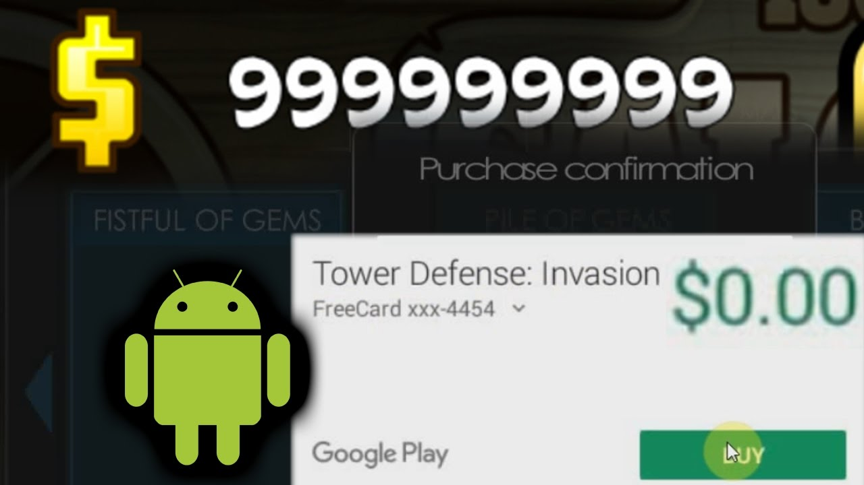
1. Introduction

Slide 4
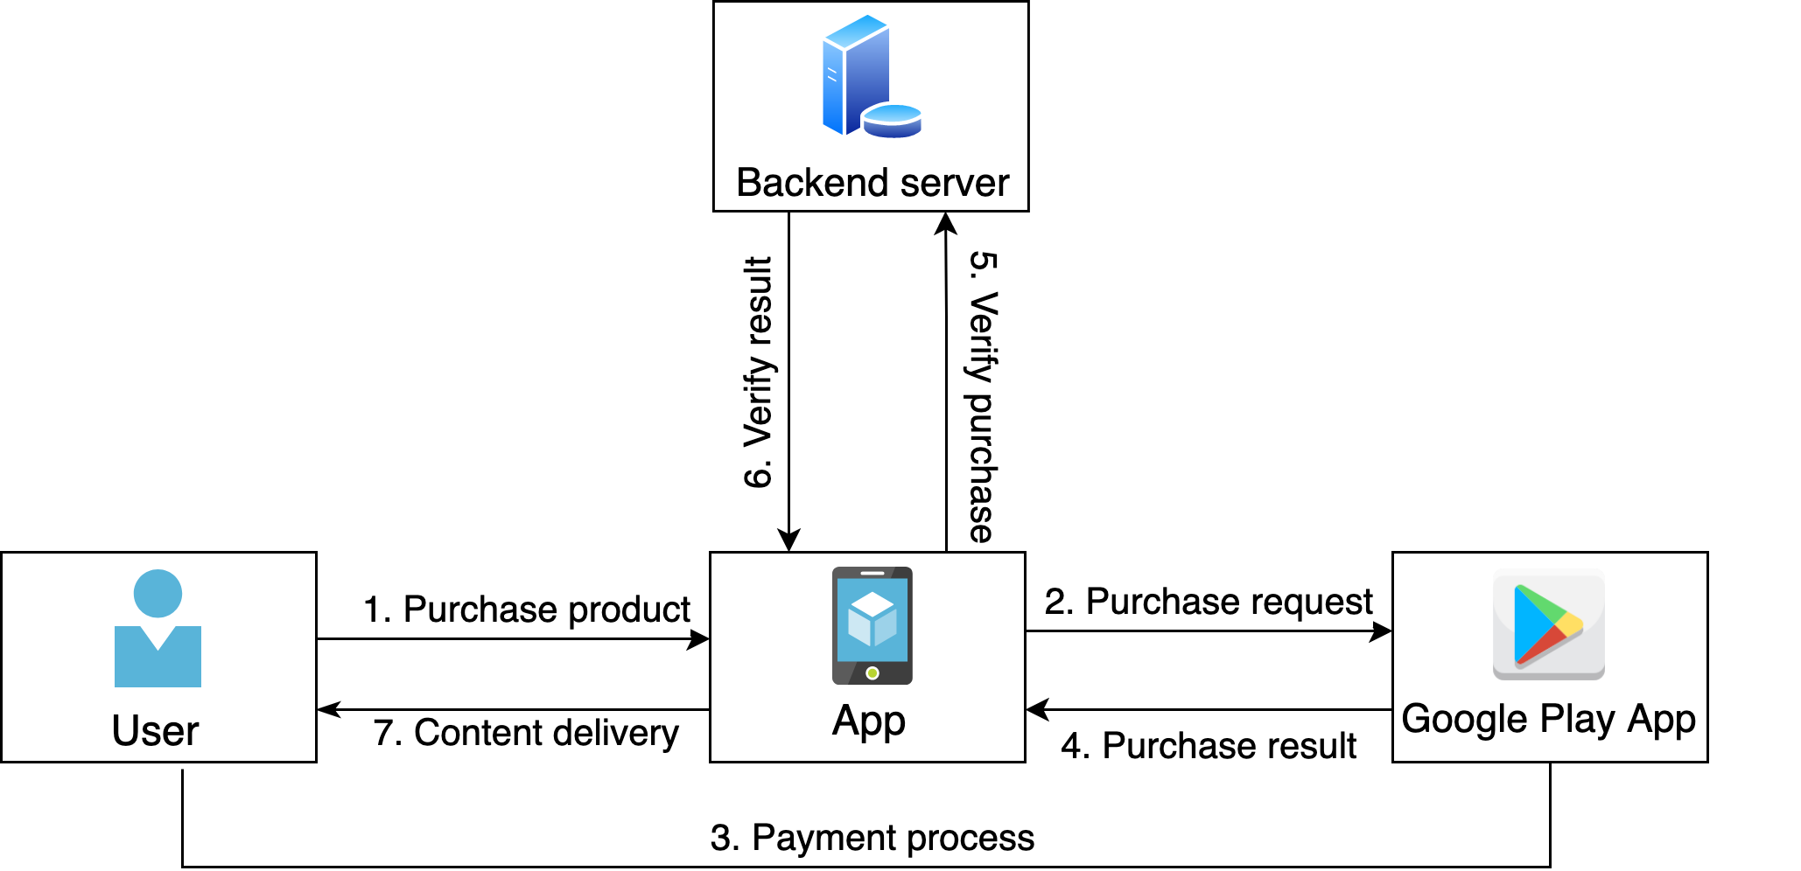
2. Google Play In-app Purchase Workflow
Google Play In-App purchase process:

Slide 5
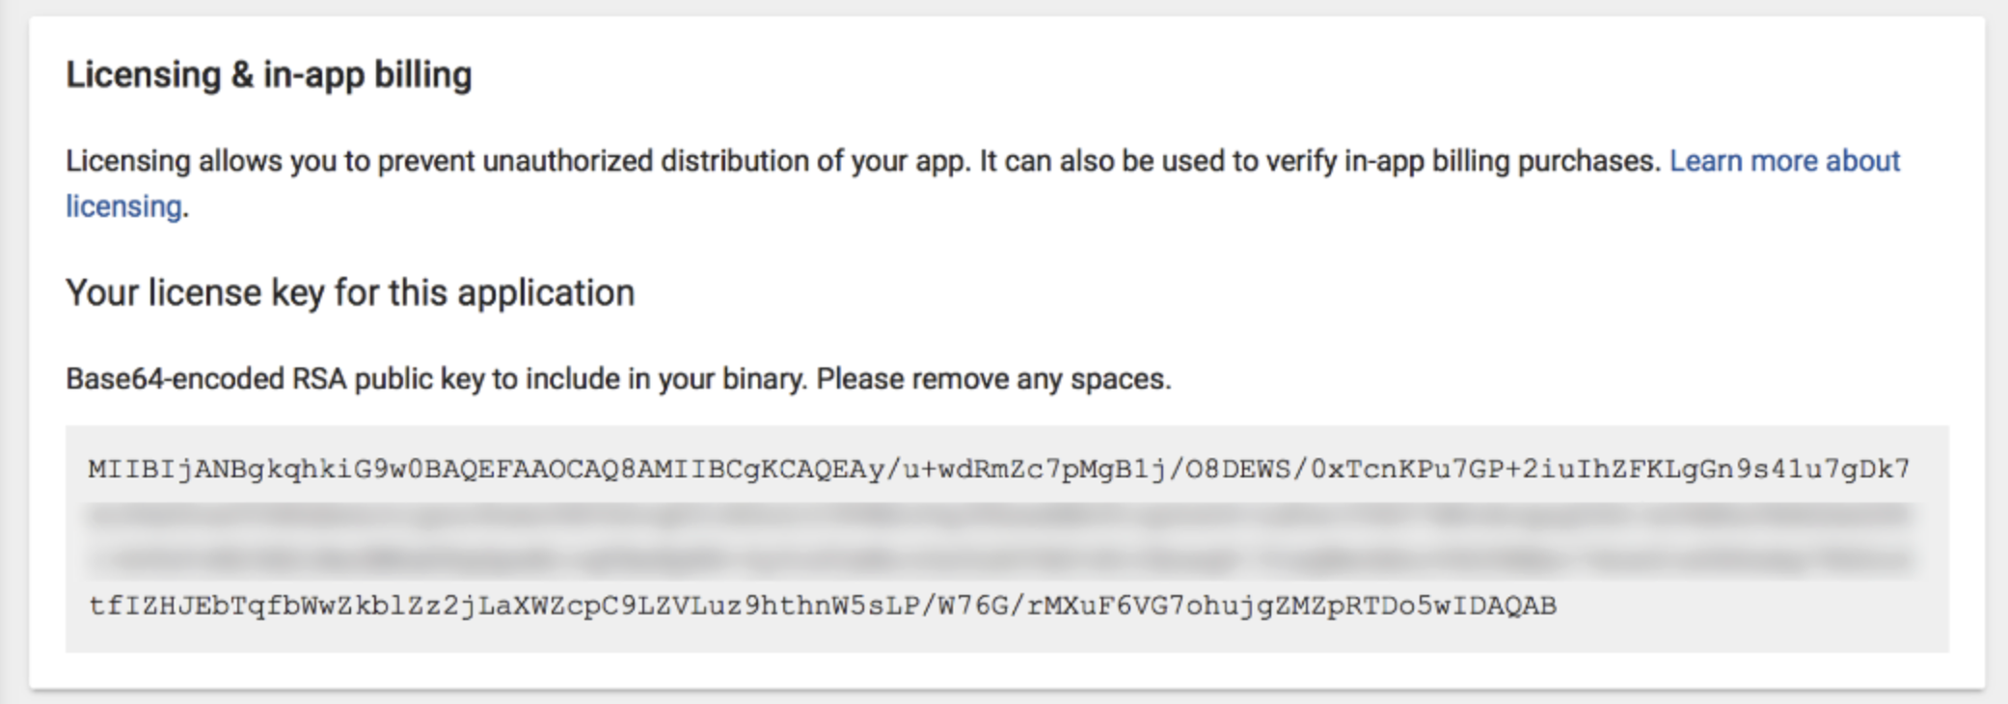
2. Google Play In-app Purchase Workflow
Purchase result verification
Every purchase has its own signature, use the Google Play provided public key for the verification.
Use Google Play Developer API `purchases.products.get` or `purchases.subscriptions.get`

Slide 6
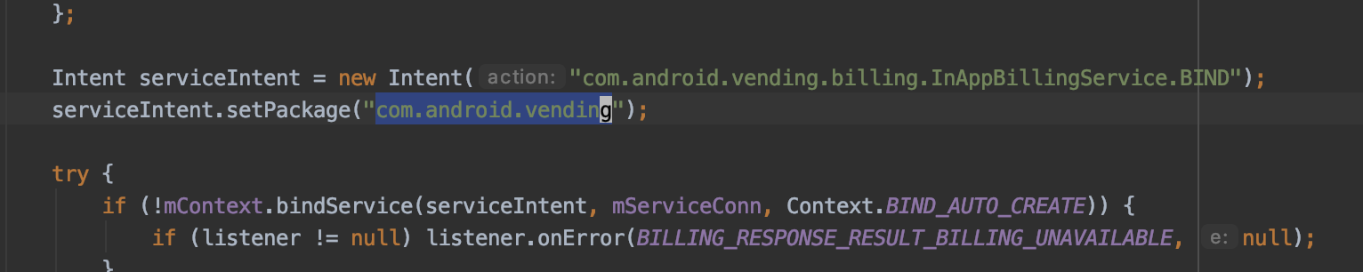
3. In-app Billing Vulnerability
Application which using Google Play In-app Billing API should create an intent to call the Google Play billing service.
After the payment process completed Google Play return a purchase result into the intent.
By changing the target package name to the impersonated Google Play billing service we can passing fraud purchase result.

Slide 7
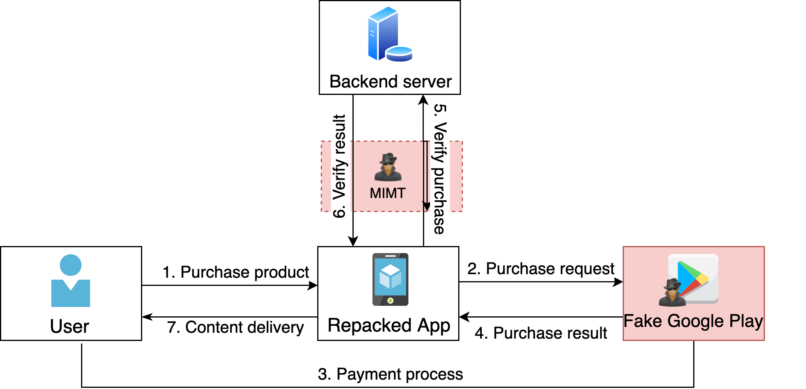
3. In-app Billing Vulnerability

Slide 8
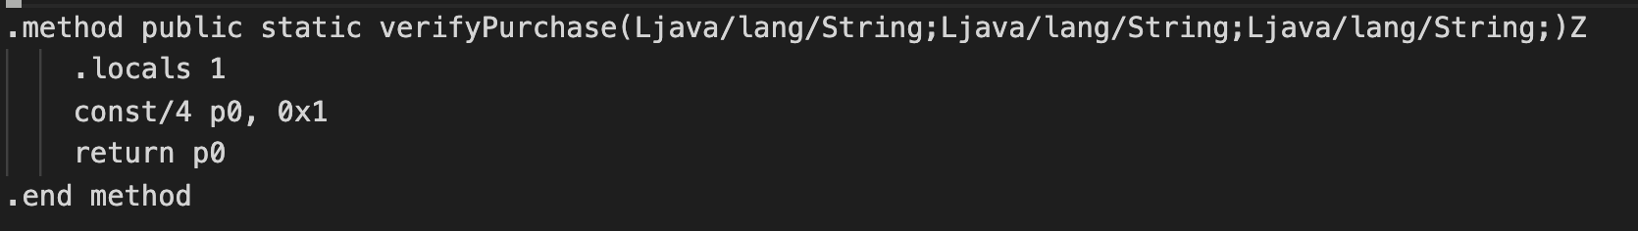
3. In-app Billing Vulnerability
Application which using unsafe purchase verification will be impact.
We can also run a proxy server to intercept the verification response to get a valid purchase
Hooking into the function that perform purchase verification, function that return boolean is easy to crack.
In game TempleRun, we modify the function verifyPurchase to always return true.

Slide 9
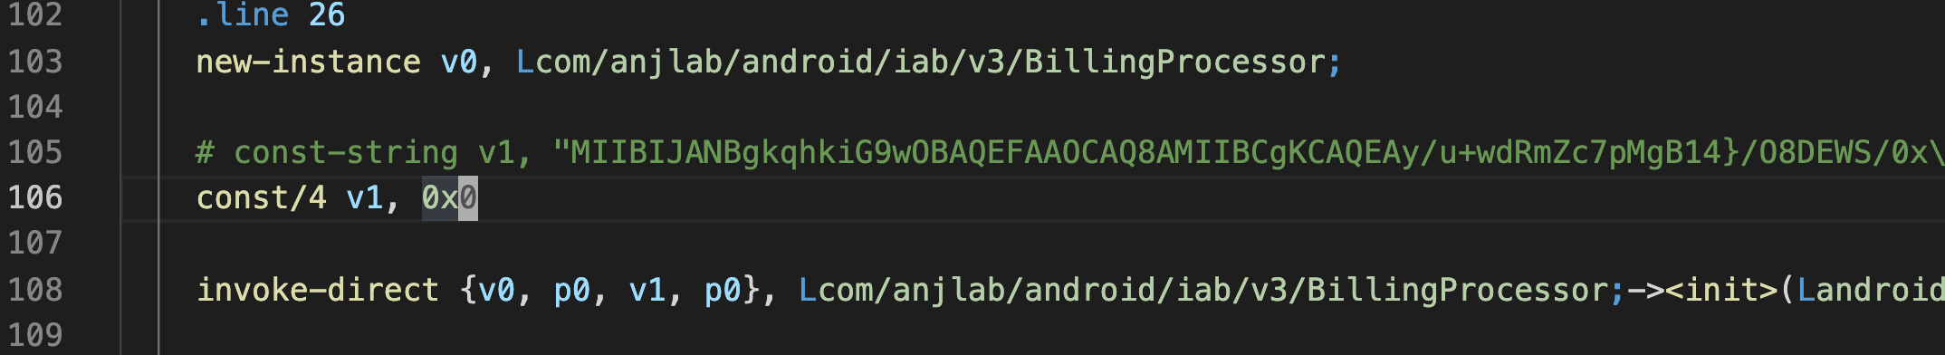
3. In-app Billing Vulnerability
Application using android-inapp-billing-v3 library, we can bypass the purchase signature verification by passing a null public key

Slide 10

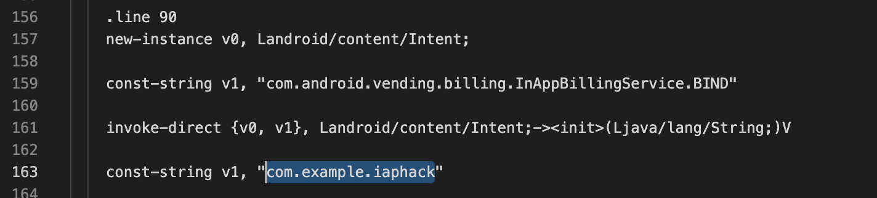
4. Exploitation
Fruit Ninja
Target:
We modify the smali code to replace google play billing service with our impersonated billing service.
Fruit Ninja do not verify the purchase result, we can easily obtain unlimited gems.

Slide 11

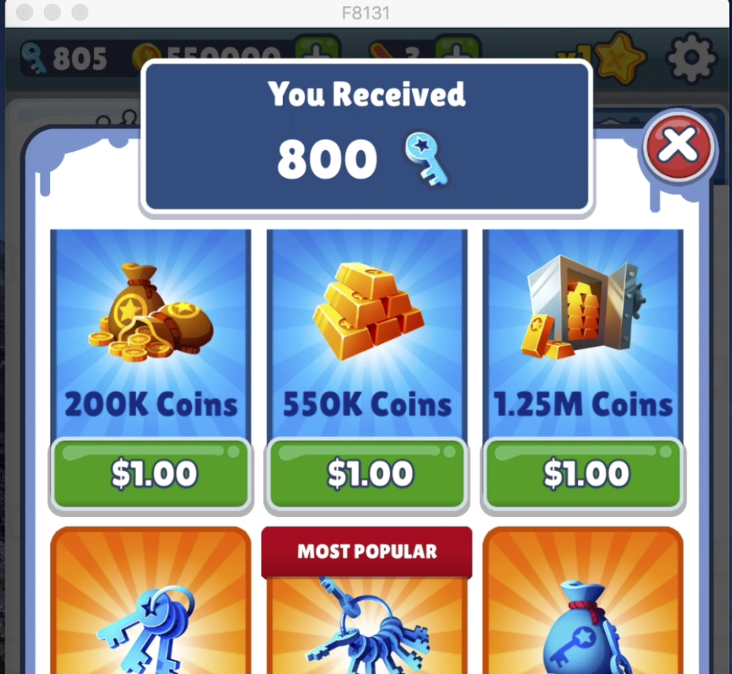
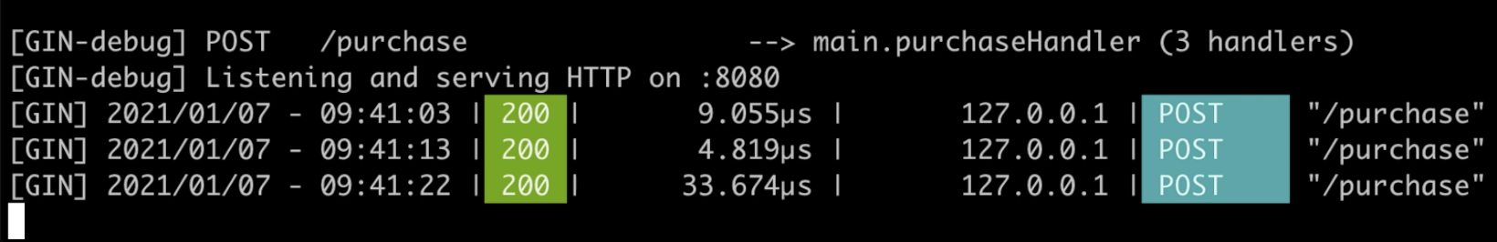
4. Exploitation
Subway Surfers
Target:
Modify the smali code: change package “com.android.vending” to our package “com.example.iaphack”
The game perform a purchase verification on a backend server, we need to intercept the http response.

Slide 12
4. Exploitation
The impersonated Google Play Billing Service.
Base on Dominik Schürmann billing-hack repository and update to implement latest Google Play Billing AIDL
Some similar apps: Lucky Patcher, Freedom

Slide 13
5. Prevention
Write native code library for your apps. Reversing low level languages is more difficult.
Use java obfuscator (e.g. Proguard) to obfuscate the code and prevent people from understanding the verification process
Use secure connection to perform the purchase verification on the backend server.

