Slide 1


Slide 2
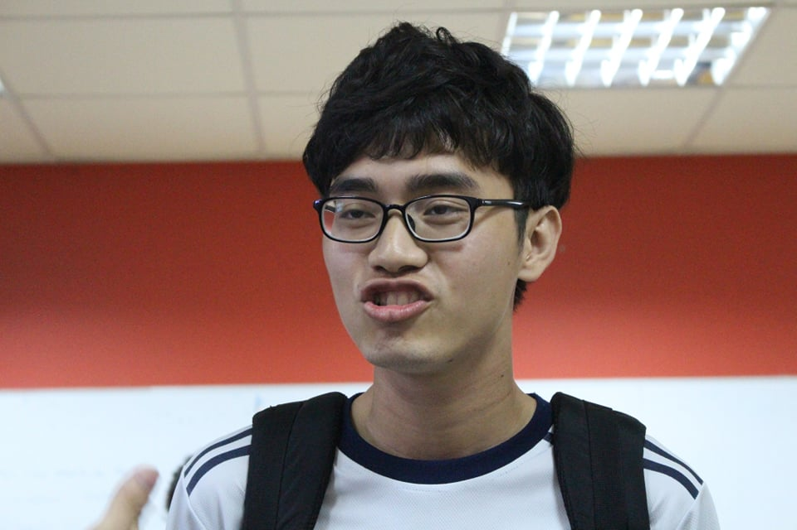
Group: TERMINATOR
NGUYỄN ĐÌNH KHANG (LEADER)
Hobbies: Love learning Chinese language and hate learning programming

Slide 3
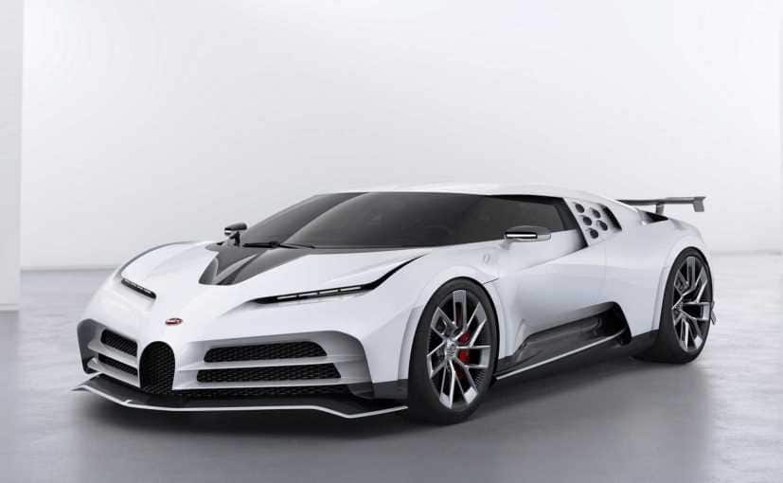
HIRE CAR MANAGEMENT SYSTEM

Slide 4
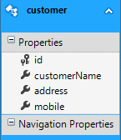
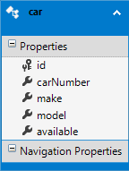
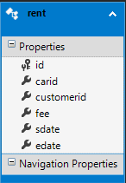
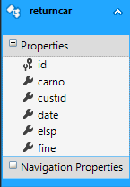
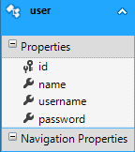
DATABASE

Slide 5

MVC5

Slide 6


