Slide 1
BOOK MANAGEMENT
Nguyễn Duy Khang – B1910652
Trần Bá Phương - B1908407

Slide 2
List of functions
Guest:
See all books
Search books by title
Login account to manage
Admin
Add categogy
Add book
Edit book
Delete book
Search books by title to delete
Search books by title to edit
Add account manage

Slide 3
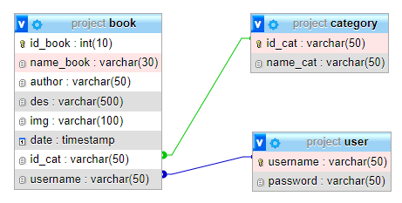
Database

Slide 4
Database
HTML
CSS
PHP
Pagination
Session
MySQL
File upload
Image saving in DB

Slide 6
SlidesCarnival icons are editable shapes.
This means that you can:
Resize them without losing quality.
Change fill color and opacity.
Change line color, width and style.
Isn’t that nice? :)
Examples:

Slide 7
Diagrams and infographics

Slide 8
Now you can use any emoji as an icon!
And of course it resizes without losing quality and you can change the color.
How? Follow Google instructions https://twitter.com/googledocs/status/730087240156643328
✋👆👉👍👤👦👧👨👩👪💃🏃💑❤😂😉😋😒😭👶😸🐟🍒🍔💣📌📖🔨🎃🎈🎨🏈🏰🌏🔌🔑 and many more...

Slide 9

Free templates for all your presentation needs
For PowerPoint and Google Slides
100% free for personal or commercial use
Ready to use, professional and customizable
Blow your audience away with attractive visuals

