Slide 1
OPEN SOURCE SOFTWARE DEVELOPMENT
Member
1. Le Tuyet Nga - B1910668
2. Nguyen Thi Bich Huyen - B1910648

Slide 2
MAIN CONTENT
Good first issue: Create Collab File Structure
Good first issue: Automatic run file with python Flask

Slide 3
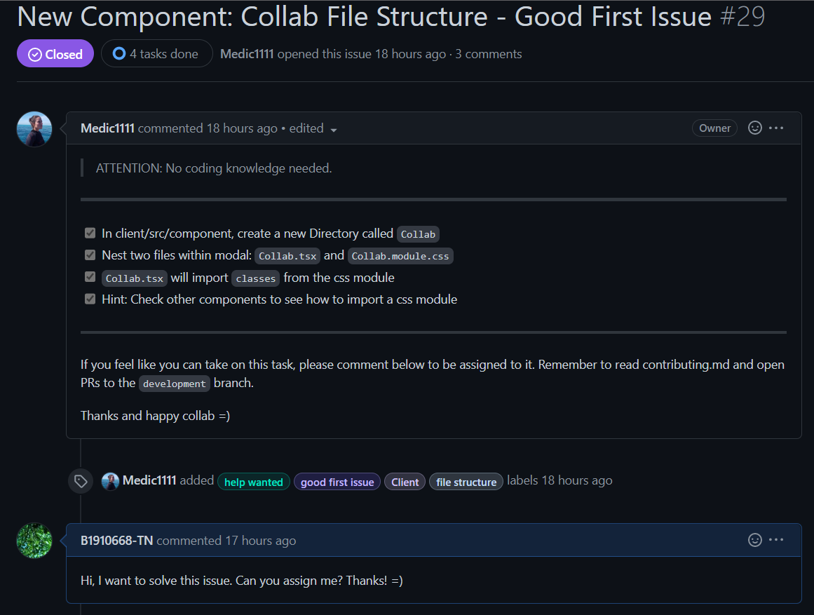

Slide 4
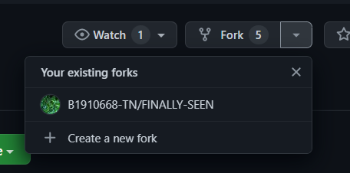
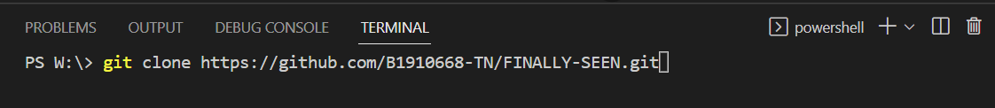
Fork repository and clone the forked repository

Slide 5

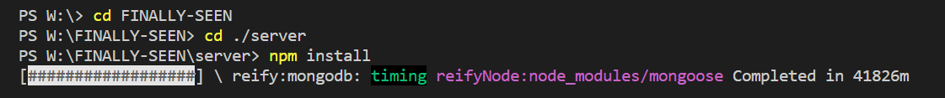

Install dependencies client and run client
Install dependencies server and run server

Slide 6
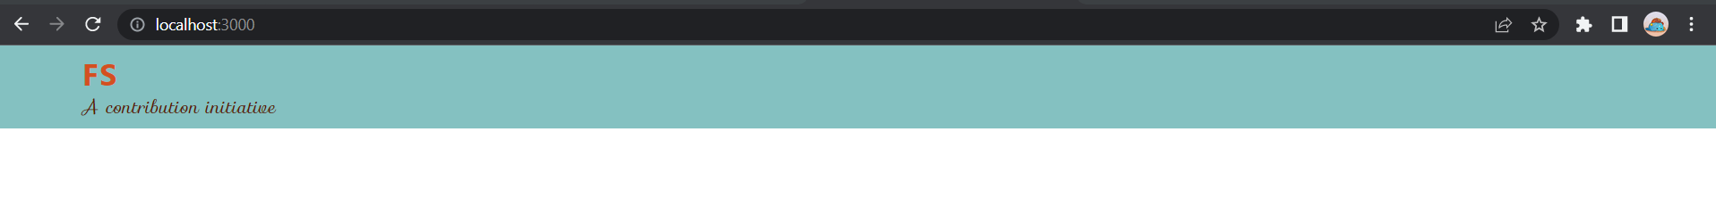
=> Successfully run

Slide 7
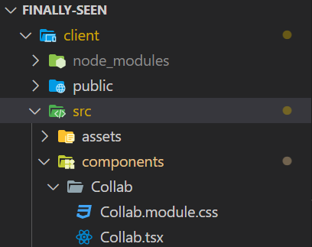
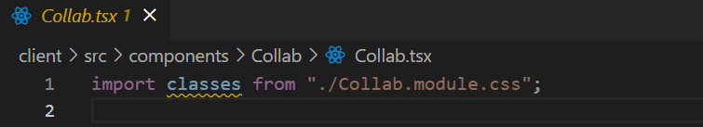
1. Create a Collab directory tree.
2. In the file Collab.tsx will import classes from the Collab.module.css

Slide 8
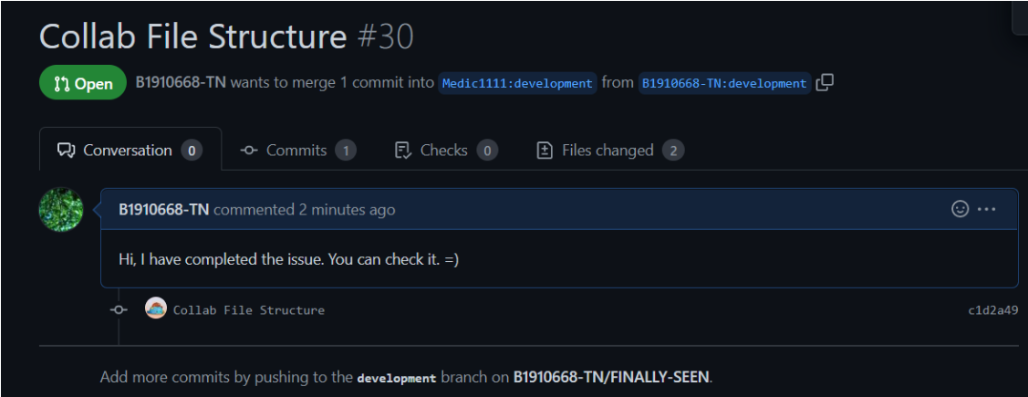
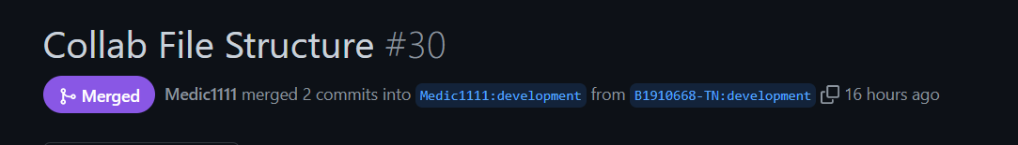
Push to the development branch

Slide 9
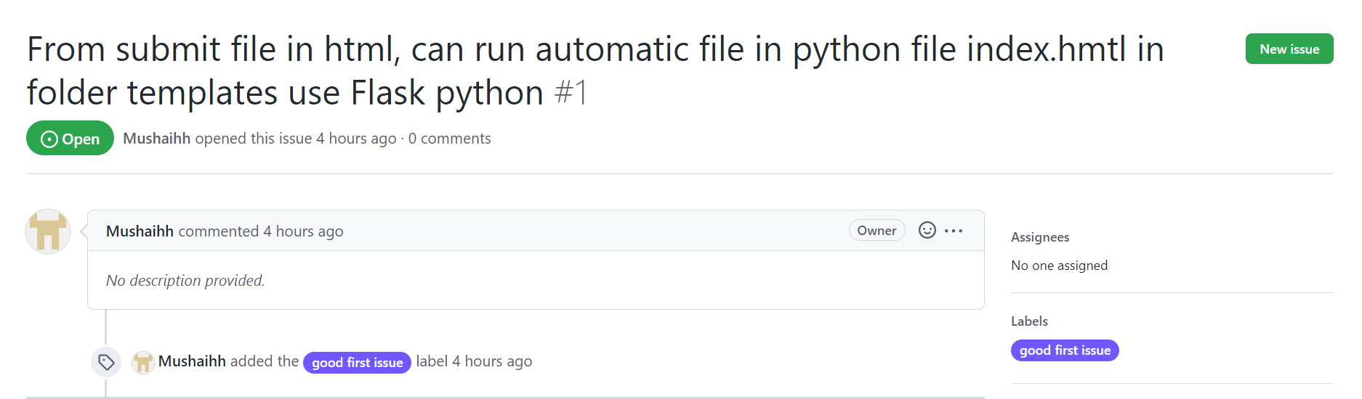
Nguyen Thi Bich Huyen

Slide 10
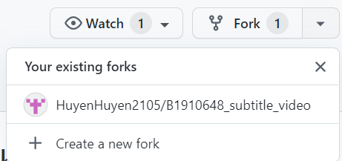
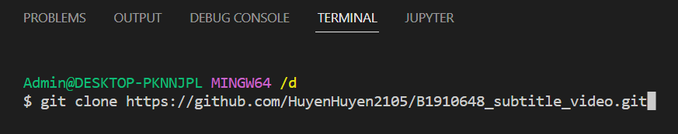
Fork repository and clone the forked repository

Slide 11
run client

Slide 12
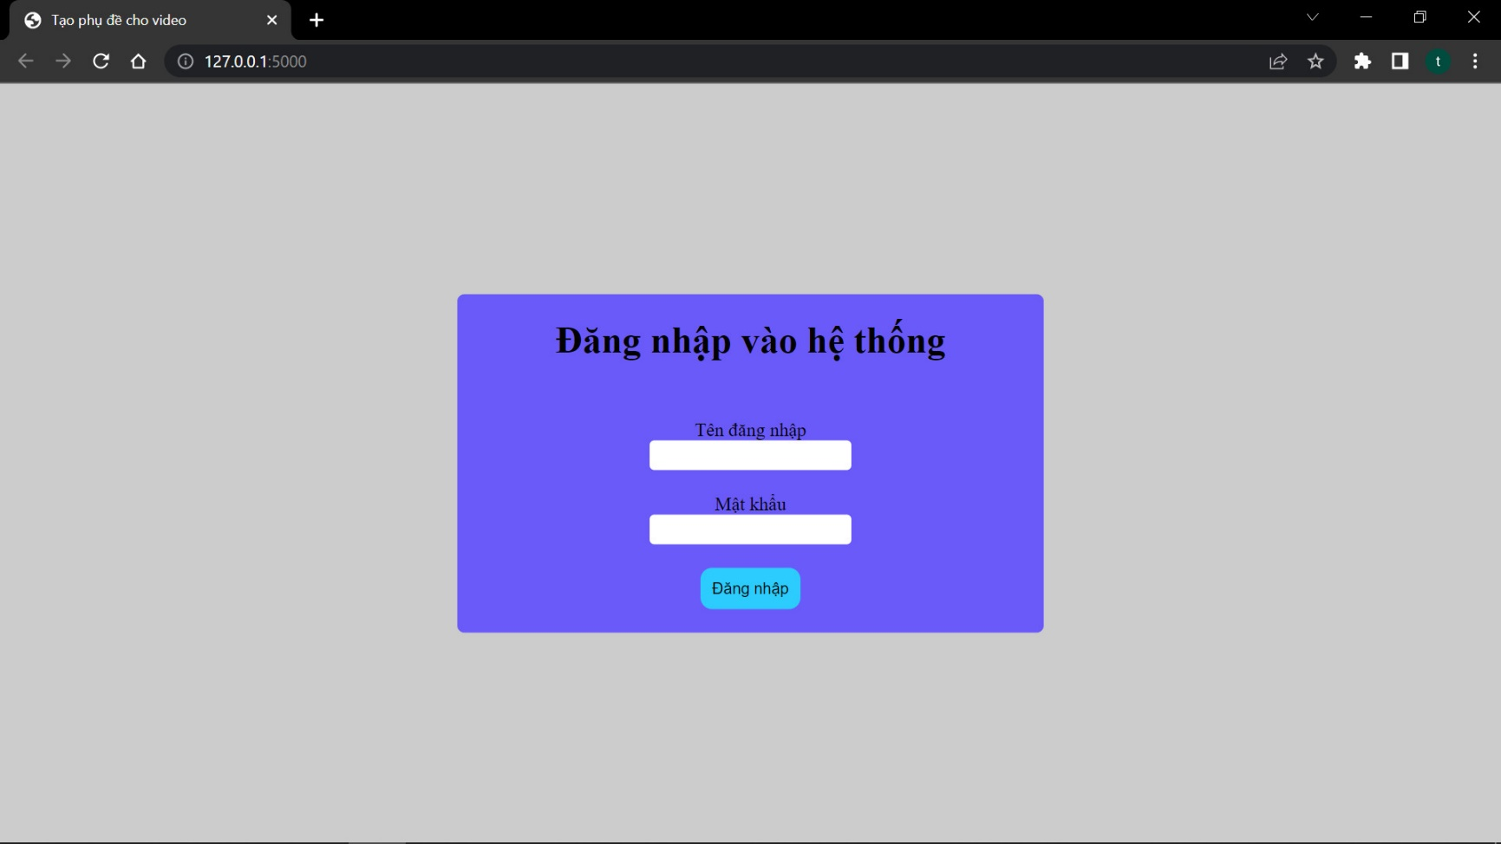
=> Successfully run

Slide 13
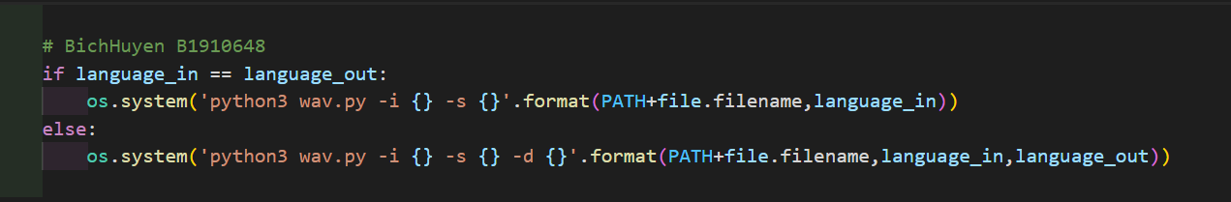
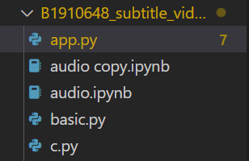
1. Open file app.py
2. In the file will app.py import module os
After write code “os.system()”

Slide 14
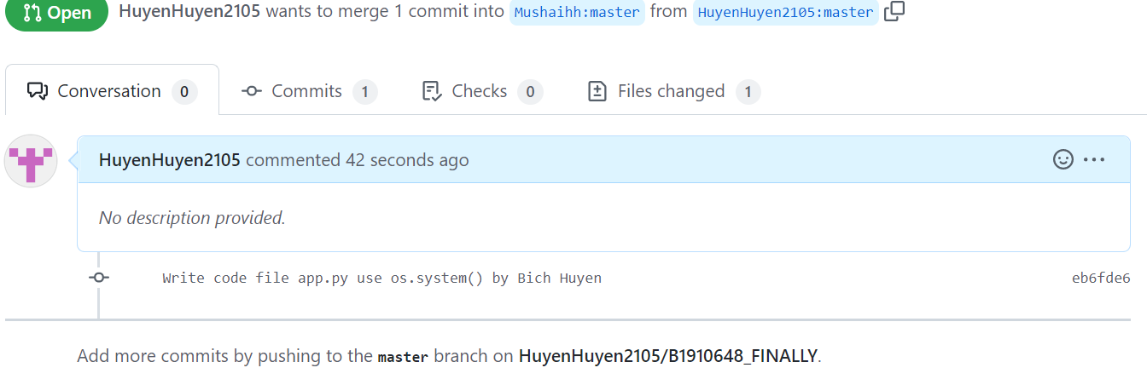
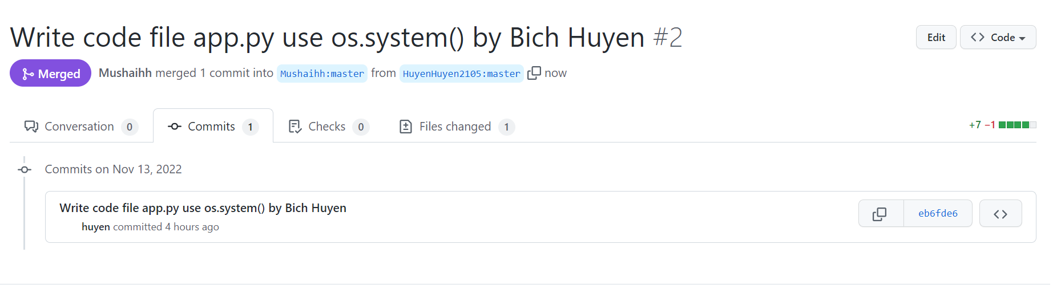
Push to the development branch

Slide 15
THANK YOU

