Slide 2
BRAZILIAN E-COMMERCE
by Olist
https://olist.com/pt-br/

Slide 3
NICE TO MEET YOU!
Thank you for coming today!
“Live as if you were to die tomorrow. Learn as if you were to live forever.” ― Mahatma Gandhi

Slide 4
TODAY’S TOPICS
Talking about SEO
8:00pm
9:30pm
9:00pm
7:15pm
8:30pm
Q&A
DATA CLEANING
Ask me anything and I’ll try my best to answer.
Using Python
ABOUT US
VISUALIZE DATA
Introducing me!!
With the help of Power BI
ANALIZE DATA
With D Beaver of course (MySQL)

Slide 5
ABOUT US
SECTION 01
We are awesome!

Slide 6
OUR VISION
Becoming the best data analyst in the world :)
“Nothing here”
I just started :D

Slide 7

KEY PERSON
Hey
Data Analyst Newbie :)
“Tell me and I forget, teach me and I may remember, involve me and I learn” (Benjamin Franklin)
Do you agree? told something is fleeting, being taught something is more memorable but learning something is unforgettable.
Khang Le

Slide 8
“To travel hopefully is a better thing than to arrive, and the true success is to labour.”

Slide 9
DATA CLEANING
SECTION 02
LOL

Slide 10
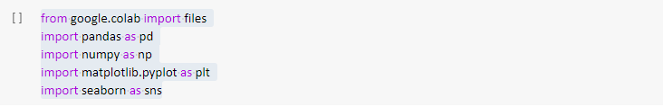
PYTHON
Import libraries
Type these
from google.colab import files
import pandas as pd
import numpy as np
import matplotlib.pyplot as plt
import seaborn as sns

Slide 11
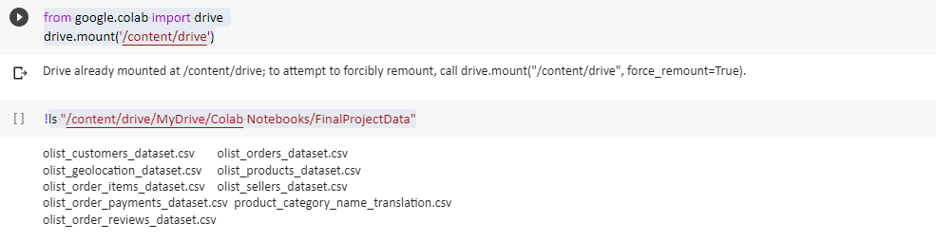
PYTHON
Import CSV Files
Then type these to mount drive (Heavy Data about 200Mb)
from google.colab import drive
drive.mount('/content/drive')

Slide 12
FEW STEPS IN PYTHON
Read, check data type, check null and duplicate
READ DATA
df_customers = pd.read_csv('/content/drive/MyDrive/Colab Notebooks/FinalProjectData/olist_customers_dataset.csv')
df_order_items = pd.read_csv('/content/drive/MyDrive/Colab Notebooks/FinalProjectData/olist_order_items_dataset.csv')
df_orders = pd.read_csv('/content/drive/MyDrive/Colab Notebooks/FinalProjectData/olist_orders_dataset.csv')
df_products = pd.read_csv('/content/drive/MyDrive/Colab Notebooks/FinalProjectData/olist_products_dataset.csv')
df_product_category = pd.read_csv('/content/drive/MyDrive/Colab Notebooks/FinalProjectData/product_category_name_translation.csv')
CHECK DATA TYPE
df_customers.info()
df_order_items.info()
df_orders.info()
df_products.info()
df_product_category.info()

Slide 13
FEW STEPS IN PYTHON
Read, check data type, check null and duplicate
CHECK NULL
df_customers.isnull().sum()
df_orders.isnull().sum()
df_order_items.isnull().sum()
df_products.isnull().sum()
df_product_category.isnull().sum()
DELETE ANY ROW WITH NaN
Use these and copy for the rest:
df_orders=df_orders.dropna(subset=['order_approved_at','order_delivered_carrier_date','order_delivered_customer_date']).reset_index(drop = True)
CHECK DUPLICATE
Exactly like check null but Replace isnull() with duplicated() .

Slide 14
CLICK ME :)
Detail of my works
https://colab.research.google.com/drive/1v4pyqwDETem__3P3Tki2n1QJb_r4dz5C

Slide 15
ANALIZE DATA
SECTION 03
What these data tell you?

Slide 16
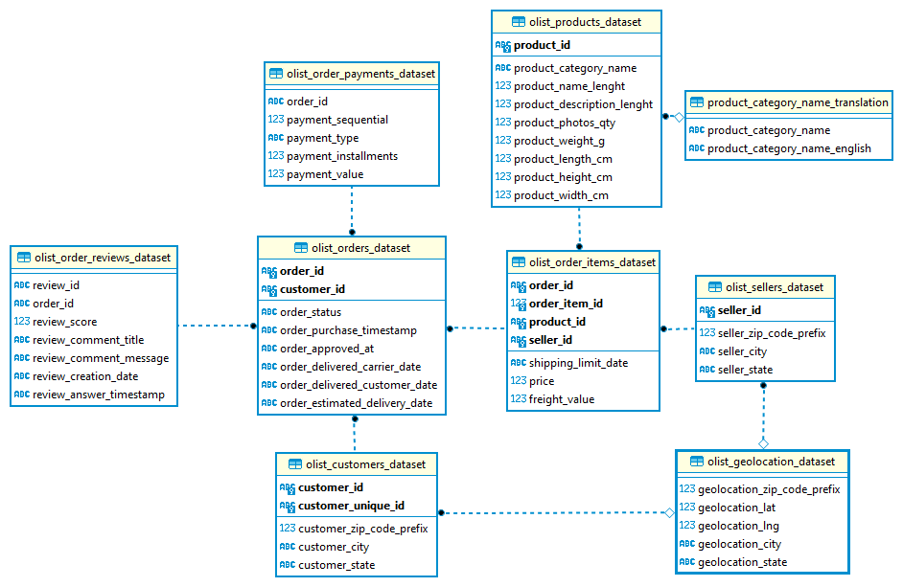
From 12:30pm to 2:00pm
?
Data Schema
From 8:30pm

Slide 17
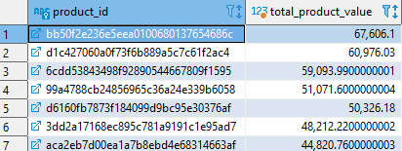
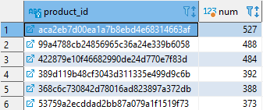
BUSINESS BY PRODUCTS TYPES
First question: Total product counts and total product values
Total product counts
Total product values
select product_id, count(*) as num
FROM olist_order_items_dataset ooid
group by product_id
ORDER BY num DESC
SELECT product_id, (sum(price)+sum(freight_value)) as total_product_value
FROM olist_order_items_dataset ooid
GROUP BY product_id
ORDER BY total_product_value DESC

Slide 18
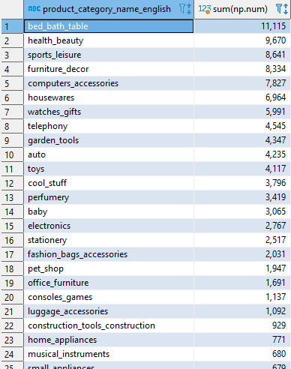
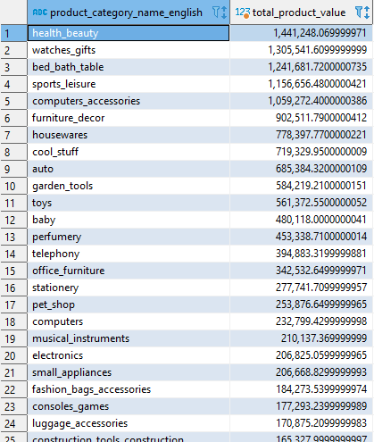
BUSINESS BY PRODUCTS TYPES
Second question: Number of Products and Value of Products categorize by types
Product’s value by type
Number of Products by type
SELECT pcnt.product_category_name_english, (sum(ooid.price)+sum(ooid.freight_value)) AS total_product_value
FROM olist_order_items_dataset ooid
JOIN olist_products_dataset opd ON ooid.product_id = opd.product_id
JOIN product_category_name_translation pcnt ON opd.product_category_name = pcnt.product_category_name
GROUP BY pcnt.product_category_name_english
ORDER BY total_product_value DESC
with number_product as
(select product_id, count(*) as num
FROM olist_order_items_dataset ooid
group by product_id )
SELECT pcnt.product_category_name_english, sum(np.num)
FROM number_product as np
join olist_products_dataset opd on np.product_id = opd.product_id
join product_category_name_translation pcnt on opd.product_category_name = pcnt.product_category_name
group by pcnt.product_category_name_english
order by sum(np.num) DESC

Slide 19
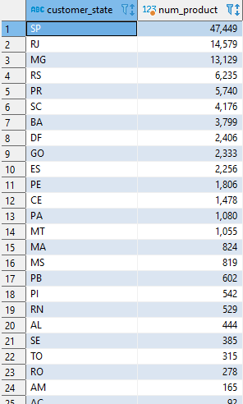
BUSINESS BY PRODUCTS TYPES
Third question: Which state has the highest product count and total values
Number of Products by State
SELECT ocd.customer_state, count(ooid.product_id) AS num_product
FROM olist_customers_dataset ocd
JOIN olist_orders_dataset ood ON ocd.customer_id = ood.customer_id
JOIN olist_order_items_dataset ooid ON ood.order_id = ooid.order_id
GROUP BY ocd.customer_state
ORDER BY num_product DESC

Slide 20
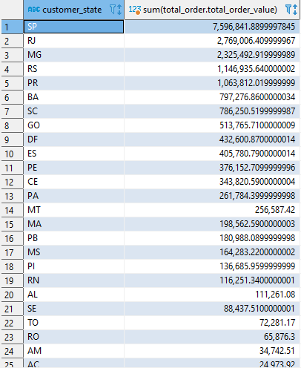
BUSINESS BY PRODUCTS TYPES
Third question: Which state has the highest order count and total values
Total values by State
WITH order_state AS
(SELECT ocd.customer_state, ooid.order_id
FROM olist_order_items_dataset ooid
INNER JOIN olist_orders_dataset ood ON ooid.order_id = ood.order_id
INNER JOIN olist_customers_dataset ocd ON ood.customer_id = ocd.customer_id),
total_order AS
(SELECT ooid2.order_id, (sum(ooid2.price)+sum(ooid2.freight_value)) as total_order_value
FROM olist_order_items_dataset ooid2
GROUP BY ooid2.order_id)
SELECT order_state.customer_state, sum(total_order.total_order_value)
FROM order_state
JOIN total_order
ON order_state.order_id = total_order.order_id
GROUP BY order_state.customer_state
ORDER BY round(sum(total_order.total_order_value)) DESC

Slide 21


BUSINESS BY PRODUCTS TYPES
Fourth question: Number of Products and Product’s Value by Year
Number of Products by Year
Product’s Value by Year
SELECT YEAR(ood.order_purchase_timestamp), count(ooid.product_id)
FROM olist_orders_dataset ood
JOIN olist_order_items_dataset ooid
ON ood.order_id = ooid.order_id
GROUP BY YEAR(ood.order_purchase_timestamp)
WITH total_order AS
(SELECT order_id, (sum(price)+sum(freight_value)) as total_order_value
FROM olist_order_items_dataset ooid
GROUP BY order_id
ORDER BY total_order_value)
SELECT YEAR(ood.order_purchase_timestamp), sum(total_order.total_order_value)
FROM olist_orders_dataset ood
JOIN total_order
ON total_order.order_id = ood.order_id
WHERE ood.order_status IN ('delivered','approved','created','shipped','processing','invoiced')
GROUP BY YEAR(ood.order_purchase_timestamp)

Slide 22
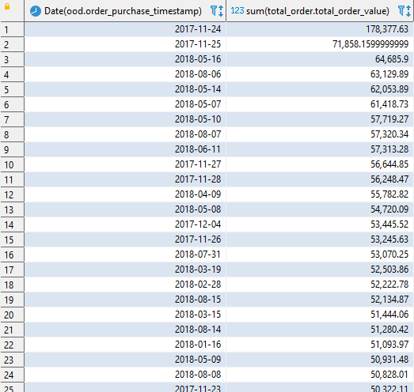
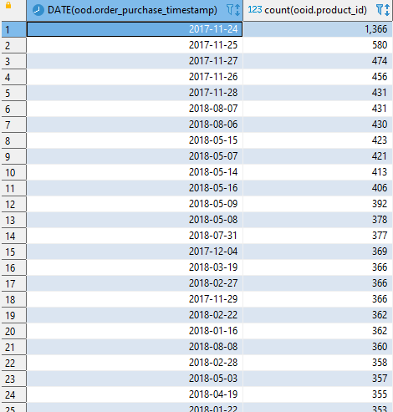
BUSINESS BY PRODUCTS TYPES
Final question: Number of Products and Product’s Value by Date
Number of Products by Date
Product’s Value by Date
SELECT DATE(ood.order_purchase_timestamp), count(ooid.product_id)
FROM olist_orders_dataset ood
JOIN olist_order_items_dataset ooid
ON ood.order_id = ooid.order_id
GROUP BY DATE(ood.order_purchase_timestamp)
ORDER BY count(ooid.product_id) DESC
WITH total_order AS
(SELECT order_id, (sum(price)+sum(freight_value)) as total_order_value
FROM olist_order_items_dataset ooid
GROUP BY order_id
ORDER BY total_order_value)
SELECT Date(ood.order_purchase_timestamp), sum(total_order.total_order_value)
FROM olist_orders_dataset ood
JOIN total_order
ON total_order.order_id = ood.order_id
WHERE ood.order_status IN ('delivered','approved','created','shipped','processing','invoiced')
GROUP BY date(ood.order_purchase_timestamp)
ORDER BY sum(total_order.total_order_value) DESC

Slide 23
VISUALIZE DATA
SECTION 04
To report of one’s best effort.

Slide 24
From 12:30pm to 2:00pm
?
POWER BI
From CLICK ME

Slide 25
“Success is a journey, not a destination.”
We keep moving forward.

Slide 26
That’s all. Thank you! :3
Any Questions?
Dataset: Brazilian E-Commerce Public Dataset by Olist
https://www.kaggle.com/datasets/olistbr/brazilian-ecommerce?select=olist_order_items_dataset.csv
Author’s ppt template: Jun Akizaki - http://thepopp.com
Power BI Template: https://community.powerbi.com/t5/Themes-Gallery/Power-BI-Wireframe-Template/td-p/2180570

