Slide 1
One of a Kind Objects: the Singleton Pattern
Nguyễn Phú Khang - 10421112

Slide 2
Table of contents
1. Definition
2. Benefits
3. Use cases
4. Implementation

Slide 3

1. Definition
- Singleton is a creational design pattern that lets you ensure that a class has only one instance, while providing a global access point to this instance.

Slide 4
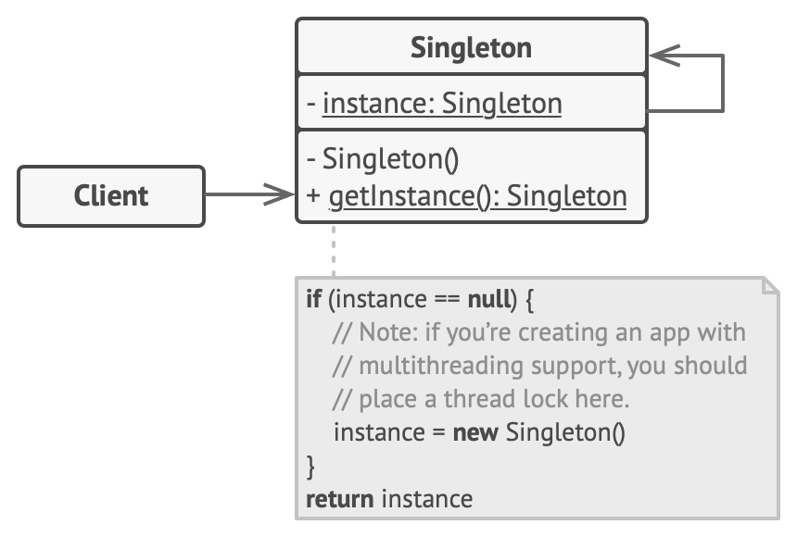
Structure:

Slide 5
2. Benefits
- You can be sure that a class has only a single instance.
- You gain a global access point to that instance.
- The singleton object is initialized only when it’s requested for the first time

Slide 6
3. Use cases
- Database connection pool
- Logger
- Configuration settings
-Thread pool, etc.

Slide 7
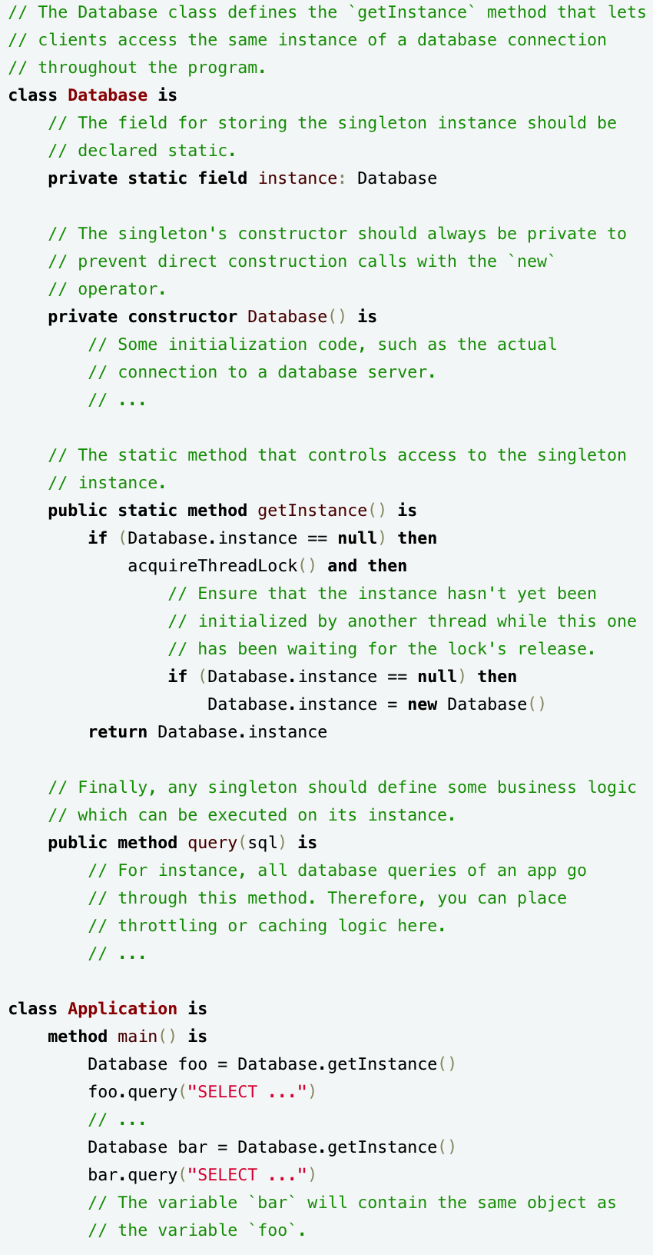
4. Implementation
Pseudocode:

Slide 8
THANK YOU

