Slide 1
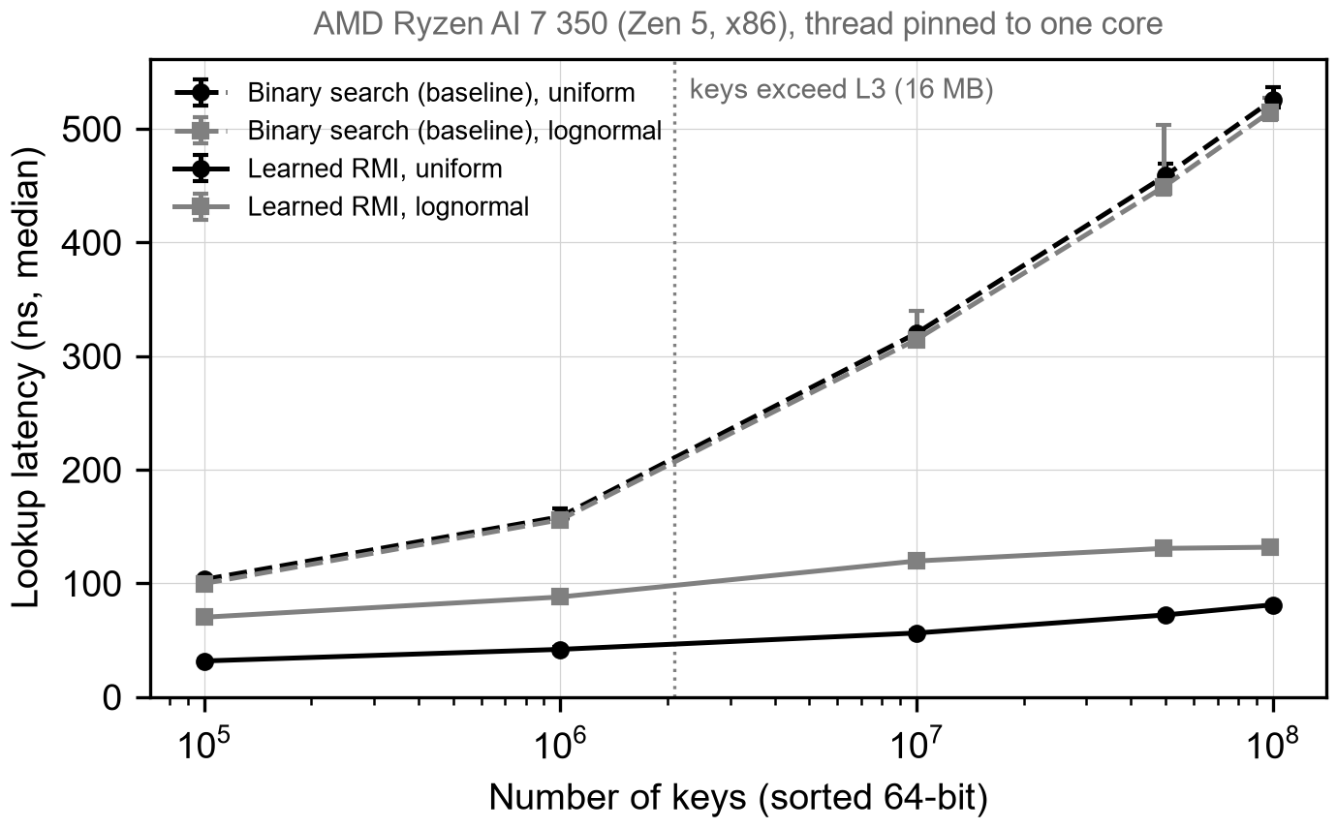
Do Learned Indexes Still Win on Modern Hardware?
01
DATABASES
On track
Today a B+tree decides where key k lies in a sorted array. A bad guess costs extra cache misses, about 100 ns each.
Key distribution matters more than expected. With the same 2.3 MB model at 100M keys, lognormal lookups took 226 ns versus 81 ns for uniform. At 10M keys, a 58 KB model lost to binary search. Lesson: test skewed data.
Binary search (std::lower_bound, -O3), the standard SOSD baseline. A tuned B+tree comes next. Today: 525 ns per lookup at 100M keys.
Learned indexes (RMI, PGM, RadixSpline, ALEX) learn key to position. Labels are free: each key's array position. One inference: a few multiply-adds plus a bounded local search.
At 100M uniform keys, the RMI cuts lookup time 6.5x: 525 to 81 ns.
Decisive run: SOSD, four datasets, perf, on AMD, Intel, ARM. Risk: counters blocked in WSL2/macOS. Fallback: AWS bare-metal.
AMD Ryzen AI 7 350 (Zen 5), pinned core, 2M random lookups, 1 warm-up, median of 5 runs, bars min/max.
Yes: search is bounded
Yes: labels = positions
Yes: model 0.3% of data
Unsure: no B+tree yet
Unsure: no inserts yet
Notes:
HOW TO USE THIS TEMPLATE (delete nothing on the slide; write your talk script below this block)
1. This is the only slide you present. No title slide, no extra slides, no animations.
2. Do not move, resize, or restyle any box, and do not change a font size. The fonts are fixed so the room can read every team at the same size. If your text does not fit, cut words: the box is the word limit.
3. Paste as plain text (Ctrl+Shift+V on Windows, Cmd+Shift+Option+V on Mac) so you do not import another font size.
4. Box 4 takes exactly one plot. Click the picture icon to insert it. Label both axes and draw the baseline on the same axes.
5. Gate check: for each of the five constraints, write yes, unsure, or no, plus a few words of evidence. "Unsure" is an honest and acceptable answer at Week 9.
6. Status: on track, at risk, or pivoted. Pivoting is fine if box 5 says why.
TIMING: 6 minutes talking, 4 minutes questions. Spend about half your talk on boxes 4 and 5. End on box 7 and wait for an answer.
SUBMIT: save as TeamNN_Midterm.pptx (two-digit team number) and upload to Canvas by the deadline posted there, so all teams can be merged into one deck.
---- YOUR SCRIPT ----
Box 1. The decision (about 40 seconds)
- Our project asks whether learned indexes (LURN-d IN-deks-iz) still outperform traditional indexes on modern hardware.
- Every database lookup must decide where a key is stored in a sorted array. Today, a B+tree (bee-plus tree) makes this decision through a sequence of comparisons.
- A poor decision does not return an incorrect result. However, it costs additional cache misses, and each miss to main memory costs approximately one hundred nanoseconds (NAN-oh-sek-unds).
Box 2. The baseline (about 30 seconds)
- Our first baseline is binary search over the sorted array, using the standard library function lower_bound (LOH-er bound) with full compiler optimization. This is the reference baseline in the SOSD (ess-oh-ess-dee) benchmark.
- On our test machine, binary search requires 525 nanoseconds per lookup at one hundred million keys. A tuned B+tree and a hash table will be added as further baselines in the next phase.
Box 3. Our approach (about 40 seconds)
- A learned index replaces the tree with a model that predicts the position of a key. We will evaluate four designs: the Recursive Model Index, or RMI (ar-em-eye), the PGM-index (pee-jee-em), RadixSpline (RAY-diks-spline), and ALEX (AL-eks).
- The training labels are free, because they are simply the positions of the keys in the sorted array.
- One inference costs a few multiply-add operations, followed by a local search inside a stored error bound. The result is therefore always exact.
Box 4. First result (about 90 seconds)
- For the first result, we implemented a two-stage linear RMI, following Kraska (KRAS-kah) and colleagues. We compared it with binary search on two synthetic key distributions, uniform and lognormal (log-NOR-mul), from one hundred thousand to one hundred million keys.
- The horizontal axis shows the number of keys on a logarithmic (log-uh-RITH-mik) scale, and the vertical axis shows the median lookup latency. The dashed lines are the binary search baseline. The solid lines are the RMI, using the best of four model sizes at each point.
- Binary search slows down sharply once the data exceeds the 16-megabyte L3 (el-three) cache, because each lookup must then wait on main memory several times.
- The RMI remains much flatter. At one hundred million uniform keys, it reduces the lookup time from 525 to 81 nanoseconds, a speedup of approximately 6.5 times, with a model of only 2.3 megabytes.
- All measurements were taken on an AMD Ryzen (RY-zen) AI 7 350 laptop processor, with the thread pinned to a single core. Each point is the median of five runs of two million random lookups, after one warm-up run.
Box 5. What surprised us (about 90 seconds)
- The most important observation concerns the key distribution. With the same 2.3-megabyte model at one hundred million keys, lognormal lookups required 226 nanoseconds, compared with 81 nanoseconds for uniform keys.
- With a very small model of 58 kilobytes at ten million keys, the RMI was in fact slower than binary search, at 341 compared with 314 nanoseconds. A linear model cannot follow a skewed distribution, so the error window, and therefore the local search, becomes large.
- This taught us that results on uniform data overstate the benefit. The real datasets in SOSD, and the PGM-index and RadixSpline, which adapt better to skew, are therefore central to the next phase.
- We also encountered a measurement problem. This processor combines two types of cores. Without pinning the thread to one core, the results were about ten percent slower and considerably noisier. We now pin every run, add a warm-up period, and report the spread.
Box 6. Next six weeks (about 40 seconds)
- The experiment that decides the project is the full SOSD benchmark on four real datasets, with hardware performance counters, on AMD, Intel, and ARM processors.
- The main risk is access to these counters. The Linux perf (purf) tool generally cannot read hardware counters inside WSL2 (dub-ul-yoo ess el two), and it does not exist on macOS. Our fallback is to rent bare-metal (bair-MET-ul) cloud instances on AWS for these runs.
Gate check (about 20 seconds)
- A wrong prediction is safe, because the search is bounded, and the labels are free. The model also fits the budget, at about 0.3 percent of the data size.
- We are unsure whether we beat a tuned baseline, because the B+tree is not yet integrated. We are also unsure about new workloads, because inserts have not been tested yet.
Closing question (then wait for an answer)
- Our question for the class is the following: for the remaining weeks, should we prioritize more real datasets, or insert-heavy workloads with ALEX?

