Slide 1
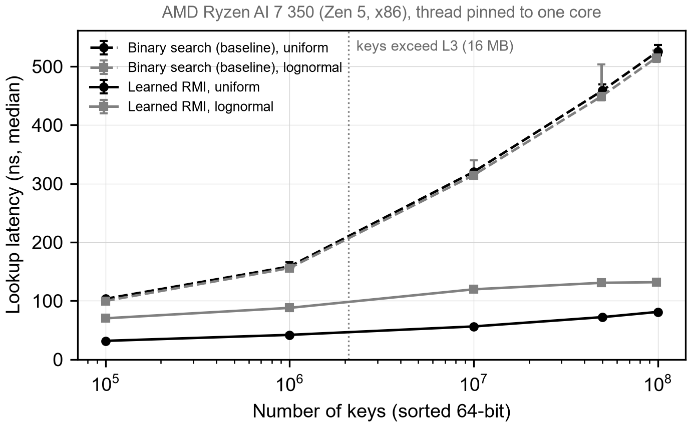
Do Learned Indexes Still Win on Modern Hardware?
01
DATABASES
On track
Today a B+tree decides where key k lies in a sorted array. A bad guess costs extra cache misses, about 100 ns each.
Key distribution matters more than expected. With the same 2.3 MB model at 100M keys, lognormal lookups took 226 ns versus 81 ns for uniform. At 10M keys, a 58 KB model lost to binary search. Lesson: test skewed data.
Binary search (std::lower_bound, -O3), the standard SOSD baseline. A tuned B+tree comes next. Today: 525 ns per lookup at 100M keys.
Learned indexes (RMI, PGM, RadixSpline, ALEX) learn key to position. Labels are free: each key's array position. One inference: a few multiply-adds plus a bounded local search.
At 100M uniform keys, the RMI cuts lookup time 6.5x: 525 to 81 ns.
Decisive run: SOSD, four datasets, perf, on AMD, Intel, ARM. Risk: counters blocked in WSL2/macOS. Fallback: AWS bare-metal.
AMD Ryzen AI 7 350 (Zen 5), pinned core, 2M random lookups, 1 warm-up, median of 5 runs, bars min/max.
Yes: search is bounded
Yes: labels = positions
Yes: model 0.3% of data
Unsure: no B+tree yet
Unsure: no inserts yet
Notes:
HOW TO USE THIS TEMPLATE (delete nothing on the slide; write your talk script below this block)
1. This is the only slide you present. No title slide, no extra slides, no animations.
2. Do not move, resize, or restyle any box, and do not change a font size. The fonts are fixed so the room can read every team at the same size. If your text does not fit, cut words: the box is the word limit.
3. Paste as plain text (Ctrl+Shift+V on Windows, Cmd+Shift+Option+V on Mac) so you do not import another font size.
4. Box 4 takes exactly one plot. Click the picture icon to insert it. Label both axes and draw the baseline on the same axes.
5. Gate check: for each of the five constraints, write yes, unsure, or no, plus a few words of evidence. "Unsure" is an honest and acceptable answer at Week 9.
6. Status: on track, at risk, or pivoted. Pivoting is fine if box 5 says why.
TIMING: 6 minutes talking, 4 minutes questions. Spend about half your talk on boxes 4 and 5. End on box 7 and wait for an answer.
SUBMIT: save as TeamNN_Midterm.pptx (two-digit team number) and upload to Canvas by the deadline posted there, so all teams can be merged into one deck.
---- YOUR SCRIPT ----
Box 1. The decision (about 40 seconds)
- Hello everyone. We are Team 1, and our project asks whether learned indexes (LURND IN-dek-siz) still outperform traditional indexes on modern hardware.
- Every database lookup must decide where a key is stored in a sorted array. Today, this decision is made by a B+tree (bee-plus tree), which follows a sequence of comparisons from the root to a leaf.
- A poor decision never returns an incorrect result. However, each additional step can cause a cache miss, and each miss to main memory costs approximately one hundred nanoseconds (NAN-oh-sek-unds).
Box 2. Beat what, exactly? (about 35 seconds)
- The baseline we must beat is binary search over the sorted array, implemented with the standard library function lower_bound (LOH-er bound) and compiled with full optimization. This is the reference baseline in the SOSD (ess-oh-ess-dee) benchmark.
- On our test machine, binary search requires 525 nanoseconds per lookup at one hundred million keys. A tuned B+tree and a hash table will be added as baselines in the next phase.
Box 3. Our approach (about 45 seconds)
- A learned index replaces the tree with a model. The model learns the relationship between each key and its position in the sorted array, and it predicts where a key should be.
- We will evaluate four designs: the Recursive Model Index, or RMI (ar-em-eye), the PGM-index (pee-jee-em), RadixSpline (RAY-diks-spline), and ALEX (AL-eks), which also supports inserts.
- The training labels are free, because they are simply the positions of the keys. One inference costs only a few multiply-add operations, followed by a small local search inside a stored error bound, so the result is always exact.
Box 4. First result (about 1 minute 40 seconds)
- For our first result, we implemented a two-stage linear RMI, following the original paper by Kraska (KRAS-kah) and colleagues, and compared it with binary search. We used two synthetic key distributions, uniform and lognormal (log-NOR-mul), from one hundred thousand to one hundred million keys.
- The horizontal axis shows the number of keys on a logarithmic (log-uh-RITH-mik) scale, and the vertical axis shows the median lookup latency in nanoseconds. The dashed lines are the binary search baseline. The solid lines are the RMI, using the best of four model sizes at each point.
- Binary search slows down sharply after the dotted line, where the data no longer fits in the 16-megabyte L3 (el-three) cache. Beyond that point, each lookup must wait on main memory several times.
- The RMI remains much flatter. At one hundred million uniform keys, it reduces the lookup time from 525 to 81 nanoseconds, a speedup of approximately 6.5 times, with a model of only 2.3 megabytes.
- All measurements were taken on an AMD Ryzen (RY-zen) AI 7 350 laptop processor. Each point is the median of five runs of two million random lookups, after a warm-up run.
Box 5. What surprised us (about 1 minute 20 seconds)
- The most surprising observation concerns the key distribution. With the same 2.3-megabyte model at one hundred million keys, lognormal lookups required 226 nanoseconds, compared with 81 nanoseconds for uniform keys.
- With a very small model of 58 kilobytes at ten million keys, the RMI was in fact slower than binary search, at 341 compared with 314 nanoseconds. A simple linear model cannot follow a skewed distribution, so the error window, and therefore the local search, becomes large. Results on uniform data therefore overstate the benefit.
- We also encountered a measurement problem. This processor combines two types of cores. Without pinning the thread to one core, the results were about ten percent slower and noticeably noisier, so every run is now pinned.
Box 6. Next six weeks (about 40 seconds)
- The experiment that decides the project is the full SOSD benchmark on four real datasets, with hardware performance counters, on AMD, Intel, and ARM processors.
- The main risk is that the Linux perf (purf) tool cannot read hardware counters inside WSL2 (dub-ul-yoo ess el two) or on macOS. Our fallback is to rent bare-metal (bair-MET-ul) cloud machines on AWS.
Gate check and closing (about 30 seconds)
- A wrong prediction is safe because the search is bounded, the labels are free, and the model uses about 0.3 percent of the data size. We are still unsure whether we beat a tuned baseline, because the B+tree is not yet integrated, and whether the approach survives new workloads, because inserts have not been tested.
- We would like to close with a question for the class: for the remaining weeks, should we prioritize more real datasets, or insert-heavy workloads with ALEX? Thank you.
Q&A: see midterm_script.md in the repo for likely questions and short answers.

