Slide 1
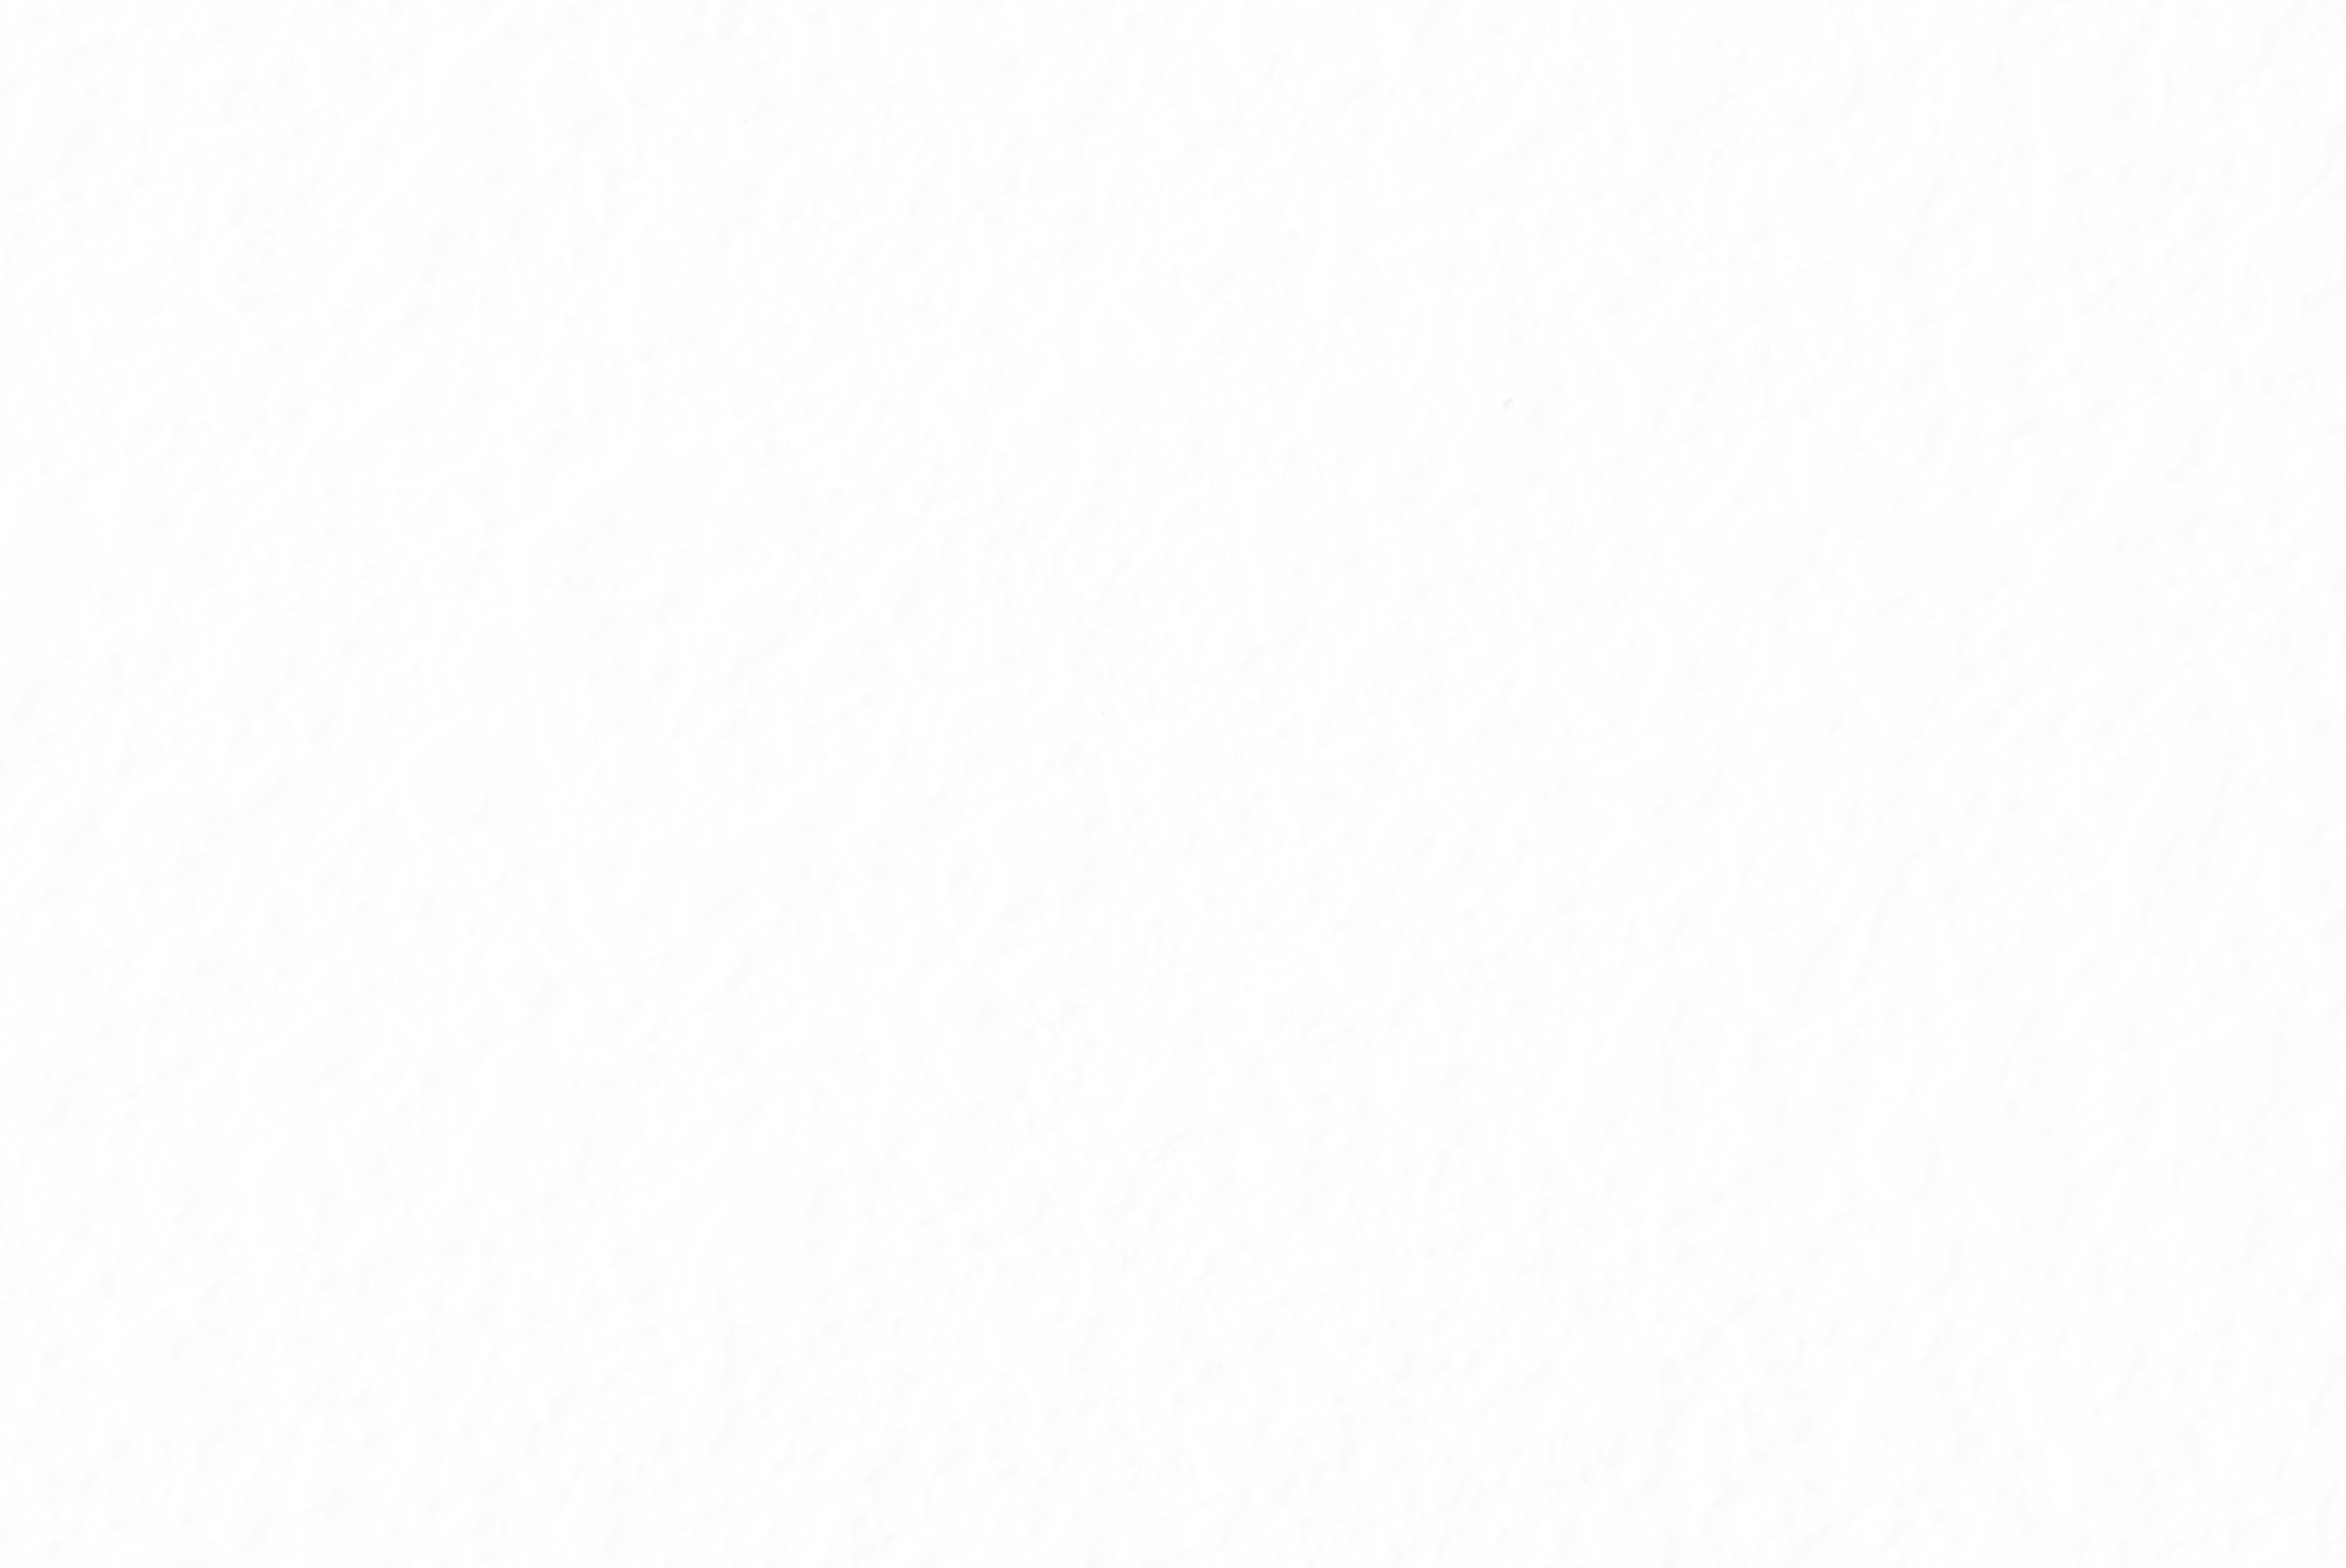



OWL
Fall 2026
Outlier Weighed Layerwise Sparsity
on small modern LLMs
CAI 5307 - NLP Project
Tuan Khang Phan
Xuan Gia Han Nguyen
Notes:
[0:15] Hi, we are Khang and Han. We are reproducing OWL, a pruning paper from ICML 2024, and testing whether its main idea still helps on small modern language models.

Slide 2

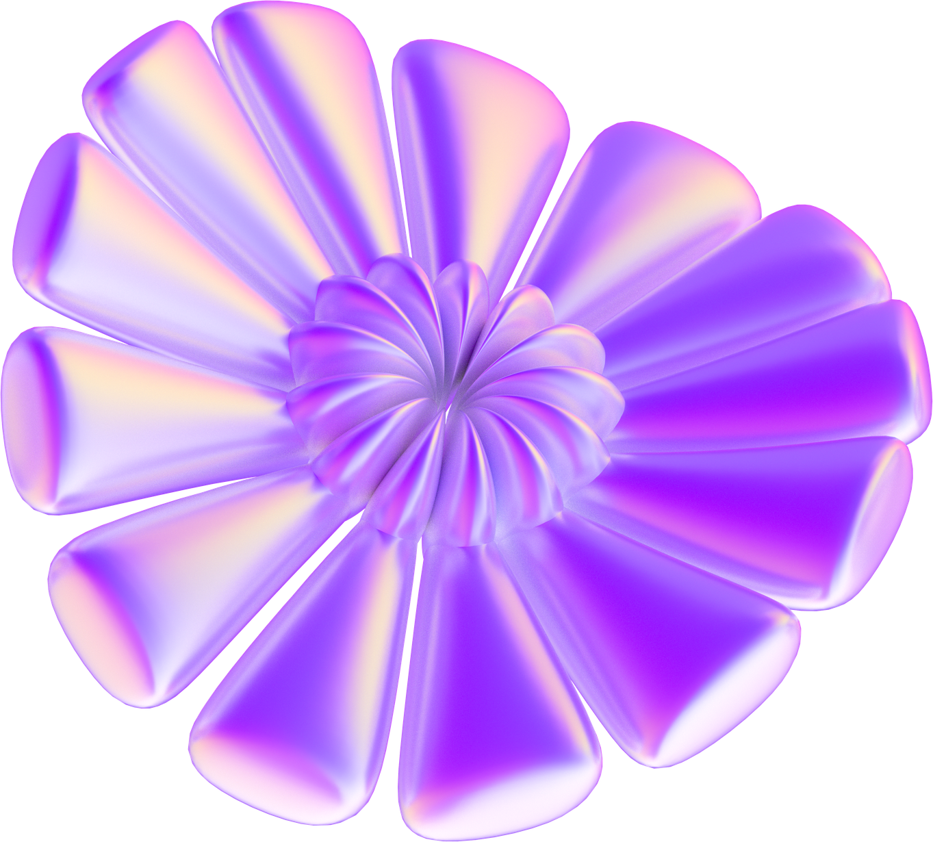
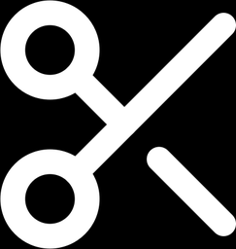
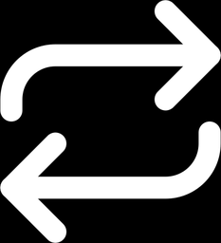
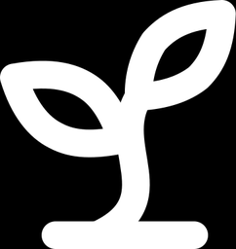
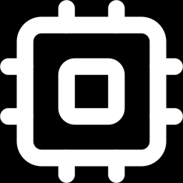
Table of Contents
What does
OWL claim?
Can we
reproduce it?
One-shot pruning and the OWL idea
Four claims, four experiments
Does it hold
on new LLMs?
What do
we need?
Our extension to Qwen2.5 and Llama 3
Models, GPU hours, timeline
Notes:
[0:15] Four parts: what the paper claims, how we reproduce it, our extension, and the resources we need.

Slide 3

1. What does OWL claim?
Pruning every layer equally breaks at 70%
Dense LLM
LLaMA-7B
Prune 70% of weights
one shot, no retraining
Sparse LLM
same sparsity in every layer
Wanda and SparseGPT score each weight, then cut the same share from every layer.
15x
worse than dense at 70% sparsity
LLaMA-7B pruned with Wanda, uniform sparsity. Lower is better. Yin et al. 2024, Tables 3 and 8.
3
Notes:
[0:40] The setting is one-shot pruning: take a trained LLM, zero out a share of its weights, no retraining. The strong methods, Wanda and SparseGPT, score each weight and remove the same share from every layer. That works at 50 percent. On LLaMA-7B dense perplexity is 5.68 and Wanda at 50 percent is 7.26. At 70 percent it jumps to 85.77, about fifteen times worse. Uniform sparsity breaks exactly where pruning would be most useful.

Slide 4
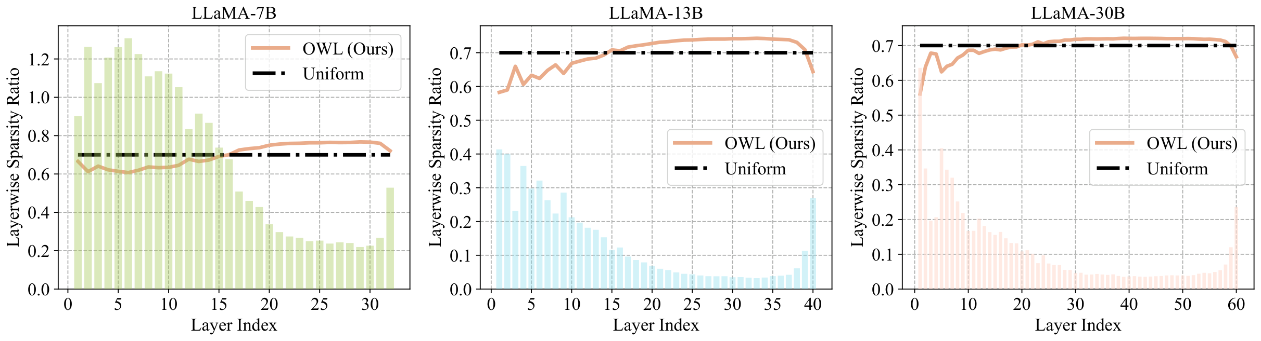
1. What does OWL claim?
OWL prunes outlier-rich blocks less
1
Score every weight
2
Count outliers
3
Set block sparsity
Wanda metric: input norm times weight size
Per block: share of weights scoring over M times the mean
More outliers, lower sparsity, inside a narrow band
A = ||X|| · |W|
LOD, one value per block
Block sparsity ~ 1 − LOD
Bars are the outlier share of each block.
Orange line is OWL's sparsity. It dips where the bars are tall.
Dashed line is uniform 70%.
Figure 1 of Yin et al. 2024 (LLaMA-7B, 13B, 30B at 70% sparsity).
4
Notes:
[0:45] OWL asks whether every layer should lose the same share. It uses the Wanda score, input norm times weight magnitude. For each Transformer block it counts outliers, weights whose score is more than M times the block average. That gives the layerwise outlier distribution, LOD. Blocks with more outliers are pruned less, and block sparsity stays in a narrow band around the target, so the total is unchanged. This is the paper's Figure 1: bars are outliers per block, the orange line is OWL's sparsity, and it dips where the bars are tall.

Slide 5
1. What does OWL claim?
Four claims we test
C1
85.77 → 24.55
C2
61.22 vs 6.62
OWL beats uniform sparsity at 70% (LLaMA-7B perplexity, Wanda). On OPT-6.7B it hurts SparseGPT.
The gain grows as models shrink: perplexity drop with Wanda at 7B vs 65B.
C3
39.4% → 46.5%
C4
Not uniform
Zero-shot accuracy improves too. Mean of 7 tasks, LLaMA-7B at 70%, Wanda.
Outliers concentrate in some blocks (LOD), and good pruning methods keep them.
5
Notes:
[0:40] We test four claims. One, OWL beats uniform sparsity at 70 percent: with Wanda on LLaMA-7B perplexity falls from 85.77 to 24.55. There is one exception we also check, SparseGPT on OPT gets slightly worse. Two, the gain grows as models shrink, 61 points at 7B but under 7 at 65B. Three, zero-shot accuracy improves, 39.4 to 46.5 on average. Four, outliers are unevenly spread across blocks, and good pruning methods keep them.

Slide 6
2. Can we reproduce it?
Four experiments, one per claim
Exp. | Paper target | What we run | Claim
R1 | Table 3 | 70% sparsity on LLaMA-7B, LLaMA-13B and OPT-6.7B. Magnitude, Wanda, SparseGPT, uniform vs OWL | C1, C2
R2 | Figure 2, Table 8 | 40% to 80% sweep on LLaMA-7B with Wanda, six ways to split sparsity | C1
R3 | Table 4 | Zero-shot accuracy on 7 tasks, dense vs 70% sparse LLaMA-7B | C3
R4 | Table 1, Figure 1 | Outlier distribution of each dense model, again after pruning | C4
Reproduced means the dense LLaMA-7B perplexity is 5.68, every R1 setting moves in the paper's direction, and our 70% perplexities are within 15% of the paper's.
Left out: LLaMA-30B and 65B, the CPU speedup study, LoRA fine-tuning.
6
Notes:
[0:35] Each claim maps to one experiment. R1 is Table 3 at 70 percent on three models. R2 is the sparsity sweep with six allocation rules. R3 is zero-shot accuracy. R4 recomputes the outlier distribution before and after pruning. We skip the 30B and 65B models and the speedup and fine-tuning studies. We call a claim reproduced when the direction matches and our perplexity is within 15 percent of the paper's.

Slide 7
2. Can we reproduce it?
R1: Table 3 at 70% sparsity
LLaMA-7B | Paper | Ours
Dense | 5.68 | 5.68
Wanda | 85.77 | 84.84
OWL + Wanda | 24.55 | 24.32
SparseGPT | 26.30 | 26.40
OWL + SparseGPT | 19.49 | 18.89
OWL helps in 5 of 6 cases. With SparseGPT on OPT-6.7B it gets worse, and we check that too.
WikiText-2 perplexity, lower is better. Bars show the paper's numbers (Yin et al. 2024, Table 3).
7
Notes:
[0:50] This is the main table we target. Bars are the paper's numbers. Dark bars are OWL, light bars are uniform. For LLaMA-7B and 13B, OWL helps both methods. For OPT with SparseGPT the OWL bar is slightly higher, and we want to see that too. Our numbers on LLaMA-7B: dense 5.68, Wanda 84.84, OWL plus Wanda 24.32, SparseGPT 26.40, OWL plus SparseGPT 18.89.

Slide 8
2. Can we reproduce it?
R2 to R4: sweep, zero-shot, outliers
R2: perplexity vs sparsity, LLaMA-7B + Wanda (log scale)
R3: mean zero-shot accuracy, 7 tasks
LLaMA-7B, 70% | Paper | Ours
Dense | 62.40 | [__]
Wanda | 39.39 | [__]
OWL + Wanda | 46.47 | [__]
SparseGPT | 44.93 | [__]
OWL + SparseGPT | 48.03 | [__]
At 70%: uniform 85.77
OWL 24.54
R4: outliers per block before and after pruning. We expect the same uneven shape to survive pruning. Ours: [__]
Paper numbers from Yin et al. 2024, Tables 4 and 8. OWL-inverse gives outlier-rich blocks more sparsity.
8
Notes:
[0:40] R2 is the sweep. On a log axis the methods are close up to 50 percent and split after 60. OWL-inverse, which gives outlier-rich blocks more sparsity, is the worst, and that supports the idea. R3 is mean zero-shot accuracy over seven tasks, and R4 is the outlier distribution before and after pruning. [Fill in our numbers before the talk.]

Slide 9


2. Can we reproduce it?
Status: paper models and extension ran
✓
Our port of OWL, Wanda, SparseGPT and magnitude pruning
Outliers per block (LOD, %)
✓
36 unit tests pass, CPU smoke run works end to end
✓
49 GPU runs done on Colab (A100 and L4), 3.8 GPU hours
✓
Dense LLaMA-7B check: perplexity 5.68, paper 5.68
OWL sparsity target per block
Found while porting: the released code scales block sparsity into a band 2λ wide, then shifts the mean to S. Some blocks leave the paper's stated range S ± λ.
PyTorch 2.14
Transformers 5.22
Qwen2.5-3B with Wanda, 70% target, M = 5, λ = 0.08. Our run on a Colab L4.
9
Notes:
[0:25] Where we are. We ported OWL, Wanda, SparseGPT and magnitude pruning to current libraries, with 36 unit tests. The charts are from our Qwen2.5-3B run: blocks with more outliers get a lower sparsity target. It showed one difference. The released code scales block sparsity into a band of width two lambda and then shifts the mean, so some blocks fall outside the range the paper states. Here block 4 gets 57%, below the 62% floor. We keep the code's behaviour and report it.

Slide 10


3. Does it hold on new LLMs?
The paper only tested LLaMA-1, 7B and up
Pre-training tokens (trillions)
Model sizes tested (parameters, log scale)
not tested in the paper
OWL paper: LLaMA-1
7B
13B
30B
65B
Ours: Qwen2.5
0.5B
1.5B
3B
7B
Ours: Llama 3.2 and 3.1
1B
3B
8B
Evidence on modern models is mixed. With SparseGPT at 70%, OWL nearly halves Llama-3-8B perplexity (85.84 to 48.07), but it slightly hurts a 1B Llama 3 at 50%.
Token counts: Touvron et al. 2023, Grattafiori et al. 2024, Qwen Team 2025. Evidence: Sieberling et al. 2025, Choenni et al. 2025.
10
Notes:
[0:40] Our extension. The paper shows the gain grows as models shrink, but only on LLaMA-1 from 7B to 65B, trained on at most 1.4 trillion tokens. Llama 3 and Qwen2.5 saw 15 to 18 trillion. Nobody tested the trend below 7B, where it should matter most, and the existing evidence is mixed. So we ask: does OWL still help small modern models?

Slide 11
3. Does it hold on new LLMs?
Three experiments, seven models
E1
Scaling within a family
E2
Does the LOD predict the gain?
E3
Hyperparameter transfer
4 x 5 grid
orange: paper default
7 models from 0.5B to 8B at 50%, 60% and 70%, uniform vs OWL.
We report the gain in log perplexity and add a shuffled OWL control.
LOD of all 10 dense models: how uneven it is, and whether it forms a U.
Spearman correlation with the OWL gain. Exploratory with 10 models.
M and λ grid on Qwen2.5-1.5B and Llama-3.2-1B, picked on held-out C4.
A weak result should not just mean bad settings.
11
Notes:
[0:40] Three experiments. E1 prunes seven models from two families, uniform versus OWL, and reports the gain in log perplexity so small and large models are comparable. As a control we shuffle OWL's block sparsities: same values, wrong blocks. E2 asks whether the shape of the outlier distribution predicts the gain. E3 reruns the paper's hyperparameter grid on two small models, so a weak result is not just bad settings.

Slide 12
3. Does it hold on new LLMs?
E1 at 70%: OWL helps 5 of 7 models
Gain from OWL: ΔL = log PPL(uniform) − log PPL(OWL)
WikiText-2 perplexity at 70%
Model | Wanda | + OWL | SGPT | + OWL
Qwen 0.5B | 395.3 | 500.1 | 181.5 | 216.0
Qwen 1.5B | 822.7 | 250.2 | 80.7 | 48.0
Qwen 3B | 161.4 | 89.1 | 31.7 | 34.5
Qwen 7B | 74.7 | 48.7 | 21.0 | 19.8
Llama 1B | 389.0 | 415.1 | 129.7 | 134.9
Llama 3B | 143.5 | 123.4 | 67.6 | 58.1
Llama 8B | 109.2 | 79.0 | 39.8 | 33.6
OWL hurts Qwen 0.5B and Llama 1B, the smallest of each family. The gain does not grow as models shrink.
E2: a more U-shaped LOD goes with a larger Wanda gain, ρ = +0.86 (n = 7). No signal with SparseGPT (+0.18).
Our runs, one calibration seed, M = 5, λ = 0.08. Positive ΔL means OWL helps. In the table, purple beats uniform and red is worse.
12
Notes:
[0:45] Our first extension result, at 70 percent sparsity. Bars above zero mean OWL beats uniform. With Wanda, OWL helps 5 of 7 models. The largest gain is on Qwen 1.5B, where perplexity drops from 823 to 250. But OWL hurts Qwen 0.5B and Llama 1B, the smallest model of each family. So the gain does not grow as models shrink, which is the opposite of the paper's trend on LLaMA-1. With SparseGPT the effect is smaller and mixed. For E2, the Spearman correlation between how U-shaped the dense outlier distribution is and the Wanda gain is +0.86. With SparseGPT it is +0.18, so no signal. That is only 7 models, so it is exploratory. These are single-seed runs, so the small differences may be noise.

Slide 13



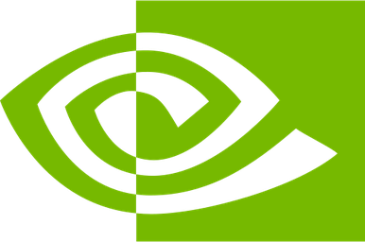
4. What do we need?
212 runs, about 26 A100 hours, no paid API
Estimated A100 hours per experiment
212
49
$0
pruning runs planned
runs done, 3.8 GPU hours so far
API cost, open weights
USF GAIVI cluster A100, H100 and L40S, free with a supervisor
Colab Pro all 49 runs so far, on A100 and L4
Backup Kaggle, Modal credit or a rented GPU (under $110)
GPU memory 24 GB for 7B and 8B, 31 GB for 13B
Reproduction
Extension
Dense check: 5.68
R1 to R4
E1 to E3
Report: Dec 4
13
Notes:
[0:35] Resources. All models are open weights, so no paid API. The plan is 212 runs and about 26 A100 hours. So far 49 runs are done in 3.8 GPU hours on Colab. A 7B model needs a 24 GB GPU and LLaMA-13B about 31. We use Colab Pro and USF's GAIVI cluster, with Kaggle or a rented GPU as backup. The report is due December 4.

Slide 14

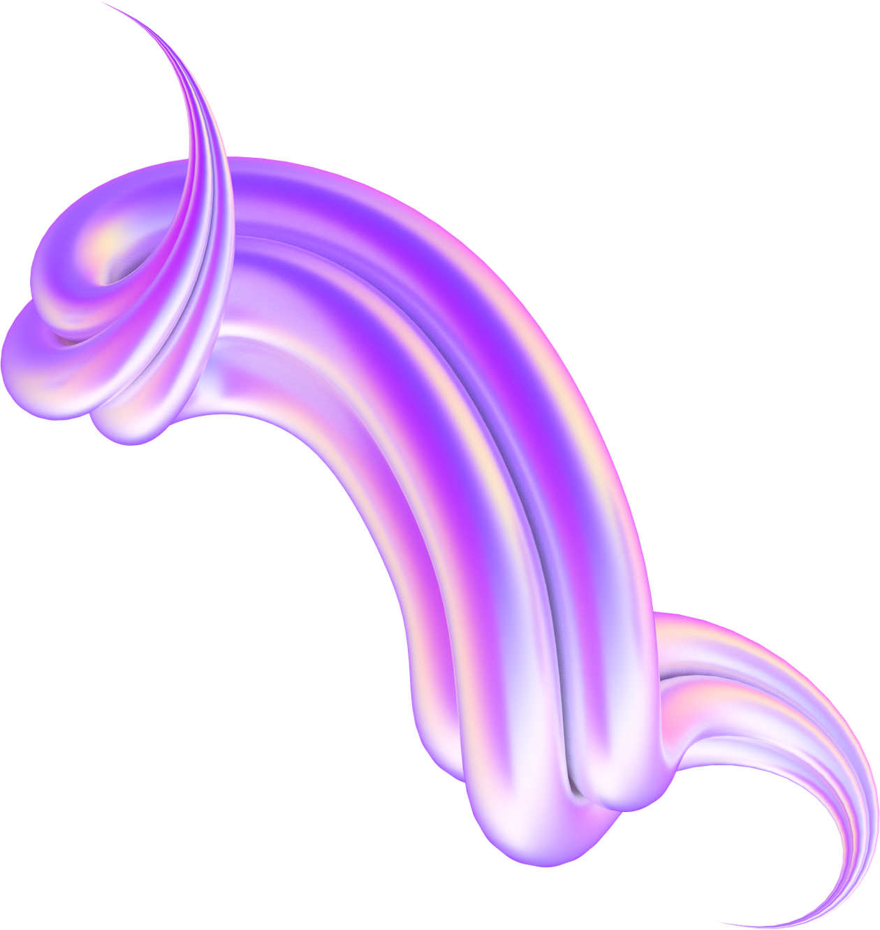


Q&A
Thank you
Code, proposal and slides are in the repo
github.com/khangpt2k6/NLP_CLASS
Notes:
[0:05] Thank you. Questions? Total target: 7:50, which leaves 10 seconds of slack under the 8 minute limit.

