Slide 1
Final report
Memory Forensics Examinations - Super Timeline Creation and Analysis
Notes:
WELCOME SCREEN → “All Content is editable –and- or you can put your logo on there”
Please Read this Notice Before you start working with this Template
Please Install the following Fonts and/or make sure its already available on your system.
Open Sans Family
Available @ fontsquirell.com
Callibri
Microsoft & Office System Font

Slide 2



01
03
NGUYEN DOAN XUAN BINH
Group members Let’s go …
02
TRAN HOANG KHANG
NGUYEN MY QUYNH (PHA PHA)
Notes:
INTRODUCTION page → “All Content is editable
For edit Footer or visible content you must getting to the Master Slide -> click “VIEW” tab -> in the “Master Views” group, click “Slide Master”. (–and- or you can changeyour logo on there”)

Slide 3
Outlines Today
Timeline
Definitions
Window
(File History)
Linux
(Plugin)
Web
Demo
Notes:
INTRODUCTION page → “All Content is editable
For edit Footer or visible content you must getting to the Master Slide -> click “VIEW” tab -> in the “Master Views” group, click “Slide Master”. (–and- or you can changeyour logo on there”)

Slide 4

File system timeline
Super timeline
Link files
Event logs
Prefetch
Shellbags
Register
FLS – The Sleuth Kit
http://computer-forensics.sans.org/
Notes:
INTRODUCTION page → “All Content is editable
For edit Footer or visible content you must getting to the Master Slide -> click “VIEW” tab -> in the “Master Views” group, click “Slide Master”. (–and- or you can changeyour logo on there”)

Slide 5
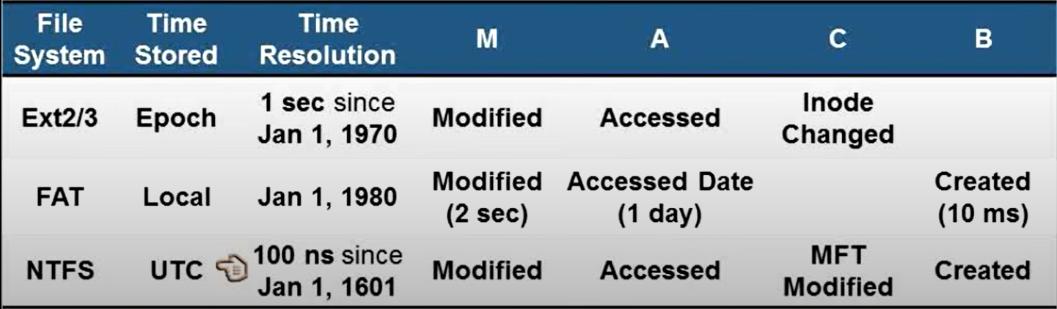
Time resolution in various File System:
http://computer-forensics.sans.org/
Notes:
INTRODUCTION page → “All Content is editable
For edit Footer or visible content you must getting to the Master Slide -> click “VIEW” tab -> in the “Master Views” group, click “Slide Master”. (–and- or you can changeyour logo on there”)

Slide 6
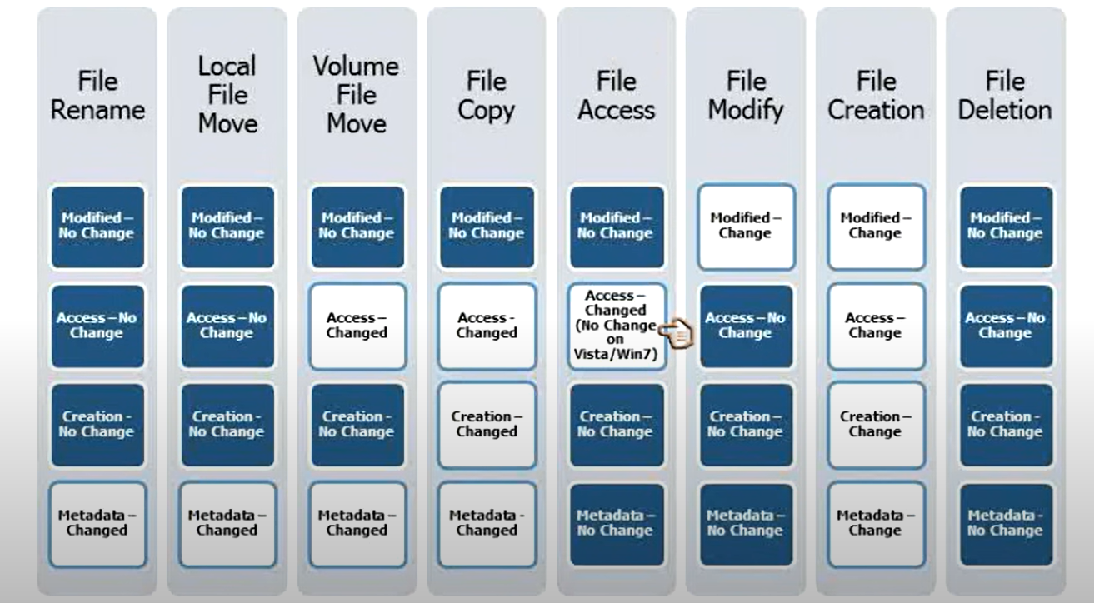
Time-rule updates
http://computer-forensics.sans.org/
Notes:
INTRODUCTION page → “All Content is editable
For edit Footer or visible content you must getting to the Master Slide -> click “VIEW” tab -> in the “Master Views” group, click “Slide Master”. (–and- or you can changeyour logo on there”)

Slide 7

Window Supertimeline
Notes:
WELCOME SCREEN → “All Content is editable –and- or you can put your logo on there”
Please Read this Notice Before you start working with this Template
Please Install the following Fonts and/or make sure its already available on your system.
Open Sans Family
Available @ fontsquirell.com
Callibri
Microsoft & Office System Font

Slide 8

File History
Notes:
WELCOME SCREEN → “All Content is editable –and- or you can put your logo on there”
Please Read this Notice Before you start working with this Template
Please Install the following Fonts and/or make sure its already available on your system.
Open Sans Family
Available @ fontsquirell.com
Callibri
Microsoft & Office System Font

Slide 9
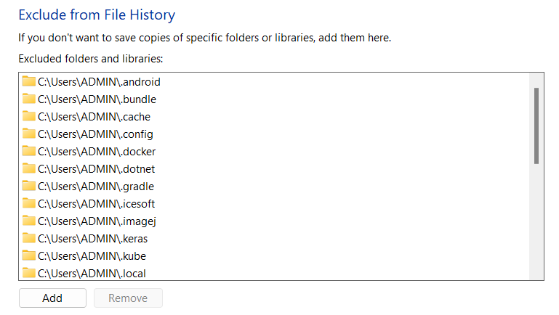
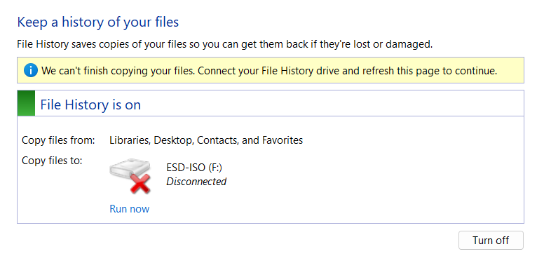

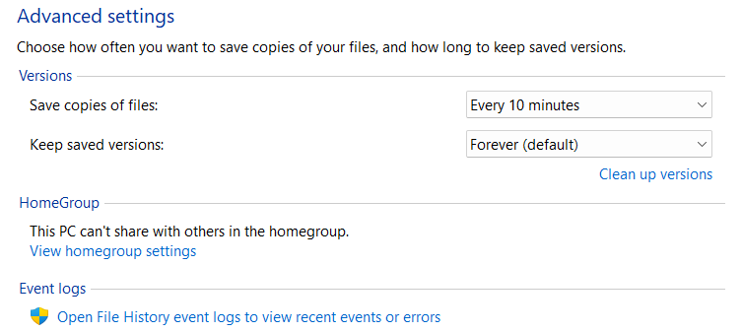

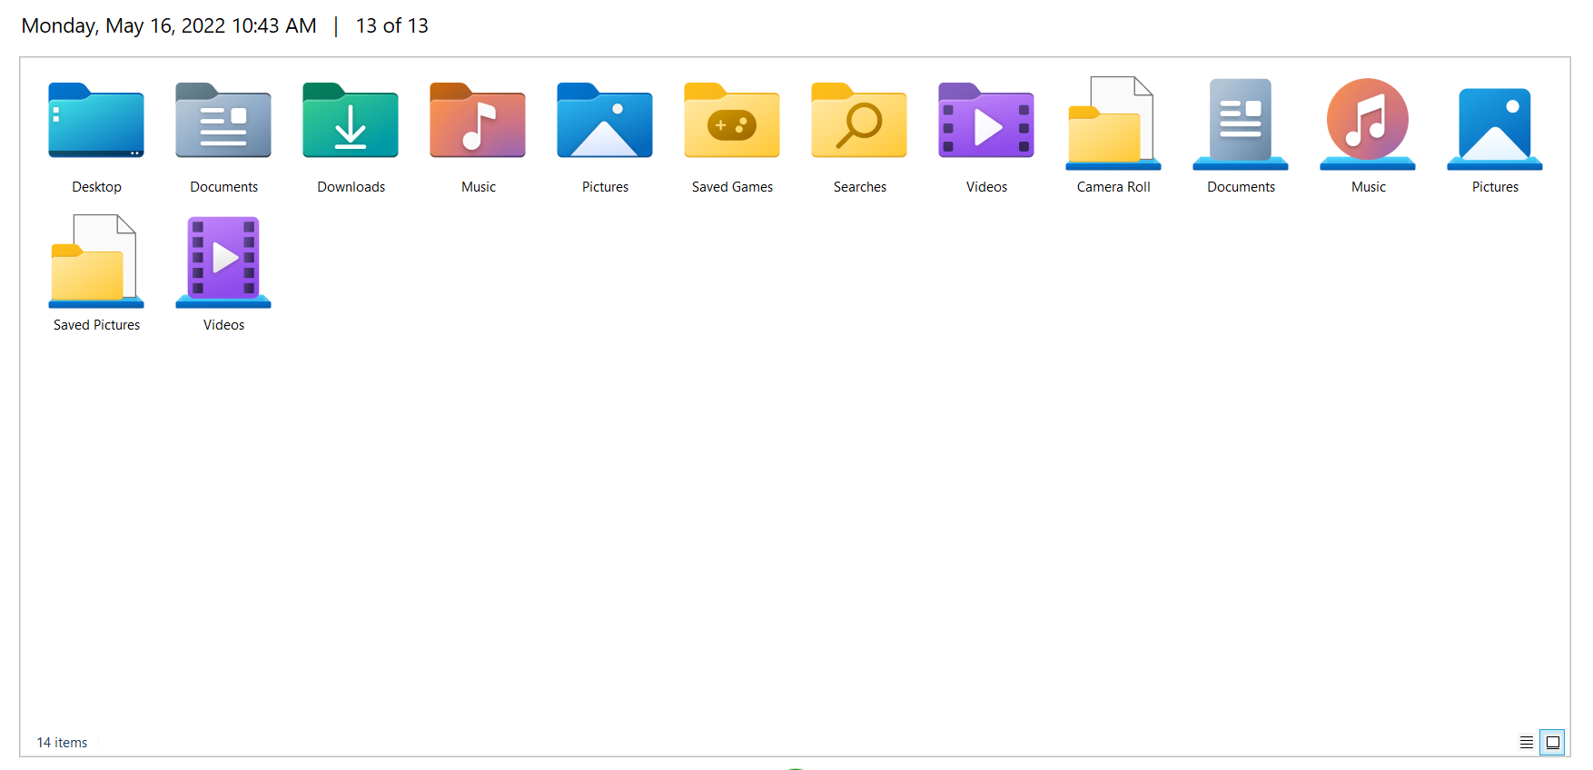
Usage:
Exclude
Time set
Connected Devices
Local backup & restore
Notes:
WELCOME SCREEN → “All Content is editable –and- or you can put your logo on there”
Please Read this Notice Before you start working with this Template
Please Install the following Fonts and/or make sure its already available on your system.
Open Sans Family
Available @ fontsquirell.com
Callibri
Microsoft & Office System Font

Slide 10

Components:
231
Catalog1.edb
Config1.xml
261
381
235
Catalog2.edb
Config2.xml
274
Configurations
Data
Notes:
WELCOME SCREEN → “All Content is editable –and- or you can put your logo on there”
Please Read this Notice Before you start working with this Template
Please Install the following Fonts and/or make sure its already available on your system.
Open Sans Family
Available @ fontsquirell.com
Callibri
Microsoft & Office System Font

Slide 11
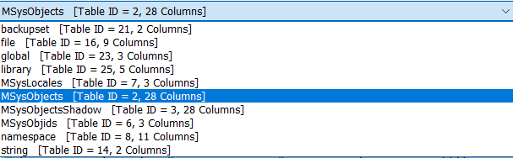
EDB Files
Table | Column | Description (all time-related values are Windows 64-bit timestamps)
backupset | id | Index of backup operation
 | timestamp | Start time of backup operation
file | id | Index of file
 | childId | Foreign key to id column of ‘string’ table (for a file’s name)
 | parentId | Foreign key to id column of ‘string’ table (for a folder where childId is located)
 | fileSize | Backed up file’s size
namespace | childId | Foreign key to id column of ‘string’ table (for a file or folder’s name)
 | parentId | Foreign key to id column of ‘string’ table (for a folder where childId is located)
 | fileRecordId | Foreing key to id column of ‘file’ table
 | fileCreated | File creation time
 | fileModified | File modification time
 | tCreated | Foreign key to id column of ‘backupset’ table
 | usn | Backed up file’s USN
string | id | Index of string
 | string | Backed up file’s name or folder path
Notes:
WELCOME SCREEN → “All Content is editable –and- or you can put your logo on there”
Please Read this Notice Before you start working with this Template
Please Install the following Fonts and/or make sure its already available on your system.
Open Sans Family
Available @ fontsquirell.com
Callibri
Microsoft & Office System Font

Slide 12
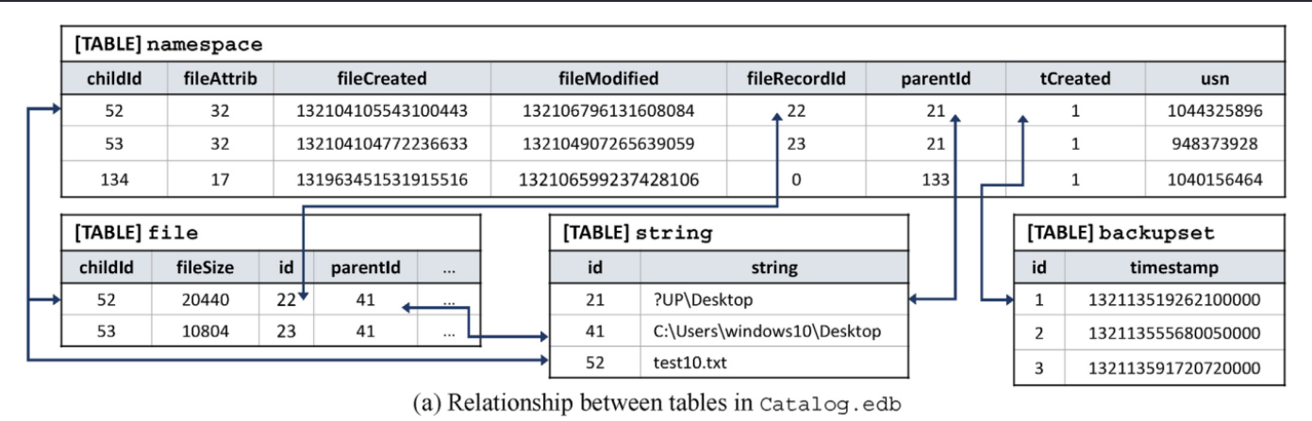
EDB Files
Notes:
WELCOME SCREEN → “All Content is editable –and- or you can put your logo on there”
Please Read this Notice Before you start working with this Template
Please Install the following Fonts and/or make sure its already available on your system.
Open Sans Family
Available @ fontsquirell.com
Callibri
Microsoft & Office System Font

Slide 13
Registry
Registry could be a good place to find potential evidence related to FileHistory on or off, last backup time etc; three of them are mentioned as follows.
1- Upon turning on the File History, a value C:\Users\Username\AppData\Local\Microsoft\Windows\FileHistory\Configuration\Config gets added with data 0×00000001, inside the key HKLM\SYSTEM\CurrentControlSet\Services\fhsvc\Parameters\Configs. It disappears when the service is turned off.
2- There is another registry key that can be used to determine the state (ON or OFF) of the File History is
HKLM\SYSTEM\CurrentControlSet\Services\fhsvc\Start: 0×00000003 (OFF)
HKLM\SYSTEM\CurrentControlSet\Services\fhsvc\Start: 0×00000002 (ON)
3- Registry analysis can also let the examiner know about last backup time. The registry key HKEY_CURRENT_USER\Software\Microsoft\Windows\CurrentVersion\FileHistory contains a value ‘ProtectedUpToTime’ with timestamp data in 64 bit hex value big endian format.
Notes:
WELCOME SCREEN → “All Content is editable –and- or you can put your logo on there”
Please Read this Notice Before you start working with this Template
Please Install the following Fonts and/or make sure its already available on your system.
Open Sans Family
Available @ fontsquirell.com
Callibri
Microsoft & Office System Font

Slide 14
Event:
Examination of event logs could be a vital step in timeline analysis and co-relating the findings. Log files related to File History can be found in Applications and Service Logs -> Microsoft -> Windows. We found following two interesting event files:
WHC under FileHistory-Core
File History Backup Log under FileHistory-Engine
The entries of Information level in WHC appears whenever File History runs, stops, turns off or on. On the other hand, File History Backup Log records warnings or error messages,
Notes:
WELCOME SCREEN → “All Content is editable –and- or you can put your logo on there”
Please Read this Notice Before you start working with this Template
Please Install the following Fonts and/or make sure its already available on your system.
Open Sans Family
Available @ fontsquirell.com
Callibri
Microsoft & Office System Font

Slide 15

Anti-forensic
1. Files are deleted from external storage:
2. Disabling and re-enabling of a backup storage device
3. Disconnecting an active backup storage device
Notes:
WELCOME SCREEN → “All Content is editable –and- or you can put your logo on there”
Please Read this Notice Before you start working with this Template
Please Install the following Fonts and/or make sure its already available on your system.
Open Sans Family
Available @ fontsquirell.com
Callibri
Microsoft & Office System Font

Slide 16
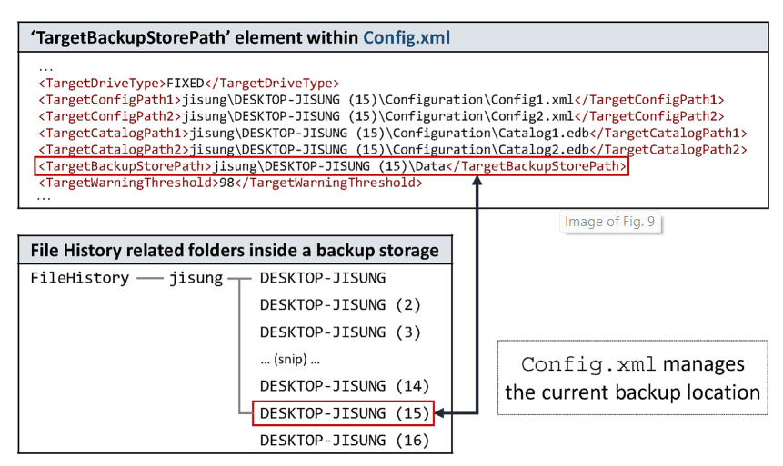
2. Disabling and re-enabling of a backup storage device
Notes:
WELCOME SCREEN → “All Content is editable –and- or you can put your logo on there”
Please Read this Notice Before you start working with this Template
Please Install the following Fonts and/or make sure its already available on your system.
Open Sans Family
Available @ fontsquirell.com
Callibri
Microsoft & Office System Font

Slide 17

Linux Supertimeline
Notes:
WELCOME SCREEN → “All Content is editable –and- or you can put your logo on there”
Please Read this Notice Before you start working with this Template
Please Install the following Fonts and/or make sure its already available on your system.
Open Sans Family
Available @ fontsquirell.com
Callibri
Microsoft & Office System Font

Slide 18
Volatility
gditimers Print installed GDI timers and callbacks
shutdowntime Print ShutdownTime of machine from registry
timeliner Creates a timeline from various artifacts in memory
timers Print kernel timers and associated module DPCs
The Volatility Foundation - Open Source Memory Forensics
Notes:
WELCOME SCREEN → “All Content is editable –and- or you can put your logo on there”
Please Read this Notice Before you start working with this Template
Please Install the following Fonts and/or make sure its already available on your system.
Open Sans Family
Available @ fontsquirell.com
Callibri
Microsoft & Office System Font

Slide 19

Web Timeline
Notes:
WELCOME SCREEN → “All Content is editable –and- or you can put your logo on there”
Please Read this Notice Before you start working with this Template
Please Install the following Fonts and/or make sure its already available on your system.
Open Sans Family
Available @ fontsquirell.com
Callibri
Microsoft & Office System Font

Slide 20
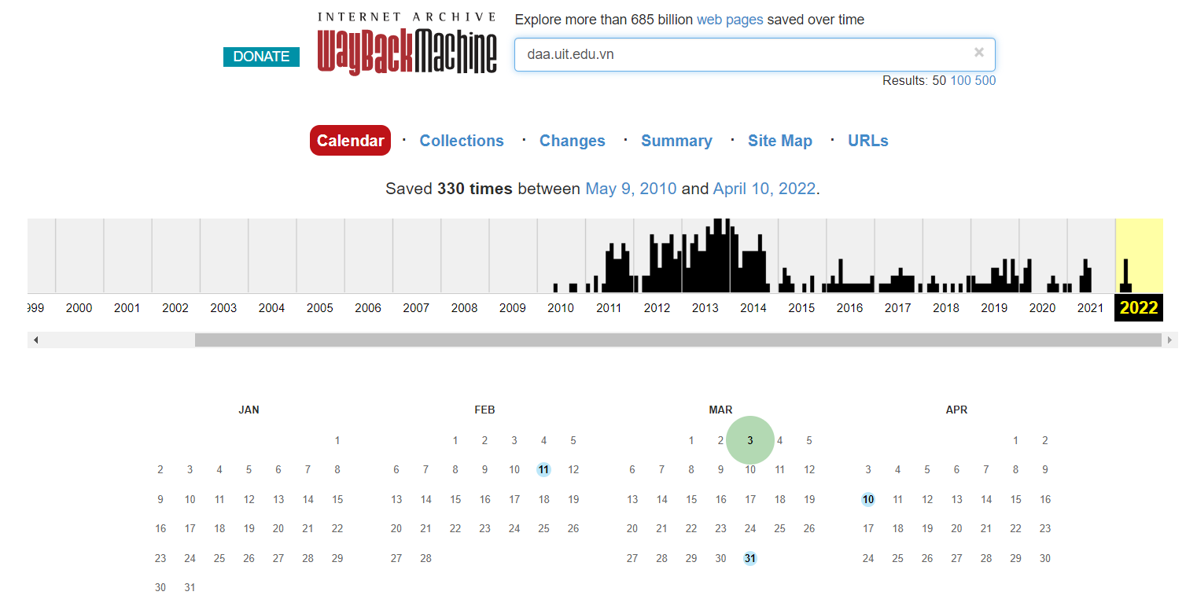
Web Timeline
Internet Archive: Wayback Machine
Notes:
WELCOME SCREEN → “All Content is editable –and- or you can put your logo on there”
Please Read this Notice Before you start working with this Template
Please Install the following Fonts and/or make sure its already available on your system.
Open Sans Family
Available @ fontsquirell.com
Callibri
Microsoft & Office System Font

Slide 21
Plaso – Log2timeline
log2timeline/plaso: Super timeline all the things (github.com)
Notes:
WELCOME SCREEN → “All Content is editable –and- or you can put your logo on there”
Please Read this Notice Before you start working with this Template
Please Install the following Fonts and/or make sure its already available on your system.
Open Sans Family
Available @ fontsquirell.com
Callibri
Microsoft & Office System Font

Slide 22
Tools for timeline:
• EnCase, FTK • Log2Timeline • The Sleuth Kit (ils, fls, mactime), PTK, Autopsy, Fiwalk • Ex-Tip • NTI FileList Pro • Zeitline (Buchholz & Falk, 2005)
• AnalyzeMFT.py • Mac-robber • DFF (Digital Forensic Framework) • The Coroner’s Toolkit (grave-robber, mactime) • NFILabs Aftertime • SIMILE Timeplot
Notes:
WELCOME SCREEN → “All Content is editable –and- or you can put your logo on there”
Please Read this Notice Before you start working with this Template
Please Install the following Fonts and/or make sure its already available on your system.
Open Sans Family
Available @ fontsquirell.com
Callibri
Microsoft & Office System Font

Slide 23
Reference
Main:
https://www.sciencedirect.com/science/article/pii/S2666281721000329
File Systems – Forensic Focus – Articles (rssing.com)
https://docplayer.net/9932295-File-history-analysis-windows-8.html
Timeline2GUI: A Log2Timeline CSV parser and training scenarios - ScienceDirect
Github:
NT334.M21.ANTN-Digital-Forensic/Seminar at main · khangtictoc/NT334.M21.ANTN-Digital-Forensic (github.com)
Notes:
INTRODUCTION page → “All Content is editable
For edit Footer or visible content you must getting to the Master Slide -> click “VIEW” tab -> in the “Master Views” group, click “Slide Master”. (–and- or you can changeyour logo on there”)

Slide 24
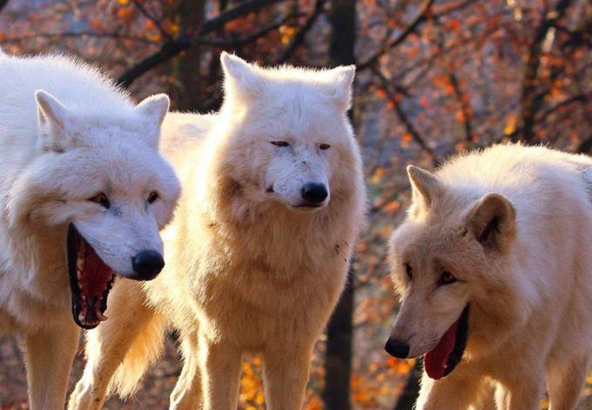
Thanks for your listening !!!
Notes:
INTRODUCTION page → “All Content is editable
For edit Footer or visible content you must getting to the Master Slide -> click “VIEW” tab -> in the “Master Views” group, click “Slide Master”. (–and- or you can changeyour logo on there”)

