Slide 1
MACHINE LEARNING FOR SECURITY VULNERABILITY DETECTION IN BLOCKCHAIN PROGRAM
Tran Hoang Khang & Nguyen Tu Ngoc & Le Hong Bang
Instructor: Phan The Duy
Dec 28th, 2022

Slide 2
Phân công nhiệm vụ
Thành viên | Nhiệm vụ được giao
Nguyễn Tú Ngọc | Tìm hiểu bối cảnh, ngữ cảnh, cơ chế/cách hoạt động/sức ảnh hưởng của lỗ hổng Reentrancy. Poster + Milestone01
Trần Hoàng Khang | Tìm hiểu cơ chế 4 loại Model. Hợp tác build và fix lại model. Final Writeup.
Lê Hồng Bằng | Thực nghiệm, lấy source code Reentrancy (Tool Slider + Etherscan), build dataset. Hợp tác build và fix lại model. Ghi nhận lại kết quả

Slide 3
Agenda
Motivation
Blockchain Security Research
Reentrancy Attack
Research method
Experiment Implementation
Evaluation & Conclusion

Slide 4
Motivation
Context/Statistics about status quo in Blockchain Security

Slide 5
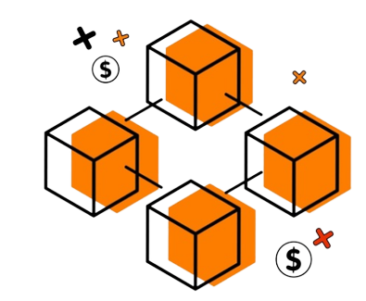
Blockchain Technology
A type of shared database which stores data in blocks that are linked together via cryptography
Data is shared among the nodes of a computer network and is irreversible.

Slide 6
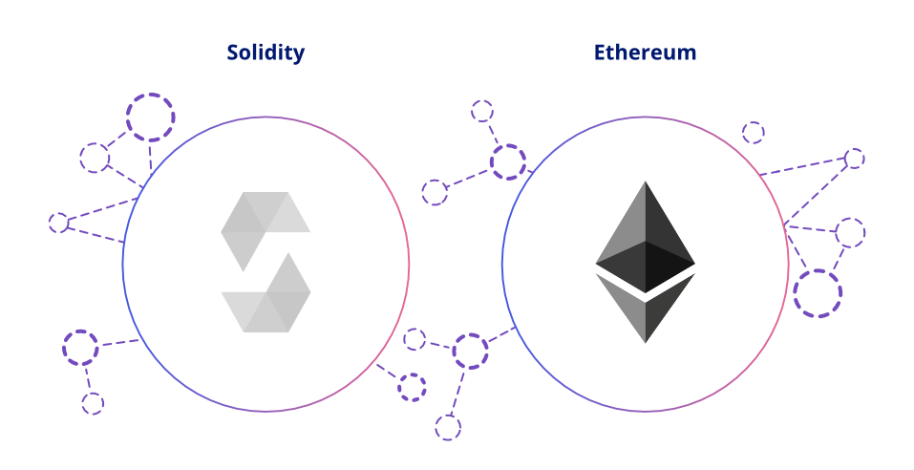

Ethereum
An open-source, decentralized blockchain which can execute Smart Contracts
Smart Contracts are written in programming languages that have some security limitations as Solidity
Therefore, in Smart Contracts, many vulnerabilities can be exploited by attackers.

Slide 7
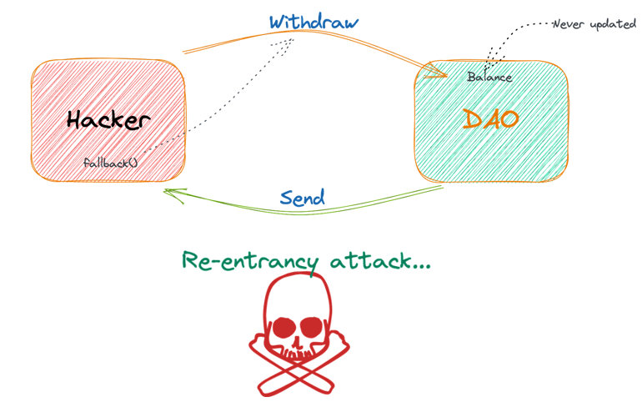
Reentrancy
Notes:
Reentrancy is a top 10 DASP vulnerability in Smart Contracts
April 19, 2020, $25 million was taken by mining reentrancy on a blockchain platform "Lendf.me“
In another case, an attacker stole US$60 million using this vulnerability in Decentralized Autonomous Organizations (DAOs) in June 2016

Slide 8


Solutions
Attention Mechanism
Deep Learning

Slide 9
Reentrancy Attack
What ? Impact ? Solution?

Slide 10

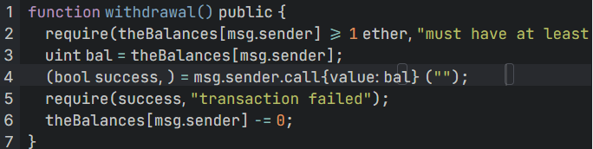
Reentrancy Attack
Initialization
Deposit
Withdraw

Slide 11
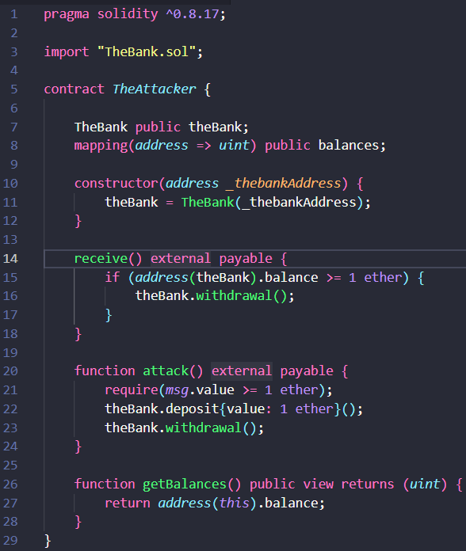
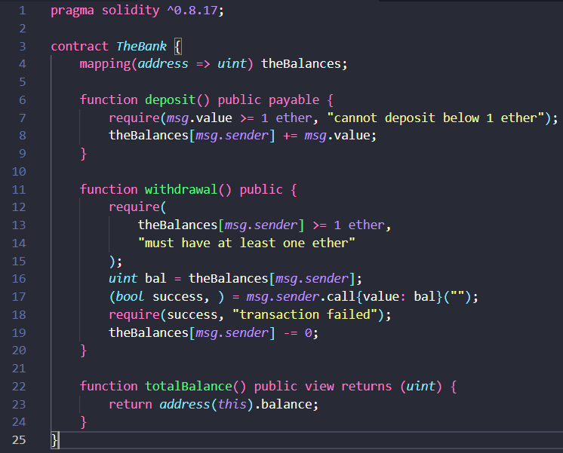

Reentrancy Attack
deposit=1
bankBal=10
bal=1
Bank.sol
Attack.sol
Notes:
+ A reentrancy attack occurs when an attacker withdraws funds from the target by recursively calling the target withdrawal function, as is the case with the DAO.
+ When the contract does not update the state (user balance) before depositing, the attacker can repeatedly call the withdraw function to withdraw all the funds in the contract.
+ Whenever the attacker receives Ether, his contract automatically calls the fallback function (fallback function is an unnamed function in the contract, which is executed when the calling function does not match any function in the contract, or the function that sends the ether). which contains no data) , where the withdrawal function is called again.
+ At this point the attack enters a recursive loop and the contract will not be able to update the attacker's balance.

Slide 12
Solution
CHECK
UPDATE
CALL
Notes:
- Check trạng thái
- Update số dư
- Gọi hàm rút tiền

Slide 13
Research Method
Relevant Models & Techniques

Slide 14
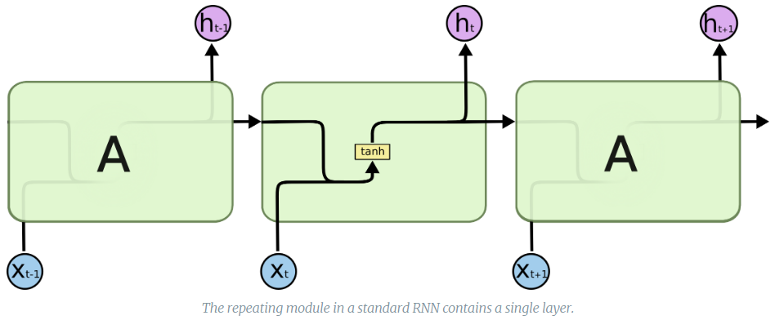
Research Method
Standard RNN
[RNN] LSTM là gì? (dominhhai.github.io)

Slide 15
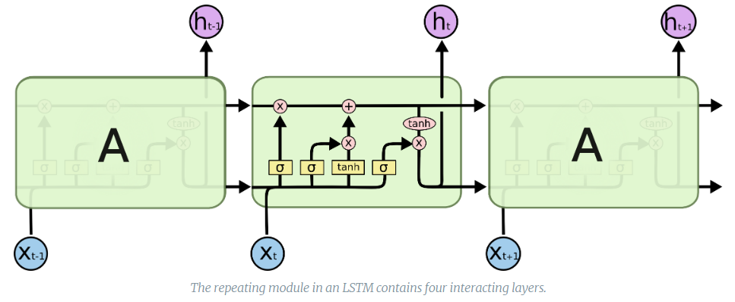
Research Method
LSTM
[RNN] LSTM là gì? (dominhhai.github.io)

Slide 16
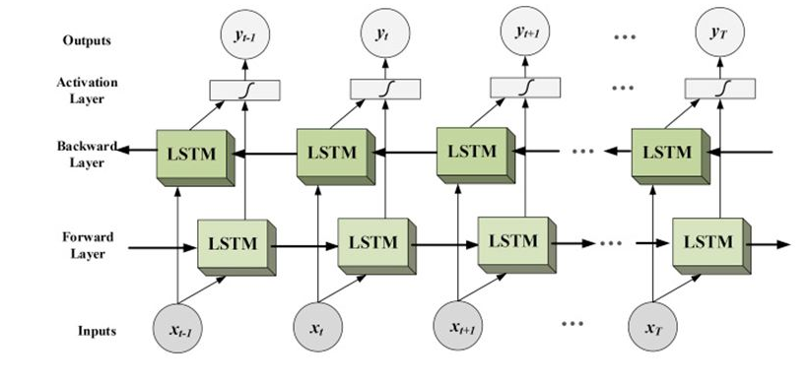
Research Method
Bidirectional LSTM
(1) Chapter 21 Bi Directional LSTM - YouTube

Slide 17
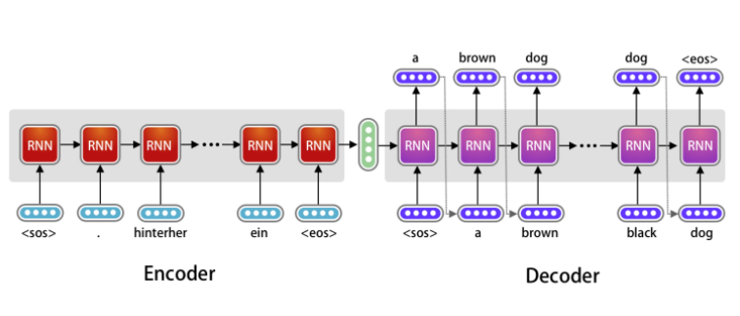
Research Method
Attention
Attention in Long Short-Term Memory Recurrent Neural Networks - MachineLearningMastery.com

Slide 18
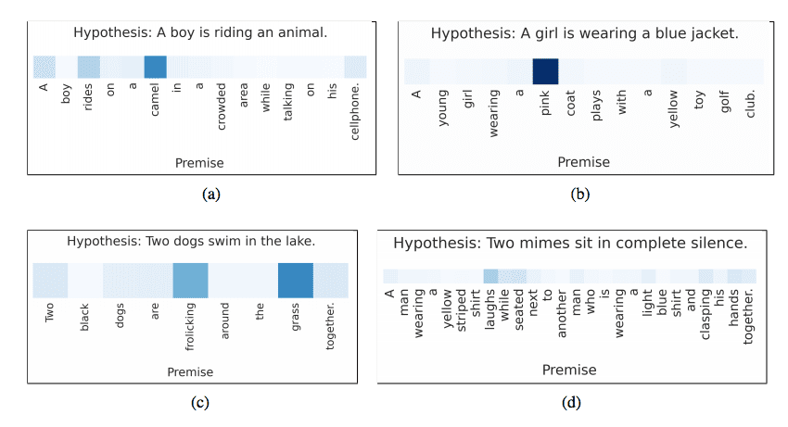
Research Method
Attention
Attention in Long Short-Term Memory Recurrent Neural Networks - MachineLearningMastery.com

Slide 19
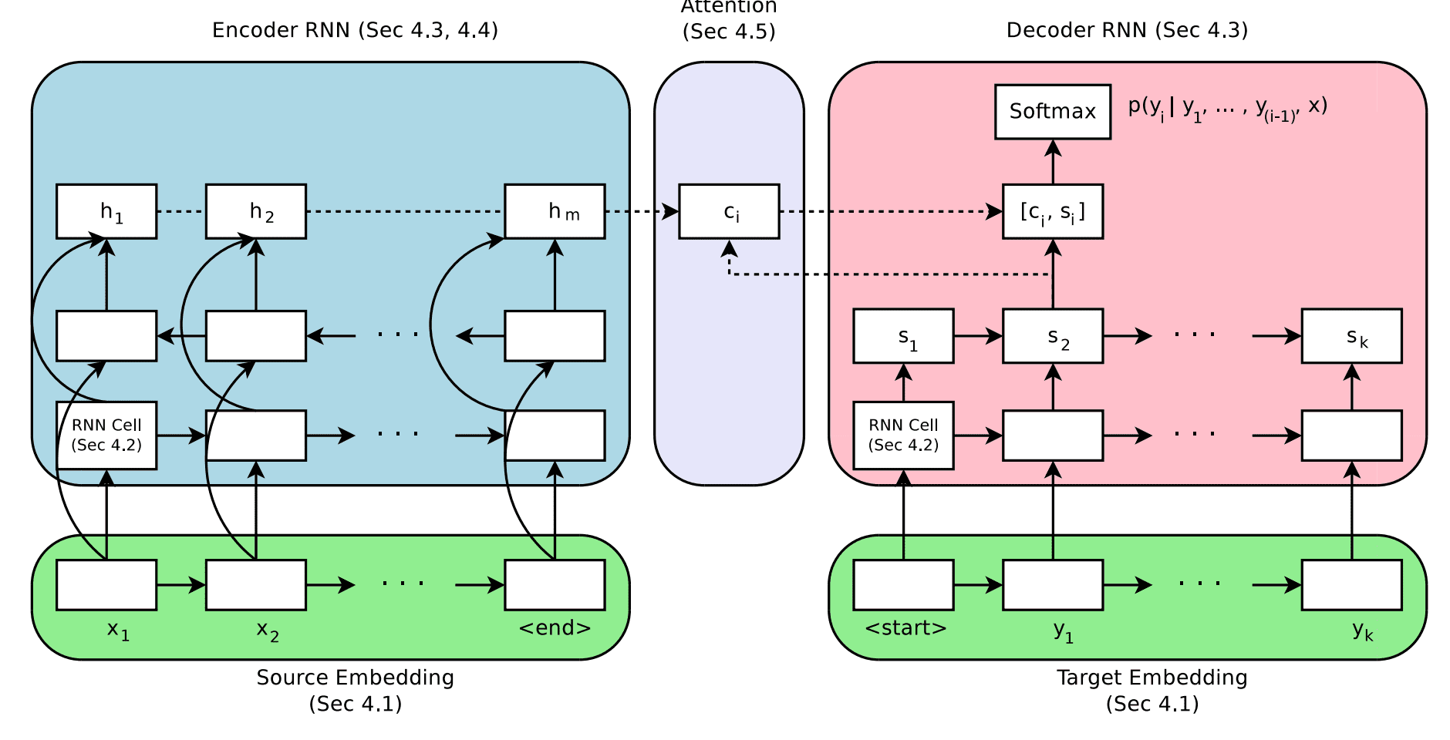
Research Method
Attention
Attention in Long Short-Term Memory Recurrent Neural Networks - MachineLearningMastery.com

Slide 20
Experiment Implementation
Build model & Operation

Slide 21
Our Process
Preparing the data
Running the model
Step 1
Step 2
Step 3
Step 4
Choosing the Neural Network
Analyzing Results

Slide 22
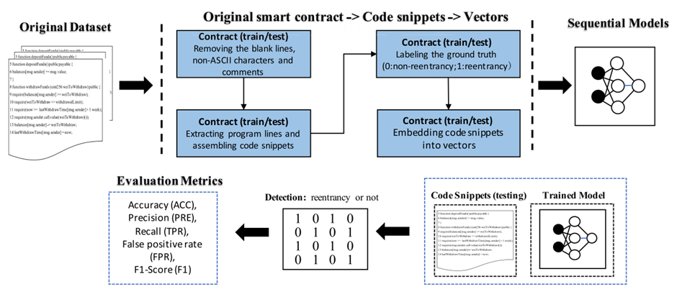
Our Process

Slide 23
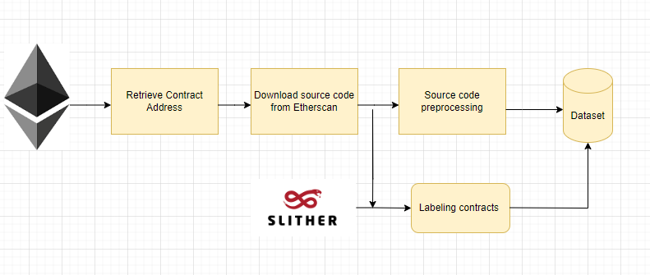
Preparing the data
Gathering source code smart contract(from Etherscan)
Pre-processing:
removing the blank lines, non-ASCII characters, and comments;
map user-defined variables to symbolic names
map user-defined functions to symbolic names
labeling (Slither)

Slide 24
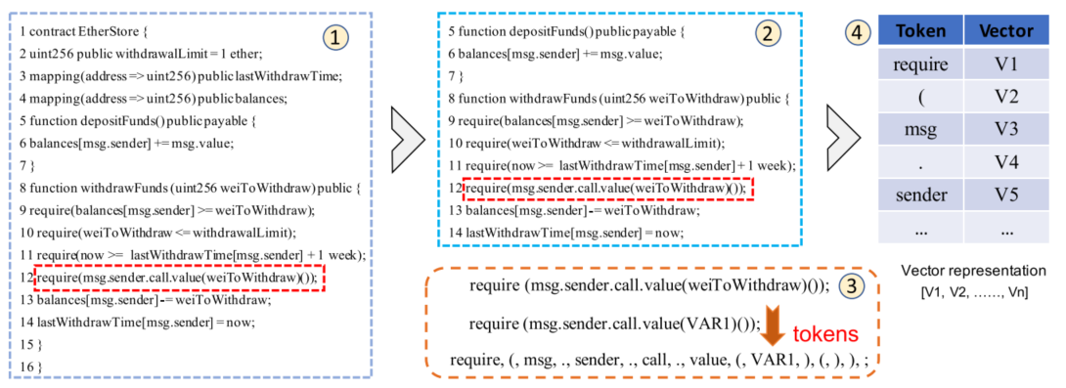
Preparing the data
Tokenize each line in source code
Vectorize each token (Word2vec)

Slide 25
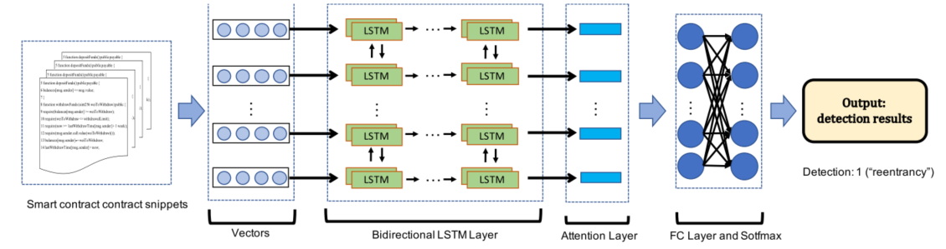
Choosing neural network
RNN
LSTM
BiLSTM
BiLSTM-attention

Slide 26
Running mode
Input -> source code -> Word2vec
Model
Training: 80%
Testing: 20%
Output -> map to the vector embeddings: 1 vulnerable/ 0 not vulnerable
Learning rate: 0.002
Dropout: 0.2
Epoch: 10
Batch-size: 64
Threshold = 0.5
Dataset
Not vulnerable | 5000
Vulnerable | 5000

Slide 27
Running mode
Google Colab: RAM 12GB
Python version: 3.8.16
Library: Pandas, numpy , tensorflow 2, sklearn, genism

Slide 28
Analyzing Results
Confusion Matrix – TP, FP, TN, FN
Accuracy, Precision, Recall
F1 score
FPR, TPR
 |  | Predicted
 |  | Negative (N) - | Positive (P) +
Actual | Negative - | True Negative (TN) | False Positive (FP) Type I Error
 | Positive + | Fake Negative (FN) Type II Error | True Positive (TP)

Slide 29
Evaluation & Conclusion
Summary & Assessment

Slide 30
Result Data
 | Accuracy | Precision | FPR | FNR | F1 Score
Simple_RNN | 0.777 | 0.811 | 0.167 | 0.279 | 0.763
LSTM | 0.832 | 0.844 | 0.15 | 0.186 | 0.828
Bi – LSTM | 0.867 | 0.881 | 0.114 | 0.151 | 0.849
Bi – LSTM - Attention | 0.847 | 0.865 | 0.128 | 0.178 | 0.843

Slide 31

Conclusion
On the tested dataset, Bi-LSTM model has the best results with  Accuracy of 86.7%  F1 score of 84.9%
The incorrect prediction of Bi - LSTM model for Smart Contracts with Reentrancy vulnerability is 15.1%, the lowest among the above models.

Slide 32

THANKS!
Any questions? <3
You can find me at:
19521671@gm.uit.edu.vn
19520396@gm.uit.edu.vn
20521665@gm.uit.edu.vn

