Slide 1

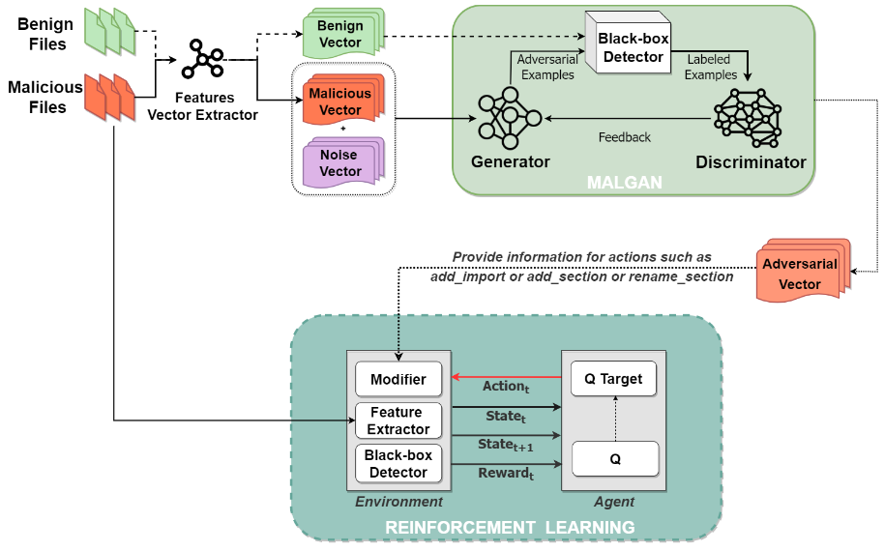
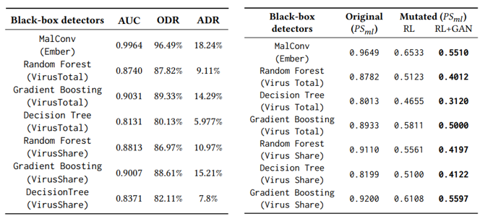
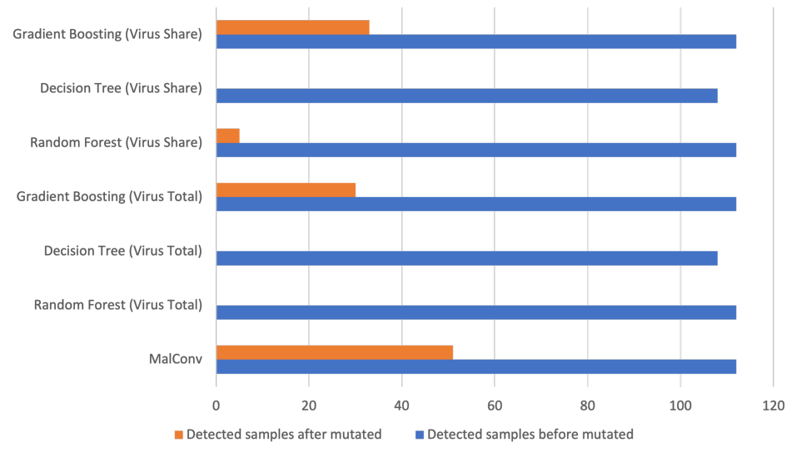


Leveraging Reinforcement Learning and Generative Adversarial Networks to Craft Mutants of Windows Malware against Black-box malware detectors
Phan The Duy, Tran Duc Luong, Nguyen Hoang Quoc An, Nguyen Huu Quyen, Nghi Hoang Khoa, Van-Hau Pham Information Security Laboratory, University of Information Technology, Vietnam National University Ho Chi Minh City
Introduction
Malicious software has grown in great popularity in recent years, posing a considerable threat to Internet users. To build an effective malware detector, it is required to collect a diversity of malware samples and their evolution, since malware authors always try to evade detectors through strategies of malware mutation. Therefore, by leveraging Reinforcement Learning (RL) and Generative Adversarial Networks (GAN), this paper explores the ability to craft mutants of malware for gathering numerous mutated samples in training a machine learning (ML)-based malware detector.
Methodology
Our work deeply investigates many aspects of efficiency between the fusion of GAN and RL on different settings for mutating an original Windows malware to escape from of the eyes of antivirus. To be more specific, there exists two modules taking over different tasks in our framework. The first module, MalGAN is responsible for transforming the malicious feature vectors into adversarial examples which then are fed to the second module (RL) to train RL agents for crafting new metamorphic malware mutants.
Fig.1 Our proposed model architecture
Experiments and Results
In this paper, we conduct 5 scenarios to demonstrate the feasibility of the proposed framework in crafting evasive mutated malware files. We have already evaluated the robustness of the VirusTotal engine and various ML-based detectors, especially MalConv - one of the state-of-the-art ML-based detectors on spotting mutants of Windows malware. The experimental results on real-world datasets prove that the combination method of RL and GAN could be a promising approach to understanding the robustness of ML-based detectors as well as the evolution of evasive malware on computers.
Tab.1 Our MalGAN module is working well in generating plausible adversarial malware vectors against black-box classifiers
Tab.2 The evasive performance of PE mutants by RL-GAN method outperforms RL-only approach
Fig.2 The total number of mutated malware out of 120 files detected by ML-based detection engines when adopting our framework in 4-action case
A paper at SoICT 2022, December 1-3, 2022, Hanoi, Vietnam – Copyright: UIT InSecLab – Email: inseclab@uit.edu.vn

