Slide 1



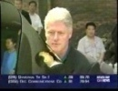
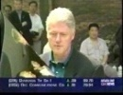
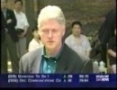
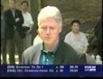
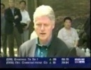

























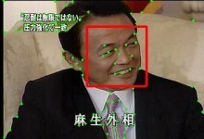
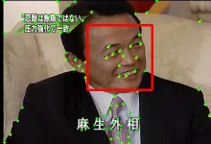



















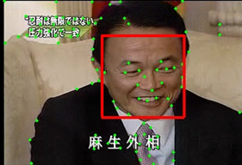
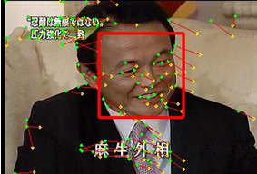





Face Processing in Video
Tác giả thứ nhất^{1,3}
Tác giả thứ 2²
Tác giả thứ 3 ^{3,1} and Tác giả thứ 4 ^{3,1}
¹ Trường ĐH……
² University of Science
HCMC, Vietnam
³ National Institute of Informatics
What ?
Why ?
We introduce a framework to process and retrieve faces in video, in which we have:
The human face is one of the most important objects in video since it provides rich information for spotting people of interest and is the basis for interpreting facts. Therefore, detecting and recognizing faces appearing in video are essential tasks of video indexing and retrieval applications.
Proposed a robust method to extract face-tracks in news video.
Built the largest face database compare to current popular worldwide face databases.
Evaluated several face-track matching methods.
Most studies have focused on static images rather than large-scale and real video dataset.
Overview
Face Detection
Face-Track Extraction
Face-Track Matching
Face-Track X
Face-Track X and Z belong to one person
Face-Track Y
Face-Track Z
Description
1. Face Detection
2. Face-Track Extraction
Frame 3014
Frame 3015
Frame 3016
The face detector implemented in OpenCV based on Viola method was used for detecting frontal views of faces in every frame of our video sequences.
We used Kanade–Lucas–Tomasi (KLT) method to create and track key/interest points between frames.
A high threshold was used to reduce the number of false positives.
The number of key points that pass through pairs of faces in consecutive frames was computed to make decision on grouping faces into face-tracks.
Input:
- Pair of consecutive frames.
- Face detection.
- List of key points.
UPDATE
Several treatments are proposed to handle tracking traps in news video.
Remove
flash-frames
Track
points
Group faces
into face-tracks
Re-generate
lost points
Flash-frame detector.
Adaptively generating key points.
Face-Track X
Face
Track
Face-Track Z
Face-Track Y
Figure 2. Process-flow of face tracker.
Min-Min
distance
Figure 1. Detection results with a high threshold.
3. Face-Track Matching
Face-track matching is done by applying similarity estimation methods (e.g. Min-Min distance) on the feature space.
Figure 3. Key/Interest points (plotted as green dots) in the left frame are tracked in the right frame. Small lines from green dots are motion of these points. Two faces in these frames share 22/23 points.
Figure 4. Apply Min-Min method for face-track matching.
Tên tác giả chính– Trường Đại học
TEL : ********* Email : *********

Slide 2


















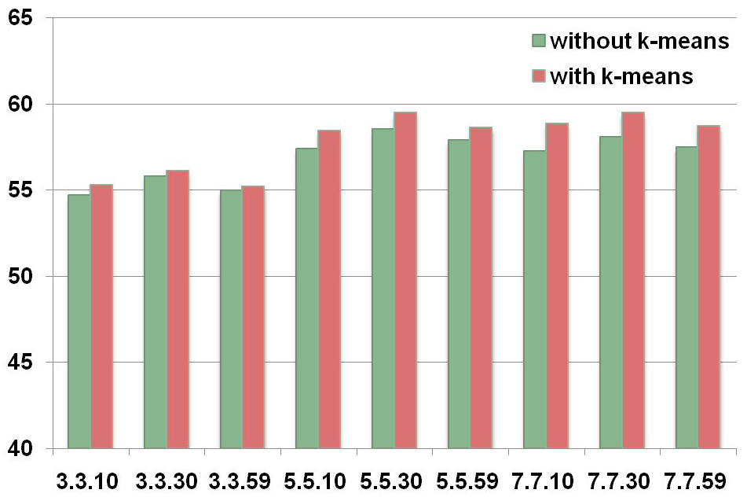
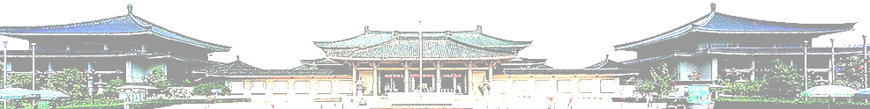
An Efficient Method for Face Retrieval from Large Video Datasets
Tác giả 1 ¹
Tác giả 2 ^{2,3}
Tác giả 3^{3,2}
Tác giả 4 ^{3,2}
Tác giả 5 ¹
Tác giả 6 ¹
¹ University of Science
HCMC, Vietnam
² Tên trường ĐH
³ National Institute of Informatics
Japan
Motivation
Contributions
The human face is one of the most important objects in video since it provides rich information for spotting people of interest and is the basis for interpreting facts. Therefore, detecting and recognizing faces appearing in video are essential tasks of video indexing and retrieval applications.
In this work, we introduce an efficient method for face retrieval that:
Has competitive performance compare to standard methods.
Most former attempts have focused on static images rather than large-scale and real video dataset.
Significantly reduces computation cost.
Robust and reliable on large-scale video datasets.
Overview
Face Detection
Face Tracking & Grouping
Face-Track Matching
Face-Track A
Face-Track A and B belong to one person
Face-Track C
Face-Track B
Face-track Extraction
Face-track Matching
Proposed Matching Method
Evaluation
Face-Track A
Dataset: TRECVID news videos from 2004 to 2006
370 hours of video in different languages.
157,524 face-tracks with about 20 million faces.
1,511 annotated face-tracks of 49 people.
D(A,B) = d
‘mean face’ of A
Feature to represent face: Local Binary Pattern (LBP)
‘mean face’ of B
Base-line methods: Min-Min, Avg-Min and Single-Face
Method | Computation cost (sec) | MAP (%)
Min-Min | 124,393 | 56.93
Avg-Min | 124,119 | 53.69
Ours (with k = 5) | 19 | 54.97
Single Face | 6 | 46.46
Face-Track B
Computing the similarity of two face-tracks:
For each face-track:
Divide the face-track into k equal parts
according to its temporal information.
Table 1. Mean Average Precision and Computational Cost of methods
For each part, select the middle face as
representative face for that part.
Compute the mean face (in terms of feature)
of the set of k representative faces (*).
Compute the Euclidean distance between
two ‘mean face’ of face-tracks.
(*) K-Means can be used as an alternate approach to select k representative faces for each face track.
Figure 1. The performance of proposed method with/without K-Means
Thanh Duc Ngo – The Graduate University for Advanced Studies (SOKENDAI)
TEL : 03-4212-2000 Email : ndthanh@nii.ac.jp

