Slide 1
Powerpoint Representation
ON
Student Report Card
By Gulam Khan

Slide 2
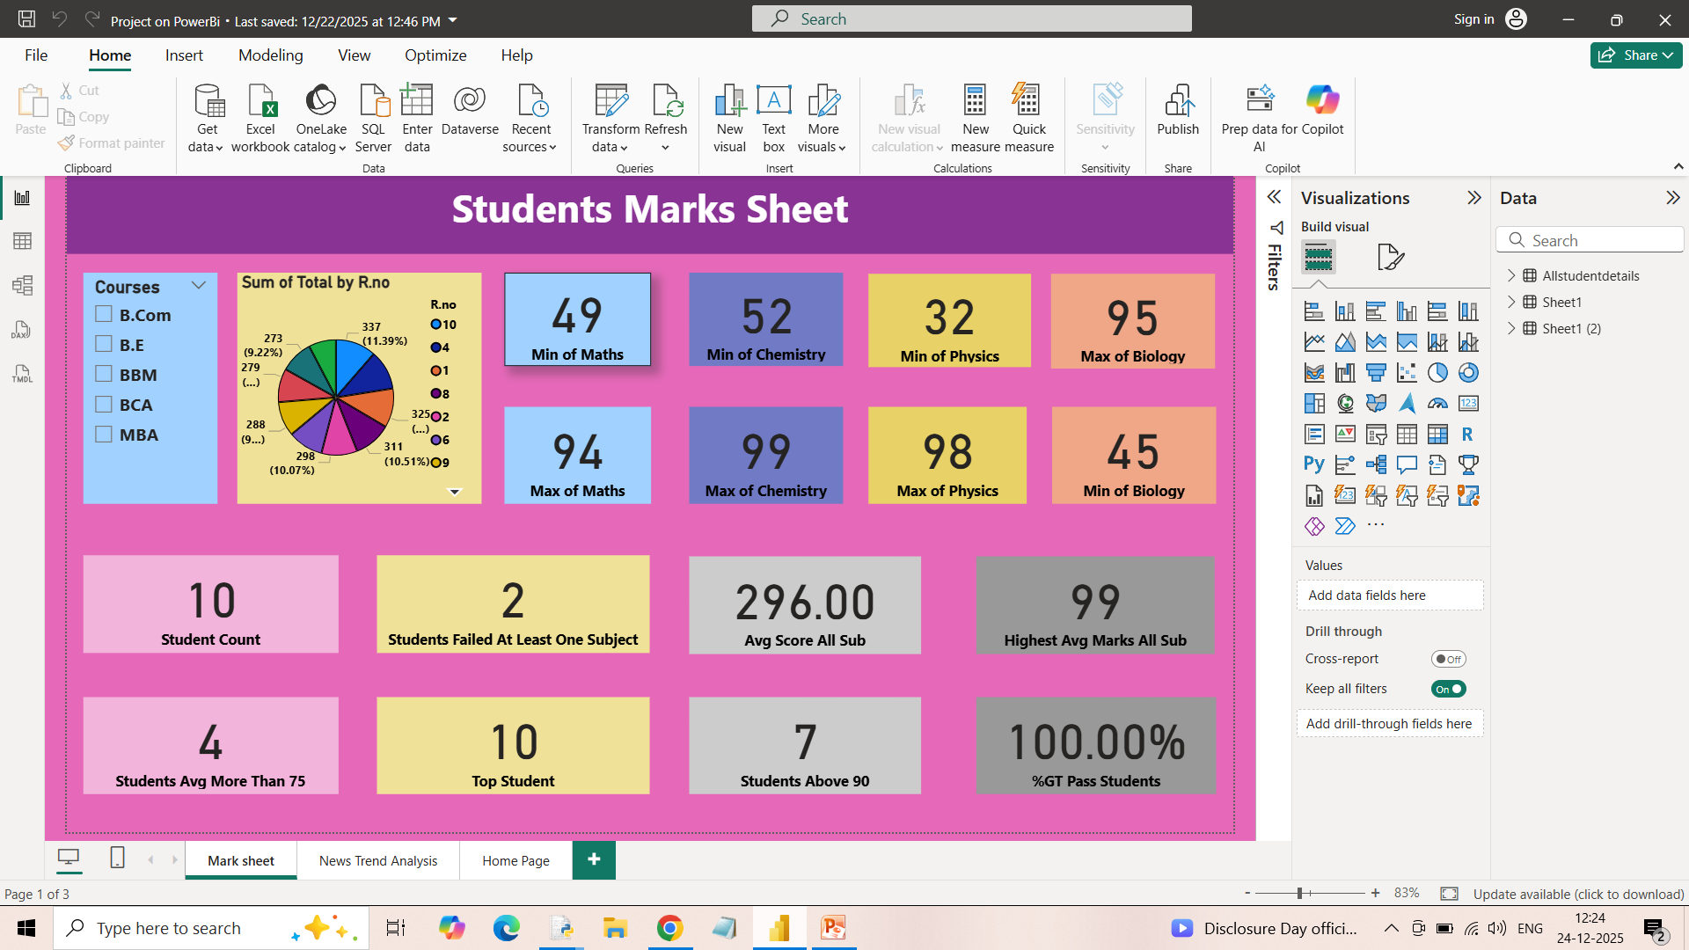
Data Visualization

Slide 3
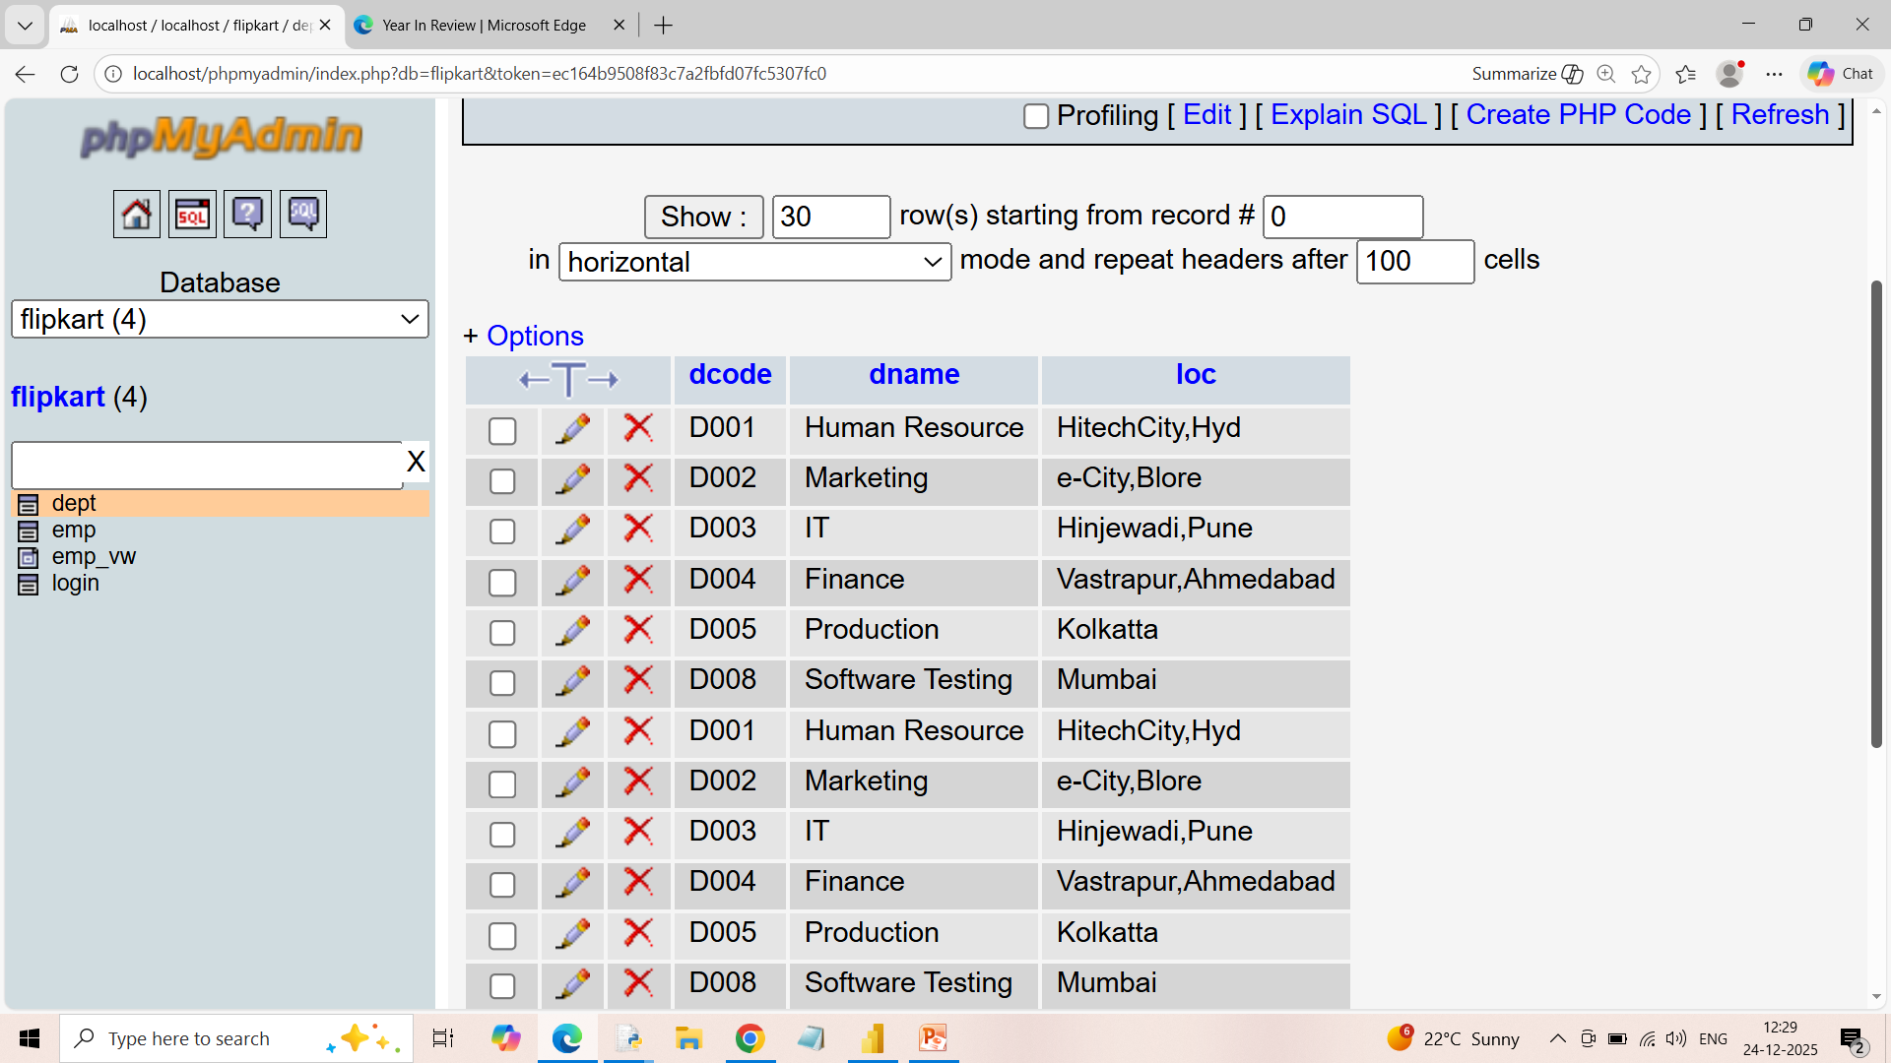
SQL Query

Slide 4

Python

Slide 5
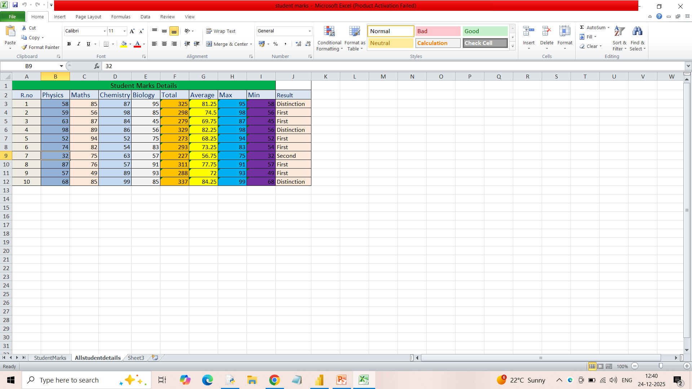
Excel

Slide 6
Summary of data visualization
This Power BI dashboard titled “Students Marks Sheet” presents a comprehensive academic performance overview for a group of 10 students, with filtering available by course (B.Com, B.E, BBM, BCA, MBA). It highlights subject-wise performance using key indicators such as minimum and maximum marks: Maths (Min 49, Max 94), Chemistry (Min 52, Max 99), Physics (Min 32, Max 98), and Biology (Min 45, Max 95). A pie chart summarizes the total marks distribution by roll number, giving a quick visual comparison of overall performance among students.
In terms of outcomes, the dashboard shows strong overall results: 100% of students passed, with 7 students scoring above 90, 4 students averaging more than 75, and 2 students failing at least one subject. The average total score across all subjects is 296, while the highest average score achieved is 99, identifying a clear top performer. Overall, the report effectively combines subject-level insights and aggregate metrics to provide a clear snapshot of student achievement and performance trends.

Slide 7
Thank you

