Slide 1






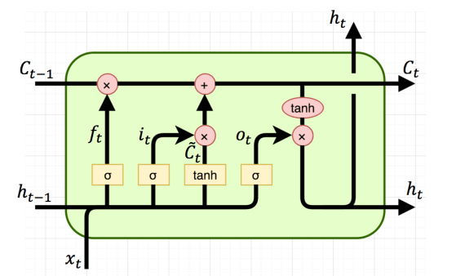


Publish Data through MQTT protocol
REAL-TIME DASHBOARD
(7)
KAFKA RULE NODE
(2)
(3)
(5)
MQTT Protocol
Kafka message
Subcribe to topics to get data
GATEWAYS
LOCALHOST
KAFKA
(1)
Send data
Predict Value
(6)
Save data
(4)
SENSOR DEVICE
DATABASE
LSTM MODEL

