Slide 1
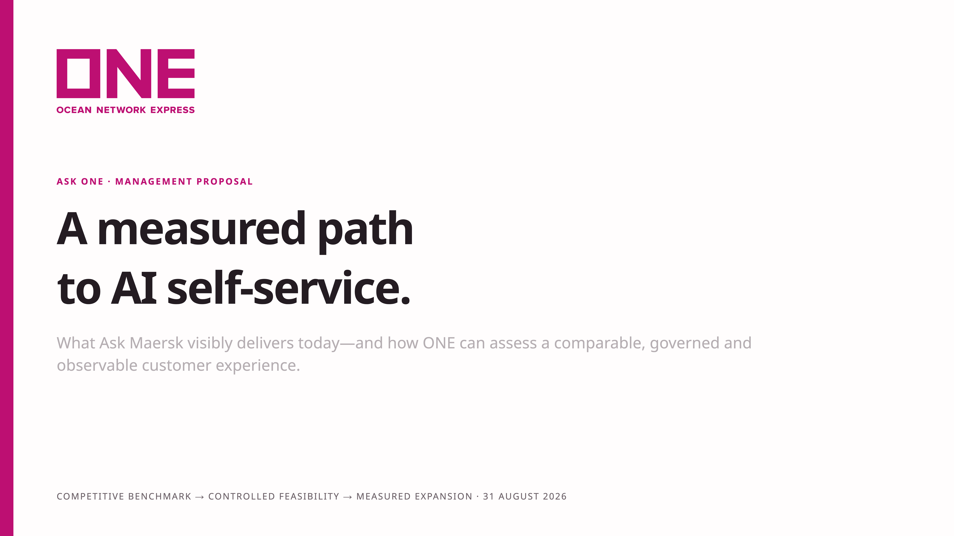
Notes:
The story starts with the customer experience already visible in the market. Ask Maersk is a useful benchmark, not a target to criticize or a claim that ONE will automatically surpass it. [Sources] - Internal: reports/maersk-research-2026-08-31.md - Internal: docs/plan.md - Visual reference: ../payloadcms-demo-main/apps/slides

Slide 2
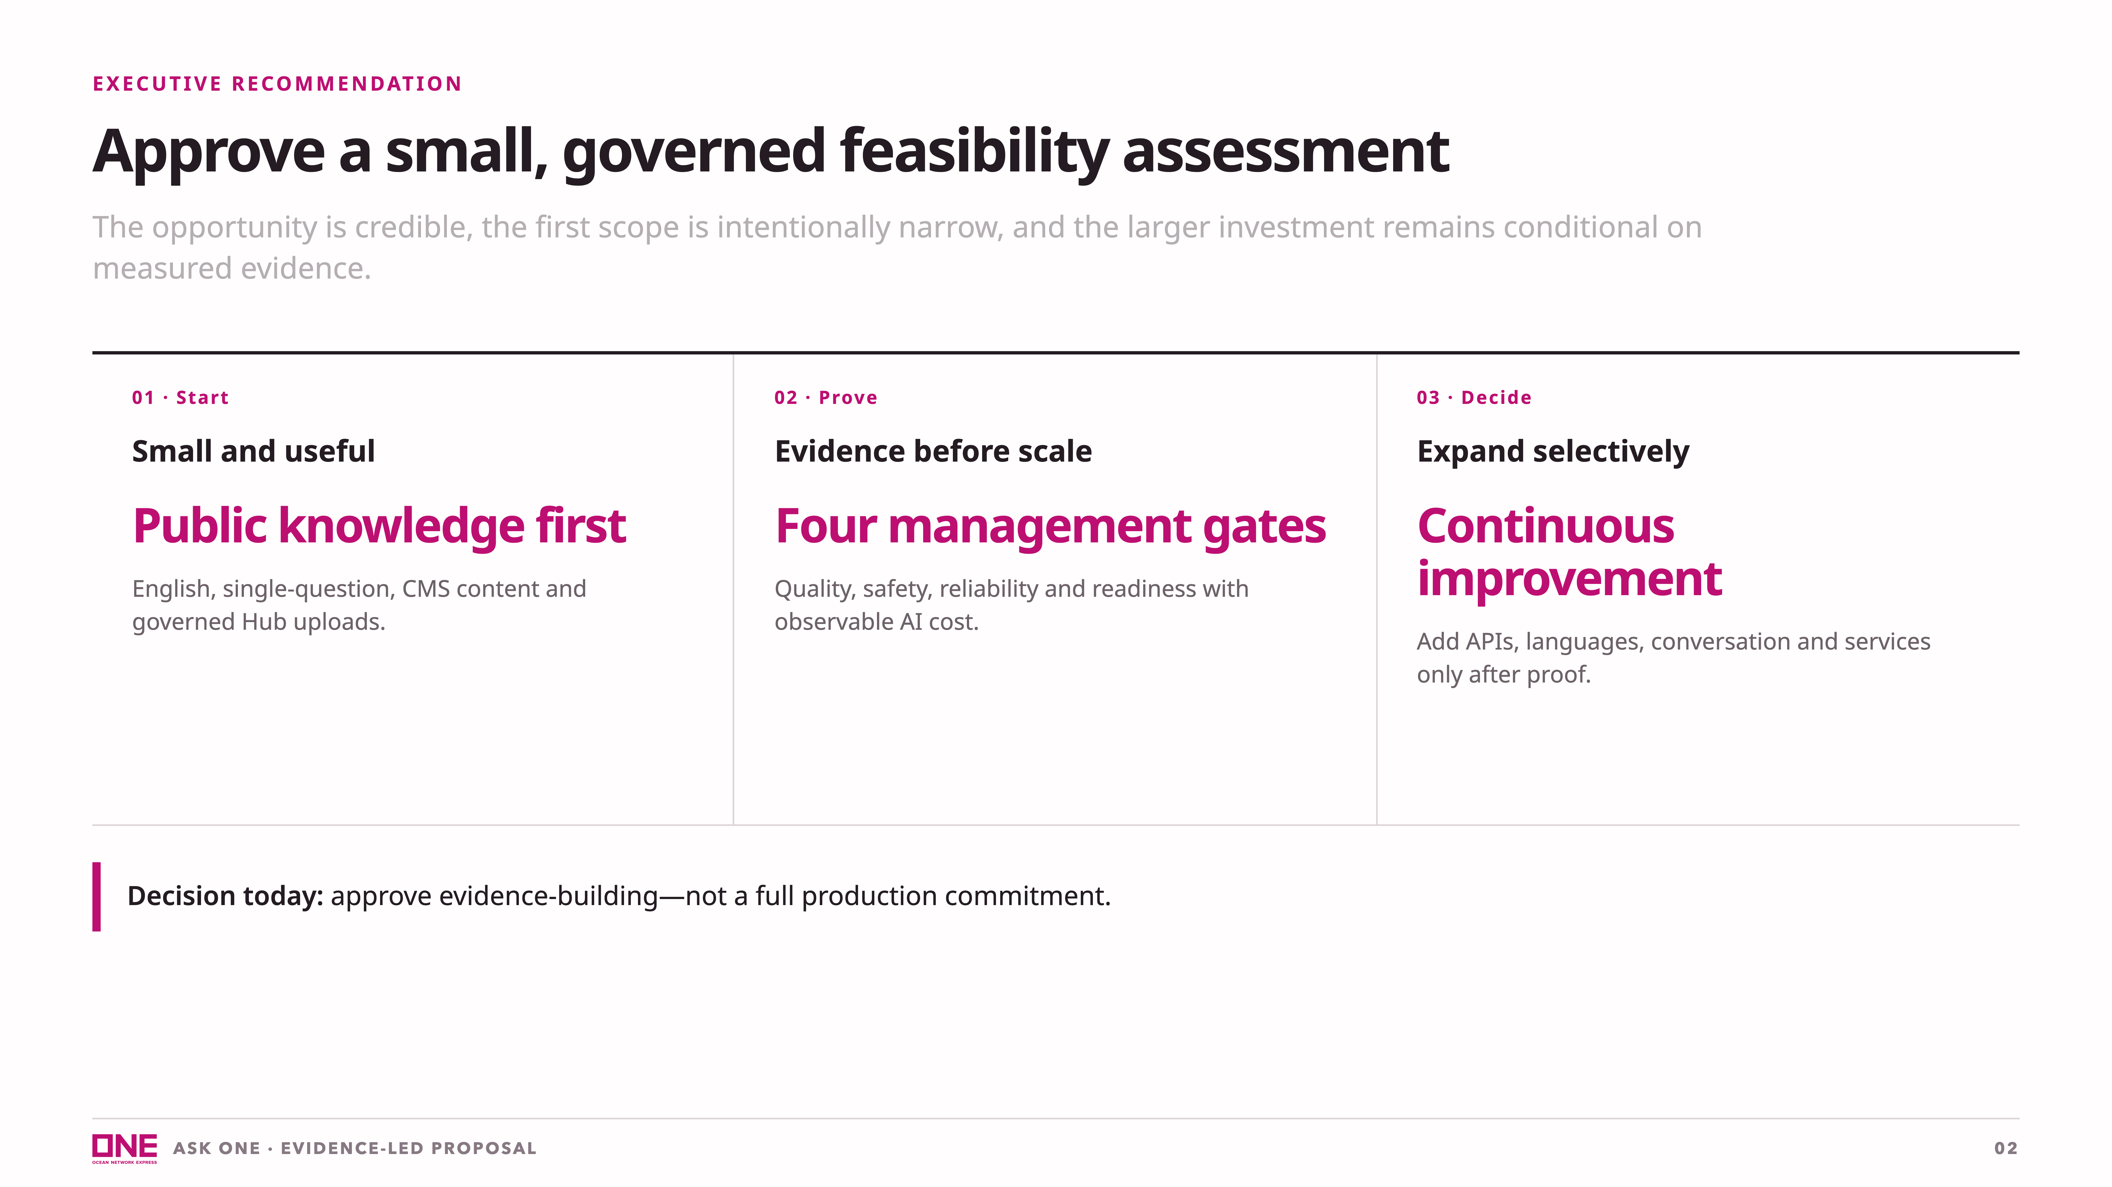
Notes:
[Sources] - Internal: docs/plan.md, sections 11–15 - Internal synthesis: reports/maersk-research-2026-08-31.md

Slide 3
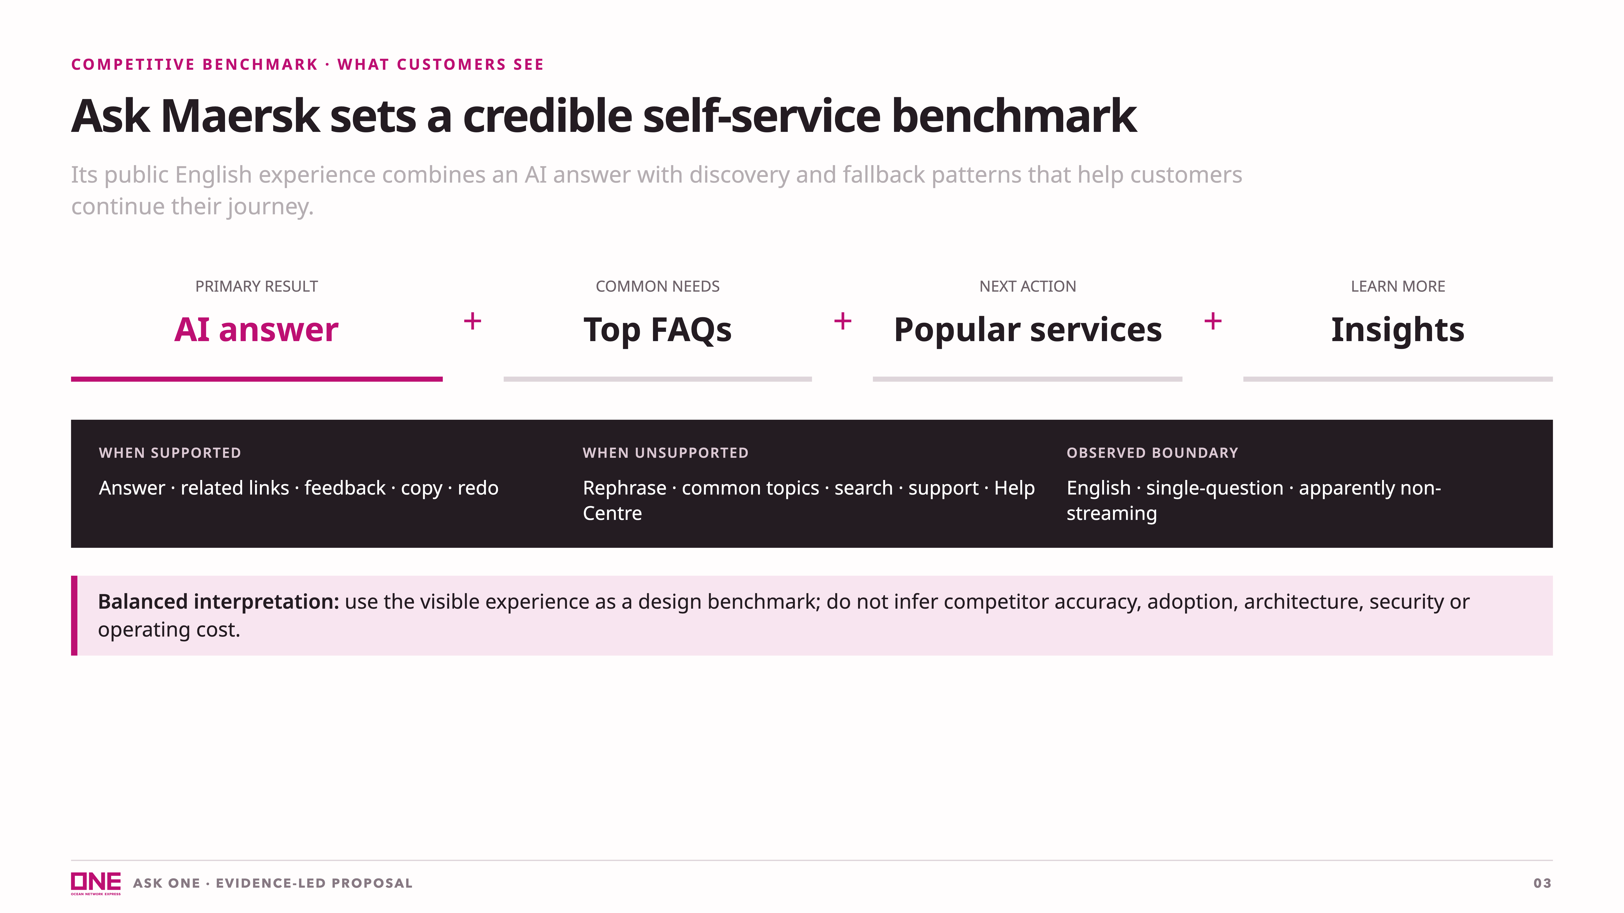
Notes:
This is a respectful summary of visible behavior, not a competitor scorecard. [Sources] - Internal: reports/maersk-research-2026-08-31.md, Capability Map and Evidence Gaps - User-provided Ask Maersk screenshots in this conversation

Slide 4
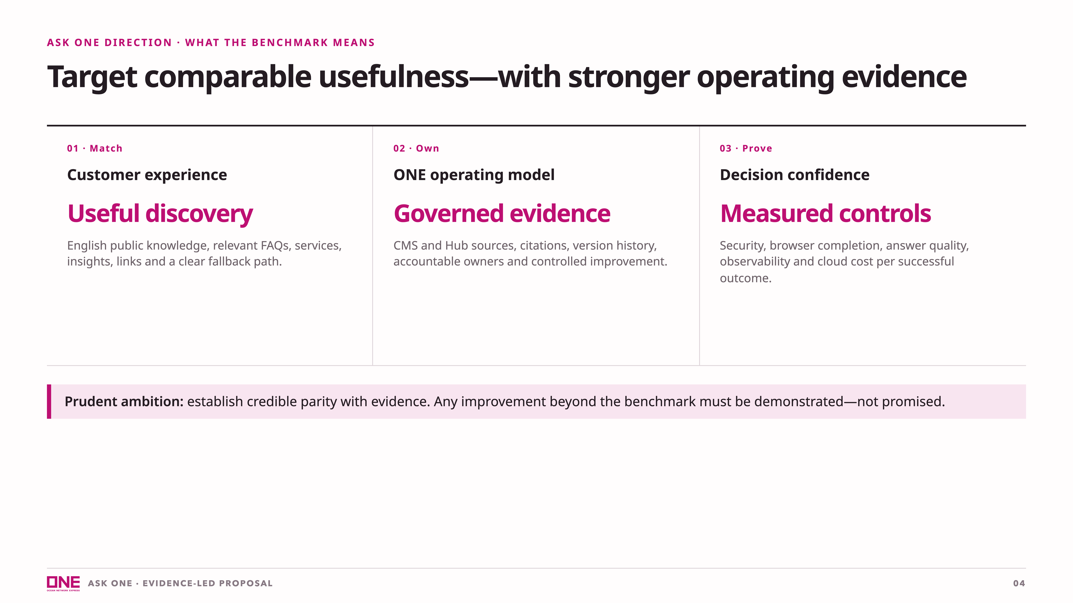
Notes:
This slide resets the competitive posture: match the useful experience, apply ONE's own governance, and let measured results determine further investment. [Sources] - Internal synthesis: reports/maersk-research-2026-08-31.md - Internal proposed controls: docs/plan.md, sections 4–10

Slide 5
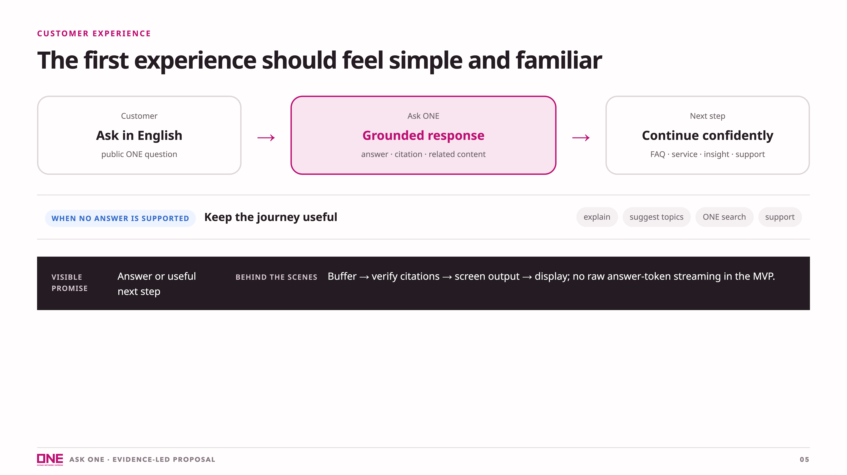
Notes:
The interaction follows the useful benchmark without copying competitor implementation details. The first release remains English, public knowledge and single-question, with no multi-turn conversation. [Sources] - Internal benchmark: reports/maersk-research-2026-08-31.md - Internal proposed experience: docs/plan.md, sections 4–5 and 11 - Gemini streaming behavior: https://docs.cloud.google.com/gemini-enterprise-agent-platform/models/capabilities/send-chat-prompts-gemini

Slide 6
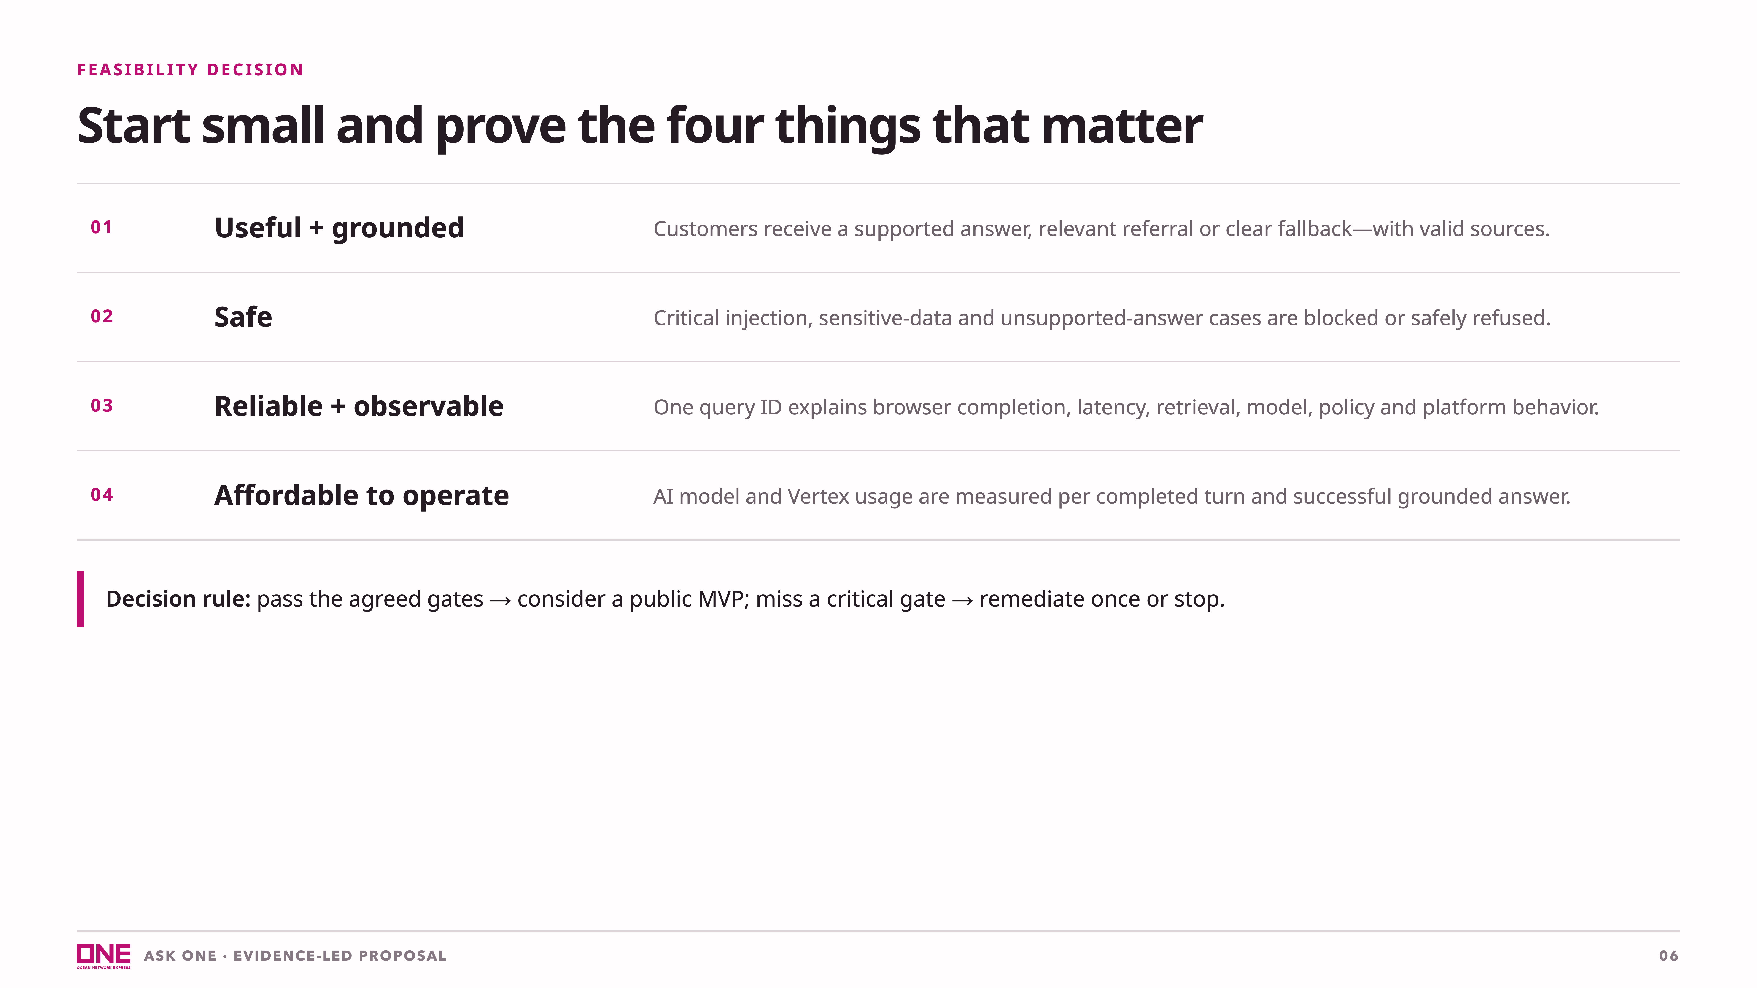
Notes:
[Sources] - Internal synthesis: reports/maersk-research-2026-08-31.md - Internal: docs/plan.md, sections 4–15

Slide 7
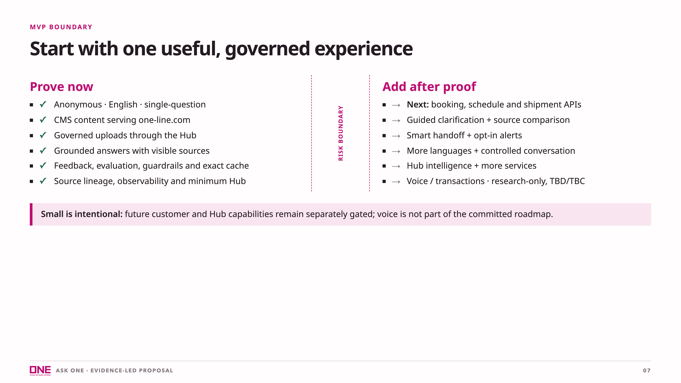
Notes:
[Sources] - Internal: docs/plan.md, sections 5, 9, 11 and 12 - Project context: https://www.one-line.com/ - Future integration context: https://ecomm.one-line.com/one-ecom

Slide 8
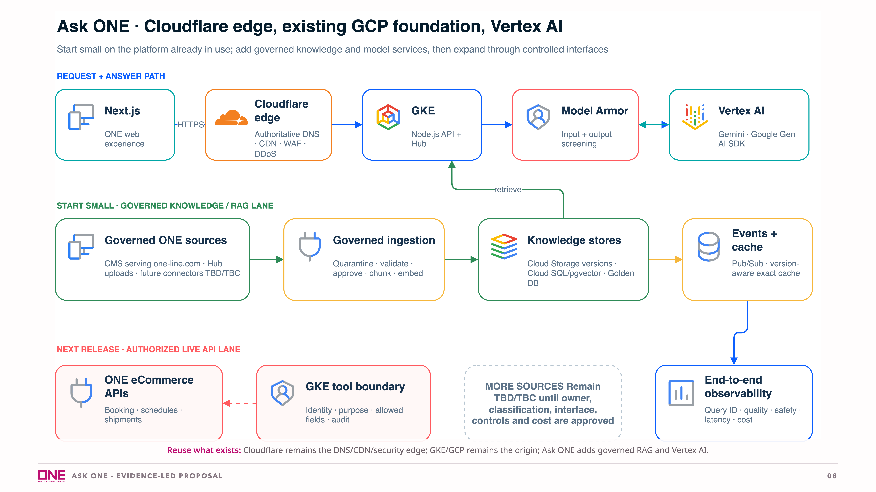
Notes:
Manager translation: reuse the platform already operated by ONE. No Google CDN or Cloud DNS is proposed. Cloud SQL with pgvector is an initial feasibility candidate, not a permanent architecture commitment. Future sources remain TBD/TBC until ownership, classification, interface, security and cost are confirmed. [Sources] - Internal: docs/plan.md, section 7 - ONE website: https://www.one-line.com/ - ONE eCommerce portal: https://ecomm.one-line.com/one-ecom - Cloudflare secure application delivery: https://developers.cloudflare.com/reference-architecture/design-guides/secure-application-delivery/ - Cloudflare proxied DNS: https://developers.cloudflare.com/learning-paths/prevent-ddos-attacks/baseline/proxy-dns-records/ - Cloudflare icon: https://simpleicons.org/?q=cloudflare - Google Cloud product icons: https://cloud.google.com/icons - GKE: https://cloud.google.com/kubernetes-engine/docs - Vertex AI: https://cloud.google.com/vertex-ai/generative-ai/docs - Cloud SQL PostgreSQL: https://cloud.google.com/sql/docs/postgres

Slide 9
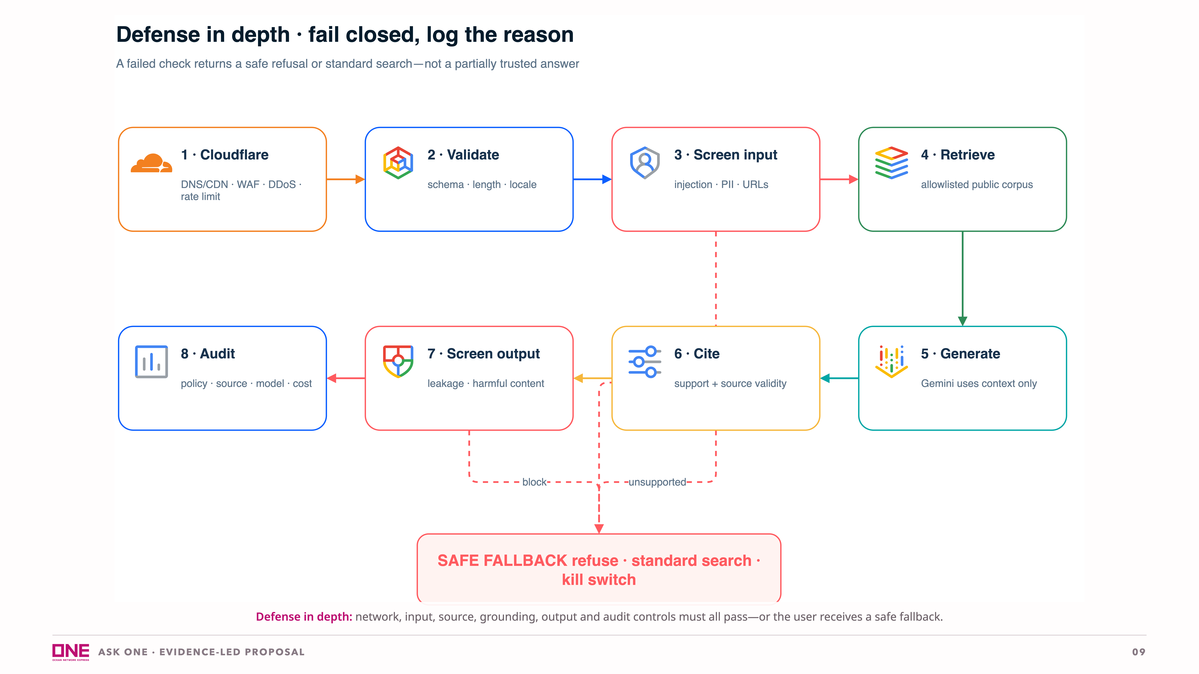
Notes:
Security is not delegated to Gemini. Model Armor is one layer inside a broader control chain. Least privilege, allowlisted sources, auditability and a kill switch remain required. [Sources] - Internal: docs/plan.md, section 6 - Model Armor: https://docs.cloud.google.com/model-armor/overview - Cloudflare secure application delivery: https://developers.cloudflare.com/reference-architecture/design-guides/secure-application-delivery/ - Cloudflare icon: https://simpleicons.org/?q=cloudflare - Google Cloud product icons: https://cloud.google.com/icons

Slide 10
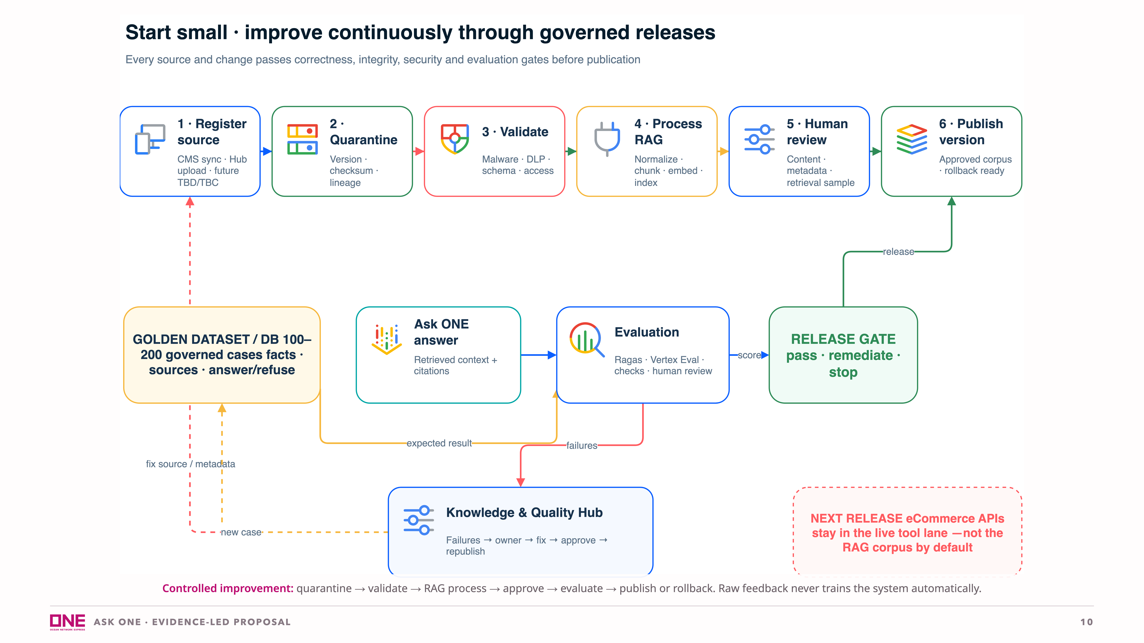
Notes:
Golden Dataset = governed evaluation cases. Golden Database = its registry and review history in Cloud SQL. Both are versioned and auditable. [Sources] - Internal: docs/plan.md, sections 3–5 and 9 - Google Cloud product icons: https://cloud.google.com/icons

Slide 11
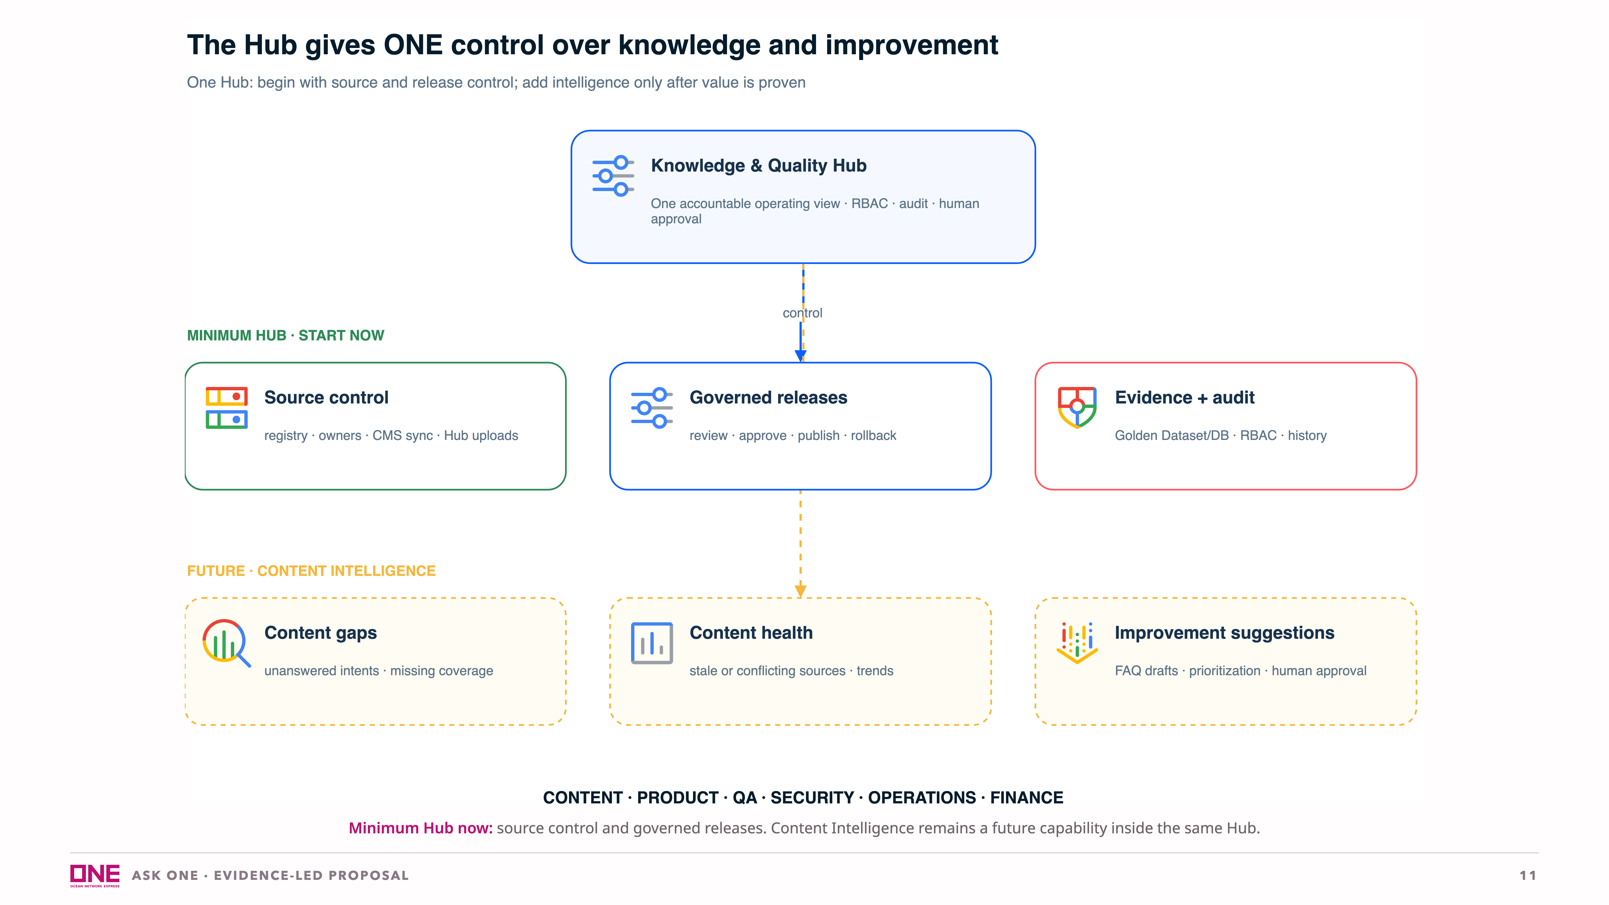
Notes:
The Hub is not a large admin application in the MVP. It provides the operating view and minimum controlled actions required to manage sources safely. Content gaps, stale/conflicting-content detection, FAQ suggestions and trend intelligence are future additions—not MVP commitments. [Sources] - Internal: docs/plan.md, sections 5 and 9 - Google Cloud product icons: https://cloud.google.com/icons

Slide 12
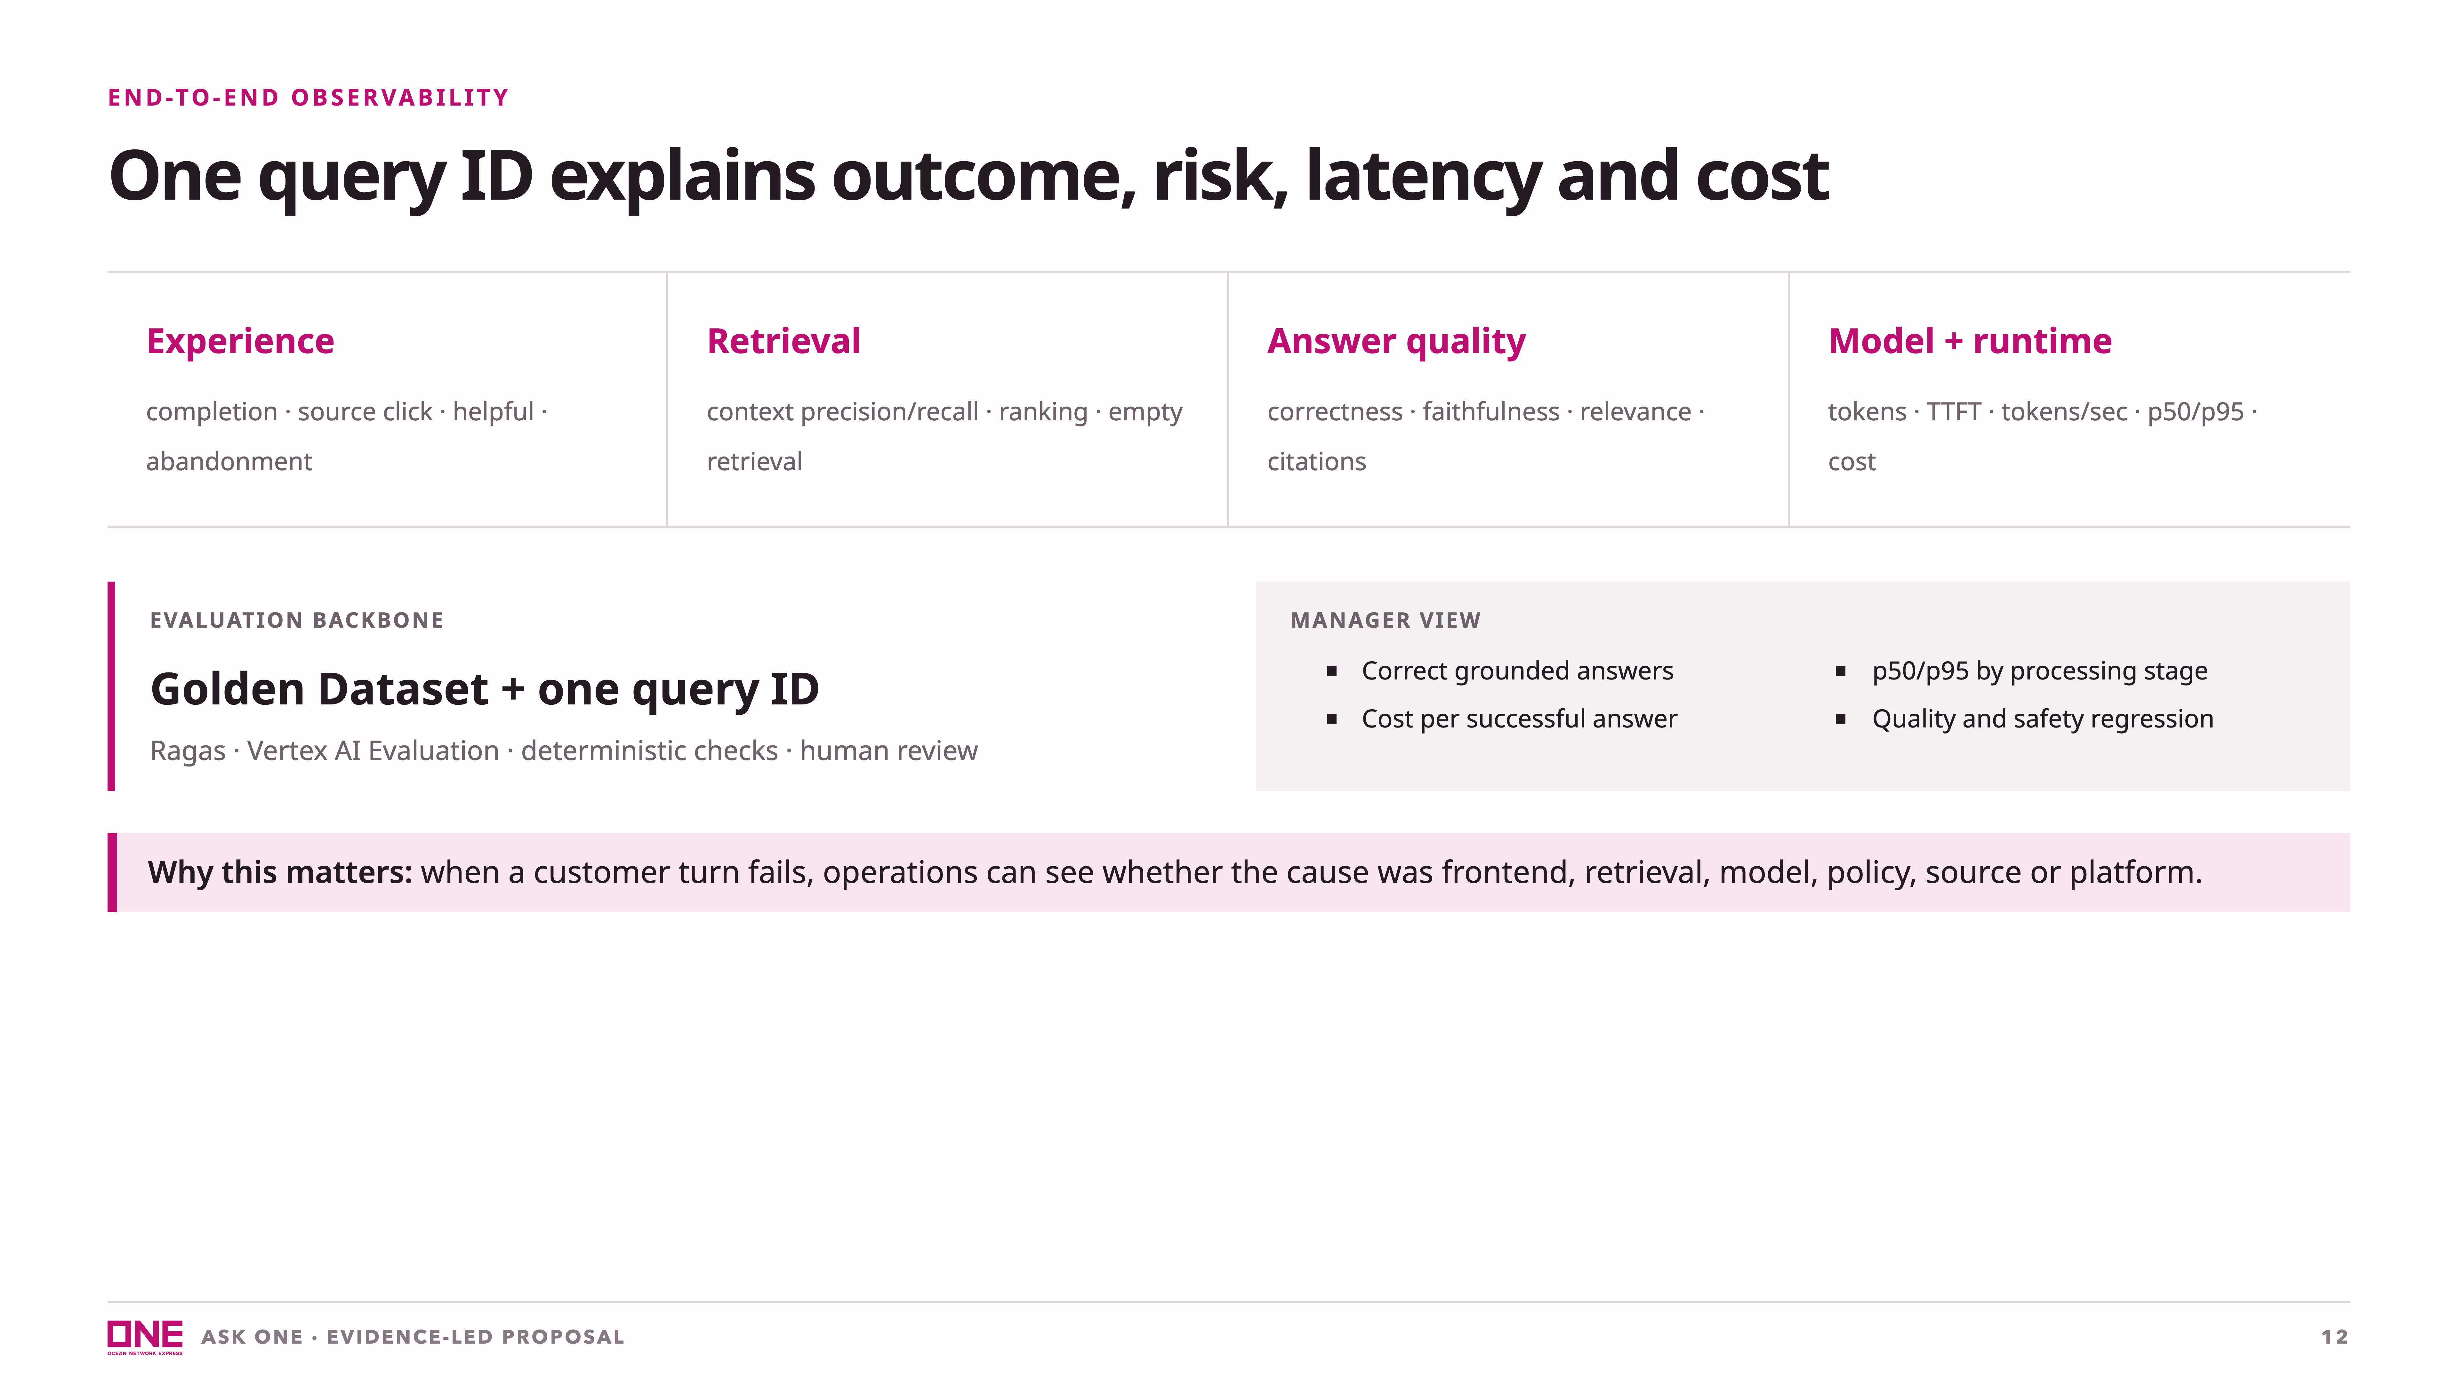
Notes:
[Sources] - Internal: reports/maersk-research-2026-08-31.md, reliability observations - Internal: docs/plan.md, sections 9 and 10 - Google Cloud Observability: https://cloud.google.com/products/observability - Ragas evaluation metrics: https://docs.ragas.io/en/stable/getstarted/rag_eval/ - Vertex AI evaluation: https://docs.cloud.google.com/vertex-ai/generative-ai/docs

Slide 13
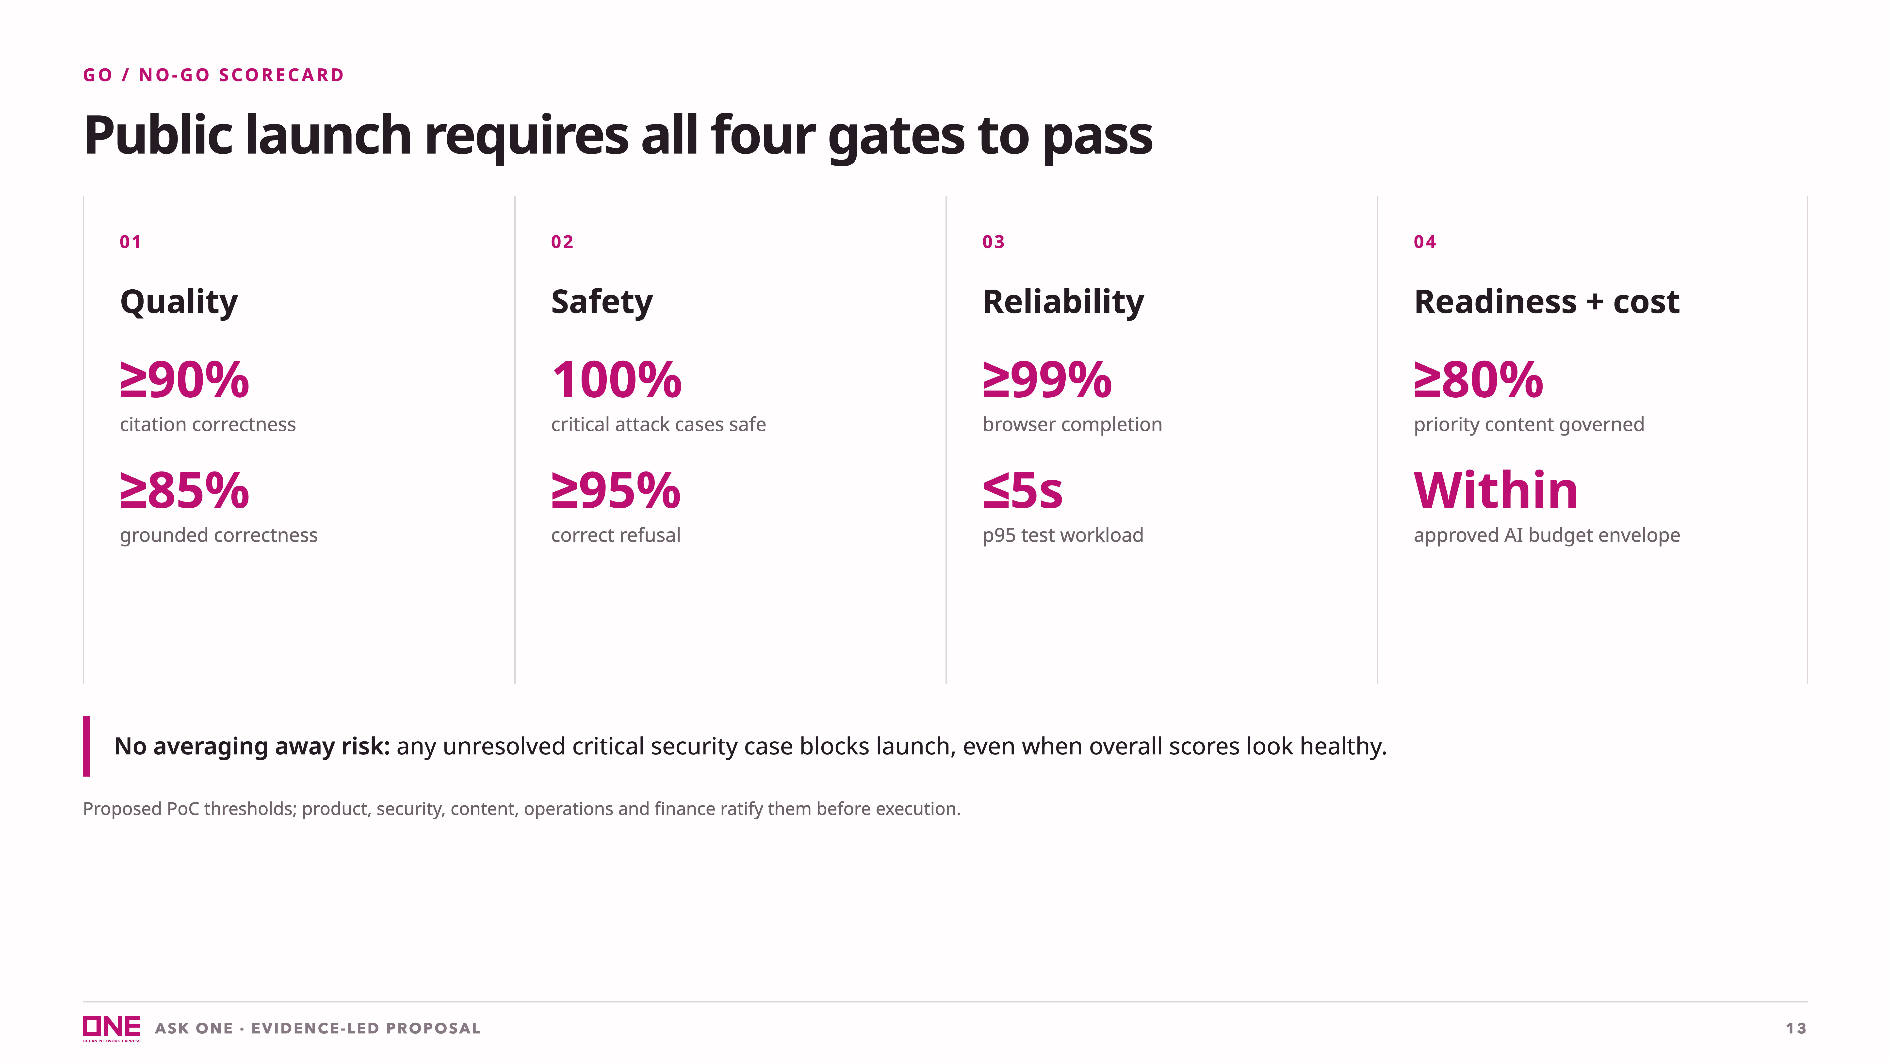
Notes:
[Sources] - Internal KPI framework: docs/plan.md, section 10 - Proposed thresholds and assumptions: slide-docs.md

Slide 14
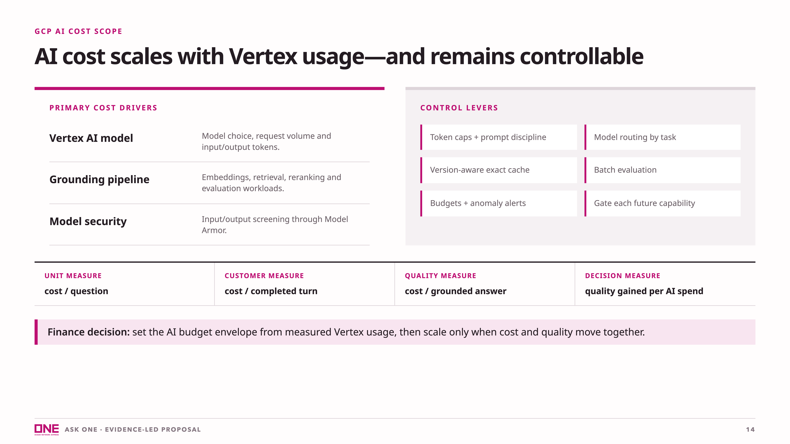
Notes:
[Sources] - Internal: docs/plan.md, sections 9, 10 and 15 - Vertex AI pricing dimensions: https://cloud.google.com/vertex-ai/generative-ai/pricing - Model Armor: https://cloud.google.com/security/products/model-armor

Slide 15
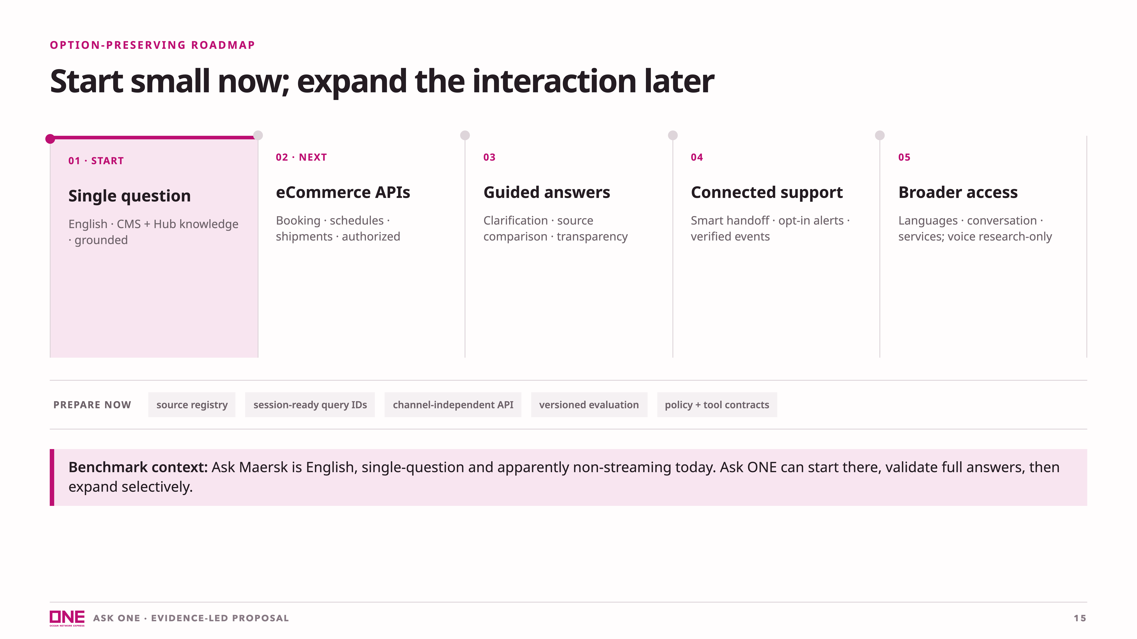
Notes:
[Sources] - Internal: docs/plan.md, section 12 - Internal benchmark: reports/maersk-research-2026-08-31.md

Slide 16
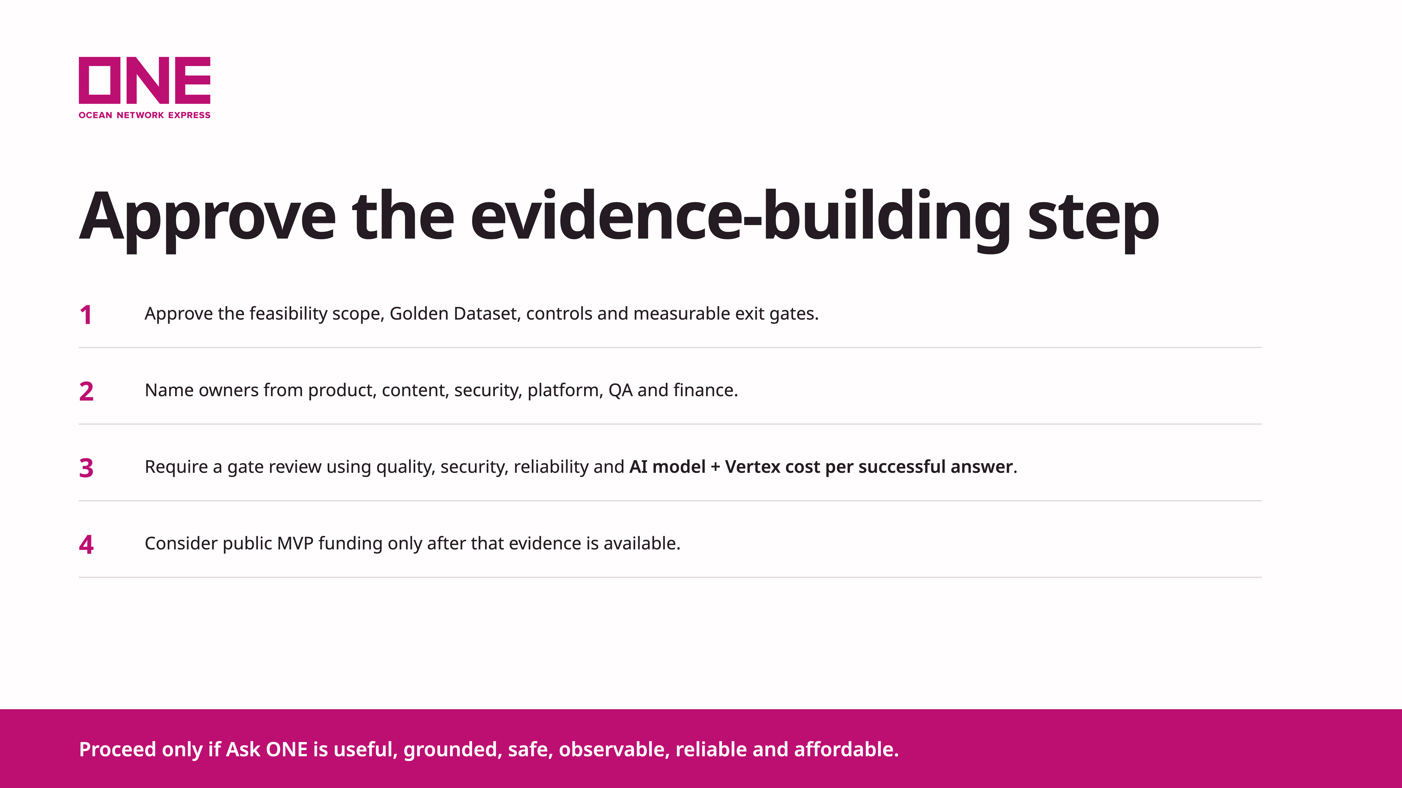
Notes:
Close on the decision. The proposal does not ask management to approve the whole roadmap. [Sources] - Internal: docs/plan.md - Cost and gate assumptions: slide-docs.md

