Slide 1
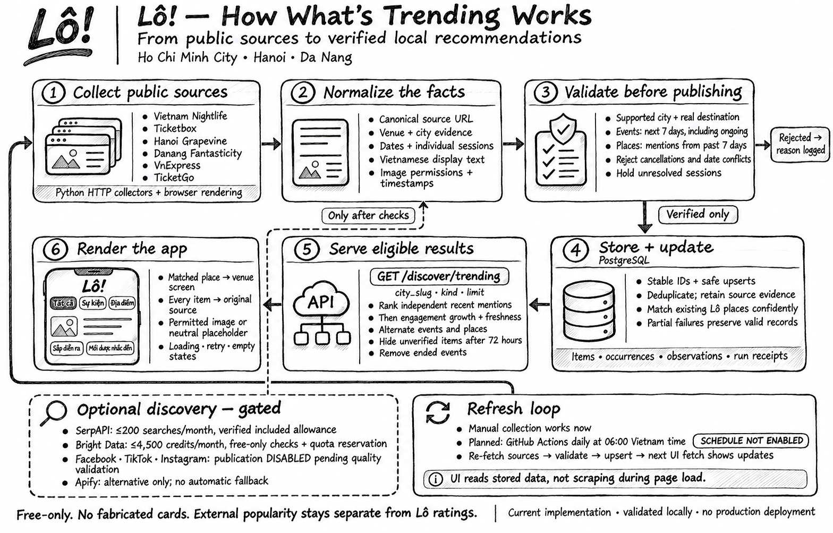
Notes:
Source artwork: LoScraper/docs/assets/trending-workflow-hand-drawn.png, supplied by the user. Pipeline documentation: https://github.com/khanh19/LoScraper/blob/stephen-develop/docs/trending.md . Status snapshot: 7 November 2026 New York / 8 November Vietnam. The illustration is preserved as an embedded image. Social publication and the daily schedule remain disabled. No production deployment is represented.

