Slide 1

PROJECT REPORT
Web Programming
Group 4:
Do Quoc Khanh – 17110041
Mai Phan Nguyet Ngan – 17110058
Tran Thuan Tuong Vy - 17110093

Slide 2
INTRODUCTION
In the modern technology era, having a website for marketing to serve user's needs is very important.
A website created must be managed by admin. An admin has privilege to manage all users' behavior.
Users can see the category, products' image and description….
The website must be user friendly and easy to use.

Slide 3
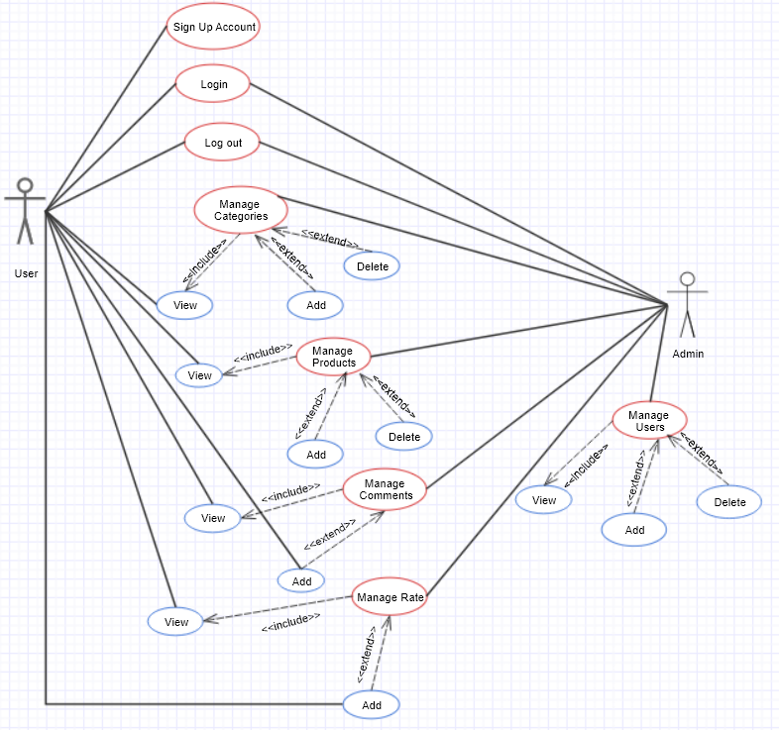
USE-CASE DIAGRAM

Slide 4
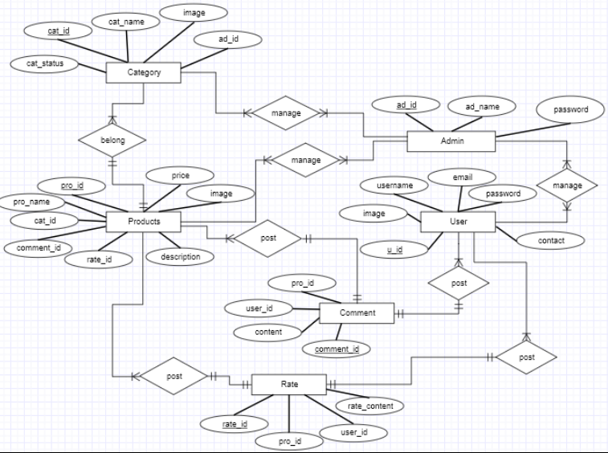
ERD

Slide 5
WORK ASSIGNMENT
Do Quoc Khanh
Write function in login Admin
Mai Phan Nguyet Ngan
Write function in login User
Tran Thuan Tuong Vy
Write function in login Admin

Slide 6
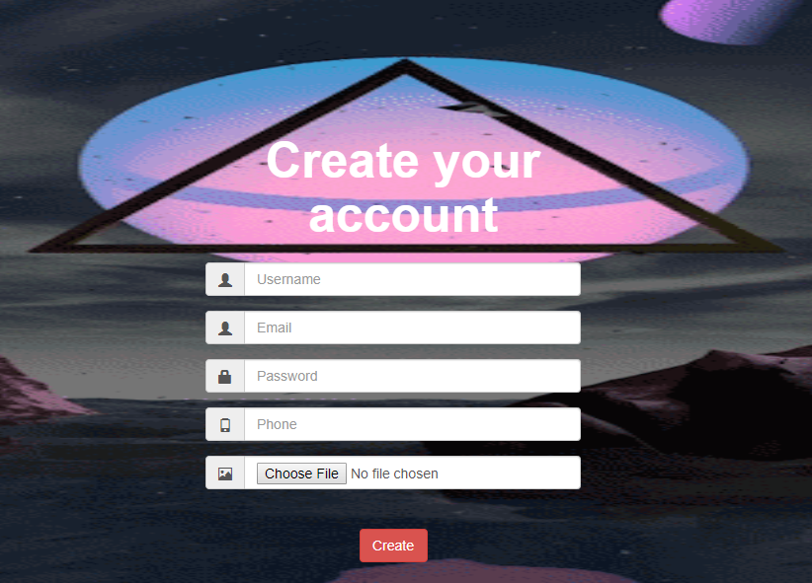
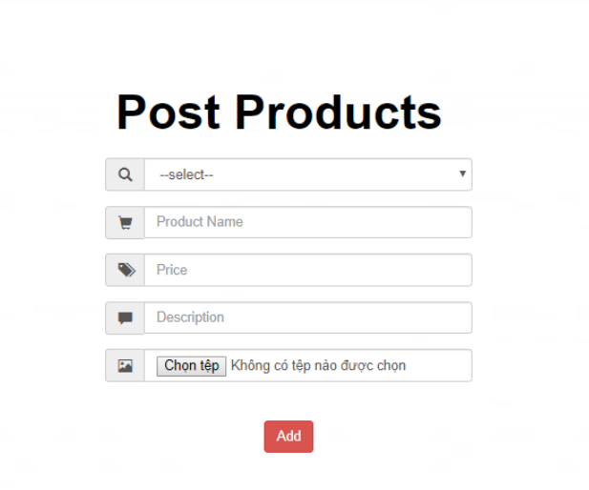
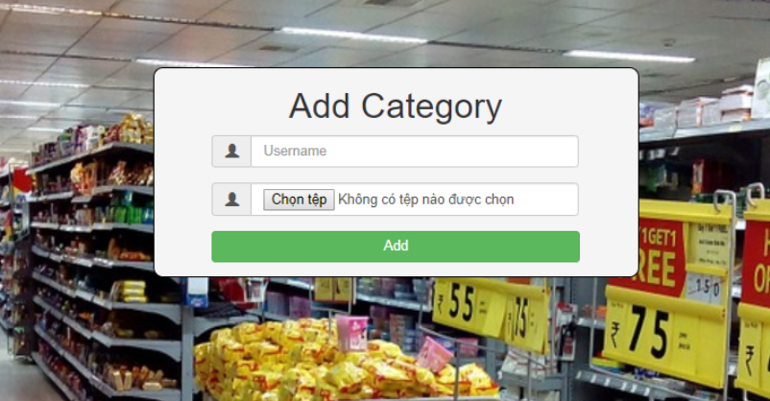
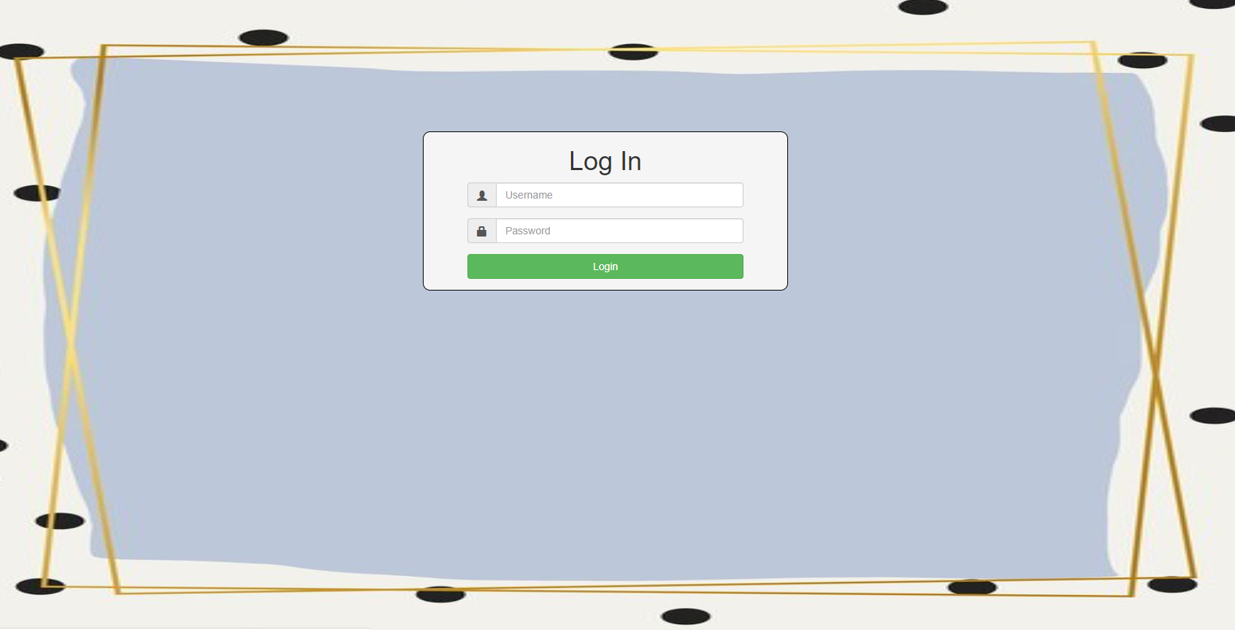
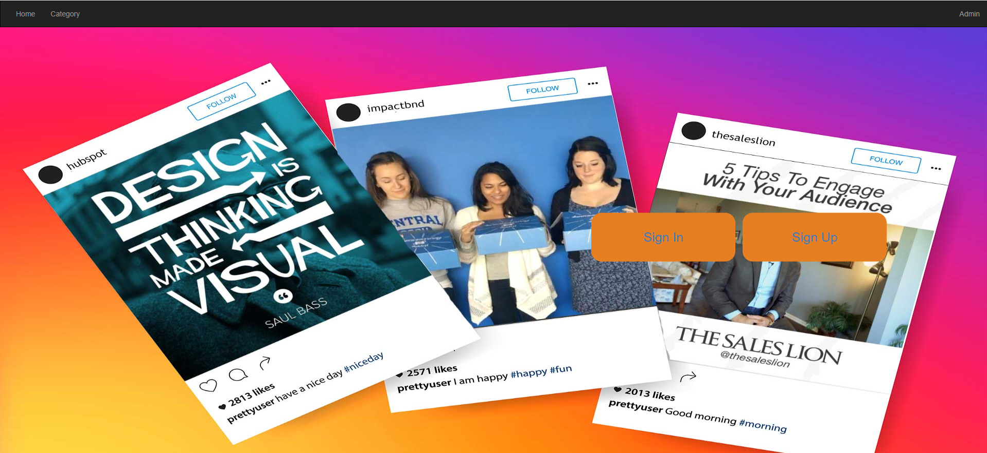
DEMO

