Slide 1


TITANIC
Logistic Regression Project
GROUP 4
Aryan Panicker - BS21DMU012
Anh Viet Doan - BS21DON043
Bang Nguyen - BS21DON020
Duy Le Duc - BS21DON032
Geethanjali Dhanish – BS21DON044

Slide 2
INTRODUCTION
GIVEN : titanic_train.csv
To Predict : whether the passenger will Survive or Not
According to the data given :
Not Survived = 0 [negative]
Survived = 1 [positive]
TOPICS TO BE COVERED
Dataframe Creation
Exploratory Data Analysis and Data Visualization
Handling Missing Data Values
Logistic Regression Model – Prediction and Evaluation
Categorical Features
Confusion Matrix and Classification Report
Feature Engineering

Slide 3
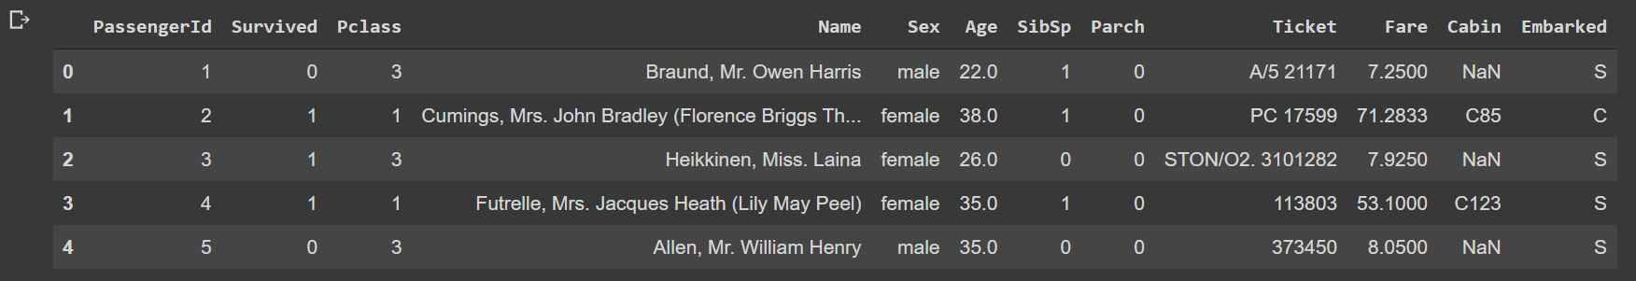
INITIAL STEPS (DATAFRAME CREATION)
LIBRARIES IMPORTED
Read CSV File and Display Dataframe
import numpy as np
import pandas as pd
import matplotlib.pyplot as plt
%matplotlib inline
import seaborn as sns
titanic = pd.read_csv('titanic_train.csv’)
titanic.head()

Slide 4
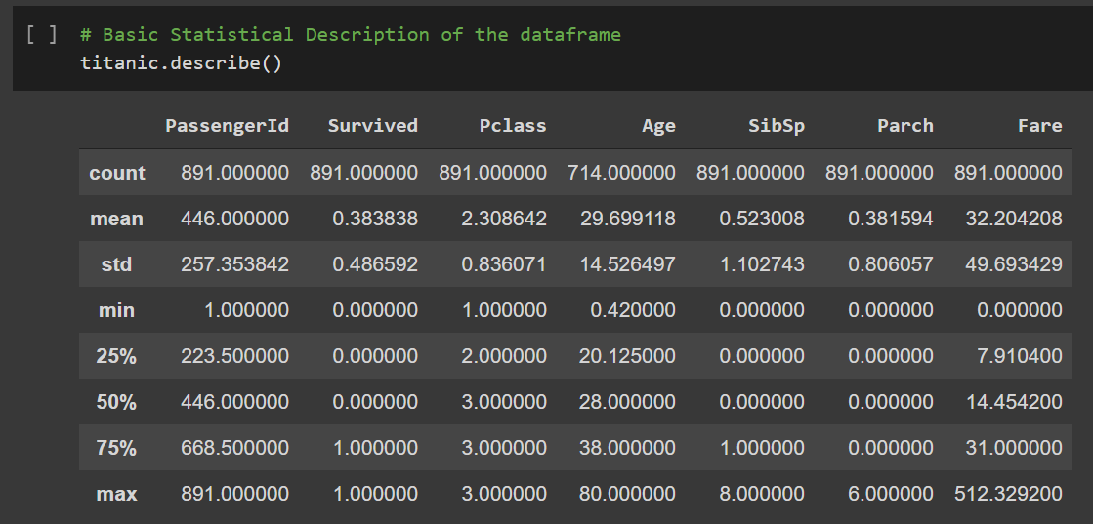
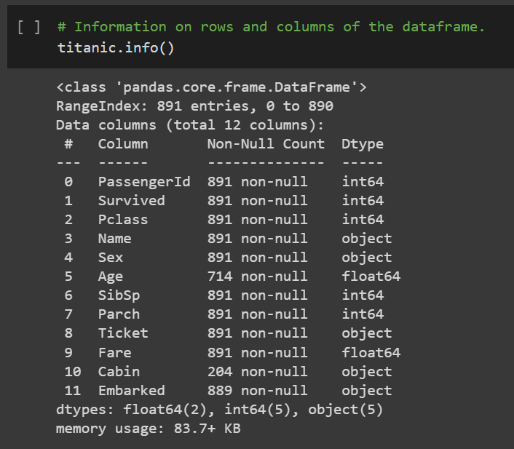
EXPLORATORY DATA ANALYSIS

Slide 5
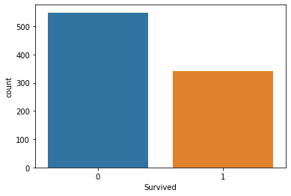
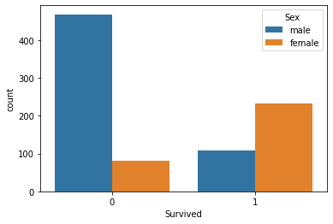
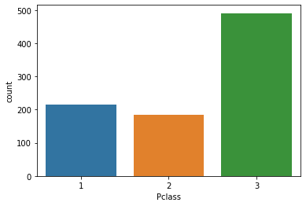
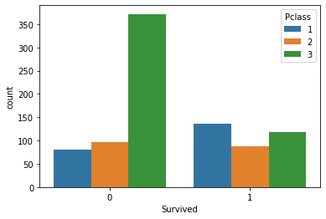
DATA VISUALIZATION
sns.countplot(titanic['Survived'])
sns.countplot(x='Survived', hue='Sex', data=titanic)
sns.countplot(titanic['Pclass'])
sns.countplot(x='Survived', hue='Pclass', data=titanic)

Slide 6
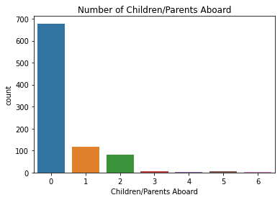
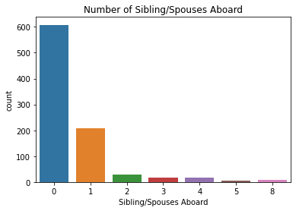
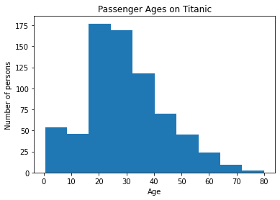
DATA VISUALIZATION
sns.countplot(titanic.Parch)
plt.title("Number of Children/Parents Aboard")
plt.xlabel("Children/Parents Aboard")
sns.countplot(titanic.SibSp)
plt.title("Number of Sibling/Spouses Aboard")
plt.xlabel("Sibling/Spouses Aboard")
plt.hist(titanic['Age'])
plt.xlabel("Age")
plt.ylabel("Number of persons")
plt.title('Passenger Ages on Titanic')

Slide 7
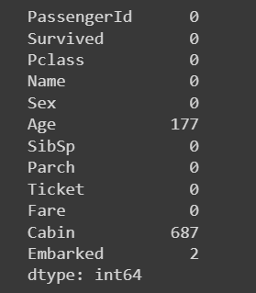
HANDLING MISSING DATA
DATA CLEANING
titanic.isnull().sum()
null_1 = titanic['Age'][titanic['Pclass'] == 1].isnull()
null_2 = titanic['Age'][titanic['Pclass'] == 2].isnull()
null_3 = titanic['Age'][titanic['Pclass'] == 3].isnull()
pc1 = titanic['Age'][titanic['Pclass'] == 1].mean(skipna = True)
pc2 = titanic['Age'][titanic['Pclass'] == 2].mean(skipna = True)
pc3 = titanic['Age'][titanic['Pclass'] == 3].mean(skipna = True)
titanic['Age'].fillna(titanic.groupby('Pclass')['Age'].transform('mean'), inplace = True)
titanic_new = titanic.drop('Cabin', axis = 1)
titanic_new.dropna(subset=['Embarked'], inplace = True)
titanic_new.drop(['PassengerId','Name','Ticket'], axis = 1, inplace = True)

Slide 8
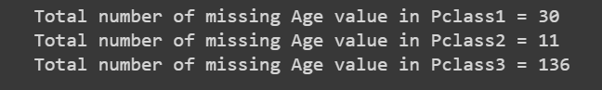

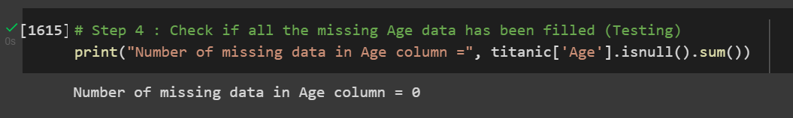
HANDLING MISSING DATA
DATA CLEANING – O/Ps

Slide 9
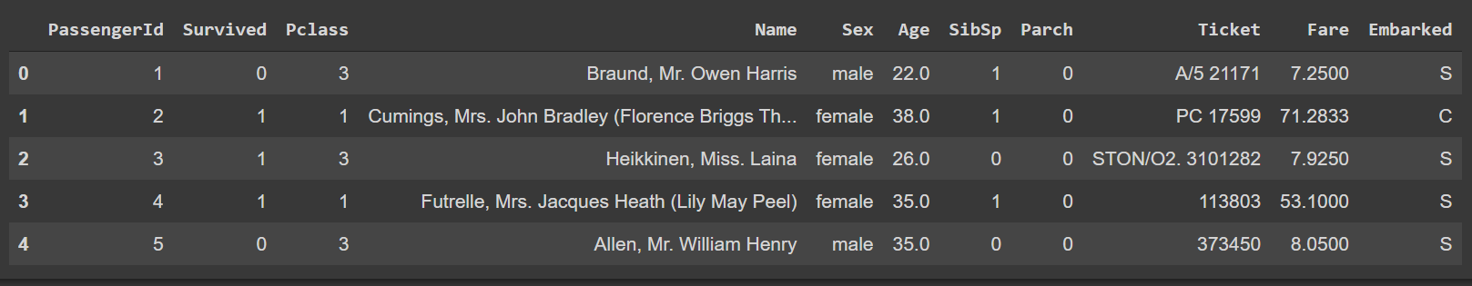
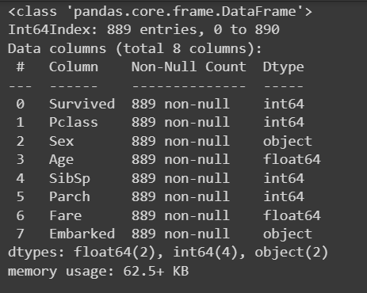
AFTER MISSING VALUES HANDLING
AFTER ADDITIONAL DATA CLEANING

Slide 10
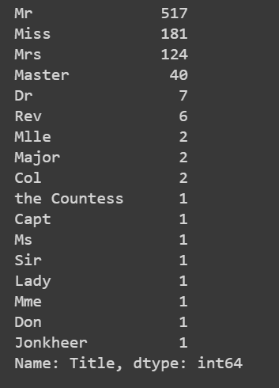
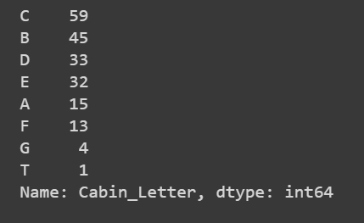
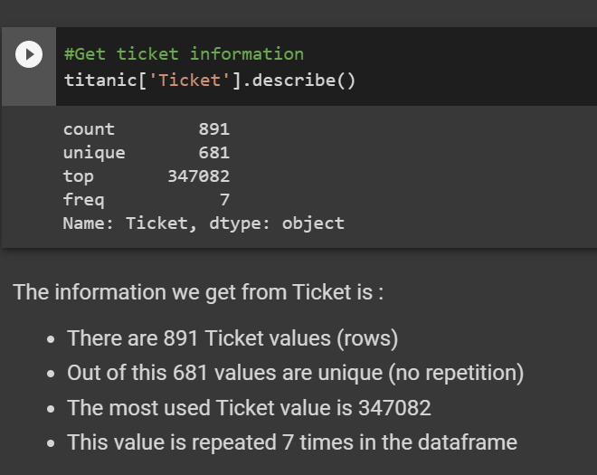
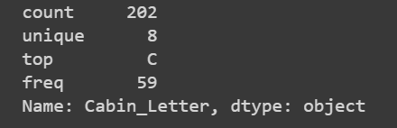
FEATURE ENGINEERING
titanic_new['Title'] = titanic['Name'].apply(lambda x: x[x.find(', ')+2 : x.find('.')])
titanic_new['Title'].value_counts()
titanic.dropna(subset=['Cabin'], inplace = True)
titanic_new['Cabin_Letter'] = titanic['Cabin'].astype(str).str[0]
titanic_new['Cabin_Letter'].value_counts()

Slide 11
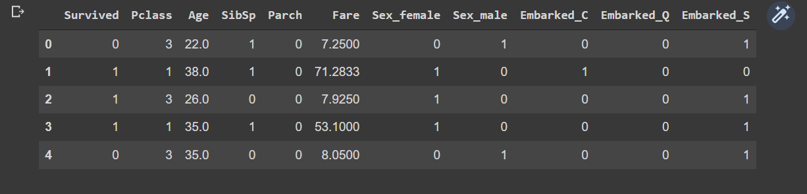
CONVERT CATEGORICAL FEATURES
titanic_new = pd.get_dummies(titanic_new,columns = ['Sex','Embarked'])

Slide 12
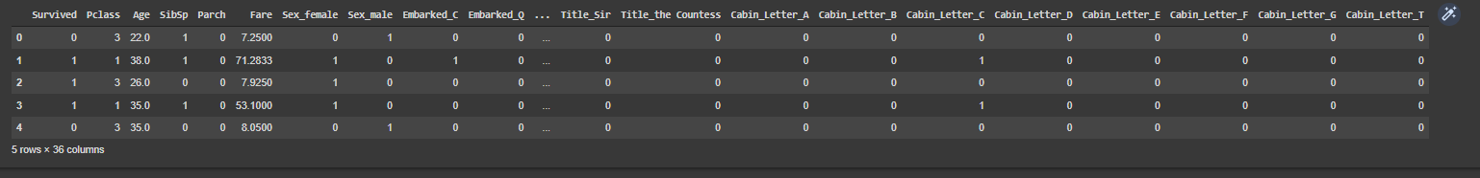
CONVERT CATEGORICAL FEATURES
titanic_new = pd.get_dummies(titanic_new,columns = ['Sex','Embarked','Title','Cabin_Letter'])

Slide 13
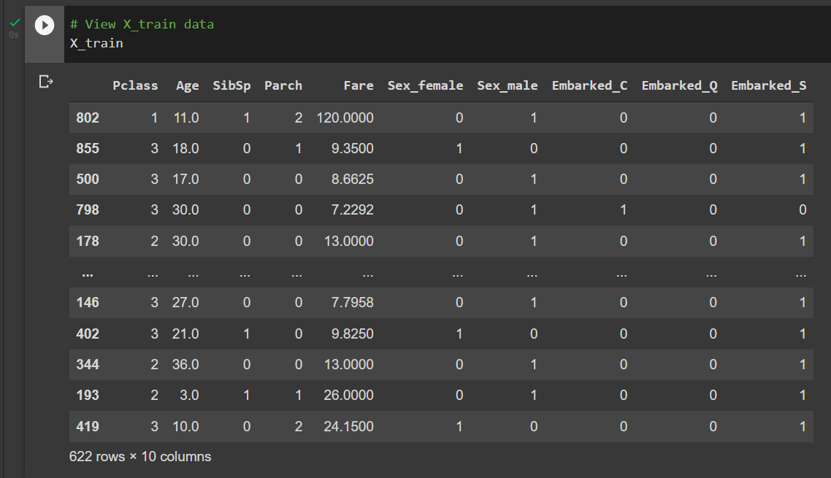
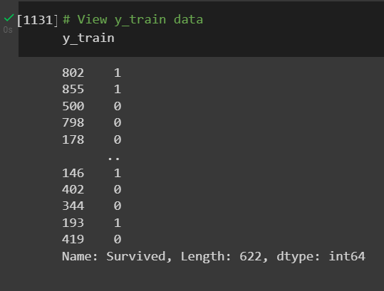
LOGISTIC REGRESSION MODEL
STEP 1 : SPLITTING THE DATA
from sklearn.model_selection import train_test_split
X = titanic_new.drop('Survived', axis = 1)
y = titanic_new['Survived']
X_train, X_test, y_train, y_test = train_test_split (X, y, train_size = 0.7, random_state = 24)

Slide 14
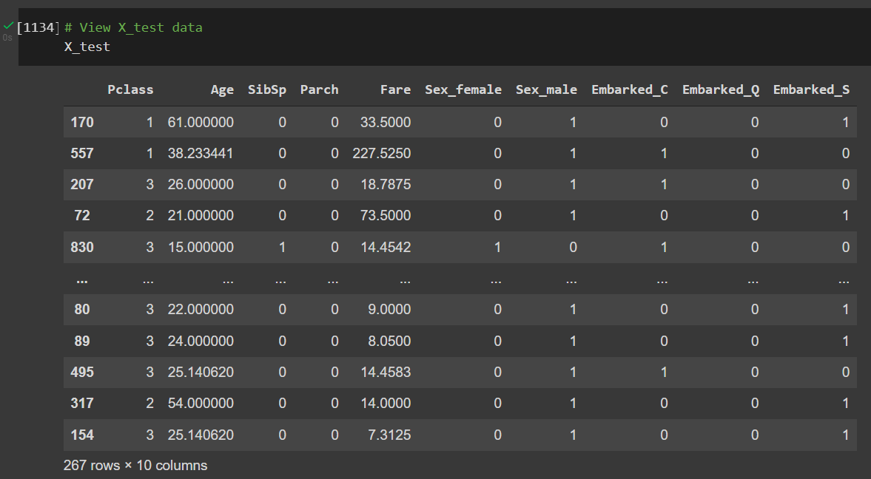
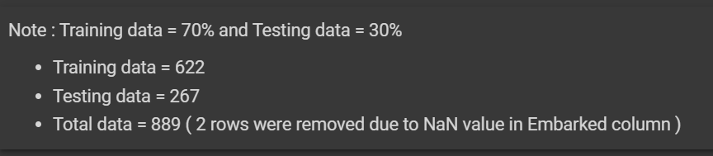
LOGISTIC REGRESSION MODEL
STEP 2 : BUILDING THE MODEL
from sklearn.linear_model import LogisticRegression
model = LogisticRegression(solver = 'lbfgs', max_iter=900)
model.fit(X_train, y_train)

Slide 15
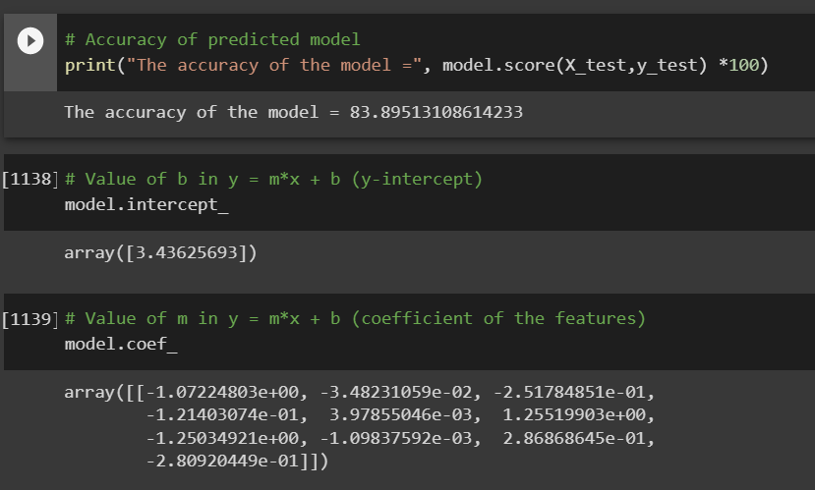
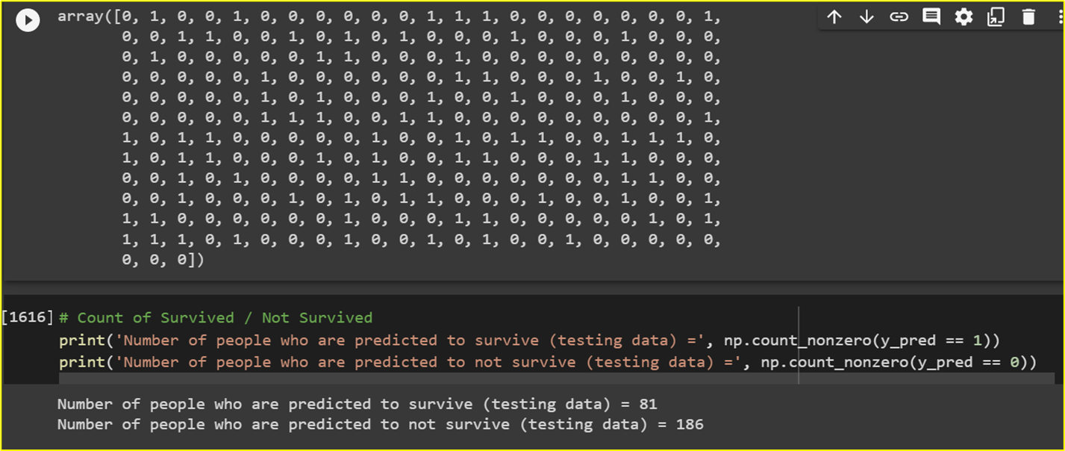
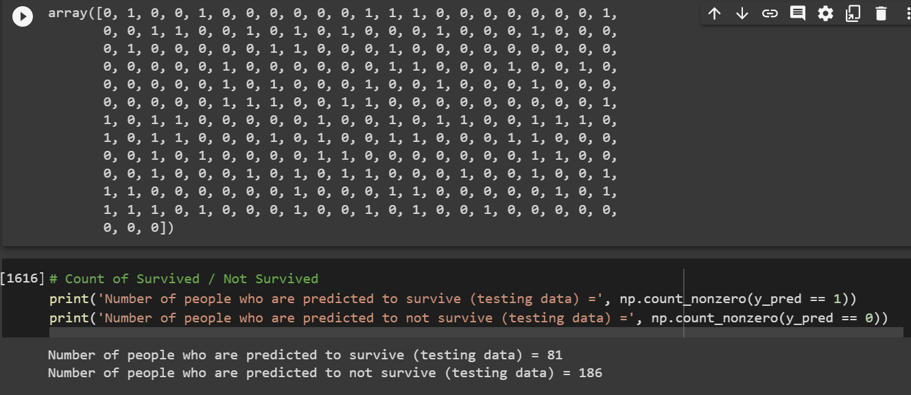
PREDICTION AND EVALUATION
y_pred = model.predict(X_test)
y_pred
model.predict_proba(X_test)

Slide 16
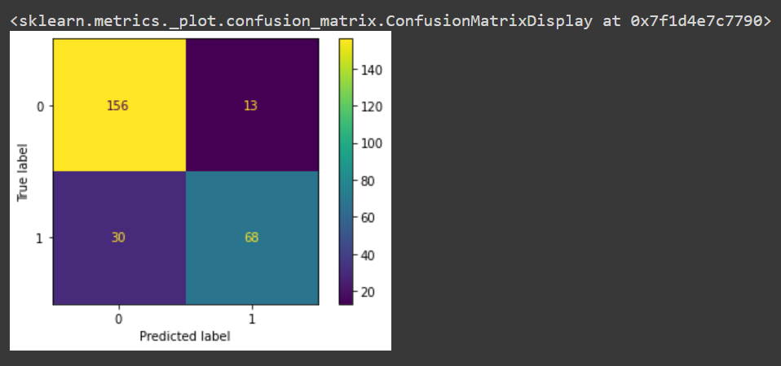
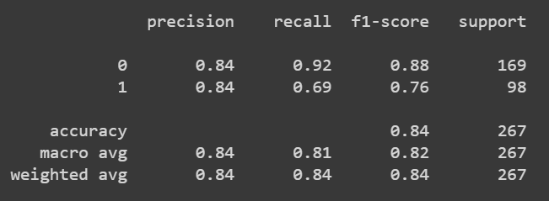
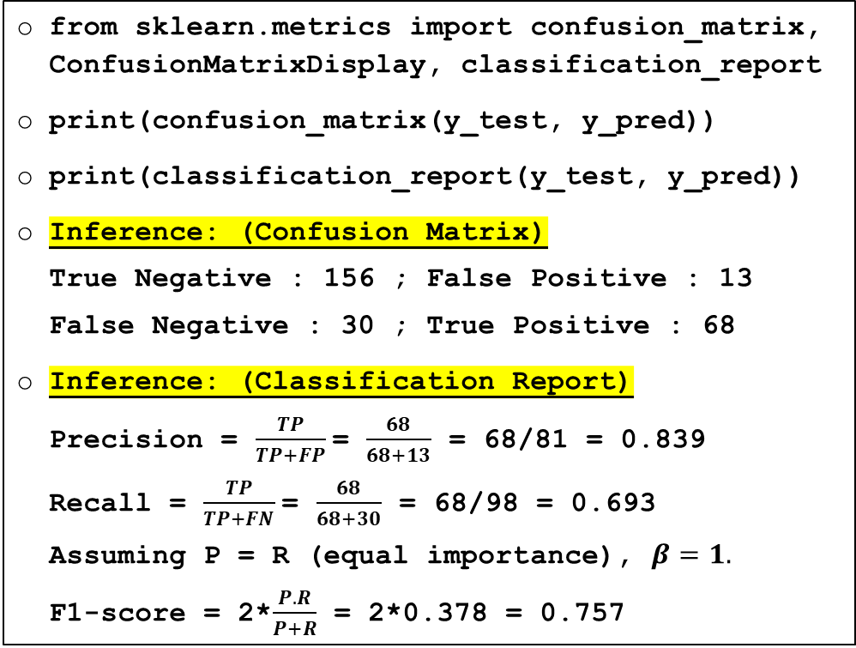
ANALYSIS – CONFUSION MATRIX AND CLASSIFICATION REPORT (WITHOUT FEATURE ENGINEERING)
from sklearn.metrics import confusion_matrix, ConfusionMatrixDisplay, classification_report
print(confusion_matrix(y_test, y_pred))
print(classification_report(y_test, y_pred))
Inference: (Confusion Matrix)
True Negative : 156 ; False Positive : 13
False Negative : 30 ; True Positive : 68
Inference: (Classification Report)
Precision = $\frac{TP}{TP+FP}$= $\frac{68}{68+13}$ = 68/81 = 0.839
Recall = $\frac{TP}{TP+FN}$= $\frac{68}{68+30}$ = 68/98 = 0.693
Assuming P = R (equal importance), $β=1.$
F1-score = 2*$\frac{P.R}{P+R}$ = 2*0.378 = 0.757

Slide 17
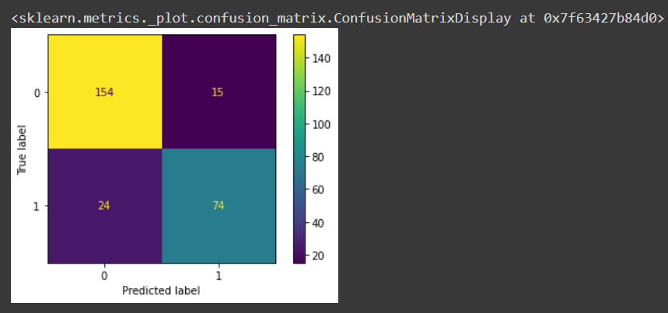
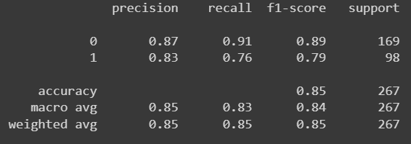
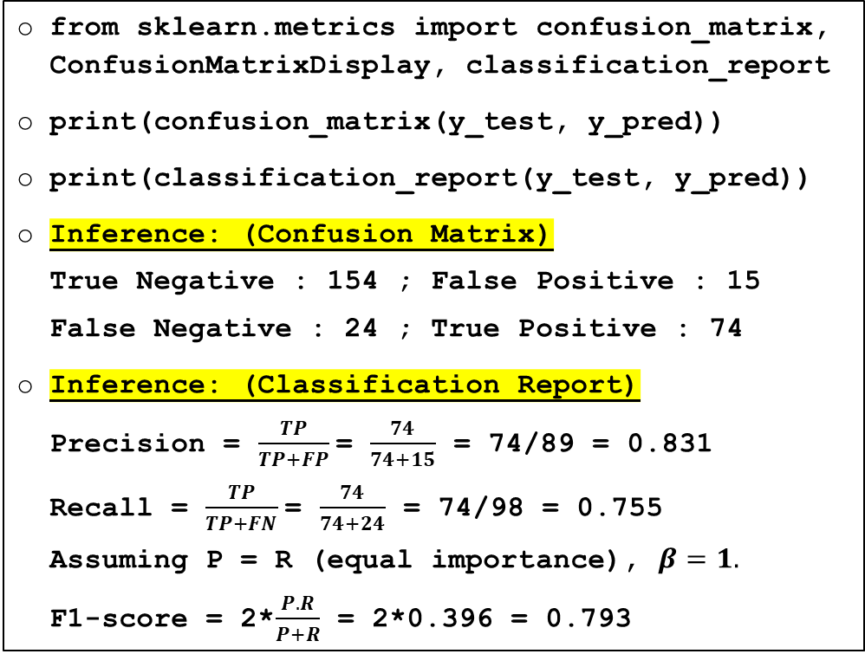
ANALYSIS – CONFUSION MATRIX AND CLASSIFICATION REPORT (WITH FEATURE ENGINEERING)
from sklearn.metrics import confusion_matrix, ConfusionMatrixDisplay, classification_report
print(confusion_matrix(y_test, y_pred))
print(classification_report(y_test, y_pred))
Inference: (Confusion Matrix)
True Negative : 154 ; False Positive : 15
False Negative : 24 ; True Positive : 74
Inference: (Classification Report)
Precision = $\frac{TP}{TP+FP}$= $\frac{74}{74+15}$ = 74/89 = 0.831
Recall = $\frac{TP}{TP+FN}$= $\frac{74}{74+24}$ = 74/98 = 0.755
Assuming P = R (equal importance), $β=1.$
F1-score = 2*$\frac{P.R}{P+R}$ = 2*0.396 = 0.793

Slide 18
MEMBERS CONTRIBUTION
S.No | Name | Contribution | Slide Nos.
1. | Aryan Panicker | Exploratory Data Analysis, Data Visualization | 4 - 6
2. | Anh Viet Doan | Missing Data Handling, Data Cleaning | 7 - 9
3. | Bang Nguyen | Building Logistic Regression Model, Model Prediction and Evaluation | 13 - 15
4. | Duy Le Duc | Feature Engineering, Categorical Data | 10 - 12
5. | Geethanjali Dhanish | Introduction, Analysis of Confusion Matrix and Classification Report | 2 – 3, 16 - 17

Slide 19


