Slide 1
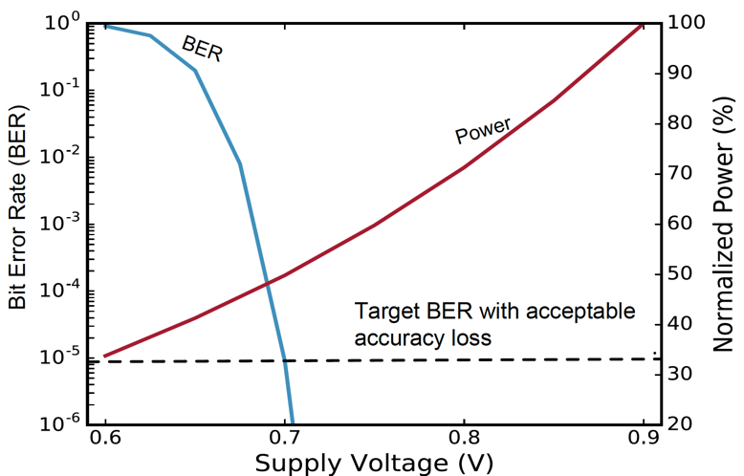
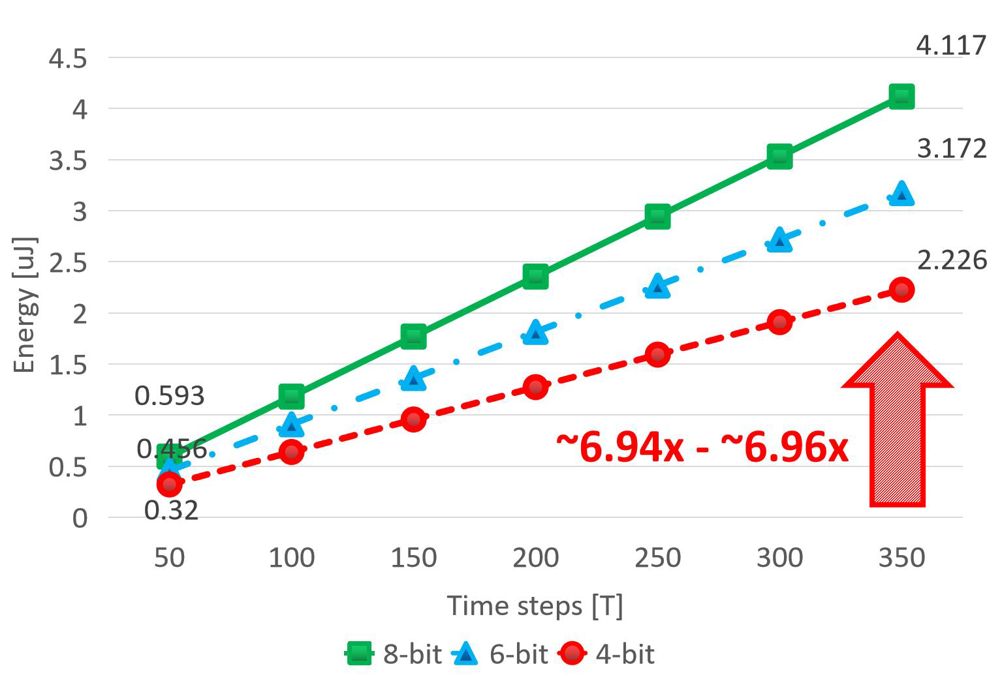
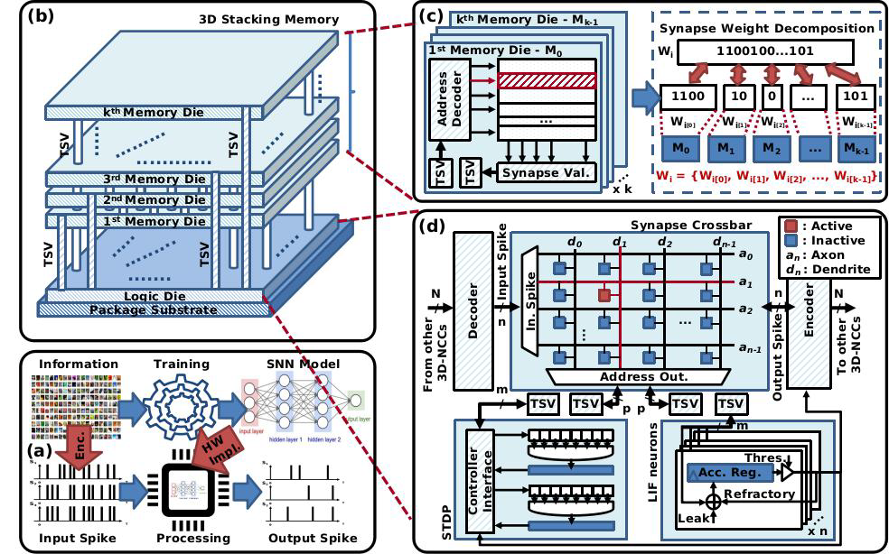
Enery per Prediction for different bitwidth and time-step
Bit Error Rate in each supply voltage
SNN Hardware architecture overview with partial memories organization

