Slide 2
Set up the table relationships
Look at each table and decide how the data in one table is related to the data in other tables. Add fields to tables or create new tables to clarify the relationships, as necessary
Refine your design
Analyze your design for errors. Create the tables and add a few records of sample data. See if you can get the results you want from your tables. Make adjustments to the design, as needed
Apply the normalization rules
Apply the data normalization rules to see if your tables are structured
correctly. Make adjustments to the tables, as needed

Slide 3

Determine the purpose of your database
It is a good idea to write down the purpose of the database on paper — its purpose, how you expect to use it, and who will use it. For a small database for a home based business
To find and organize the information required, start with your existing information

Slide 4
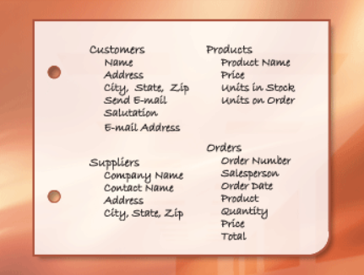
Dividing the information into tables
To divide the information into tables, choose the major entities, or subjects

Slide 5
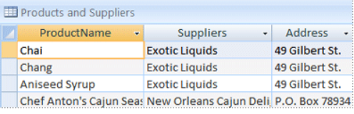
In this case, each row contains information about both the product and its supplier
A second problem with this design comes about when you need to modify information about the supplier
When you design your database, always try to record each fact just once

Slide 6
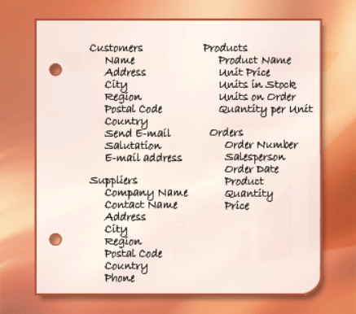
Turning information items into columns
To determine the columns in a table, decide what information you need to track about the subject recorded in the table
Once you have determined the initial set of columns for each table, you can further refine the columns

Slide 7
Specifying primary keys
Each table should include a column or set of columns that uniquely identifies each row stored in the table. This is often a unique identification number, such as an employee ID number or a serial number. In database terminology, this information is called the primary key of the table
Access using the key fields to quickly join data from multiple tables and aggregate data for you

Slide 8
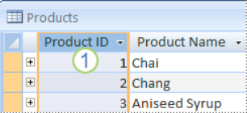
A column set to the AutoNumber data type often makes a good primary key. No two product IDs are the same
In some cases, you may want to use two or more fields that, together, provide the primary key of a table

Slide 9
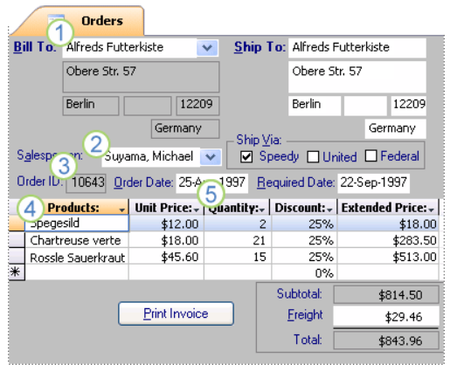
Creating the table relationships
Now that you have divided your information into tables, you need a way to bring the information together again in meaningful ways
1. Information in this form comes from the Customers table
2. ...the Employees table
3. ...the Orders table...
4. ...the Products table
5. ...and the Order Details table.
Access is a relational database management system. In a relational database, you divide your information into separate, subject-based tables. You then use table relationships to bring the information together as needed

Slide 10
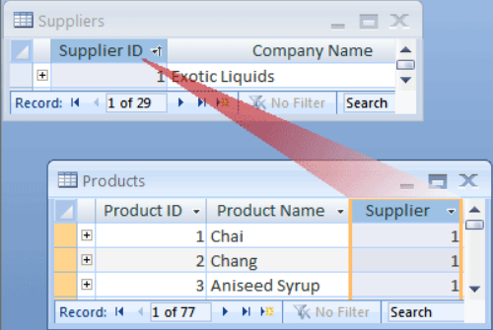
To represent a one-to-many relationship in your database design, take the primary key on the "one" side of the relationship and add it as an additional column or columns to the table on the "many" side of the relationship. In this case

Slide 11
Refining the design
Once you have the tables, fields, and relationships you need, you should create and populate your tables with sample data and try working with the information: creating queries, adding new records, and so on. Doing this helps highlight potential problems
As you try out your initial database, you will probably discover room for improvement. Here are a few things to check for
Did you forget any columns? If so, does the information belong in the existing tables?
Are any columns unnecessary because they can be calculated from existing fields?
Are you repeatedly entering duplicate information in one of your tables?
Do you have tables with many fields, a limited number of records, and many empty fields in individual records?
Has each information item been broken into its smallest useful parts?

