Slide 1
Data Mining Technique
Phùng Chí Nguyên
Lê Trung Hiếu
Lê Dương Công Phúc

Slide 2
Classification: Definition
Training set là một tập dữ liệu chứa một tập hợp attributes, trong đó có một attribute là class
Tìm ra model cho class attribute dựa vào giá trị của các thuộc tính khác
Dữ liệu input thường chia thành 2 phần:
Training set dùng để build model
Test set dùng để validate model

Slide 3
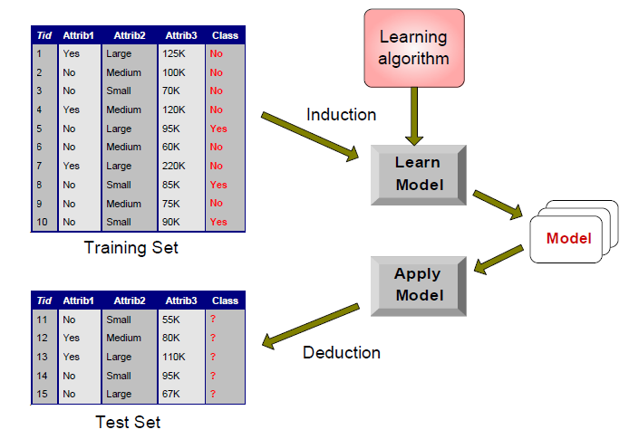
Minh họa Classification Task

Slide 4
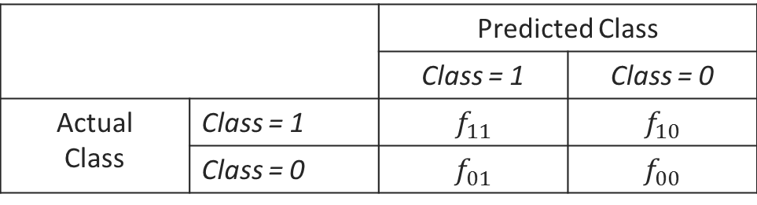
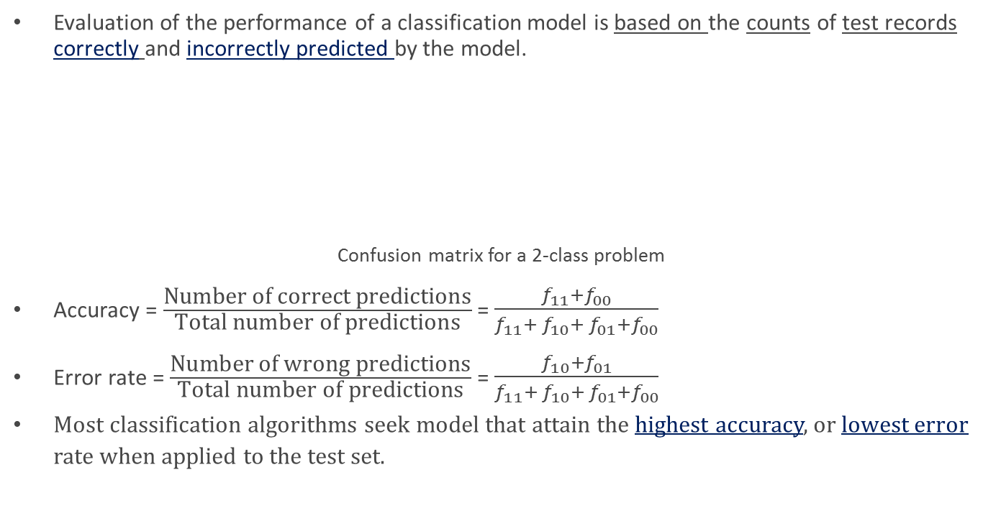
Evaluate the performance of a classification model
Evaluation of the performance of a classification model is based on the counts of test records correctly and incorrectly predicted by the model.
Confusion matrix for a 2-class problem
Accuracy = $\frac{\text{Number} \text{of} \text{correct} \text{predictions}}{\text{Total} \text{number} \text{of} \text{predictions}}$ = $\frac{f_{11}+f_{00}}{f_{11}+{ f}_{10}+ f_{01}+f_{00}}$
Error rate = $\frac{\text{Number} \text{of} \text{wrong} \text{predictions}}{\text{Total} \text{number} \text{of} \text{predictions}}$ = $\frac{f_{10}+f_{01}}{f_{11}+{ f}_{10}+ f_{01}+f_{00}}$
Most classification algorithms seek model that attain the highest accuracy, or lowest error rate when applied to the test set.
 |  | Predicted Class
 |  | Class = 1 | Class = 0
Actual Class | Class = 1 | $$f_{11}$$ | $$f_{10}$$
 | Class = 0 | $$f_{01}$$ | $$f_{00}$$

Slide 5
Classification Techniques
Decision Tree based Methods
Rule-based Methods
Memory based reasoning
Neural Networks
Naïve Bayes and Bayesian Belief Networks
Support Vector Machines

Slide 6
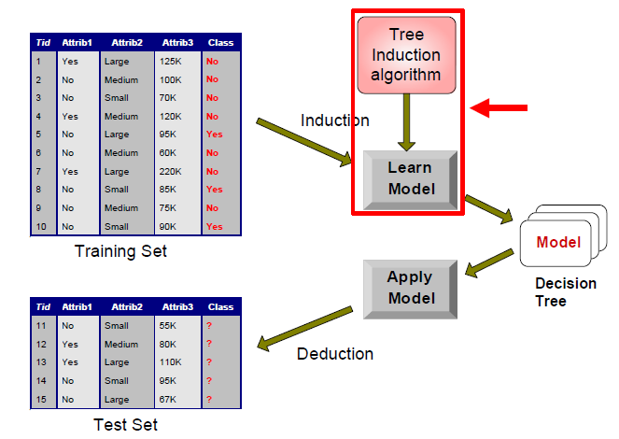
Decision Tree Classification Task

Slide 7
Decision Tree Induction
Hunt’s Algorithm (one of the earliest)
CART
ID3, C4.5, C5
SLIQ,SPRINT
ToDo:
Tìm hiểu Hunt’s Algorithm + C4.5 – References: References\Data Mining\Introduction to Data Mining - Pang-Ning Tan\Slide\chap4_basic_classification.pdf
Các công thức cơ bản để chia nhánh trong Decision tree

Slide 8
Choosing Attributes to Split On: Using Entropy

Slide 9
Pivot Tranformation
Chuyển record thành columns trong SQL Server
http://msdn.microsoft.com/en-us/library/ms140308.aspx
http://dotnetgalactics.wordpress.com/2009/10/23/using-sql-server-20052008-pivot-on-unknown-number-of-columns-dynamic-pivot/

