Slide 1
Crack detection

Slide 2
paper
Comparison of deep convolutional neural networks and edge detectors for image-based crack detection in concrete – 2018
  Data set: SDNet2018
  An overall performance comparison between image processing technique and deep learning (train from scratch + transfer learning)

Slide 3
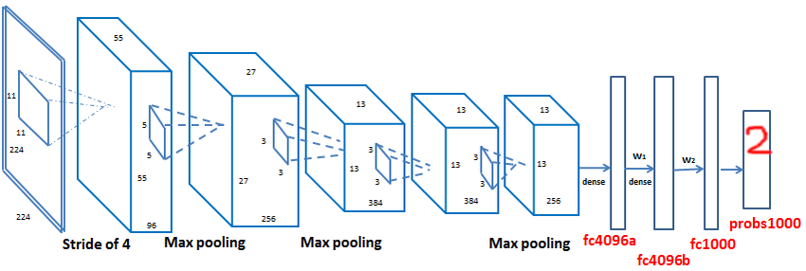
Training Alexnet from scractch on Alexnet architecture
Original Alexnet architecture
  Batch normalization + Dropout(0.4) + Max Pooling

Slide 4
Training Alexnet from scractch on Alexnet data set
Data set
  50,000 images
    Training: 36459 images, 365 batches/epoch
    Validation: 8413 images
    Testing: 11220 images

Slide 5
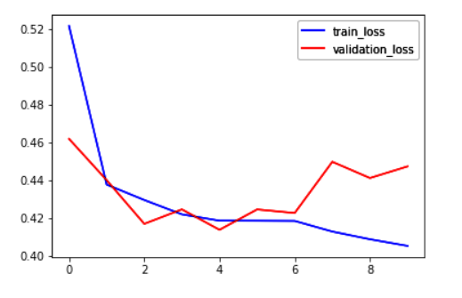
Training Alexnet from scractch on Alexnet training
Profile:
  Optimizer: lr=0.002, beta_1=0.9, beta_2=0.999
  Loss: binary cross entropy
  GTX 1080TI
  55s/epoch
  10 epochs
  over-fit after 4 epochs
  Accuracy: 85%

Slide 6
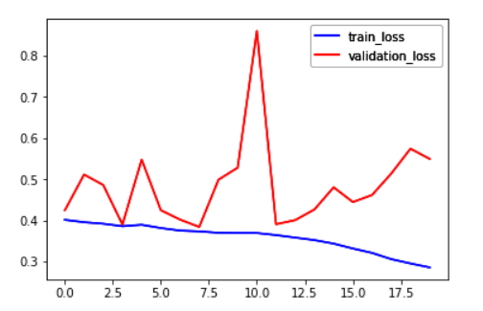
Training Alexnet from scractch on Alexnet
20 more epochs
  Accuracy
    83%

Slide 7
Next step
Visualize the learned features to figure out how does the network learn.
Other optimizer: RMSProp, Adadelta, learning rate
Other ideas?

