Slide 1
BUBBLE
SHOOTER
GAME
Team 2:
HaTNK ©
DungHK1
TuanND2

Slide 2
01
Introduce
02
Idea diagram
CONTENT
03
Self review
Demo
04

Slide 3
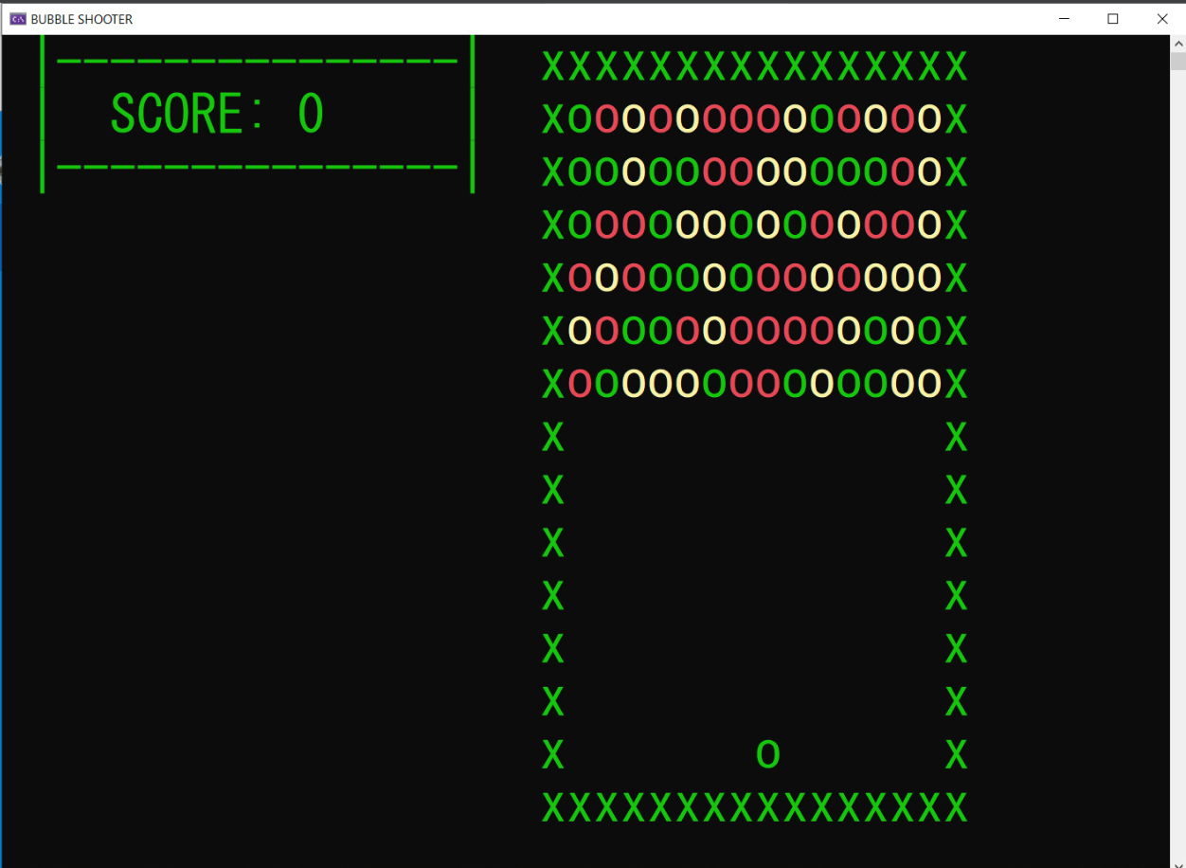
GAME INTRODUCTION
“Bubble shooter" is "a good and attractive intellectual game with a beautiful colorful interface". With your intelligence, remove all the balls from space.”

Slide 4
IDEA
DIAGRAM

Slide 5
OVERVIEW
GENERAL MODE:
WAIT
PLAY
LOSE
EXIT
PLAY MODE:
SHOOTING
CREATING BUBBLE
NO THING

Slide 6
START
WAIT
PLAY
LOSE
2 THREADS:
BUBBLE CREATE
SHOOTER CONTROL
DISPLAY SCORE
GET KEY INPUT
NAVIGATION
PLAY?
Y
LOSE?
Y
LOSE
N
N
N
EXIT PLAY?
N
EXIT?
END
Y
Y
WAIT

Slide 7
CREATE BUBBLE
SHOOTER CONTROL
END THREAD
N
PLAYING?
GET KEY INPUT
Y
SHIFT BUBBLE DOWN
SWITCH
SHOOTING
MOVING
EXIT PLAY
CHECK LOSE
LOSE GAME
Y
LOSE?
N
LOSE?
WAIT
N
CREATE NEW BUBBLE ROW
Y
END THREAD
SLEEP

Slide 8
IMPLEMENT
Class Point
Class Bubble
Class Shooter
Class Game Interface

Slide 9
Class Point
Coordinates X, Y
Character
Color
Attribute
Method
Draw
Eraser

Slide 10
Class Bubble
Point*
Attribute
Draw
Eraser
Moving
Method

Slide 11
Class Shooter
Bubble*
Attribute
Score calculation
Shooting
Control
Change color
Moving
Draw
Method

Slide 12
Class Game Interface
Method
Update game interface
Create bubble row

Slide 13
SELF REVIEW

Slide 14
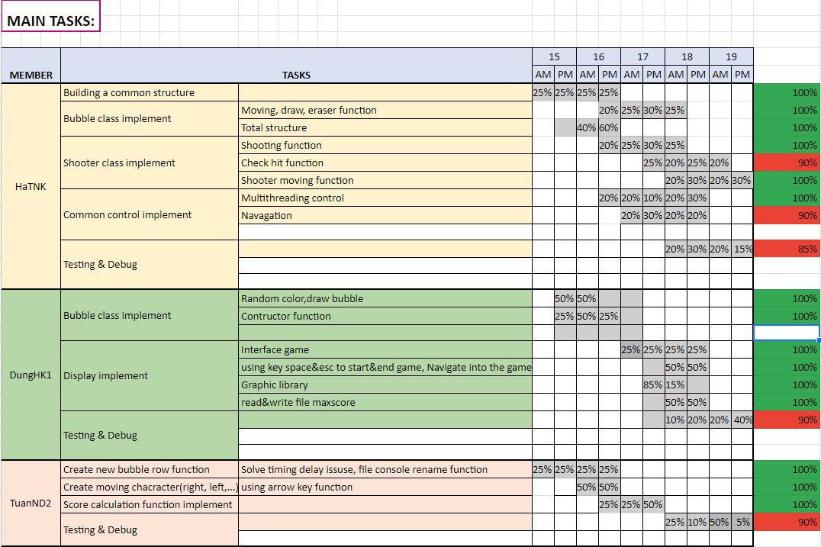

Slide 15
THANK YOU

