Slide 1
QuizFlow
C++
The Future of Learning — Powered by a C++ OOP Engine
An intelligent full-stack quiz platform for Diploma in IT students.
Presented by: [Your Name]
[Course] | [College Name] | Guide: [Guide Name]

Slide 2
Problem Statement
02
Why this project exists
“Traditional learning lacks engagement, instant feedback, and healthy competition. Students cannot easily practice, revise, or challenge their peers.”
+ No real-time feedback
— students revise without knowing if they are right
+ Boring revision
— no gamification or motivation to keep going
+ No competition
— no way to brainers compare with friends or peers
+ No progress tracking
— hard to see strengths and weak topics

Slide 3
Objectives
03
What we set out to achieve
+ Full-stack quiz platform
— for Diploma in IT students
+ 5 subjects
— with timed quizzes across easy / medium / hard difficulty
+ Real-time 1v1 battle mode
— compete live against friends or random players
+ Progress tracking
— results, streaks, achievements and global leaderboard
+ Pure OOP design
— demonstrate inheritance, polymorphism, encapsulation and abstraction in C++
+ Admin control
— full CRUD for quizzes & questions, plus analytics

Slide 4
Introduction to QuizFlow
04
Learning + Gaming in one platform
+ Two ways to practice:
— Solo mode & Battle mode make it fun
+ 1. Solo Quizzes
— pick subject → chapters → difficulty → timed quiz
+ 2. Battle Mode
— real-time 1v1 against friends (room code) or random players
+ Live global leaderboard
— podium for the top 3, full rankings table
+ Personal profile
— avatar, streaks, achievements, battle history
+ Admin panel
— overview stats, quiz management, student table, analytics

Slide 5
Tech Stack
05
Three layered backends, one unified platform
Layer | Technology | Purpose
Frontend | HTML5, CSS3, Vanilla JS, Canvas + SVG | UI, animations, real-time widgets
Backend #1 | C++17 (MSVC) — OOP console app | Core OOP engine, classes & polymorphism
Backend #2 | Node.js + ws + better-sqlite3 | WebSocket battle server (port 9090)
Backend #3 | C++17 custom WebSocket server | Raw TCP + RFC 6455, OpenSSL, SQLite3
Database | SQLite (quizflow.db, WAL mode) | 8 tables: users, questions, battles...
Design | Glassmorphism / holographic UI | Modern dark theme, responsive

Slide 6
System Architecture
06
How the pieces talk to each other
Frontend
Static HTML / CSS / JS (14 pages)
WebSocket (WS)
Node.js Battle Server
WebSocket (ws) • port 9090
better-sqlite3 → quizflow.db
C++ Console App (OOP)
quizflow.exe • class hierarchy
C++ WebSocket Server
raw RFC 6455 • OpenSSL • SQLite3
C++ OOP core engine
Alternative full WS server

Slide 7
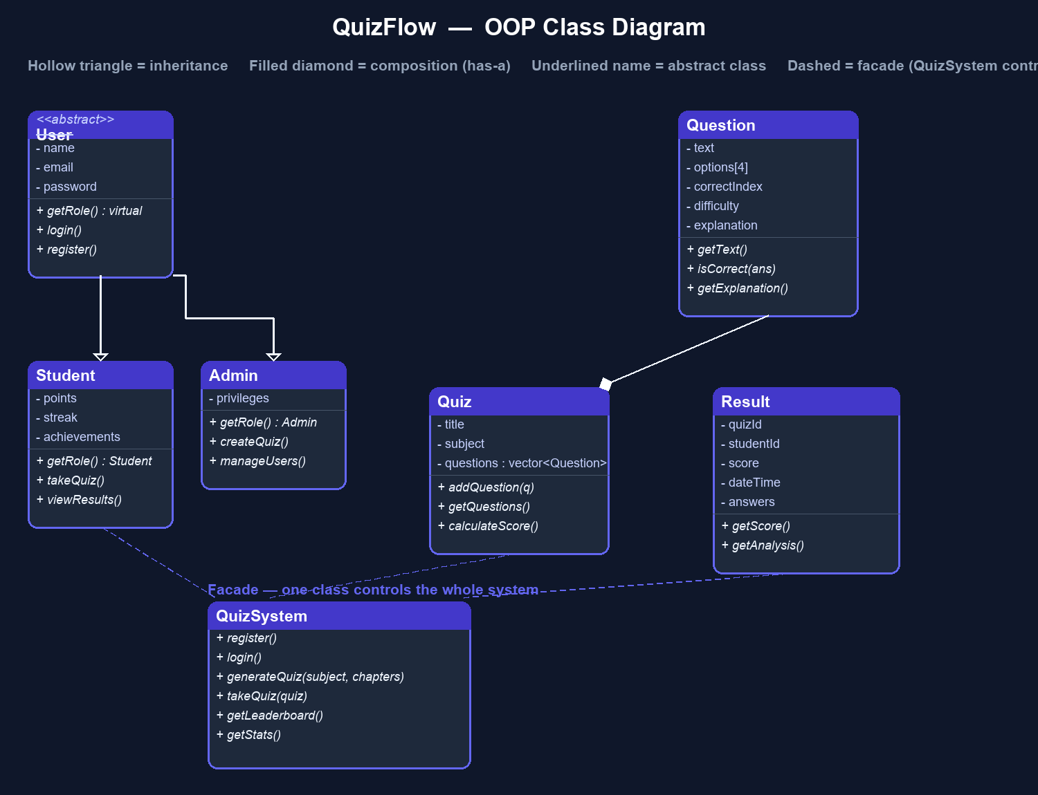
OOP Concepts Used
07
The heart of the project
+ Abstraction
— User is an abstract base with pure virtual getRole()
+ Inheritance
— Student & Admin extend User
+ Polymorphism
— base pointers call overridden methods at runtime
+ Encapsulation
— Question hides data, exposes getters
+ Composition
— Quiz has-a vector<Question>
+ Facade pattern
— QuizSystem controls everything

Slide 8
C++ Battle Server — Full-Stack OOP Core
08
WebSocket protocol written from scratch
+ Custom WebSocket server
— built from raw TCP sockets, no external library
+ RFC 6455 compliance
— handshake, frame read/write, ping/pong, masking
+ BattleManager class
— all battle game logic in one place
+ Database class
— clean SQLite3 wrapper
Same requirements, two solutions:
C++ proves the OOP core; Node.js powers fast real-time battles.
+ Domain structs
— Player, Question, BattleRoom, BattleResult, LeaderboardEntry
+ OpenSSL integration
— secure handshake support

Slide 9
Database Design
09
SQLite — 8 tables, WAL mode, foreign keys ON
Table | Stores
users | students & admins (hashed passwords)
questions | subject, chapter, 4 options, correct index, difficulty
battle_rooms | live rooms, codes, timers, current question
battle_players | scores and readiness per battle
battle_answers | every answer from both players, correctness
battle_results | scores, winner, finish time
leaderboard | wins, losses, draws, total points
results | attempt history behind the dashboard

Slide 10
Key Features
10
What the platform lets you do
+ Solo quiz flow
→ syllabus → chapters → quiz → timed questions → detailed result review
+ Battle mode
→ quick match or private room (code QF-XXXX) with live scores
+ Animated UI
→ SVG timer ring, score popups, countdown, particle background
+ Admin panel
→ full CRUD for quizzes/questions + analytics charts
+ Profile & progress
→ avatar, streak, achievements, battle history
+ Leaderboard
→ top-3 podium + full ranked table

Slide 11
Live Demo
11
Watch it work end-to-end
1. C++ Console App Run quizflow.exe — register, login, take a quiz, view leaderboard
2. Battle Server node server/battle-server.js → open two browsers → 1v1 with room code
3. Admin Panel Create a quiz with questions, view analytics
4. Database Inspect quizflow.db tables live (questions, leaderboard)

Slide 12
Challenges Faced
12
And how they were solved
WebSocket from raw TCP sockets — implementing RFC 6455 framing, masking, fragmentation
Real-time sync — keeping two players' answers and scores in perfect sync
Database consistency — WAL-mode SQLite under concurrent live battles
Responsive glassmorphism UI — polished look on mobile and desktop
Bugs & debugging — WebSocket edge cases, timing issues in battle games

Slide 13
Results & Achievements
13
Proof the project works
1200+
24
5800+
92%
students onboarded
quizzes available
attempts recorded
success rate
+ Real-time battles
— room codes, instant matchmaking, disconnect handling
+ Admin capability
— manage all content without touching the database directly
+ Complete tracking
— achievements, streaks, per-question analysis

Slide 14
Future Scope
14
Where QuizFlow goes next
+ Mobile app
— take quizzes and battles on the go
+ AI-generated questions
— endless fresh content automatically
+ Tournaments
— 3+ player multiplayer battles
+ Cloud deployment
— move from localhost to real hosting (Render / Vercel)
+ Anti-cheat
— fair play during live battles

Slide 15
Thank You!
Questions are welcome.
QuizFlow • OOP Made Practical • [Your Name]

