Slide 1

Course ID: 8011E001 Computer programming & data processing 數據運算程式設計
Le Nguyen Quoc Khanh
黎阮國慶
Python Pandas

Slide 2
data

Slide 3
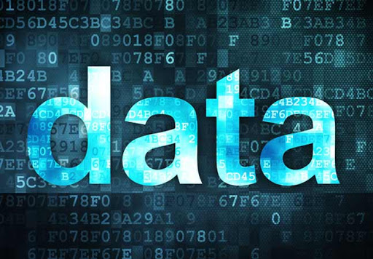
Type of data
Image data
Text data
Sound data
Signal data
Physical data
Biological data
…
http://effvision.com/?q=node/106

Slide 4
Dataset format
2 parts:
Label (class)
Data
Label | D1 | D2 | D3 | … | Dn
1
0
0
1
0
…
1

Slide 5
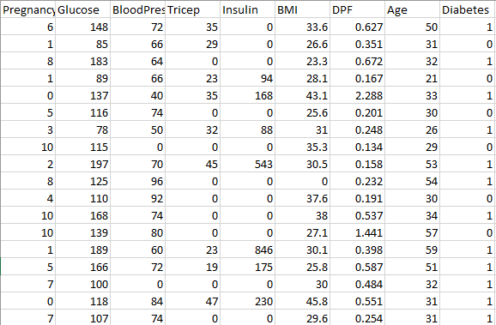
Dataset format
Example of CSV data

Slide 6
Public resources for dataset
UC Irvine Machine Learning Repository
https://archive.ics.uci.edu/ml/index.php
Google Dataset
https://toolbox.google.com/datasetsearch
Kaggle
https://www.kaggle.com/
https://towardsai.net/p/machine-learning/best-free-datasets-for-machine-learning-and-data-science/stanfordai/3451/

Slide 7
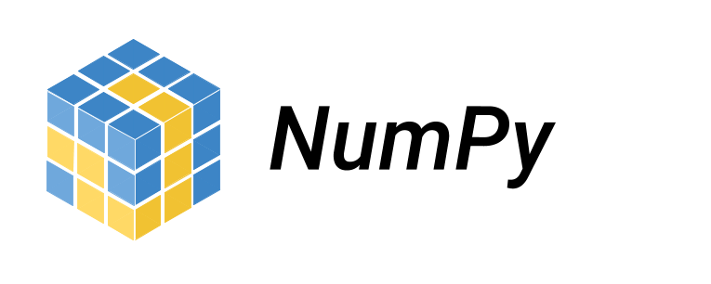
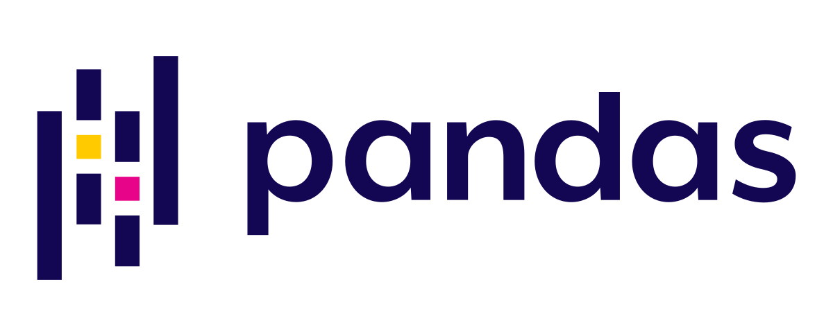
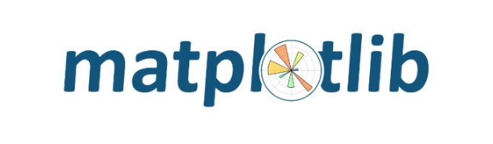
Key libraries
CSV
NumPy
Pandas
Matplotlib

Slide 8
Considerations When Loading CSV Data
CSV File Header
Comments
Delimiter
Quotes

Slide 9
How to load data?
Load CSV with Python Standard Library
csv.reader()
Load CSV File With NumPy
numpy.loadtxt()
Load CSV File With Pandas
pandas.read_csv

Slide 10
Data Visualization
Univariate Plots
Multivariate Plots

Slide 11
Data Analysis using Pandas

Slide 12
Pandas
[pandas] is derived from the term "panel data", an econometrics term for data sets that include observations over multiple time periods for the same individuals. — Wikipedia

Slide 13
What's Pandas for?
This tool is essentially your data’s home
Through pandas, you get acquainted with your data by cleaning, transforming, and analyzing it.

Slide 14
How does Pandas fit into the data science toolkit?
Conjunction with other libraries
Top of NumPy package
Jupyter Notebook is a good environment for Pandas

Slide 15
Install & Import
terminal program (for Mac users) or command line (for PC users)
conda install pandas
pip install pandas
!pip install pandas
Import
import pandas as pd

Slide 16
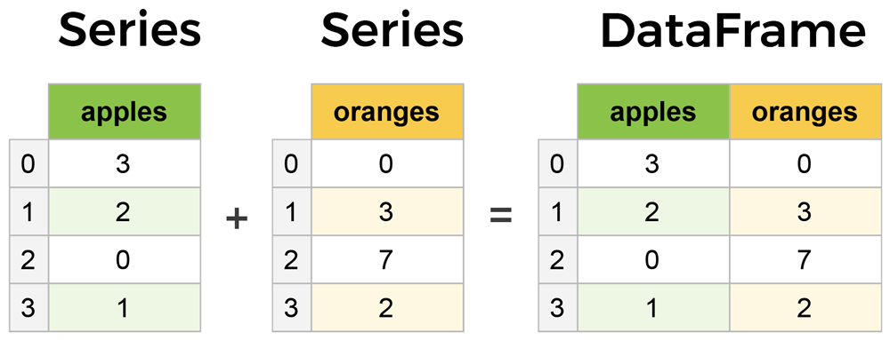
Core components of pandas

Slide 17
Outline
Creating DataFrame
Input – Output
DataFrame Operations
Viewing and Inspecting Data
Selection of Data
Filter, Sort and Groupby
Data Cleaning
Join/Combine

Slide 18
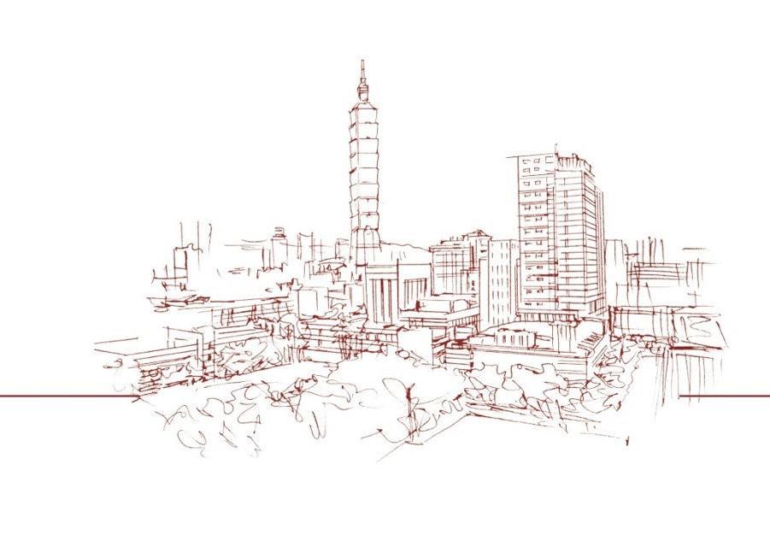
Thank you for your attention
2020/03/05

