Slide 1

Course ID: 8011E001 Computer programming & data processing 數據運算程式設計
Le Nguyen Quoc Khanh
黎阮國慶
Python Matplotlib

Slide 2
Python matplotlib
Data Visualization in Python

Slide 3
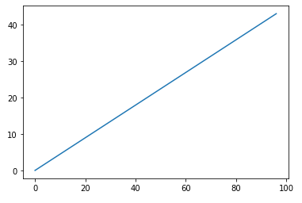
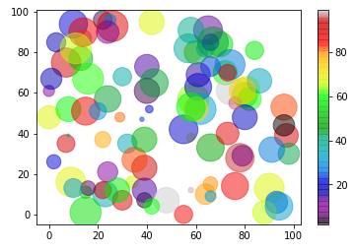
What is Matplotlib?
Matplotlib is a low level graph plotting library in python that serves as a visualization utility.
Matplotlib is open source and we can use it freely.
Matplotlib is mostly written in python, a few segments are written in C, Objective-C and Javascript for Platform compatibility.
https://github.com/matplotlib/matplotlib

Slide 4
Matplotlib Getting Started
Installation
pip install matplotlib
Import
import matplotlib
Checking Matplotlib Version
print(matplotlib.__version__)

Slide 5
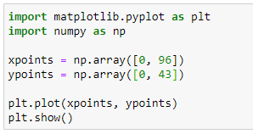
Matplotlib Pyplot
Pyplot
import matplotlib.pyplot as plt
The x-axis is the horizontal axis.
The y-axis is the vertical axis.

Slide 6

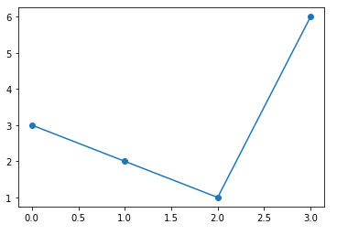
Matplotlib Markers
use the keyword argument marker to emphasize each point with a specified marker

Slide 7
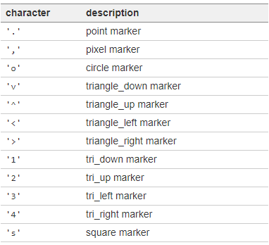
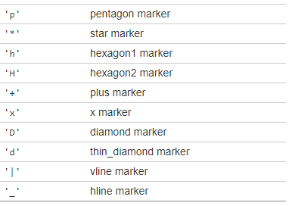
Matplotlib Markers
List of markers
https://matplotlib.org/api/_as_gen/matplotlib.pyplot.plot.html

Slide 8
Matplotlib Markers
Marker Size
keyword argument markersize or the shorter version ms
Marker Color
keyword argument markeredgecolor or the shorter mec to set the color of the edge of the markers
keyword argument markerfacecolor or the shorter mfc to set the color inside the edge of the markers
Note: can use Hexadecimal color values

Slide 9
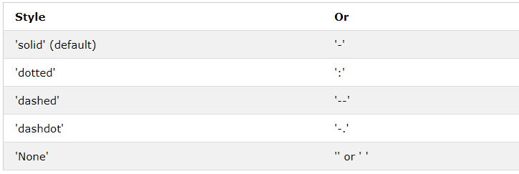
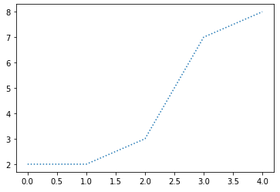
Matplotlib Line
keyword argument linestyle, or shorter ls

Slide 10
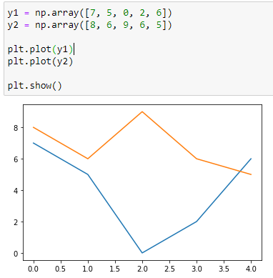
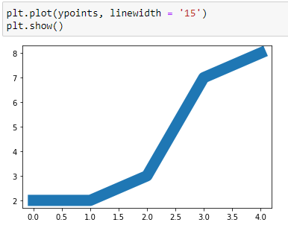
Matplotlib Line Width
Line Width:
keyword argument linewidth or the shorter lw
Multiple lines
adding more plt.plot() functions

Slide 11

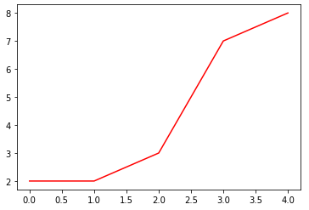
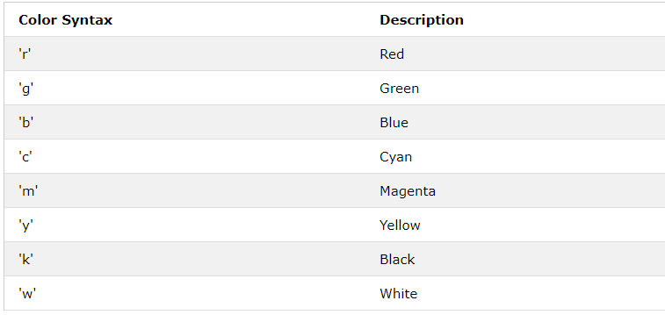
Matplotlib Line Color
keyword argument color or the shorter c
can use Hexadecimal color values

Slide 12
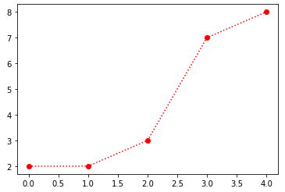

Matplotlib Markers
Format Strings fmt
marker|line|color

Slide 13
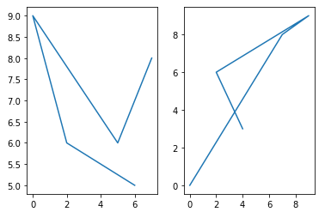
Matplotlib Subplots
subplots() function: draw multiple plots in one figure
takes three arguments that describes the layout of the figure
rows
columns
index of the current plot

Slide 14
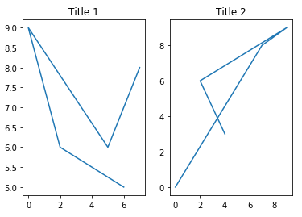
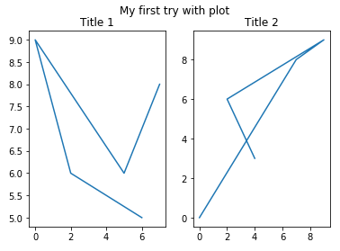
Matplotlib Title
add a title to each plot with the title() function
add a title to the entire figure with the suptitle() function

Slide 15
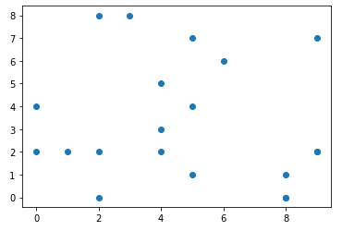
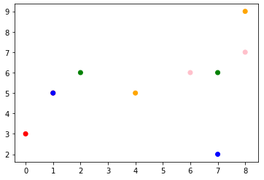
Matplotlib Scatter
Creating Scatter Plots
use the scatter() function to draw a scatter plot
x-axis & y-axis

Slide 16

ColorMap
Matplotlib module has a number of available colormaps
keyword argument cmap with the value of the colormap
include the colormap in the drawing by including the plt.colorbar() statement

Slide 17
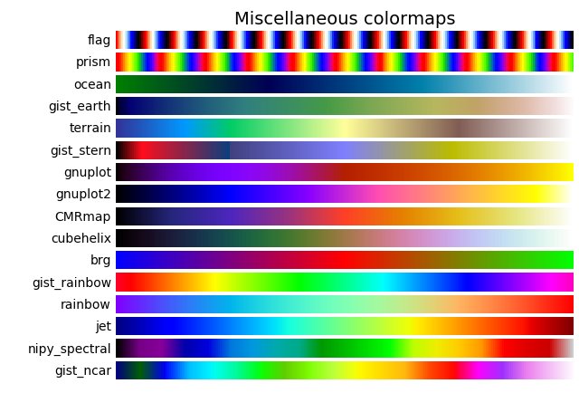
ColorMap
https://matplotlib.org/3.1.0/tutorials/colors/colormaps.html

Slide 18
Matplotlib Scatter
change the size of the dots with the s argument
adjust the transparency of the dots with the alpha argument

Slide 19
Matplotlib Bars
use the bar() function to draw bar graphs
If you want the bars to be displayed horizontally instead of vertically, use the barh() function
color
keyword argument width to set the width of the bars
The default width value is 0.8

Slide 20
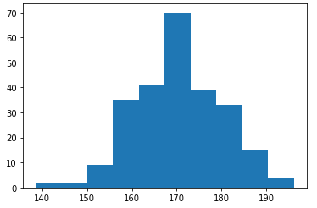
Matplotlib Histograms
A histogram is a graph showing frequency distributions.
It is a graph showing the number of observations within each given interval
use the hist() function to create histograms

Slide 21
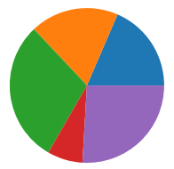
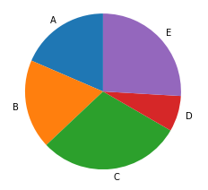
Matplotlib Pie Charts
use the pie() function to draw pie charts
Add labels to the pie chart with the label parameter
change the start angle by specifying a startangle parameter
Notes:
first wedge starts from the x-axis and move counterclockwise

Slide 22
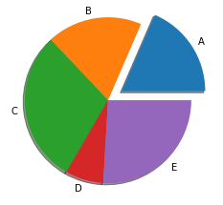
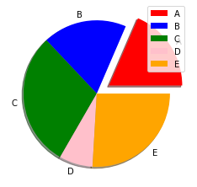
Matplotlib Pie Charts
One of the wedges to stand out? ➔ explode parameter
Add a shadow to the pie chart ➔shadows parameter
add a list of explanation for each wedge ➔ legend() function
add a list of explanation for each wedge, use the legend()
To add a header to the legend, add the title parameter to the legend function
Show value ➔ autopct argument

Slide 23
Matplotlib Save Figures
savefig (fname, dpi=None, facecolor='w', edgecolor='w', orientation='portrait', papertype=None, format=None, transparent=False, bbox_inches=None, pad_inches=0.1, frameon=None, metadata=None)

Slide 24
Working with text
xlabel: add text in x label
ylabel: add text in y label
title: add text in title

Slide 25
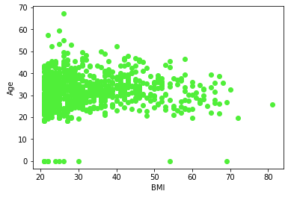
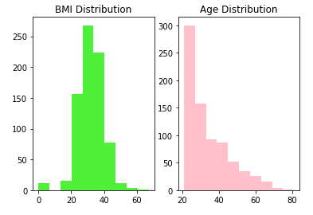
In-class exercise
Correlation between Age and BMI
BMI Distribution

