Slide 1

Course ID: 80110002 Computer programming & data processing 數據運算程式設計
Le Nguyen Quoc Khanh
黎阮國慶
Data Analysis using Pandas

Slide 2

Pandas
[pandas] is derived from the term "panel data", an econometrics term for data sets that include observations over multiple time periods for the same individuals. — Wikipedia

Slide 3
What's Pandas for?
This tool is essentially your data’s home
Through pandas, you get acquainted with your data by cleaning, transforming, and analyzing it.

Slide 4
How does Pandas fit into the data science toolkit?
Conjunction with other libraries
Top of numpy package
Jupyter Notebook is a good environment for Pandas

Slide 5
Install & Import
terminal program (for Mac users) or command line (for PC users)
conda install pandas
pip install pandas
!pip install pandas
Import
import pandas as pd

Slide 6
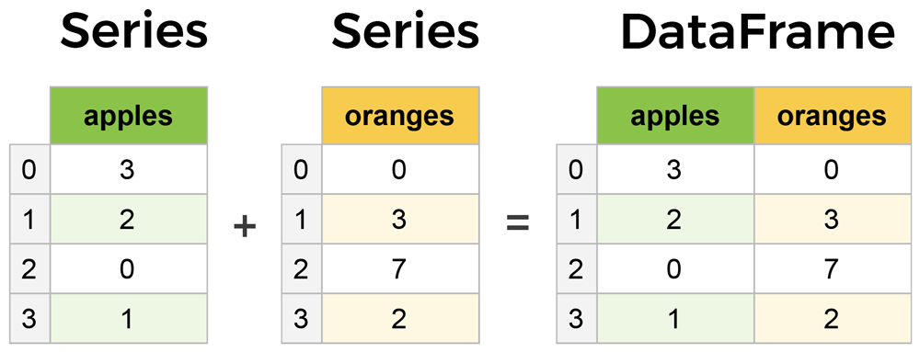
Core components of pandas

Slide 7
Outline
Creating DataFrame
Input – Output
DataFrame Operations
Viewing and Inspecting Data
Selection of Data
Filter, Sort and Groupby
Data Cleaning
Join/Combine

