Slide 1
QSPY Logging and Visualization
Teensy
COM
QTools
Matlab
QSPY Record (binary)
QSPY Record (Readable)
Evaluation
Qspy logging – C++ level
Decide the logging rate
Decide the logging format
What should we log?
How often should we log?
Write an adapter to feed the logged record into the QTools program. (Python/C++)
Qtools returns a readable human file.
Qtools also returns helpful diagram such as sequential diagram
Write a Matlab parser to get the interested values from the Human-readable file
Plot the data

Slide 2
Synchronization between SFU CCU MC
SYNC_REQUEST
SFU
CCU
SYNC_READY
MC
SYNC_TRIGGER
SYNC_TRIGGER
SYNC_CONFIRM
What if SYNC_TRIGGER from CCU to SFU doesn‘t arrive?

Slide 3
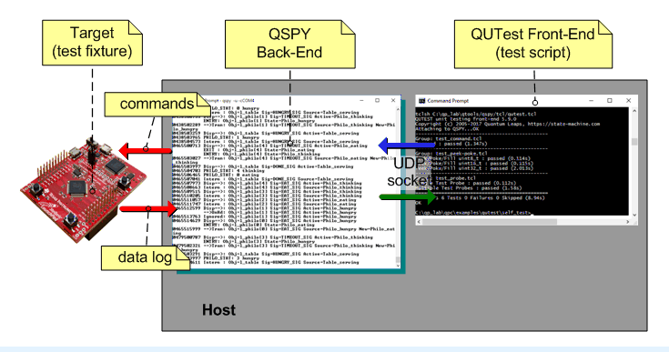
Teensy‘s serial port is temporarily „disconnected“ on reset
This disconnection forces Qspy to exit → Qutest also fail.
We implement the QspyRelayPort – a simple python script.
This script handles the disconnection by trying to reconnect to Teensy‘s SERIAL, while maintain the TCP connection with Qspy.
Teensy
Serial
TCP
QspyRelayPort:
qrelay.py

