Slide 1

Bank Marketing Campaign
Ly Nguyen
lilydq@yahoo.com

Slide 2
Content
Problem Understanding
Data Exploratory Analysis
Feature Importance
Model Building
Hyper-parameter Tuning
Model Evaluation
Results

Slide 3
Problem Understanding
European banking institution perform marketing campaigns based on phone calls to reach out to target customers in order to recruit them to Term Deposit subscriptions.
The bank develop a prediction model to predict customers who are receptive to subscriptions.
The campaigns were based on phone calls. Customers are contacted more than one time in order to access Term Deposit.

Slide 4
Dataset
41188 records
20 features
From May 2008 – November 2010

Slide 5
Data Exploratory Analysis
Features are both categorical and numerical
Categorical features: 10
Numerical features: 9
Target variable: binary (Yes/No)

Slide 6
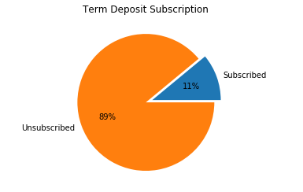
Data Exploratory Analysis
Has the client subscribed a term deposit? ('yes', 'no')

Slide 7
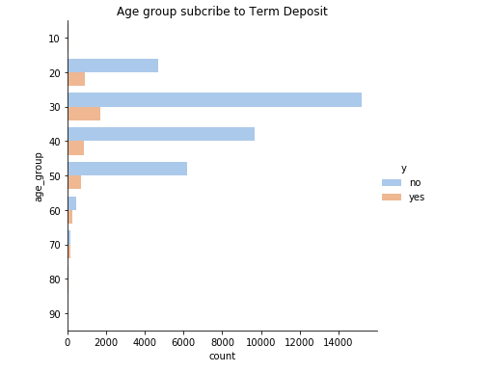
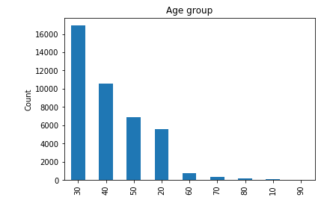
Data Exploratory Analysis
Customer's Age

Slide 8
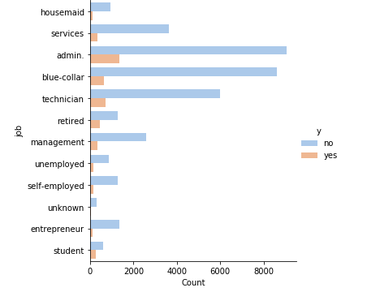
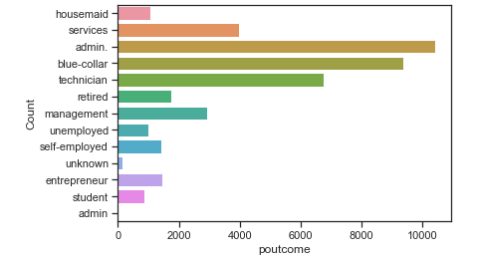
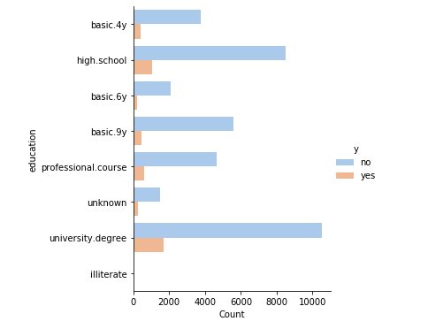
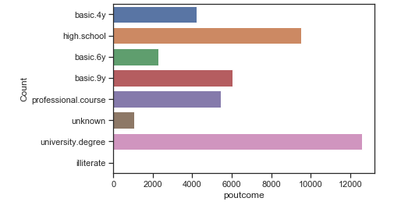
Data Exploratory Analysis
Job
Education

Slide 9
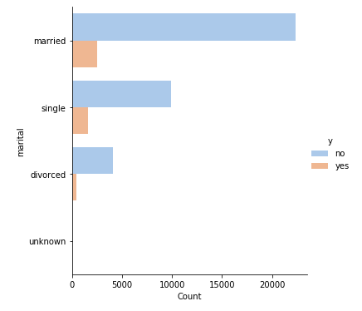
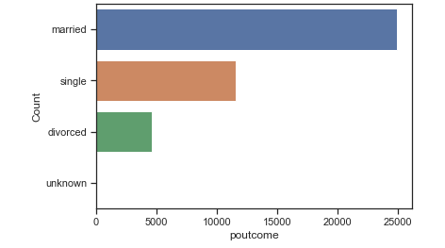
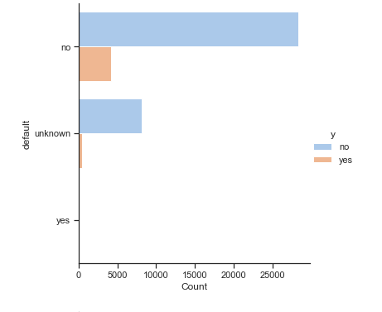
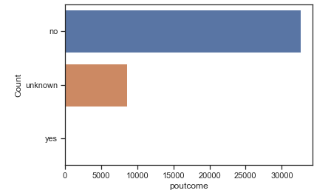
Data Exploratory Analysis
Marital
Default

Slide 10
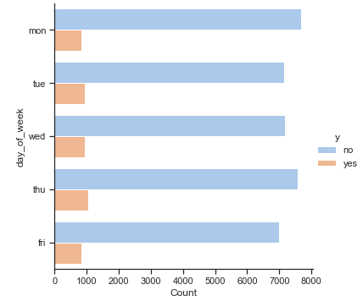
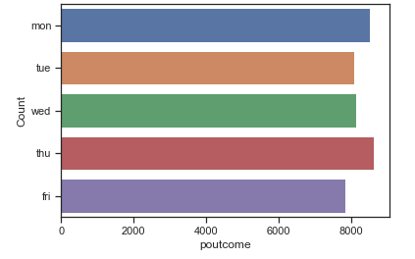
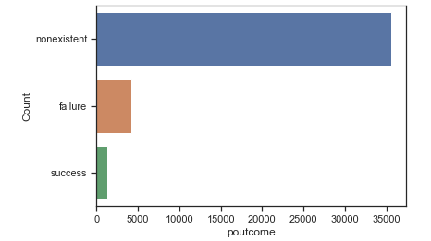
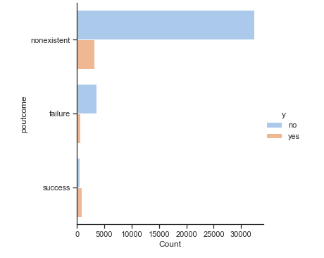
Data Exploratory Analysis
Day_of_week
poutcome

Slide 11
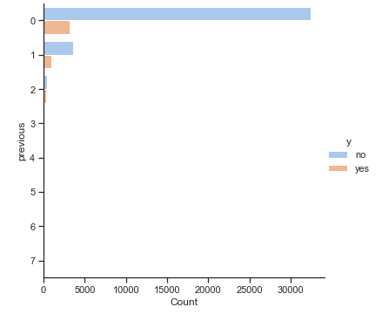
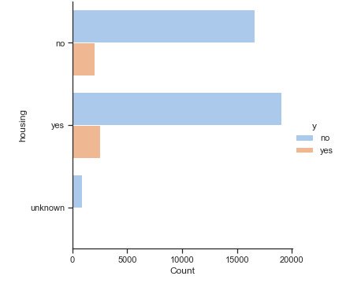
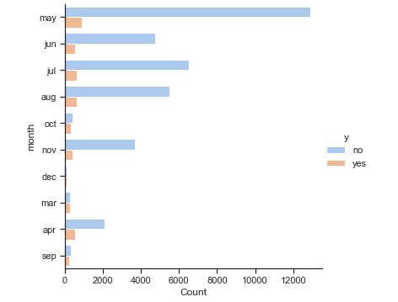
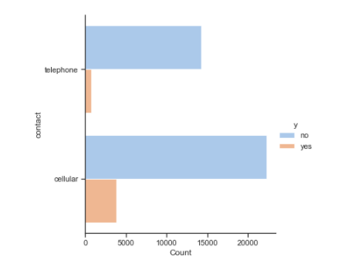
Data Exploratory Analysis

Slide 12
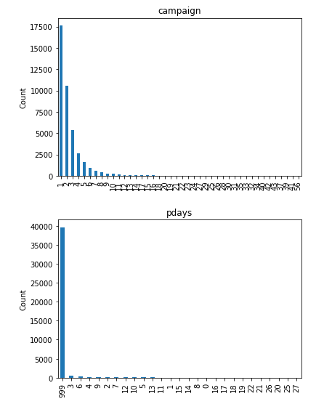
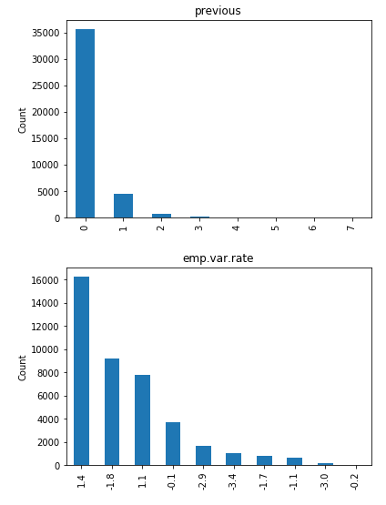
Data Exploratory Analysis

Slide 13
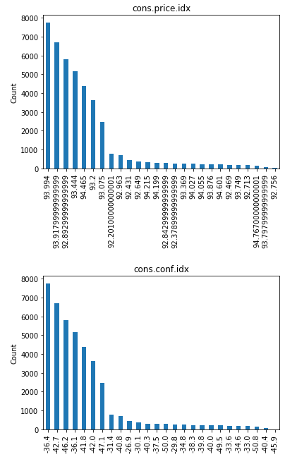
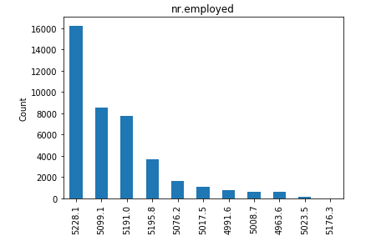
Data Exploratory Analysis

Slide 14
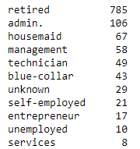
Data Exploratory Analysis
Missing values:
There are no missing values (e.g. NA, null), but there are unknown values in 'job', 'marital’, 'education’, 'default’, 'housing’, 'loan’
Use inferences to create rules to impute the unknown data.
E.g. Age > 60 can be retired. The statistics of people who are over 60:
E.g. There will be a relationship between job and education. For example, 'admin', 'management', and 'technician' normally have university degree. Most of technicians have professional development.

Slide 15
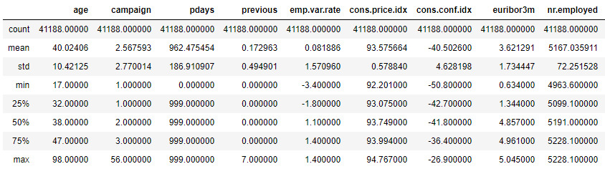
Data Exploratory Analysis
Outliers:
we can see 'age', 'campaign' and 'previous' are the features that have outliers. However, the value are acceptable in the real world so we do not need to remove them.

Slide 16
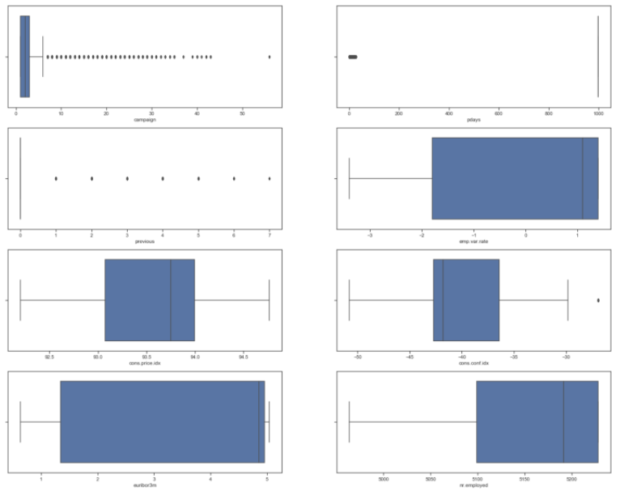

Slide 17
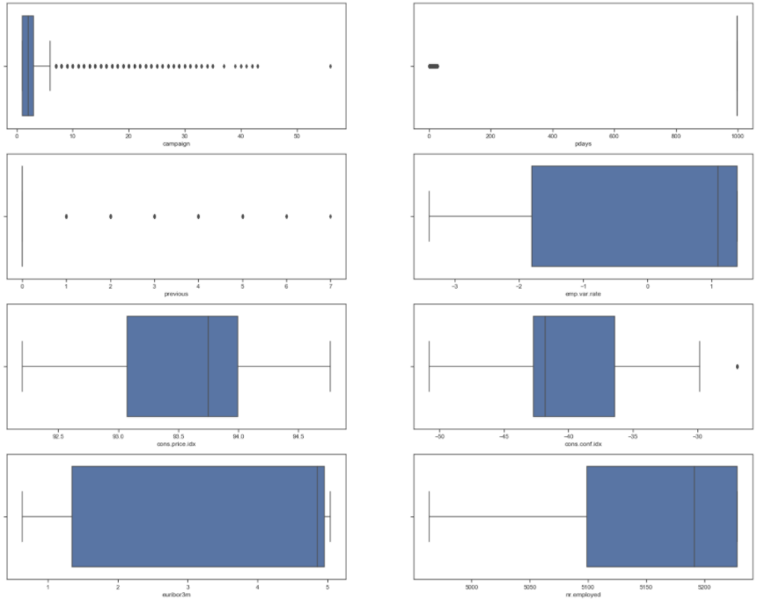

Slide 18
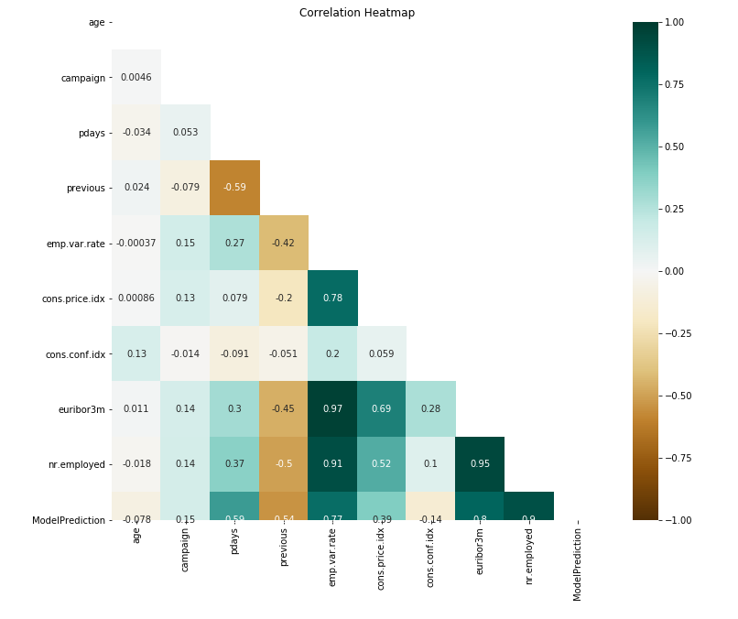
Correlation Analysis

Slide 19
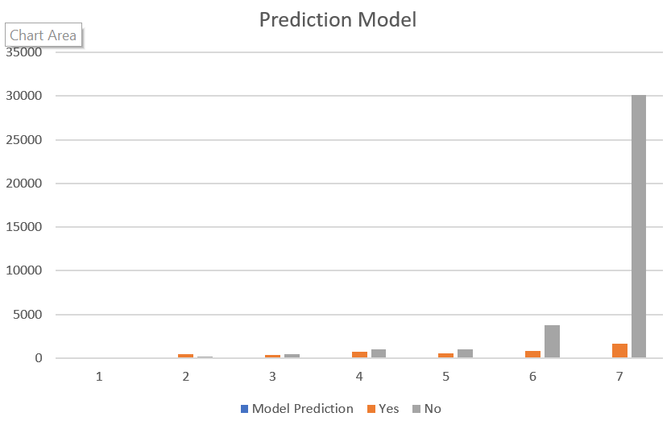
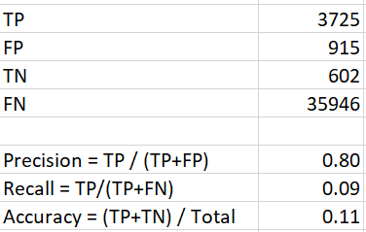
Model Prediction
Assume that the threshold for prediction is 0.6

Slide 20
Findings
This is imbalanced dataset (89% of the data are not subscribed to Term Deposit and only 11% of the data subscribed)
There is a feature that is unnecessary but highly affects the output target, which need to be deleted: -duration
There are unknown values that we can impute to improve the dataset quality: -job -education
There are highly correlated features that need to be taken care of: -euribor3m, nr.employed, emp.var.rate
Data cleaning: -the data values are consistent and no need further processing
Outliers:
- Not need to removed

Slide 21
Findings
Given the prediction model values, assume the threshold to predict Term Deposit =‘Y’ will be equal or larger than 0.6, the model has poor performance in prediction that need to be taken care of.
E.g. resampling

Slide 22
Feature Enginering
Label Encoding:
Use one hot encoding and label encoding for categorical variables and target variable

Slide 23


Training/Test sets
We split the dataset into 70%-30% for the training and test sets
After encoding, the data we have:
Target variable

Slide 24
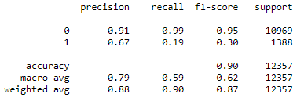
Logistic Regression

Slide 25
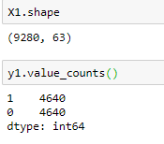
Under-sampling
The imbalanced datasets causes a skewness in the data distribution, create the minority class and the majority class.
The bias in the data cause the machine learning model ignore the minority class.
To address the problem of class imbalance, we will randomly resample the dataset using under-sampling. Under-sampling means to delete examples from the majority class.

Slide 26
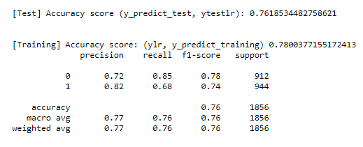
Logistic Regression with under-sampling data

Slide 27
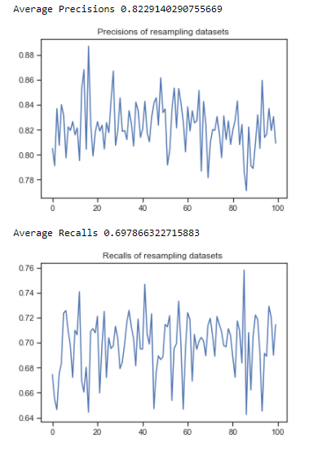
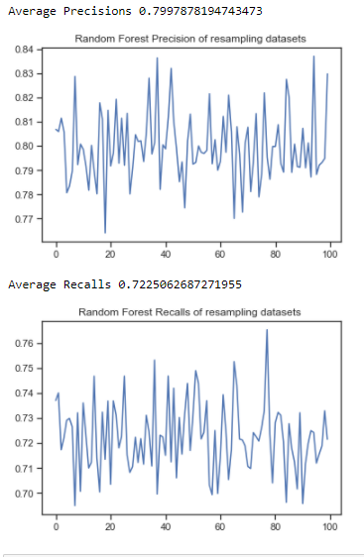
Logistic Regression with under-sampling data
Random Forest with under-sampling data

Slide 28
Conclusions
Explored and analyzed the dataset
Handle unknown values
Further studies can be performed to improve the models e.g. cross validation, feature importance, hyper parameter tuning, etc.

Slide 29
Recommendations
Target Customers
Occupation | admins, technicians, blue-collar, management, retired clients
Age | From 20s-50s, especially the group of 30s
Education | Target to customers with high education like university degree, professional education, or high school
Marital | Married
New customers | Target to new customers who have been contacted before
Contact type | Preferred cellular phone

