Slide 1
Efficient weighted probabilistic frequent itemset mining in uncertain databases
518H0520 – Pham Viet Gia Khanh
520H0648 – Tran Phi Khanh

Slide 2
Introduction​
Mining w-PFI in Uncertain Databases
Exact w-PFI Algorithm
Approximate w-PFI Algorithm
​Experimental Evaluation​

Slide 3
Introduction
In the past decade, uncertain data mining has gained significant interest due to its applicability in numerous emerging fields.
A key issue in this domain is discovering frequent itemsets within uncertain databases.
Unlike traditional databases, items in uncertain databases do not have a definite presence, leading to the development of various probabilistic models to measure itemset frequency.
This research addresses the complexity of mining frequent itemsets in environments where data certainty is not guaranteed and propose a novel method for weighted probabilistic frequent itemset (wPFI) mining that is designed to be more efficient than existing methods.

Slide 4
Mining Weighted Probabilistic Frequent Itemsets (w-PFI) in Uncertain Databases

Slide 5
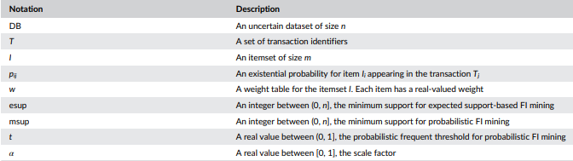
Summary of the notations

Slide 6
Uncertain databases?
Definition 1: An uncertain dataset DB is a set of transaction databases DB={T 1 ,T 2 ,...,T n }, where each transaction Ti contains a subset of an itemset along with an existential probability for each item.
For example:
[{1, 4, 7, 10, 13, 16, 19, 22, 25, 28, …}, …] (actually deterministic database)
[1:0.2044321468661019, 2:0.9460796312222369, 3:0.2977076146327191, 4:0.06141169098384047, 5:0.6925834385605795, …] (uncertain database)

Slide 7

Possible World?
Definition 2: The concept of a possible world W represents a subset T of the uncertain database with an existential probability of:
It's the foundational concept for defining the probabilistic nature of the data items in uncertain databases.

Slide 8
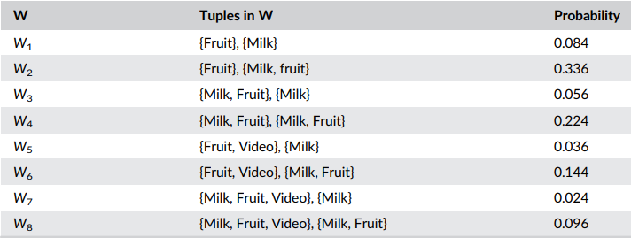
Possible World?
The weight table:
The possible worlds and their existential probabilities:

Slide 9
Possible World?
Take the possible world W5, for example. In this world, Tom purchases two items {Fruit, Video} and Lucy buys only one item {Milk}. Thus, the probability of this world is 0.036, calculated by (1 − 0.4) × 1.0 × 0.3 × 1.0 × (1 − 0.8).

Slide 10
Expected support-based frequent itemset
Definition 3: Describes an itemset as an expected support-based frequent itemset (ePFI) if it meets or exceeds a specified minimum expected support threshold (esup) in the possible world.

Slide 11
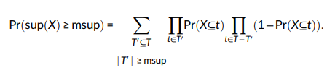
Probabilistic Frequent Itemset
Definition 4: Given uncertain dataset (DB), a minimum support (msup), and a probabilistic frequent threshold (t), an itemset X ⊆ I is a probabilistic frequent itemset if and only if Pr(sup(X) ≥ msup) ≥ t
Pr(sup(X) ≥ msup) is defined as below:

Slide 12
Weighted Probabilistic Frequent Itemset
Definition 5: Given an uncertain dataset (DB), a weight table (w), a minimum support (msup), and a probabilistic frequent threshold (t), an itemset X ⊆ I is a weighted probabilistic frequent itemset if and only if w(X)Pr(sup(X) ≥ msup) ≥ t.
w(X) is the weight of the itemset X calculated by the average weight of the items in X, which is widely adopted in the weighted frequent item mining

Slide 13

Itemset Weight
Definition 6: For an itemset X ⊆ I, the weight of X is the average weight of the items in the itemset X:

Slide 14
Exact w-PFI Algorithm

Slide 15
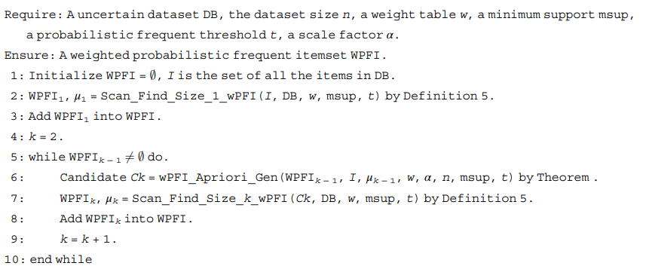
wPFI-Apriori algorithm

Slide 16
wPFI-Apriori algorithm
This serves as the overall structure for mining uncertain databases. It uses the concepts and theoretical foundations laid out in the paper to determine the frequent itemsets, taking into account the uncertainty and weights of the items.

Slide 17
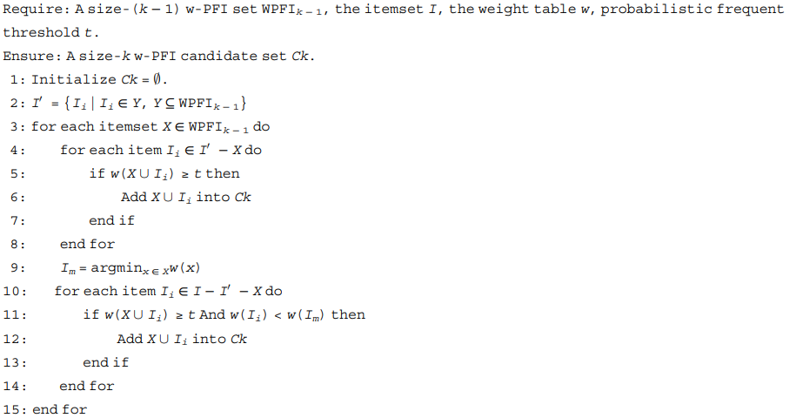
w-PFI candidate generation and pruning

Slide 18
w-PFI candidate generation and pruning
This algorithm does not take into account the mean occurrence values (mu) or a probability model for pruning. Instead, it looks at the weighted support directly and compares it to a threshold t.

Slide 19
Approximate w-PFI Algorithm

Slide 20
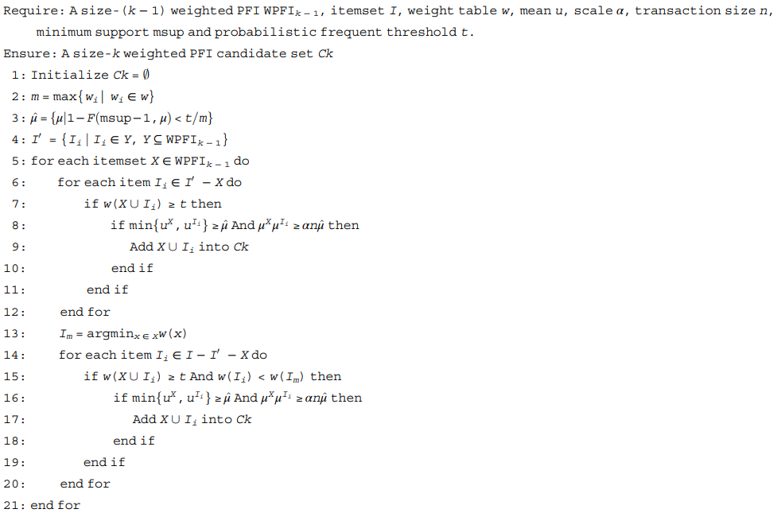
w-PFI candidate generation and pruning based on a probability model

Slide 21
w-PFI candidate generation and pruning based on a probability model
This is an enhancement of the second algorithm and is used within the first algorithm. It refines the process of candidate generation by applying a more efficient approach, likely based on the probabilistic models, where it uses the mean occurrence values (mu) and weights (w) to determine the support and then prunes based on these estimates.

Slide 22
Experimental Evaluation​

Slide 23
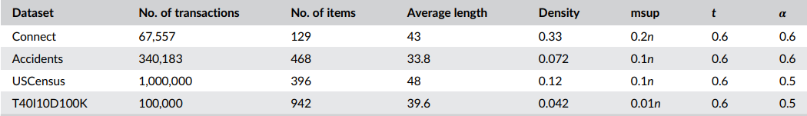
Experimental settings
Characteristics and default parameters of datasets:
All of dataset above are actually deterministic databases. To generate the uncertainties in these databases, we assign an existential probability to each item in the transactions, as widely done by the existing methods in the current community. The probabilities are drawn from a Gaussian distribution with mean (0.5) and variance (0.125). Meanwhile, the weight table w for the items in each database are drawn from the uniform distribution in (0, 1].

Slide 24
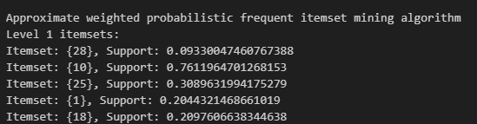
Result
This is a part of an example result of w-PFI-AP:

Slide 25
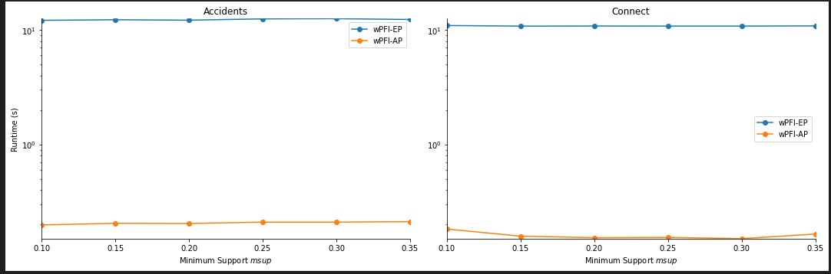
Result
This is the effect of msup on runtime:

Slide 26
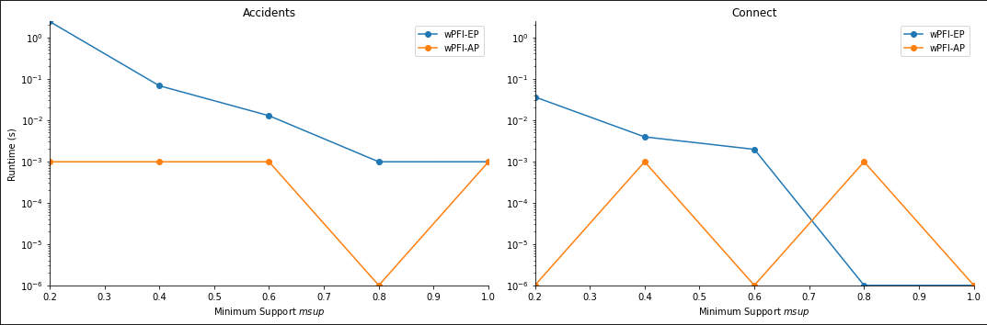
Result
This is the effect of t on runtime:

Slide 27
Result
Because of the limitation of resource, we can not evaluate the entire of the first 10k transactions in the dataset and the 4 datasets.
We tried to estimate based on only 2 datasets (Accidents and Connect), chose only the first 10 items of each transaction (the number of transactions is still 10k).
That is reason why the line graphs might not illustrate the enhanced on performance and the reduction of running time clearly.
However it is enough for practicing.

Slide 28
Result
With java version, everything seems to be better.
We can evaluate the entire of the first 10k transactions in the dataset and the 4 datasets together with a new dataset named “GeneratedDB”, which is generated from our code.
We have visualized the “Running Time” of the “eWPFI” and “aWPFI” with default “msup” and “t”, so there will not be the comparison between the multiple value of “t” or “msup”.
However we have added the “Theoretical Big O Notation” to compare with the actual “Running Time”.

Slide 29
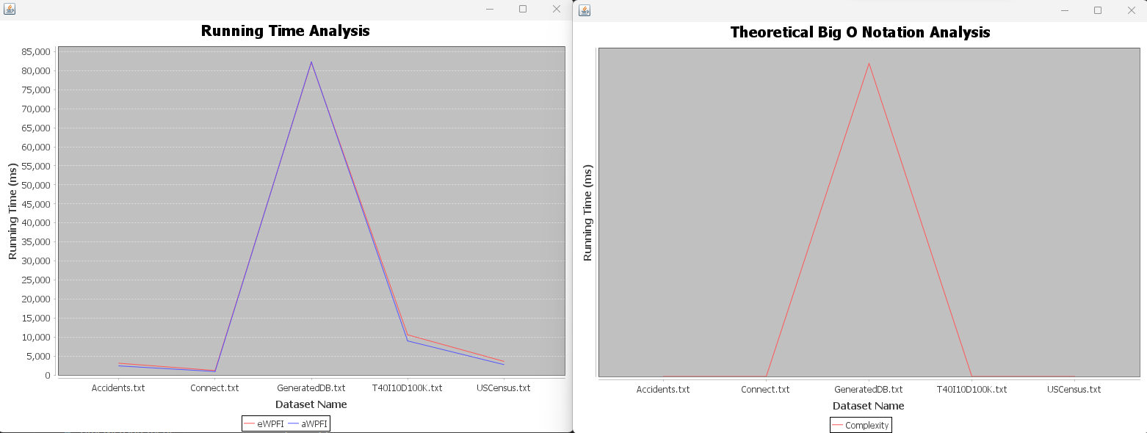
Result

Slide 30
Summary
To sum up, with small dataset, 'Exact weighted probabilistic frequent itemset mining'(eWPFIM) algorithm returns more levels of itemsets mean that it has discovered not just individual items but also their combinations up to a certain length that occur frequently together. This can be very useful for understanding complex patterns within the data, but additional levels of itemsets may not always provide actionable insights or could represent redundant or obvious information that doesn't aid decision-making.
Besides, higher-level itemsets may sometimes include noise, leading to overfitting, especially in uncertain databases where the presence of an item in a transaction can be probabilistic. Moreover, more levels usually require greater computational resources. In some cases, finding a balance between the depth of the itemsets and the computational cost is necessary, especially with very large datasets.
The quality of the discovered itemsets is crucial. An algorithm that yields high-confidence, high-lift itemsets that are potentially useful for prediction or recommendations might be preferred even if it produces fewer levels of itemsets. It is especially right with the 'Approximate weighted probabilistic frequent itemset mining'(aWPFIM) algorithm.
This one uses the support threshold(msup) to determine how frequently an itemset appears in the dataset, scaling factor(alpha) to adjust the influence of the weight in the support calculation, and probabilistic frequent threshold(t) to decide whether an itemset's probabilistic measure is sufficient for it to be considered frequent, unlike the eWPFIM algorithm, which only uses (t), so it seem to perform faster despite returning fewer levels of itemset. Undoubtedly, higher-level itemsets that meet high support and confidence thresholds can be very valuable, but if the goal is to identify simple and strong rules to inform immediate business decisions, fewer levels with very high support might be adequate and preferred.

Slide 31
THANK YOU

